Slide 1
Up2U All Hands
Discussion & Final conclusions
14 May 2020

Slide 2
Discussion
WP5 Jupyter notebooks on Learning Analytics an achievement of the project? They’re a new OER developed using project tools
Admin roles of project website and social media accounts
Sustainability of pedagogical support
How to make ICT security more visible?

Slide 3
Results (1/4)
General financial overview
  Q13 MM: overspend of 162 MM… BUT!
  Q13 Budget: on track
  Disclaimer: these numbers will be updated after the official end of the project (May)
Proved: interchangeability and interoperability
Standardised data collection and LA with xAPIs

Slide 4
Results (2/4)
932 schools initiated teacher training (April 2020)
2273 teachers and 71671 students
Get Started! successfully used in Slovenia
67 repositories available on eduOER
Improvement of Open Cloud Mesh protocol

Slide 5
Results (3/4)
Moodle versioning: 3.3 to 3.6.2
Completed documentation of Application Toolbox
SWOT analysis on cyber security
  Perceived not very useful (early 2020), but what if the analysis was carried out after the COVID-19 outbreak?
Security Guidelines

Slide 6
Results (4/4)
Market analysis
Business models
  Tools for NRENs & schools
  eLearning Platform
  University-as-a-Hub
  Autonomous use

Slide 7
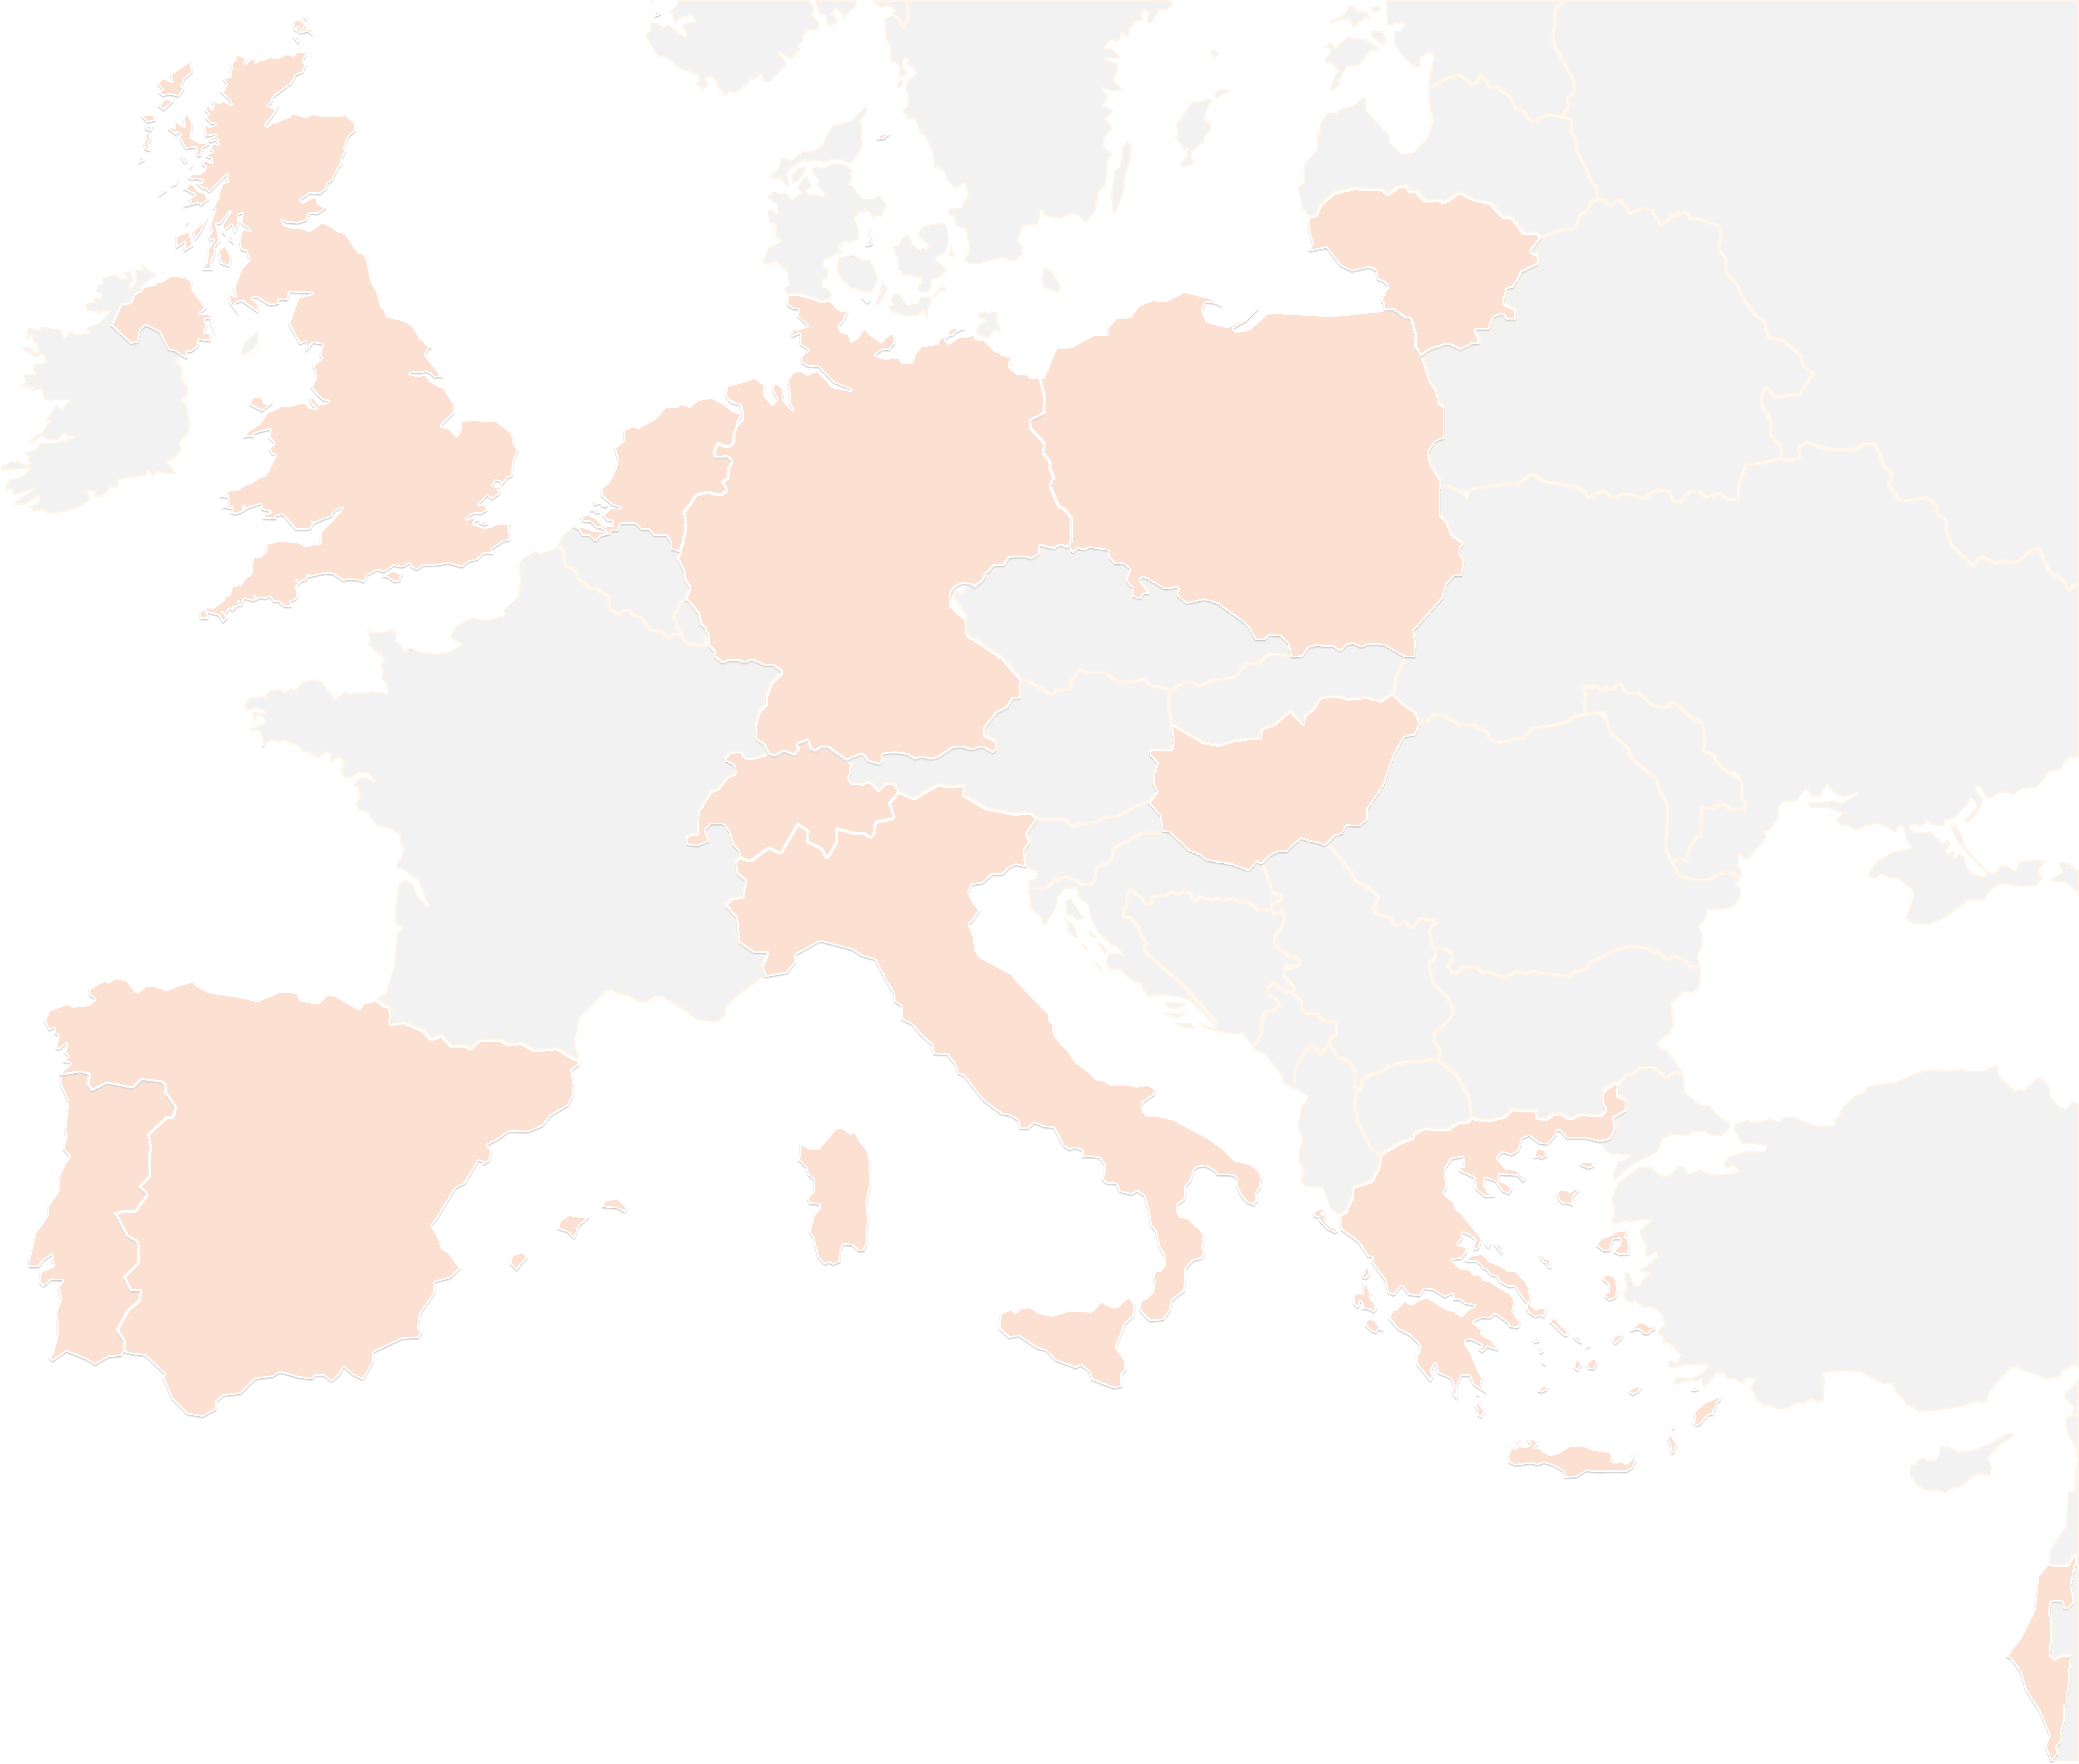
THANK YOU FOR YOUR ATTENTION!
contact@lists.up2university.eu
#up2universe

