Slide 1
Up2U All Hands
Casper Dreef & Mary Grammatikou
GÉANT, NTUA
14 May 2020

Slide 2
Agenda
Time | Topic | Presenter
12:00 - 12:30 (30') | Welcome Introduction WP1 - Project management overview: general overview openUp2U | Casper Dreef Mary Grammatikou
12:30 - 12:45 (15') | WP2 - Dissemination and Outreach | Barbara Tóth
12:45 - 13:15 (30') | WP5 - Learning community management and skills trainings Results and Lessons Learned First Pedagogical Results from the CPD | Stefano Lariccia Nadia Sansone
13:15 - 13:45 (30') | WP7 - Pilot coordination and continuous risk assessment Pilots: Results -feedback | Michal Zimniewicz
13:45 - 14:00 (15') | WP3 - Cloud-based infrastructure services | Ilias Hatzakis

Slide 3
Agenda
Time | Topic | Presenter
14:00 – 14:30 (‘30) | Coffee break
14:30 - 14:40 (10') | WP4 - Integrated application toolbox | Allan Third
14:40 -14:50 (10') | Coffee break | ALL
14:40 - 14:50 (10') | WP6 - Roadmap for security and trust | Gabriella Paolini
14:50 - 15:20 (30') | WP8 - Sustainability | Faraz Fatemi Moghaddam
15:15 - 15:45 (30') | Discussion | ALL
15:45 - 16:00 (15') | Final Conclusions | Casper Dreef

Slide 4
Some numbers
Since the start of the project:
7 General Assemblies
  Including launch events and a Techno-Pedagogical Workshop
  Amsterdam, Porto, Athens, Göttingen, Poznan and online
7 Board meetings
70+ Management team meetings

Slide 5
Some numbers
7 Internal webinars
3 EC reviews
  Final review in July
33 deliverables
3 Technical reports

Slide 6
2 major risks encountered (and mitigated)
GDPR
  Joint Controller Agreement
  Privacy Notice
  Minor consent
Force Majeure
  COVID-19 outbreak
  Schools closed
  openUp2U

Slide 7
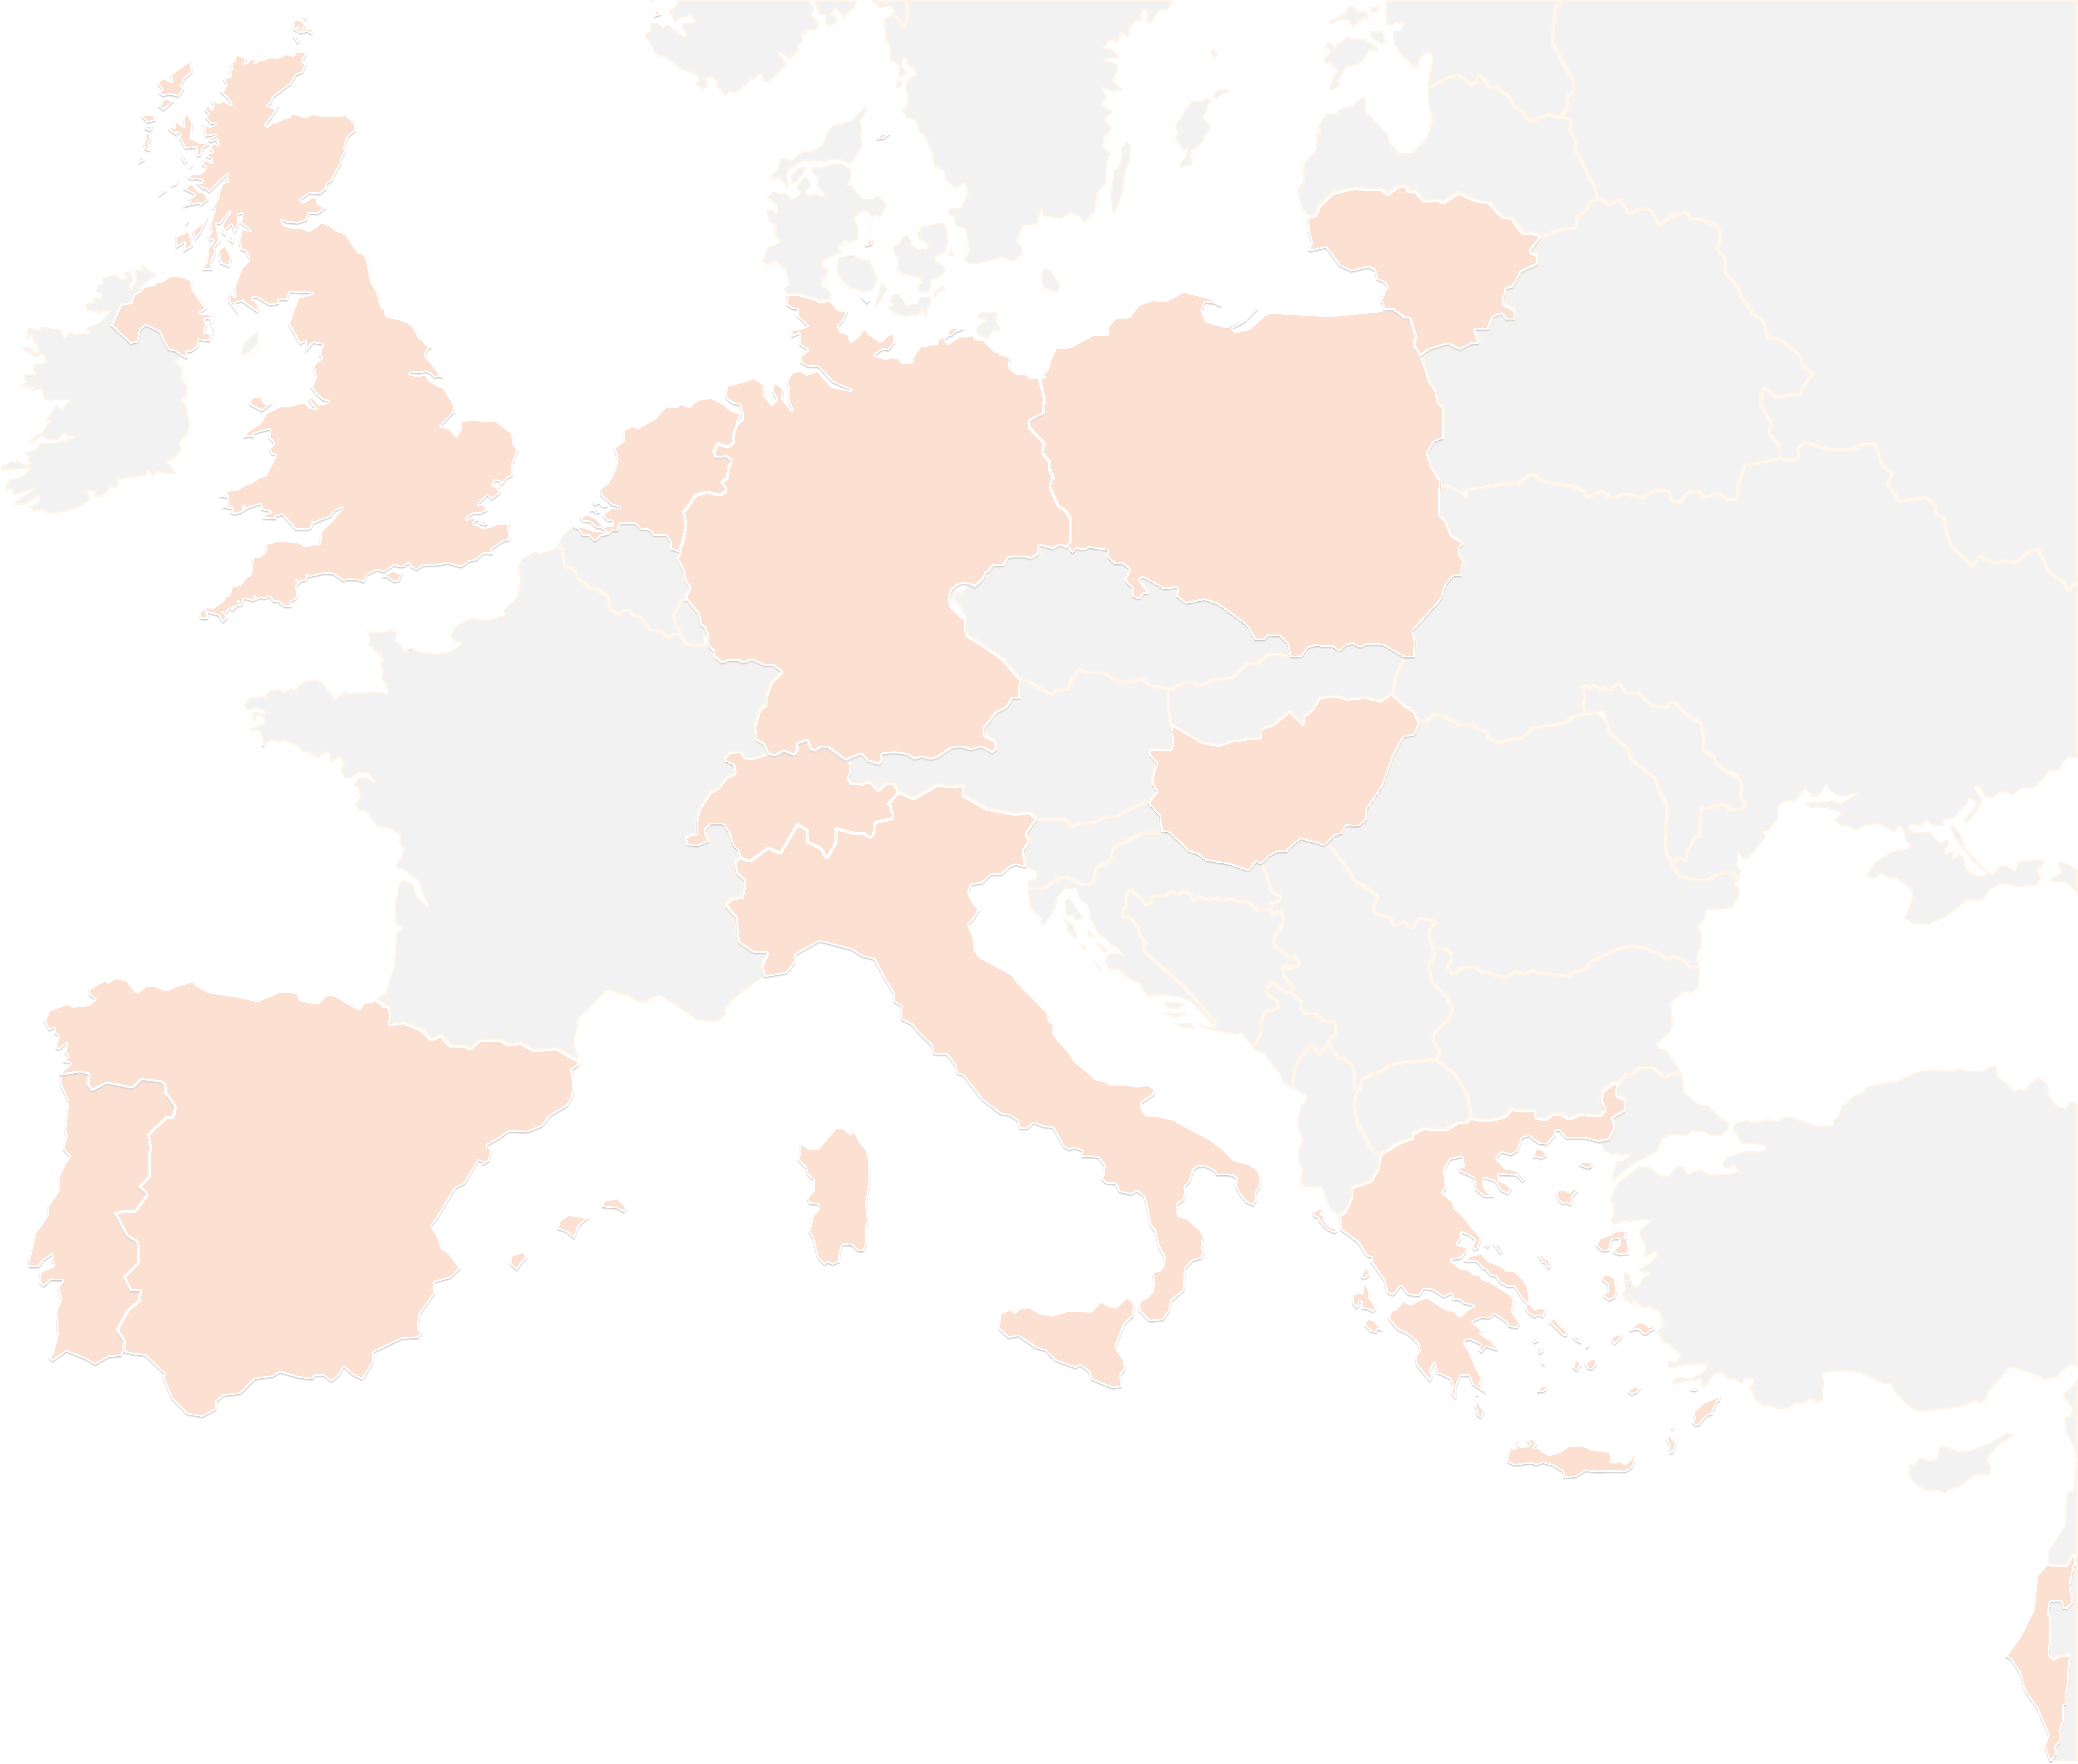
THANK YOU FOR YOUR ATTENTION!
contact@lists.up2university.eu
#up2universe

