Slide 1
WP8
Sustainability & Exploitation
Faraz Fatemi Moghaddam
GWDG
Up2U General Assembly

Slide 2
Overview
Eco-System Analysis
  Market Analysis
Business Models
  Design
  Implementation
  Results
Exploitation of Results
Conclusion

Slide 3
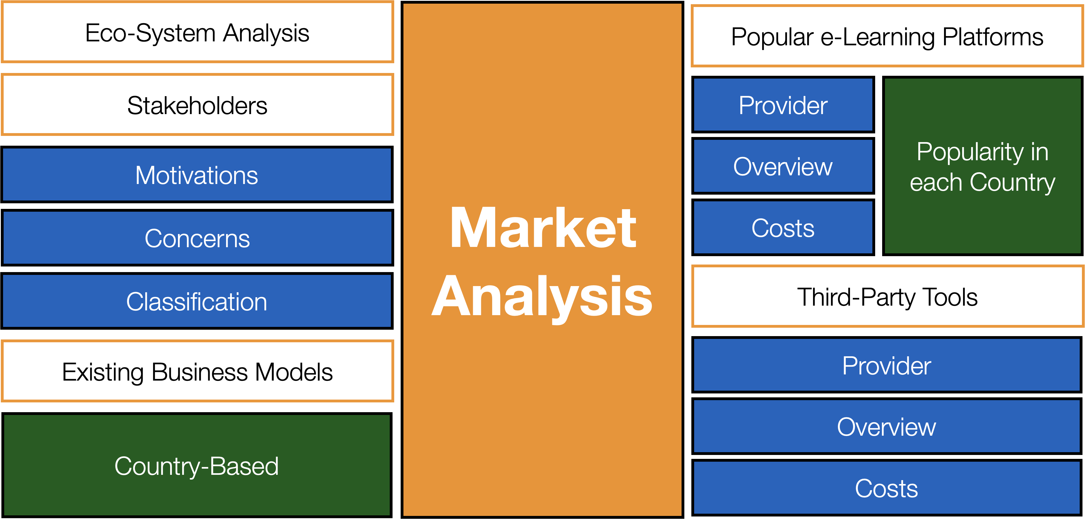
Eco-System Analysis

Slide 4
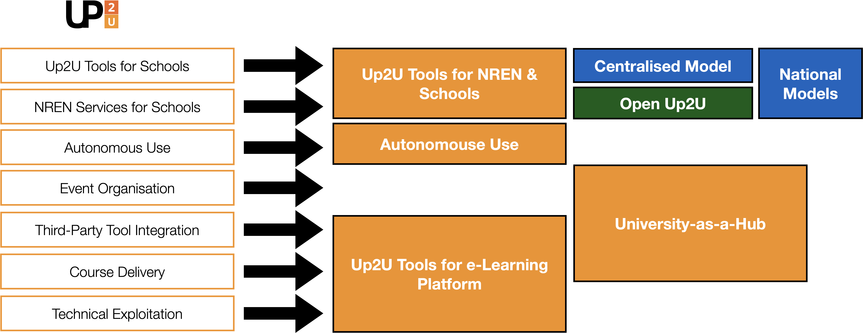
New Business Models

Slide 5
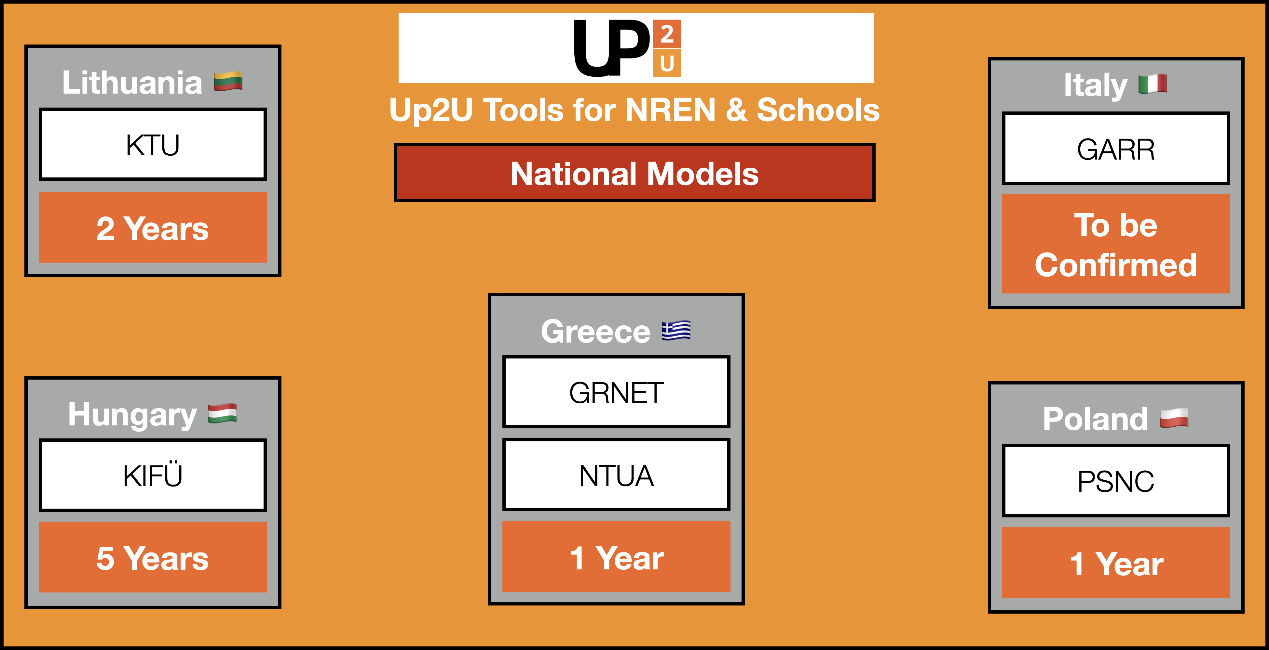
National Models

Slide 6
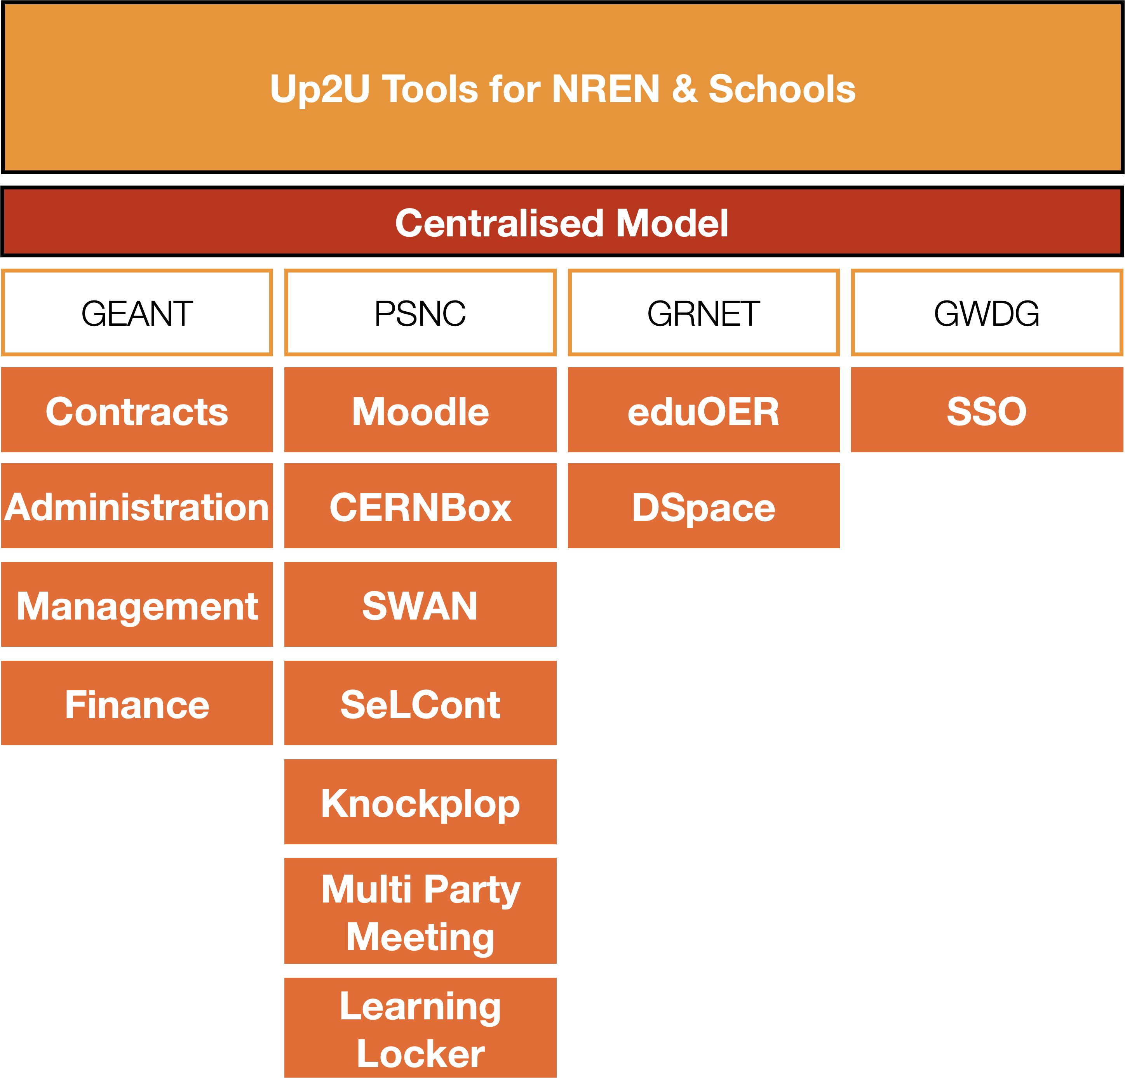
Centralized Model

Slide 7
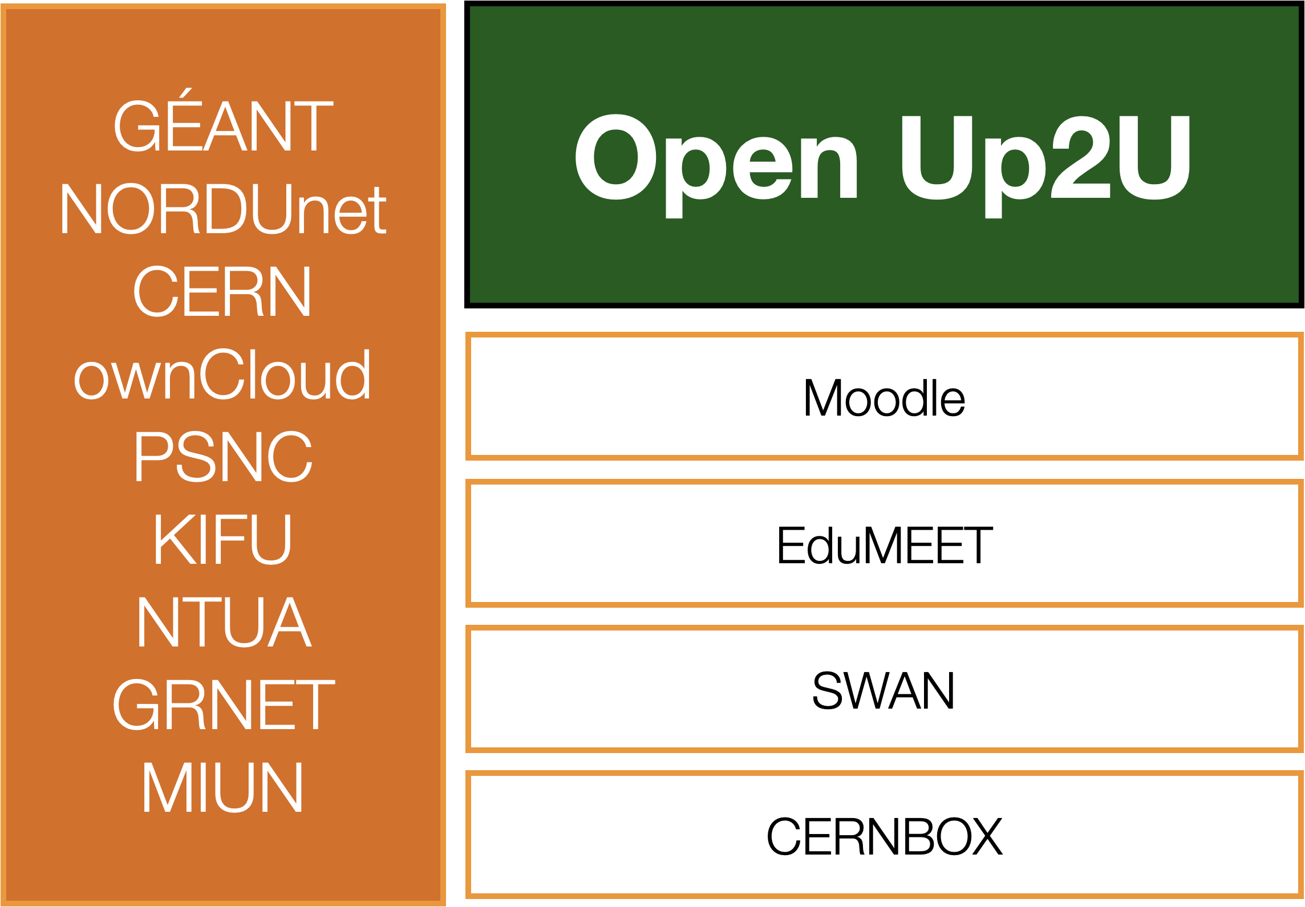
Open Up2U

Slide 8
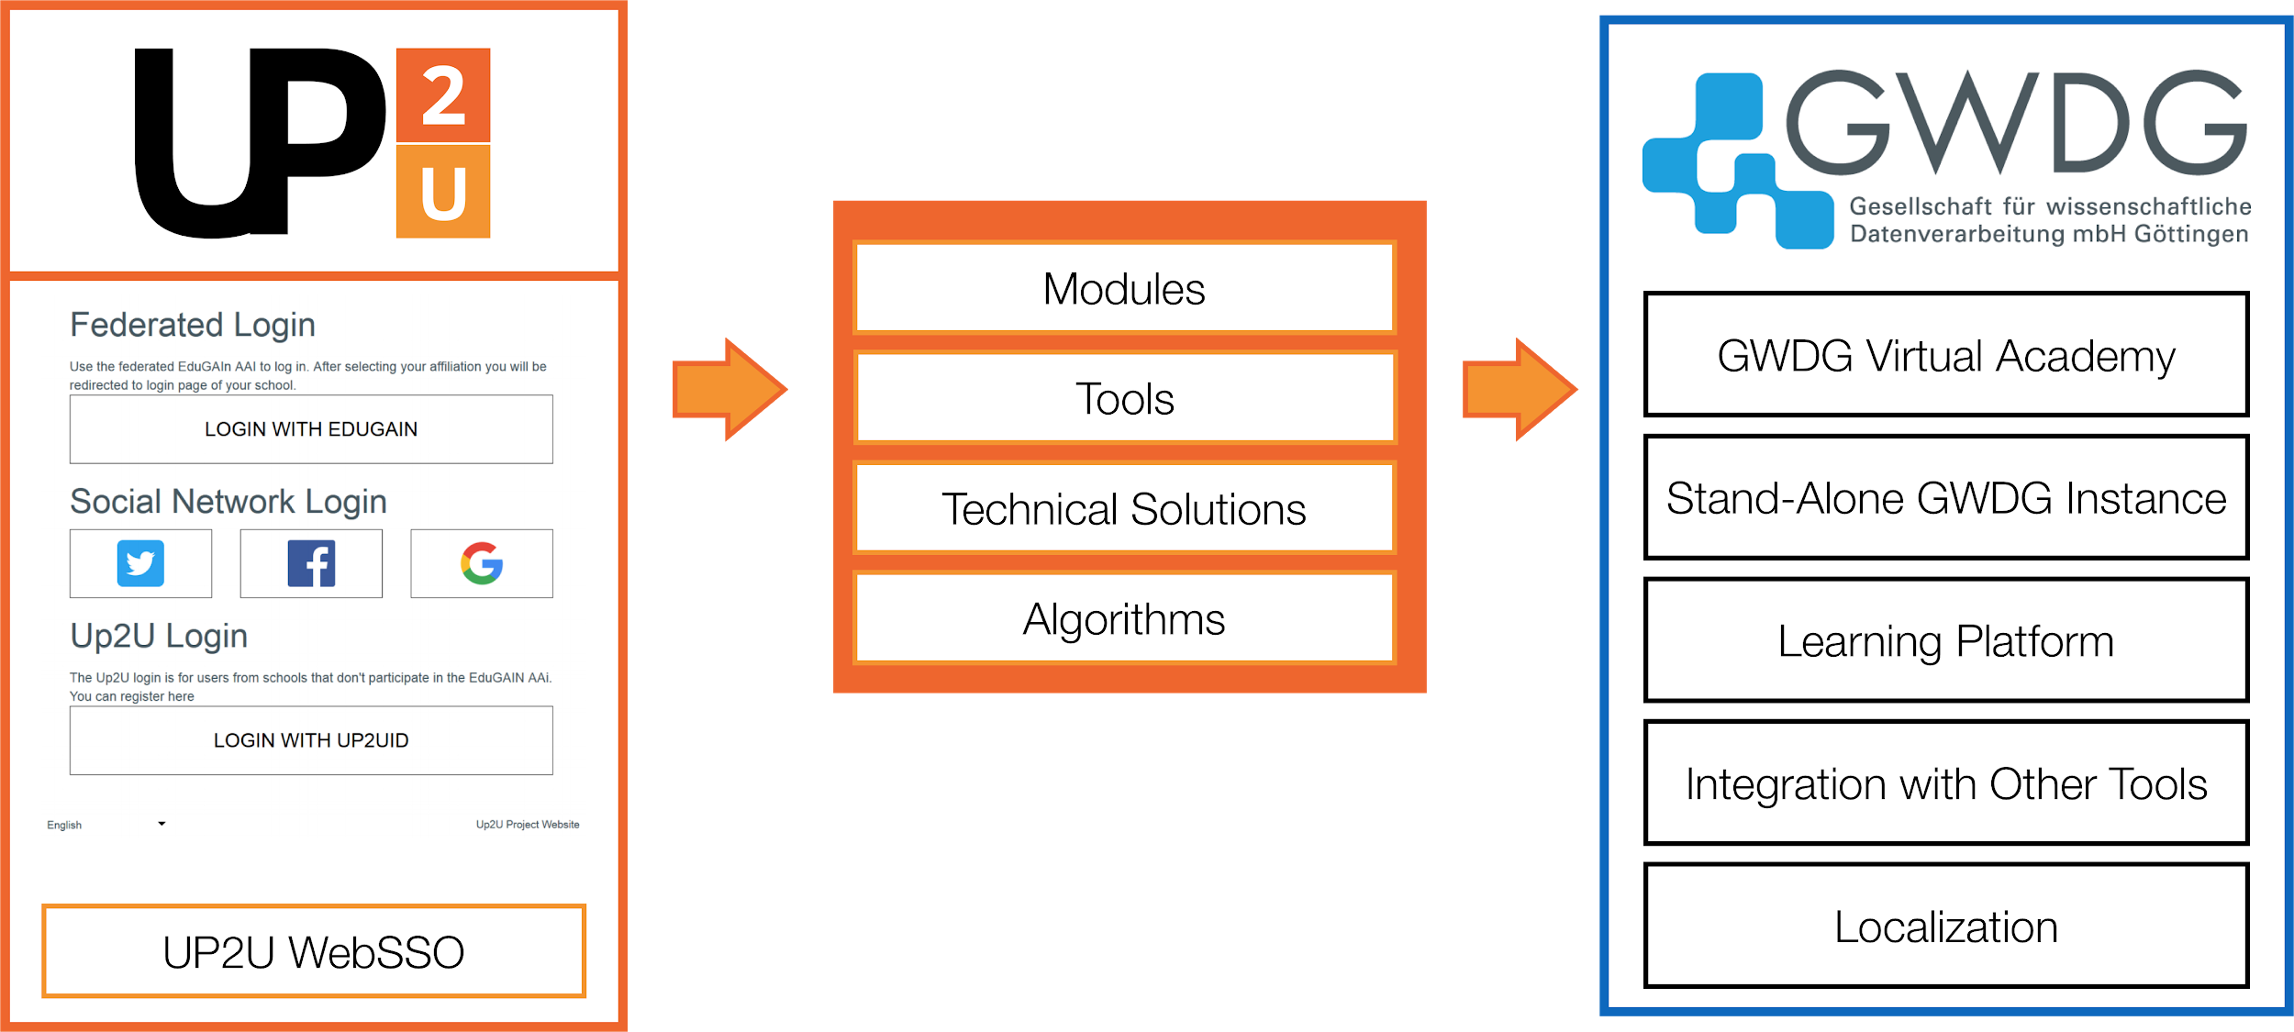
Up2U as an E-Learning Platform

Slide 9
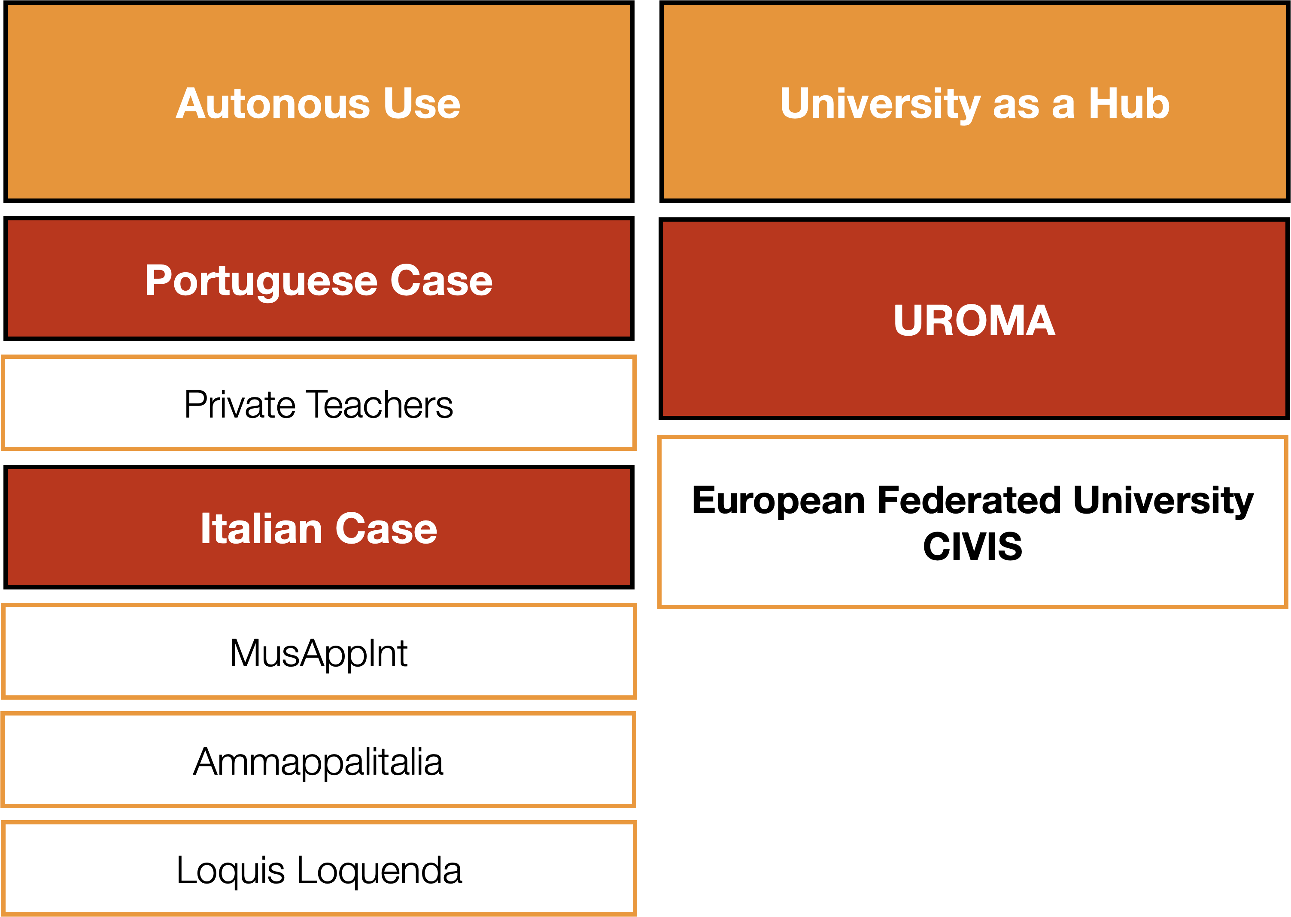
Autonomous Use & U-HUB

Slide 10
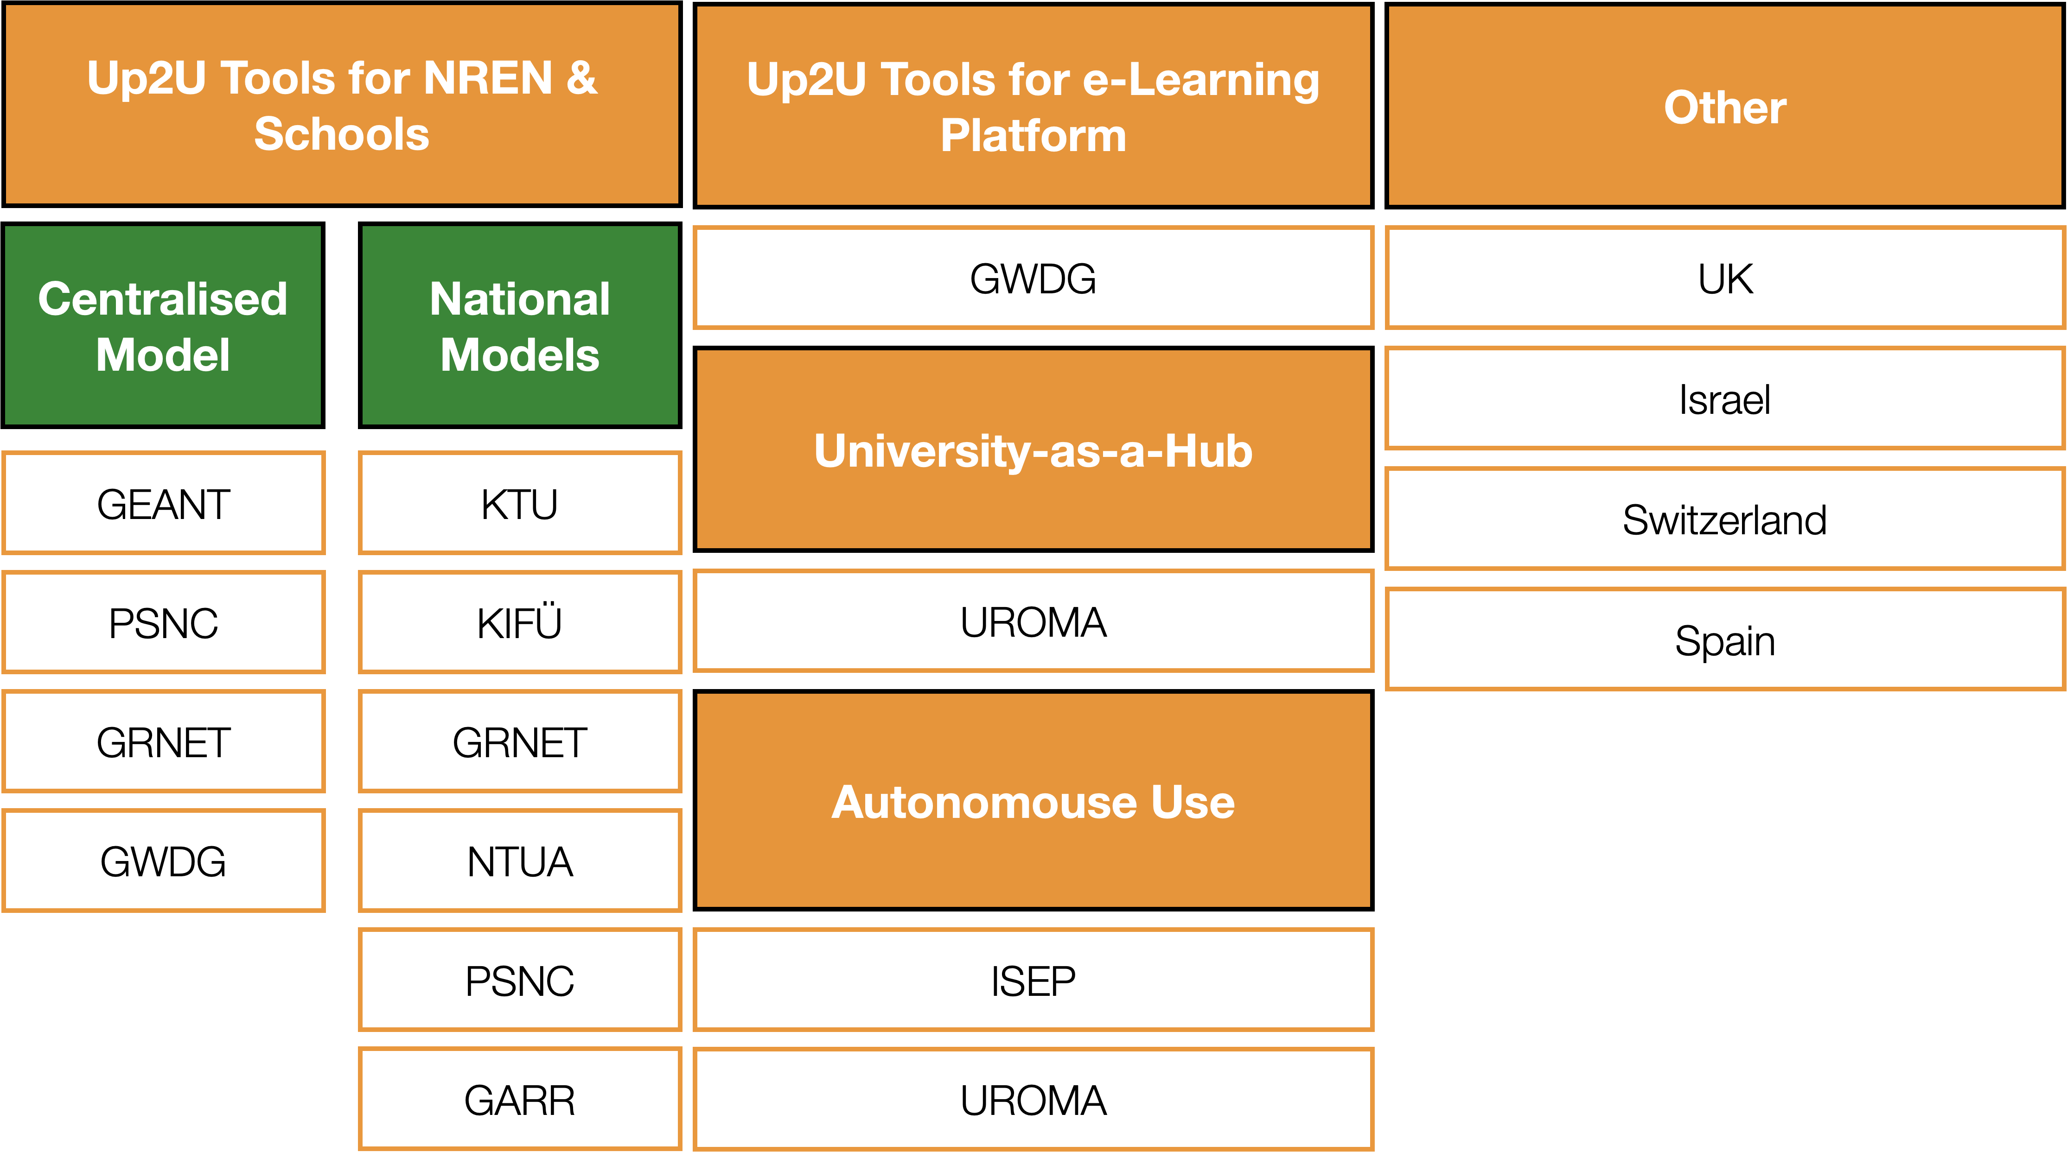
Exploitation of Results

Slide 11
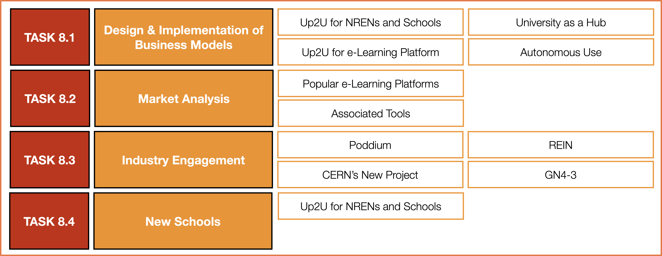
Conclusion

Slide 12
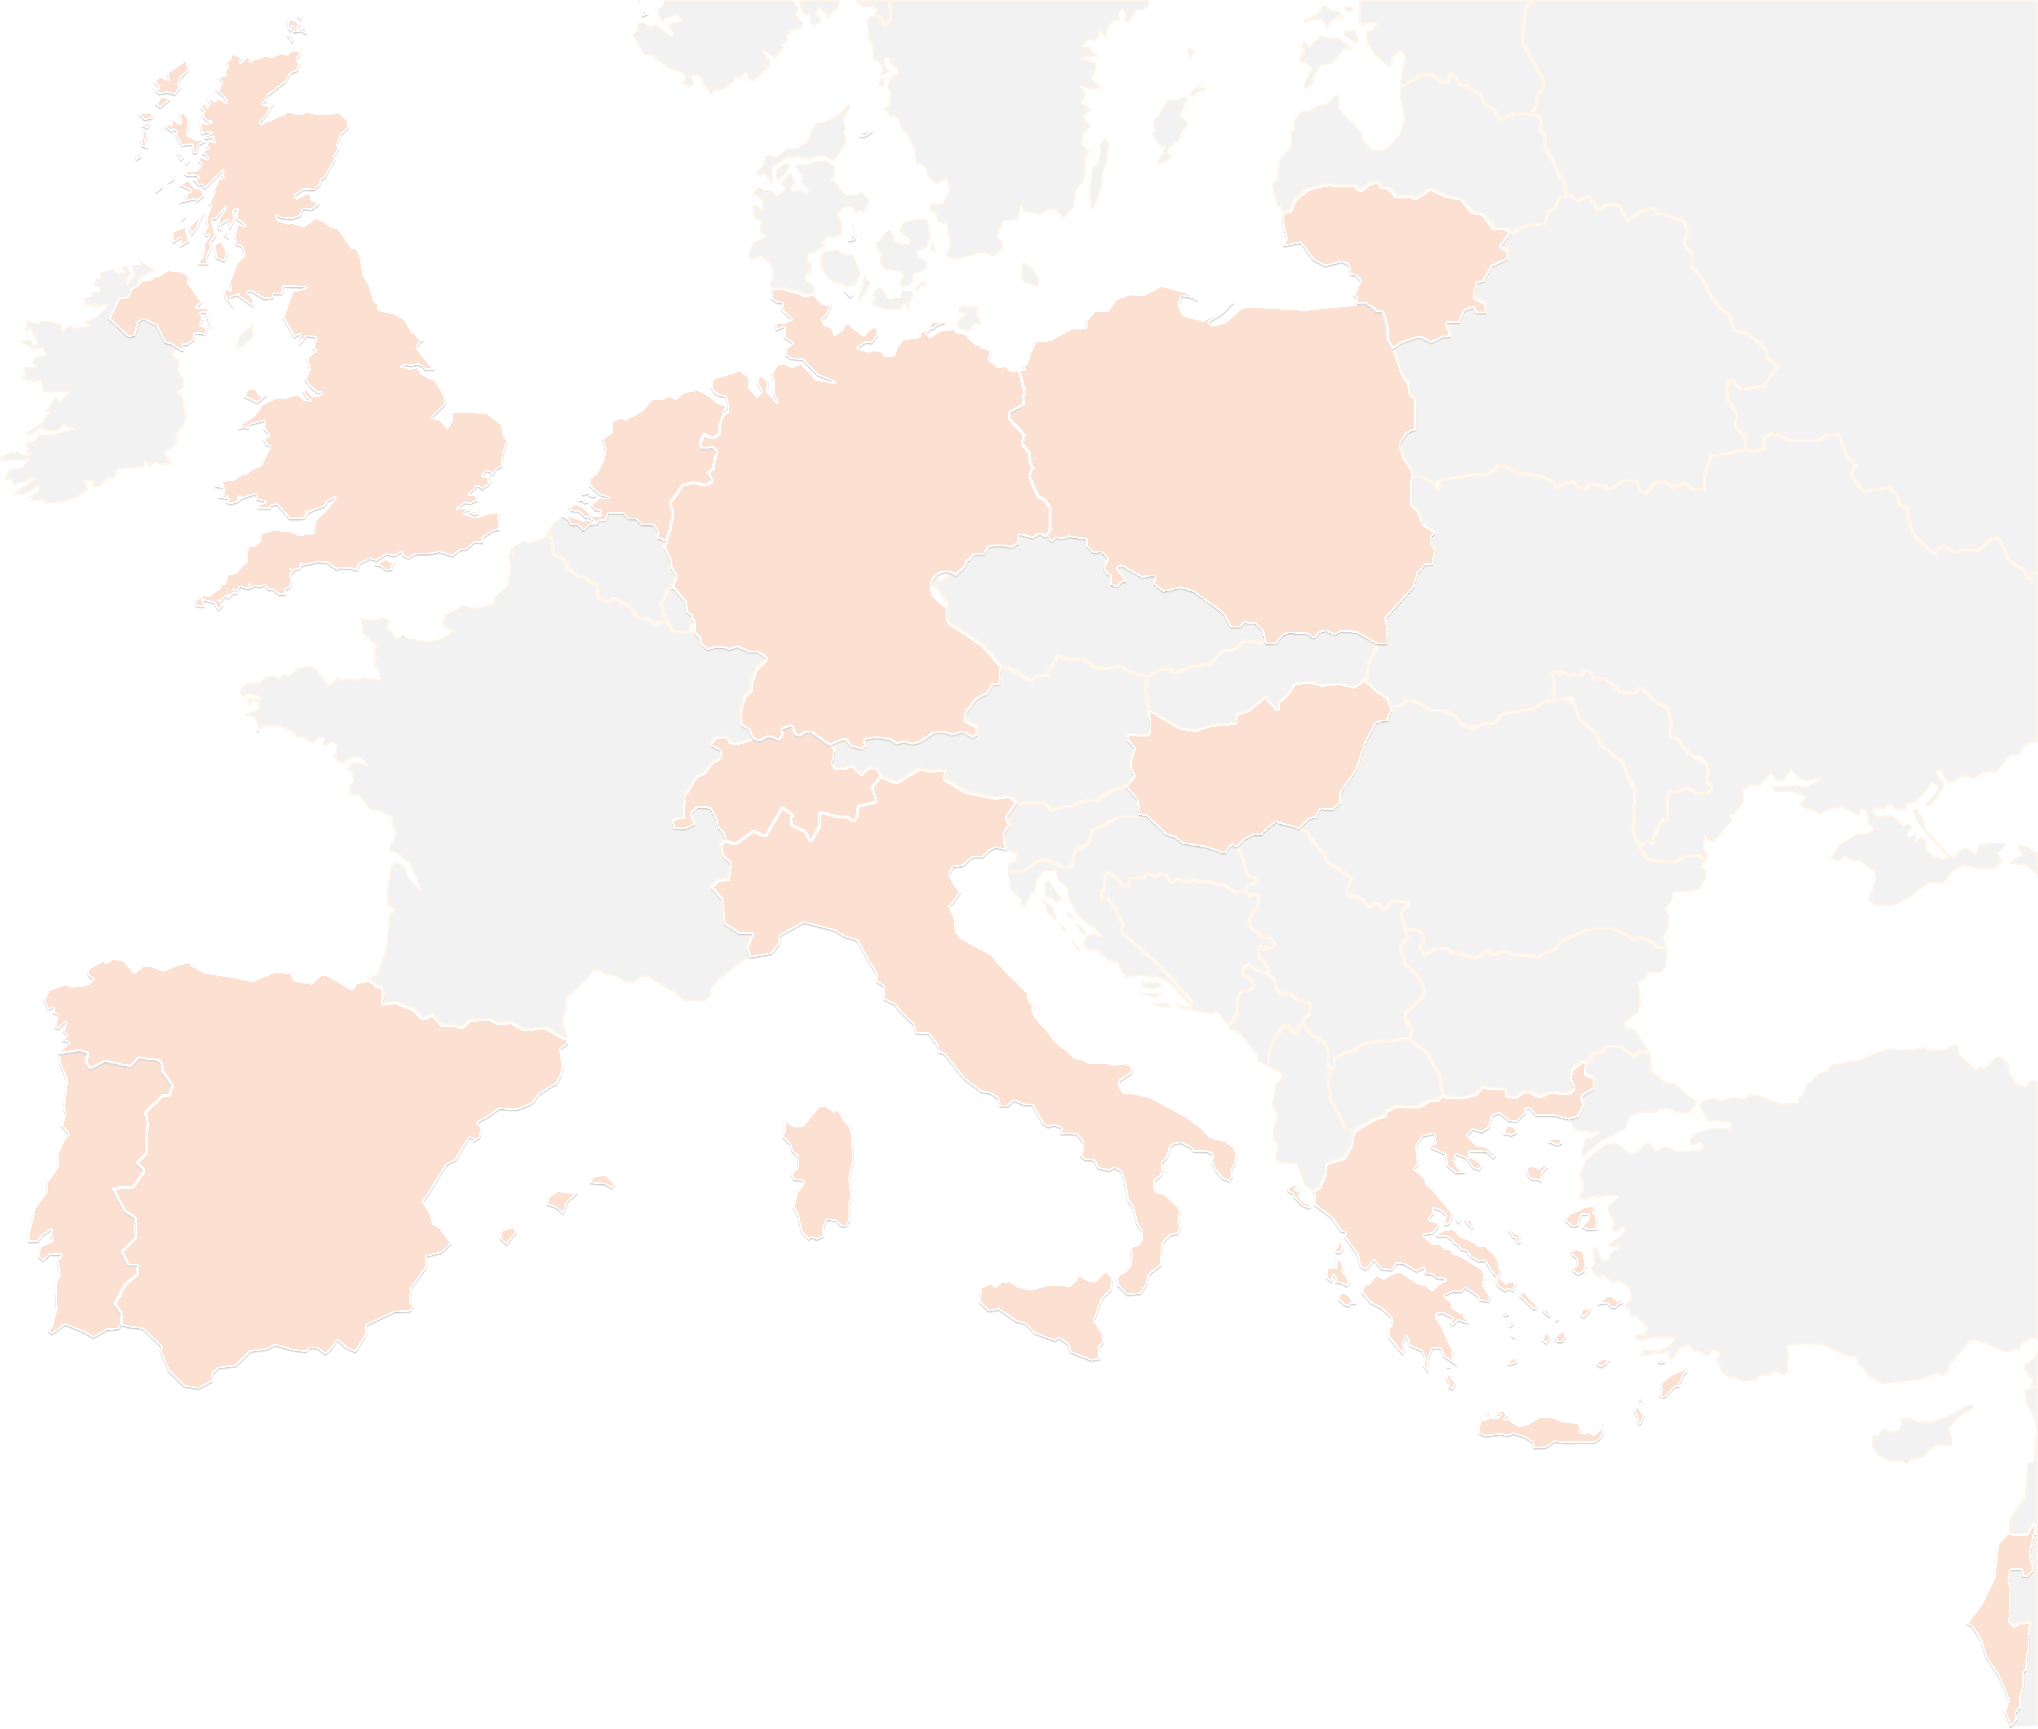
THANK YOU FOR YOUR ATTENTION!
contact@lists.up2university.eu
#up2universe

