Slide 1
WP2-Dissemination and outreach
Barbara Tóth
KIFÜ, Hungary

Slide 2
Latest updates
  Deliverable 2.4-Final dissemination and outreach summary
    Technical Review is done, final adjustments are currently ongoing
    Some inputs are still missing, the responsible persons were notified multiple times, last chance to provide input!
    Deliverable has to be submitted for EC review 29 May 2020.
  Video production
    Teachers’ testimonies
      Supporting document-not mandatory
    Success stories via Zoom

Slide 3


Latest updates
  Social Media
    Thematic posts are ongoing
    Will be a post about this AHM
    Farewell post is scheduled
    ! Decision needed about: who is going to edit/cater to the website, and the social media channels from 01 June 2020?
  Pedagogical Evaluation of the Pilots: the production of a flyer is currently ongoing, expected to be ready by the last week of May.

Slide 4
Requests
  Last chance to promote the project’s achievements and the success stories of the pilots!
  Please provide news items for the website!
  If you have pictures we can create a FB album along with some texts.
  Ask your social media admins to promote the project’s content! All partners are tagged on FB (and Twitter), but only a few partners share our content.

Slide 5
WP2 in numbers
  Up2U was promoted in 38 national events and 35 international conferences
  The project also held 5 workshops at international conferences, a number of workshops at national events, and supported the organisation of national training activities.
  The project featured in 25 national and 6 international publications
  Altogether 24 peer-reviewed papers were published

Slide 6
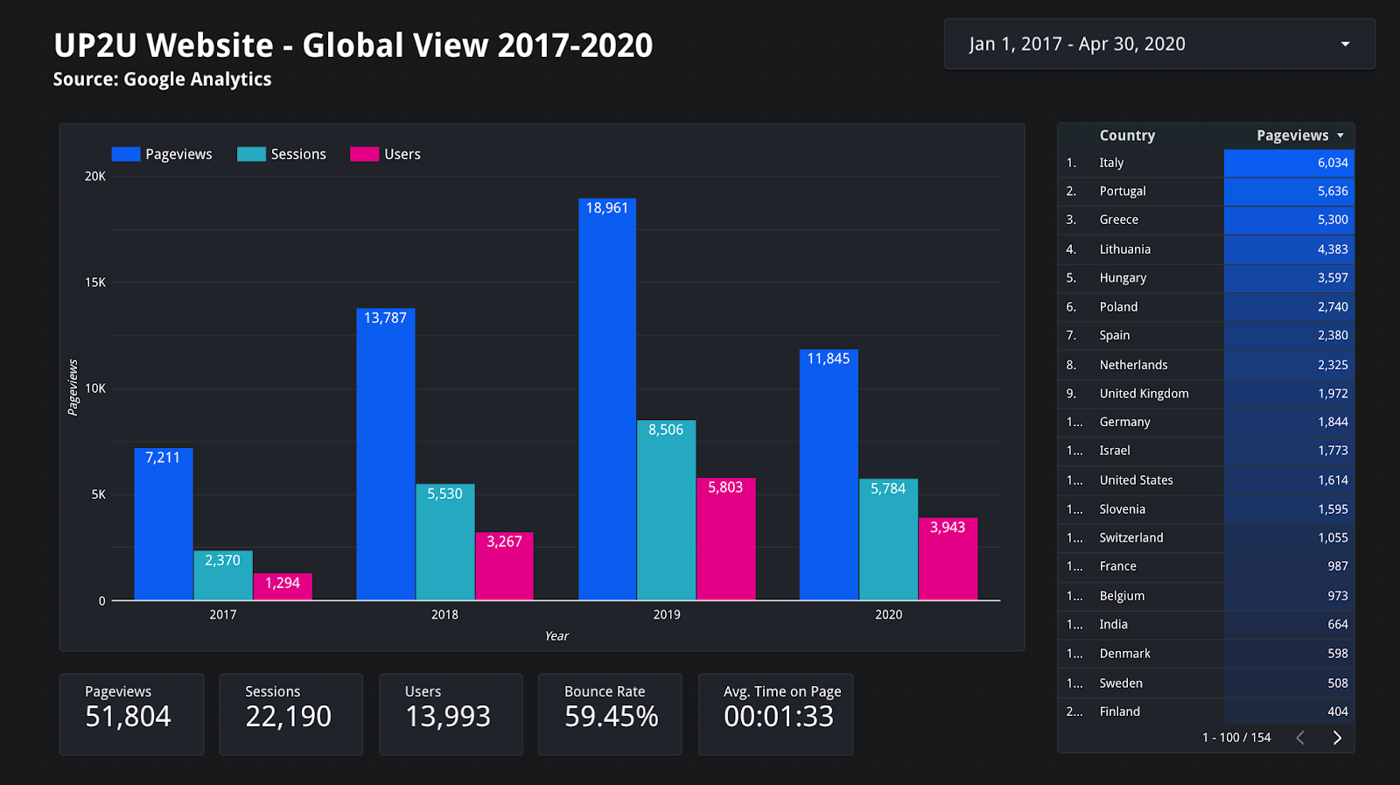

Slide 7
Up2U social media presence
  Facebook
377 likes
400 followers
121 posts
most popular post reached 7500 ppl
  Twitter
171 followers
204 tweets
most popular tweet reached 5100 ppl
Slideshare-70 material uploaded

Slide 8
Up2U official KPIs (M25-41)
KPI | Quantity
Number of scientific publications produced by Up2U | 8
Up2U produced 11 peer reviewed papers in the M25-M41 period.
Number of Up2U community events organised (webinars, tutorials and training) | 6
Up2U organized 1 workshop at an international conference (TNC 2019), 3 global webinars and multiple online trainings/webinars in the pilot countries peer in the M25-M41 period.

Slide 9

Any questions?
  Thank you for your attention!

