Slide 1

Karl Meyer | GÉANT Services Update
eduVPN
eduMEET
WiFiMon
InAcademia

Slide 2
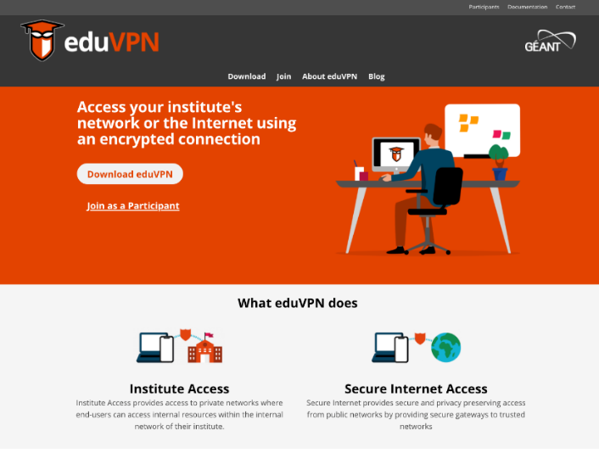
eduVPN – eduVPN.org
  Open-Source, Free VPN solution for NRENs and Institutions
  Institutions can build their own eduVPN service quickly and easily
  Ideal for remote learning

Slide 3
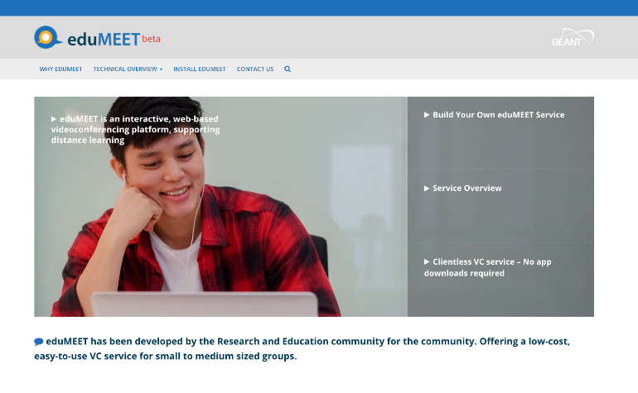
eduMEET – eduMEET.org
  Open-Source, Video Conferencing System
  Institutions can build their own eduMEET service quickly and easily
  No client software – 100% web-based
  Ideal for remote learning

Slide 4
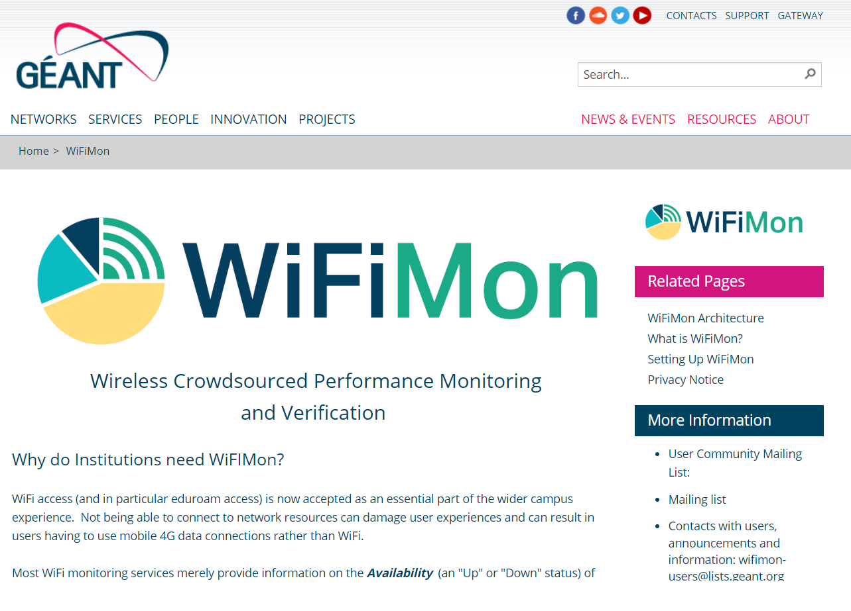
WiFiMon – geant.org/wifimon
  WiFi Monitoring service for institutions
  Crowd-Sourced measurements
  Perfect for large scale campus implementations

Slide 5

InAcademia – inacademia.org
  eduGAIN based identity verification for student offers/discounts
  Looking to recruit Institutions to build critical mass
  Simple implementation
  Needs Pan-NREN awareness

Slide 6
Thank you
Any questions?

