Slide 1



Metadata PushMDQ
Sprint demo #6 (Final)– 30th June 2020
Martin van Es /Alan Lewis/Niels van Dijk/Halil Adem
Q2 2020
Public
www.geant.org

Slide 2

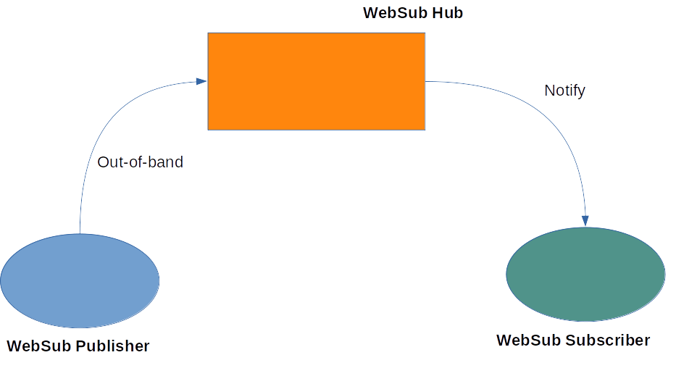
Aims and objectives
Problem statement
  Efficient metadata distribution is vital for all federations
    As federations scale, exchanging a flat file becomes problematic
    Propagation delays can open the possibility of compromise
    MDQ goes some way to addressing this issue
    BUT is deterministic and a SPOF
Solution proposal
  A push-based publisher-subscriber approach based on websub
    Metadata publisher publishes to a hub
    Interested parties subscribe
    Hub send notifications when an update occurs
    Metadata propagation time is reduced

Slide 3

Starting point - eduGAIN metadata exchange

Slide 4

Some basic assumptions
We cannot change the trust framework
  Federations establish trust with their entities
  eduGAIN provides trusted aggregated metadata
We must remain backwards compatible
  Most federations are using a flat file structure for metadata
  Some federations have implemented MDQ protocol
We want to make some significant improvements
  Improve propagation time for changes
  Reduce processing overhead

Slide 5
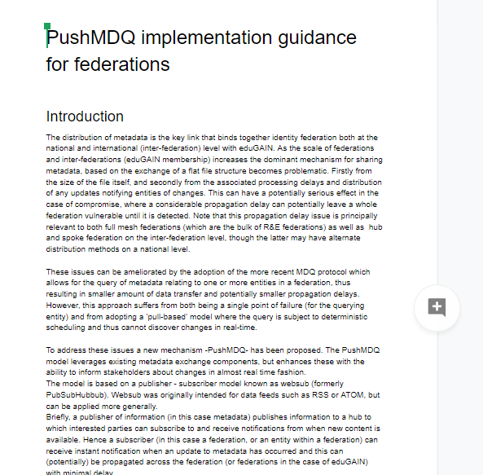
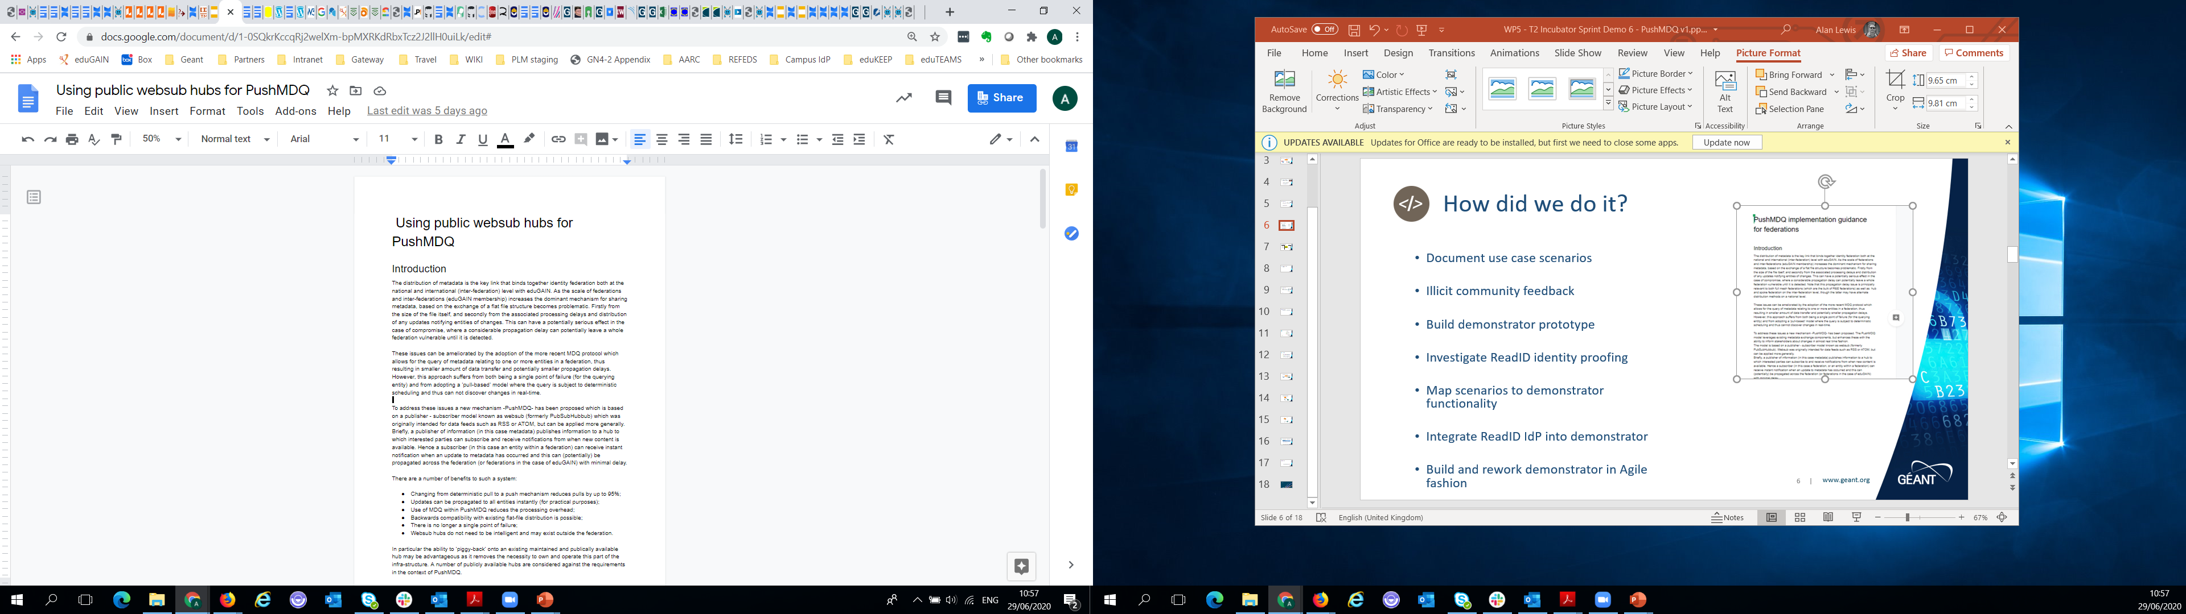
What did we do?
  Investigate websub offerings
  Develop pyFF implementation
  Investigate public websub hubs
  Understand best practice for deployments
  Test with federation flat-file metadata
  Discuss results with stakeholders

Slide 6

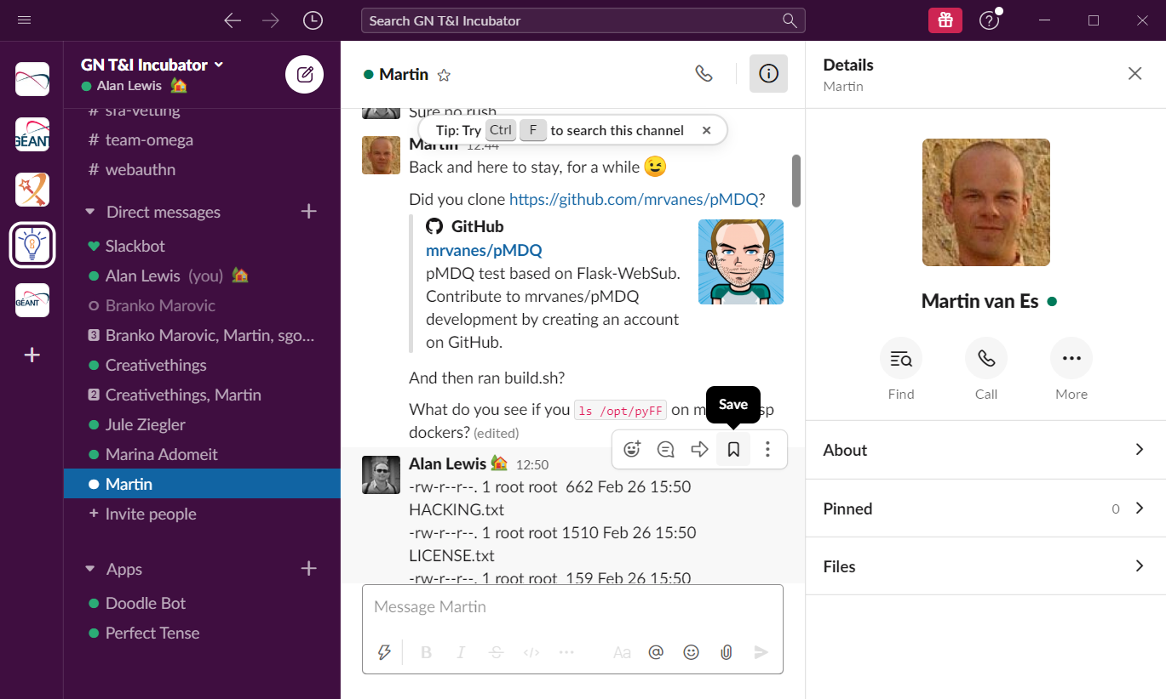
How did we do it?
  Understand spec(s) and terminology
  Understand the pyFF perspective
    Metadata endpoints
    pyFF Notifications
  Build pyFF implementation using Flask-websub
    Publisher/Subscriber/Hub
  Test with federation metadata
  Document considerations and constraints
  Gather details on community websub hubs
mrvanes/pyFF

Slide 7

Implementation Demonstration
Martin

Slide 8

What did we learn
Adoption of PushMDQ has a number of potential benefits
  Changing from deterministic pull to a push mechanism reduces pulls by up to 95%
  Updates can be propagated to all entities instantly (for practical purposes)
  Use of MDQ within PushMDQ reduces the processing overhead
  Backwards compatibility with existing flat-file distribution is possible
  There is no longer a single point of failure
  Websub hubs do not need to be intelligent and may exist outside the federation

Slide 9
Notification of changes with flat-file pull

Slide 10
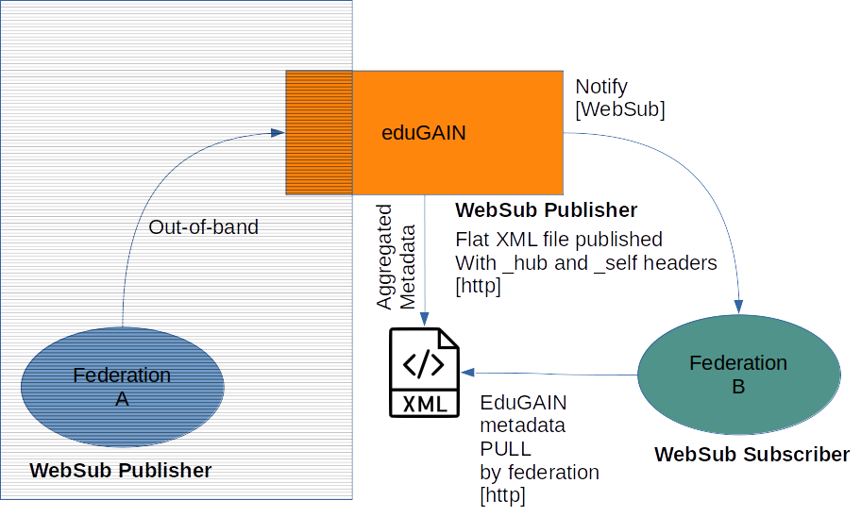
WebSub notification with Flat file pull

Slide 11
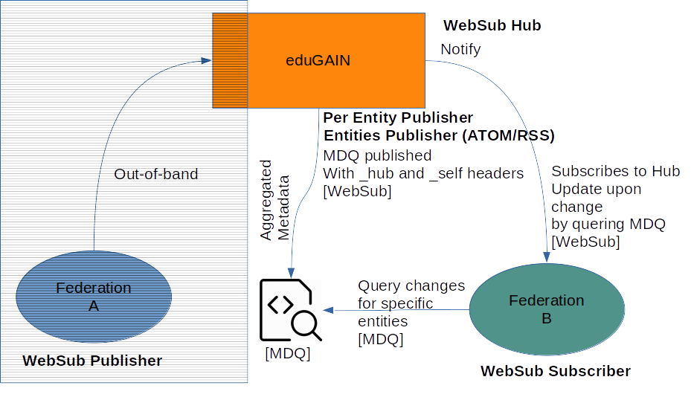
Websub per entity notification

Slide 12
Deployment considerations
Adoption of PushMDQ needs careful consideration to maximise the benefits – see
  https://docs.google.com/document/d/10ZbBSyMXa5pR6J2BgResnxWRz1cxQWCUJEruJ8W-6QM/edit?usp=sharing
The protocol must be implemented (at least) at federation level
For maximum benefit subscribers and publishers support MDQ
A hub must be established – but a public hub could be used
A hub resilience mechanism should be in place
Batch processing delays at the federation must be minimised
Notification thresholds for pulling of changes must be set
The end to end trust model needs to be worked out
Missed notification and back off strategy must be implemented

Slide 13

How do I find out more?
w3C WebSub specification
https://www.w3.org/TR/websub/
Implementation on GitHub
https://github.com/mrvanes/pyFF
Use of public websub hubs
https://docs.google.com/document/d/1-0SQkrKccqRj2welXm-bpMXRKdRbxTcz2J2llH0uiLk/edit?usp=sharing
Implementation guidance for federations
https://docs.google.com/document/d/10ZbBSyMXa5pR6J2BgResnxWRz1cxQWCUJEruJ8W-6QM/edit?usp=sharing

Slide 14

Looking ahead
Stakeholders support the idea of a pilot with eduGAIN
  Interest (at least) from SURFnet, DFN and GRnet
  May also be of interest to Seamless Access
Handover to eduGAIN with support from Incubator (as needed)
  Create pilot proposal
  Infoshare to engage federations

Slide 15

Thank you
www.geant.org
© GÉANT Association on behalf of the GN4 Phase 2 project (GN4-2).
The research leading to these results has received funding from
the European Union’s Horizon 2020 research and innovation programme under Grant Agreement No. 731122 (GN4-2).

