Slide 1



Community-based Trust Establishment
Sprint demo #6 (Final) – 30th June 2020
Branko Marovic/Alan Lewis/Sergio Gomez
Q2 2020
Public
www.geant.org

Slide 2


Aims and Objectives
Follow-up on SFA Distributed Vetting
  Aim: Focus on a specific flow identified in cycle #1
    Community-based (Web of Trust Approach)
    Assumes a pre-existing trust fabric exists for R&E ☺
Identify and/or develop tools to support this approach
  Aim: Detail the workflow and develop a PoC demo
    Use existing tools and services where possible
    Gather community feedback

Slide 3

Overall workflow - Recap
Initiation
Identity
Proofing
Identity
Verification
Issuance
Record keeping
Activation

Slide 4

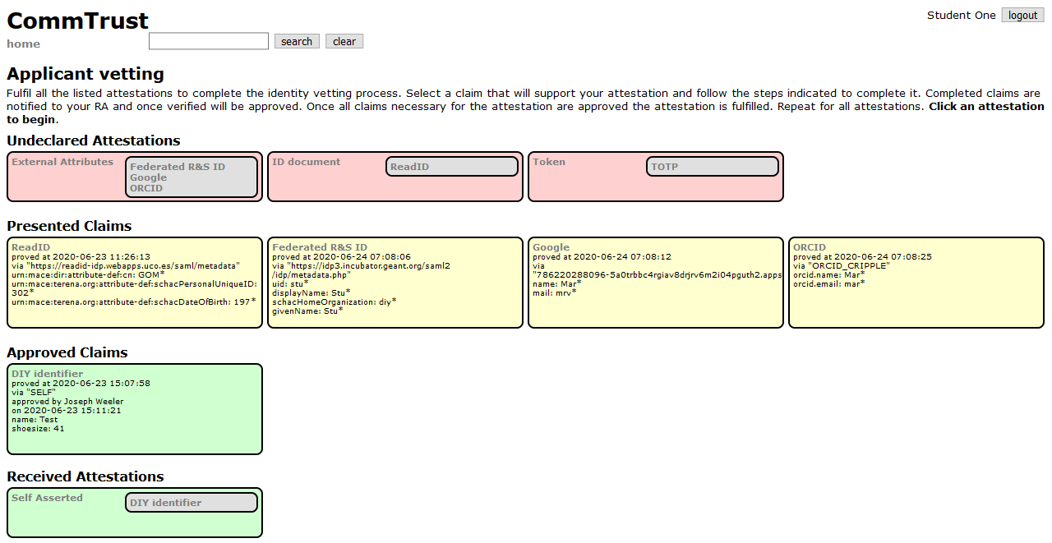
What did we do?
  Identify use cases
  Elaborate typical flows
  Design data model
  Define a demonstrator architecture
  Develop PoC that illustrates key use cases
  Demonstrate PoC and gather feedback on areas of applicability
PoC Demonstrator

Slide 5

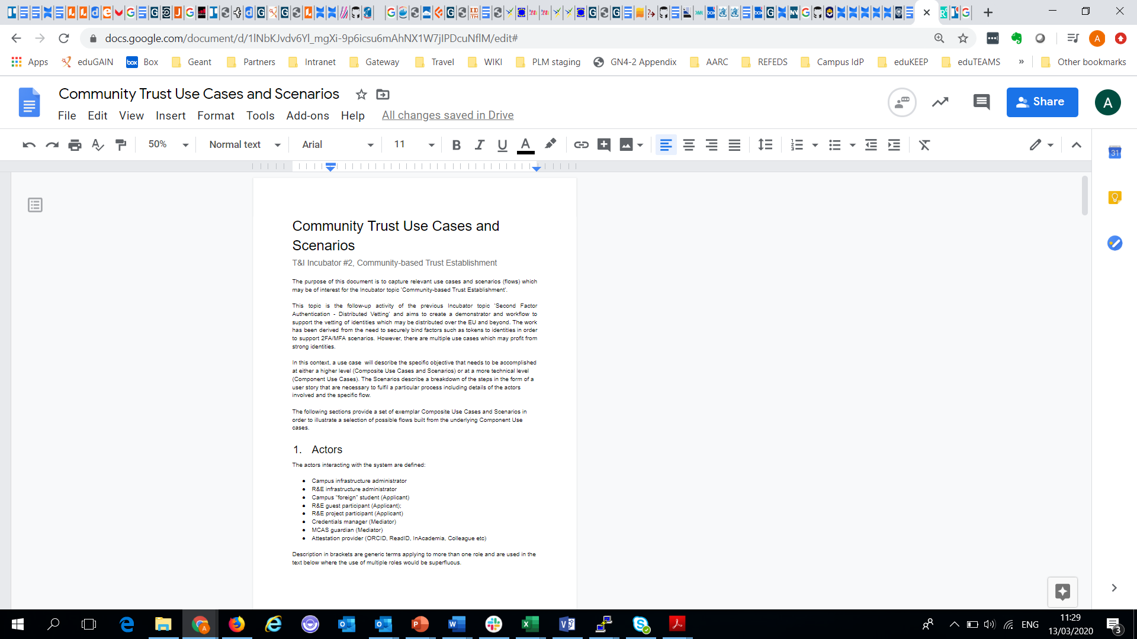
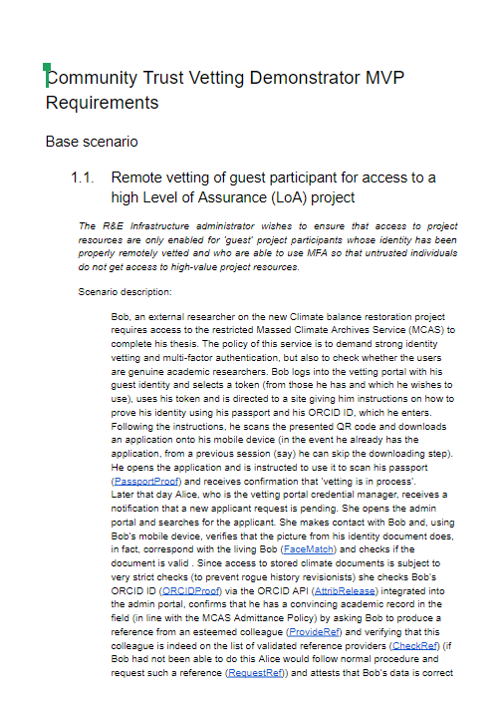
How did we do it?
  Document use case scenarios
  Elicit community feedback
  Build demonstrator prototype
  Investigate identity verification methods - ReadID, Google, ORCID, etc.
  Map scenarios to demonstrator functionality
  Integrate ReadID IdP into demonstrator
  Build and rework demonstrator in agile fashion

Slide 6

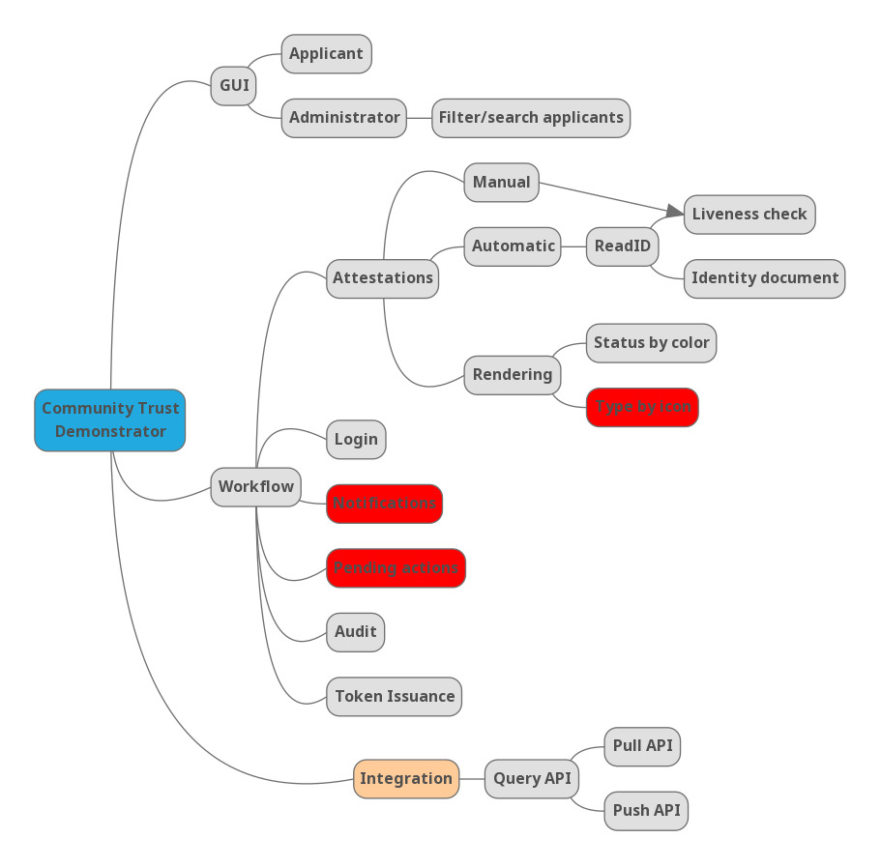
Developing demonstrator functionality
USE CASE: As an applicant, I want to be guided through the workflow to register a token so it is easy to achieve.
GUI should contain descriptive text to explain the workflow process to the applicant
The GUI should be arranged in a hierarchical fashion revealing different levels of information at each level Top level……..
Starting with the demo EPIC..
Breaking down to categorised user stories……
Leading to implied requirements

Slide 7


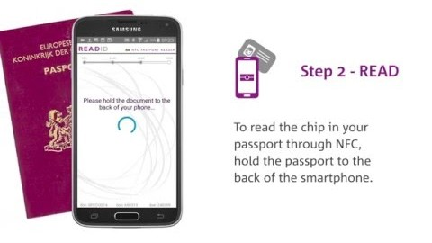
ReadID - Identity Proofing
ReadID identity proofing solution
Reads ICAO 9303 compliant documents
Mobile app/SDK and SaaS backend
Facial matching – ‘liveness’ check
Here’s how it works

Slide 8

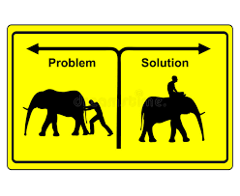
What was achieved
Understand use cases
Explore problem space
Capture community feedback/needs
Demonstrate the concepts
Demonstrator PoC created
ReadID identity proofing integrated
API defined
Documentation set created

Slide 9

Demonstrator PoC demo
Martin/Sergio

Slide 10
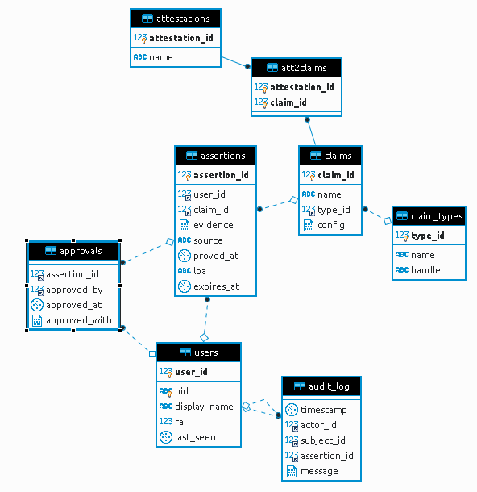
What did we learn?
  Some large collaborations already have their own solution
  Not all research data is highly sensitive – no need for 2FA
  The semantics around proof are complicated
  Many possible workflows –> building blocks
  Should define an integration API for services (eduTEAMS)
  Possibility of a generalised identity vetting solution
  Data model

Slide 11

How do I find out more?
For information on demonstrator usage see:
https://wiki.geant.org/display/gn43wp5/CommTrust+demonstrator+usage
For use cases, demo code, data model description see:
https://wiki.geant.org/display/gn43wp5/ComTrust+demonstrator

Slide 12




Looking ahead
User identity vetting services such as READID and others are beneficial for the R&E community for:
  Onboarding of users into research communities
  Enrolling foreign (guest) students into a campus
However…..
APIs do not align well with those use by research communities
Capabilities – e.g. LOA, that can be established differ
So next…..
Investigate the business case for establishing a identity vendor broker supporting
  Pan-European R&E use cases
  standardised API(s) to multiple vendor solutions

Slide 13

Thank you
www.geant.org
© GÉANT Association on behalf of the GN4 Phase 2 project (GN4-2).
The research leading to these results has received funding from
the European Union’s Horizon 2020 research and innovation programme under Grant Agreement No. 731122 (GN4-2).

