Slide 1



Identity Broker
Sprint demo #3.3 – 13th October 2020
Alan Lewis/Branko Marovic/Jule Ziegler
Q4 2020
Public
www.geant.org

Slide 2

Background
It is proposed…..
More research collaborations and rising student numbers are increasing the pressure on enrolment processes
  Identity verification in person is costly and may be impractical
  Knowledge-based enrolment is vulnerable to data breaches
  Sending identity documentation is slow and open to fraud
Solutions exist for automated ID verification that might
  Improve efficiency
  Reduce costs
  Minimise errors
??Could these be of use to the R&E community??

Slide 3
Aims and Objectives
Investigate business case for remote identity verification using ID documents
  Validate the problem and explore the nature and extent of the need
  Collect use cases from NRENS, Research VOs and institutions
    Onboarding users into a research community
    Enrol ‘foreign’ students onto a campus
  Investigate the capabilities of commercial solutions
If of interest, examine the possible ways to enable within R&E, e.g.
  An identity broker service for a set of commercial solutions
  A centralised identity verification service offered by GEANT
  A collective procurement exercise
  Information gathering and dissemination
Document findings and discuss with stakeholders

Slide 4

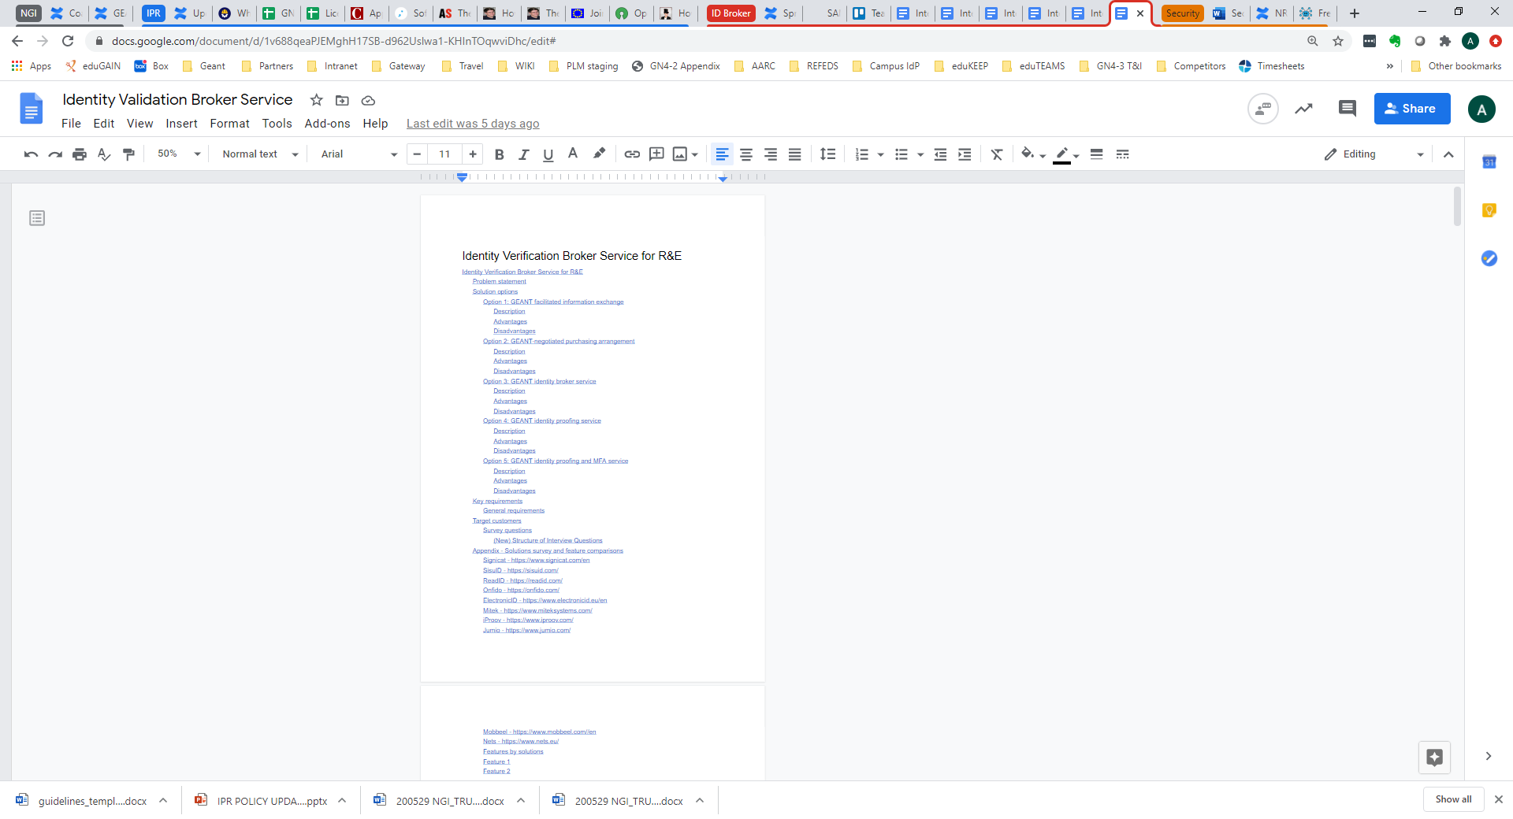
Activities status
Status
Investigate solution providers
Identify interviewees
Build questionnaire
Conduct interviews
Revise questions
Analyse results
Map to possible approaches
Stakeholder feedback









Slide 5





Identity Verification using ID documents
Capture
Validate
Selfie
Verify
Prescence
Capture an image from the document
Validate image against templates and RFID extracted information
Applicant takes selfie
Verify applicant using facial matching
Check real applicant is presenting the information (fraud detection)
  Signicat (Norway)
  SisuID (Finland)
  Onfido (U.K)
  ReadID (Innovalor N.L)
  ElectronicID (Spain)

Slide 6

Methodology
Interview sessions with NRENS, institutions and VOs
Design a set of questions covering key areas
  Current and future use cases
  Present approaches and status
  Problems and drivers
  Requirements
  Operational and business needs
Very early for most so little clear idea on many specifics
Later interviews used more general questions
Feedback of points raised in the earlier interviews
But

Slide 7

Interviews
A total of eight interviews held so far
Introductory material sent to provide orientation
Present approach
  Do you manage the enrolment of users for your institutions/communities?
  What solutions do you currently employ to support this?
  Is the reliable verification of user identities a problem for you now?
Current and future needs
  To address the problems identified are there plans to develop or procure any additional solutions?
  What are the principle use cases that must be supported?
  When do you plan to make such improvements?
Technical requirements
  What levels of assurance are needed by the relying party services you support?
  What forms of identity proof should be supported??
  What interfaces are needed to integrate to your existing AAI/IdM system?
Business Needs
  Would you prefer any offering to be operated within the R&E community?
  Would you be prepared to pay for such an offering and what would be your preferred model?
  Are there any specific legal or regulatory requirements that should be supported?
When | Who | Type | Organisation
17/09 | Peter Clijsters | NREN Hub and Spoke Fed. | SURF
18/09 | Jarno Laitinen | VO | CSC – LUMI EuroHPC
23/09 | Christoph Graf | NREN Full Mesh Fed. | SWITCH
24/9 | Elina Toivanen | University | Univ. Turku
2/10 | Rhys Smith/Joe Steele | NREN Full Mesh Fed. | JISC
9/10 | Davide Vaghetti | NREN Full Mesh Fed. | GARR
12/10 | Miroslav Milinovic | NREN Hub and Spoke Fed. | CARnet
12/10 | David Huebner/Peter Gietz | VO | CSC - DARIAH

Slide 8

Findings summary so far…
We identified some commonality in a number of areas:
  Use Cases identified
  Current processes used
  Status of interviewees w.r.t ID verification solutions
  Issues and drivers for improvements
  General functional requirements
  Solution scope
Next steps for most is to gather member feedback
Interest in any proposal we may bring forward.

Slide 9

Next steps
To get a fuller picture we plan:
  Further analyse and summarise the needs we have discovered
  Map the needs to the general solution characteristics
  Write a proposal presenting
    Solution capabilities
    Benefits
    Deployment possibilities
  Review the proposal with stakeholders
  Detail possible next steps for preferred approach
  Consider developing a survey to gauge the wider interest

Slide 10

Thank you
www.geant.org
© GÉANT Association on behalf of the GN4 Phase 2 project (GN4-2).
The research leading to these results has received funding from
the European Union’s Horizon 2020 research and innovation programme under Grant Agreement No. 731122 (GN4-2).

