Slide 1



Identity Broker
Sprint demo #3.6 – 9th February 2021
Alan Lewis/Branko Marovic/Jule Ziegler/Miika Tuisku
Q1 2021
Public
www.geant.org

Slide 2

Background
It is proposed…..
Research collaborations and rising student numbers are increasing the pressure on enrolment processes
  Identity verification in person is costly and may be impractical
  Knowledge-based enrolment is vulnerable to data breaches
  Sending identity documentation is slow and open to fraud
  Increased drive for remote interaction
Solutions exist for automated ID verification that might
  Improve efficiency
  Reduce costs
  Minimise errors
??Could they be of use to the R&E community??

Slide 3
Aims and objectives
Investigate business case for remote identity verification using ID documents
  Validate the problem and explore the nature and extent of the need
  Collect use cases from NRENS, Research VOs and institutions
    Onboarding users into a research community
    Enrol ‘foreign’ students onto a campus
  Investigate the capabilities of commercial solutions
If of interest, examine the ways to enable capabilities within R&E
  An identity broker service for a set of commercial solutions
  A centralised identity verification service offered by GEANT
  A collective procurement exercise
  Information gathering and dissemination
Document findings and discuss with stakeholders

Slide 4

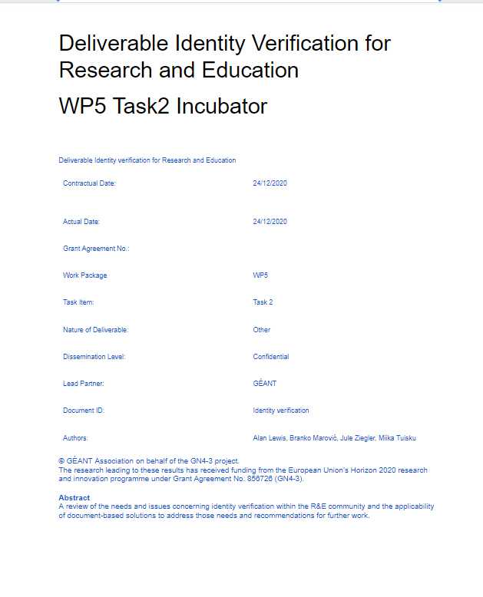
Activities status
Status
Investigate solution providers
Identify interviewees
Build questionnaire
Conduct interviews
Revise questions
Analyse results
Stakeholder feedback
Investigate business case
Create recommendations report










Slide 5

Digital identity -overall workflow
You are here
Initiation
Identity
Proofing
Registration and enrolment
Issuance
Record keeping
Activation

Slide 6
Digital IDs – mind the gap
McKinsey Global Institute

Slide 7
The R&E gap
Harmonised and interoperable identity management policies
Document-based credentials recovery
HO IdP
eIDAS IdP
MyAcademic ID
Document-based identity for
remote applicants
Document-based identity for
higher LoA
NIST - 800-63-3

Slide 8
R&E digital identity options
Within R&E a number of digital ID approaches are available
eIDAS (born 2014)
  19 national eID schemes in 15 of the EU27 countries (58%)
  Only around 10% od services can be accessed with a ‘foreign’ eID
  Slow roll-out with remaining interoperability issues
  Limited mandatory attributes and lack of persistent identifiers
  EU-centric
European Student Card Initiative
  Use of eIDAS eID to enrol in a HO
  MyAcademicID provides an identifier allowing eIDs to be used via eduGAIN
  Only addresses the student segment
  National and pan-national eiDs exist
  EDSSI will do further work, deployment is still in the future.

Slide 9
Identity proofing steps

Slide 10





Identity verification using ID documents
Capture
Validate
Selfie
Verify
Prescence
Capture an image from the document
Validate image against templates and RFID extracted information
Applicant takes selfie
Verify applicant using facial matching
Check real applicant is presenting the information (fraud detection)

Slide 11

Commercial solution providers
Identified around 20 document-centric ID proofing vendors
Many originated in the digital payments industry to speed onboarding and fraud prevention
Platform offering and components for biometric and/or document matching
Examples are:
  Signicat (Norway)
    https://www.signicat.com/en
    Platform Identity hub for eID/social ids, document scanning, live interviews, validation with authoritative sources
  SisuID (Finland – consortium)
    https://sisuid.com/index.html
    Identity and authentication platform supporting document scanning and facial recognition
  Onfido (U.K)
    https://onfido.com/
    Document verification, facial matching and authentication solution
  ReadID (Innovalor N.L)
    https://readid.com/
    Document verification using NFC and facial matching
  ElectronicID (Spain)
    https://www.electronicid.eu/en
    Document verification using optical capture with video-based facial matching

Slide 12
Methodology
Interview sessions with NRENs, institutions and VOs
Designed a set of questions covering key areas
  Current and future use cases
  Present approaches and status
  Problems and drivers
  Requirements
  Operational and business needs
Very early for most: little clear idea on many specifics
Approach adapted as interview progressed
Feedback of points raised to interviewees
But

Slide 13

Interviews
When | Who | Type | Organisation
17/09 | Peter Clijsters | NREN Hub and Spoke Fed. | SURF
18/09 | Jarno Laitinen | VO | CSC – LUMI EuroHPC
23/09 | Christoph Graf | NREN Full Mesh Fed. | SWITCH
24/9 | Elina Toivanen | University | Univ. Turku
2/10 | Rhys Smith/Joe Steele | NREN Full Mesh Fed. | JISC
9/10 | Davide Vaghetti | NREN Full Mesh Fed. | GARR
12/10 | Miroslav Milinovic | NREN Hub and Spoke Fed. | CARnet
12/10 | David Huebner/Peter Gietz | VO | CSC – DARIAH
10/11 | Marko Loukkaanhuhta Jari Kotomäki | University | Univ. Aalto
A total of nine interviews held
Also, some exchanges with CERN
Introductory material sent to provide orientation
Present approach
  Do you manage the enrolment of users for your institutions/communities?
  What solutions do you currently employ to support this?
  Is the reliable verification of user identities a problem for you now?
Current and future needs
  To address the problems identified are there plans to develop or procure any additional solutions?
  What are the principle use cases that must be supported?
  When do you plan to make such improvements?
Technical requirements
  What levels of assurance are needed by the relying party services you support?
  What forms of identity proof should be supported??
  What interfaces are needed to integrate to your existing AAI/IdM system?
Business Needs
  Would you prefer any offering to be operated within the R&E community?
  Would you be prepared to pay for such an offering and what would be your preferred model?
  Are there any specific legal or regulatory requirements that should be supported?

Slide 14

Findings
Findings were grouped into a number of categories
  Scope and use cases
  Change drivers
  Current status and solution landscape
  Requirements
  Business factors
  Implementation approach

Slide 15
Findings – Scope and use cases
The inferred/conjectured use cases were validated
  Enrolment of (often remote) students or of researchers into RO or VO
  Enrolment of ‘foreign’ students into a university
In addition we found
  Enhanced vetting for issuing or recovery of second-factor authentication tokens.
  Identity vetting for password recovery
  Enrolment of remote or short-term institutional staff and contract employees
Perhaps also remote learning has additional use cases

Slide 16

Findings – Change drivers
No strong sense of urgency from NRENs – institution driven
Research organisations are more motivated – global memberships
Key motivations include:
  Increased efficiency leading to cost reductions and applicant satisfaction
  Improvements in quality of vetting process
  Lack of suitably trained staff
  Responding to growth in on-line learning
  Reduction in errors –improving security

Slide 17










Findings – Current status & solution landscape
Very early days in this area for R&E
Limited knowledge of solutions and few deployments
Rising awareness and some investigations underway
Home institutions are leading here – NRENS are following
eIDAS aware, but coverage and attributes limited

Slide 18

Findings - Requirements
Complete requirements set, as yet non-authoritative
Proposed requirements were generally accepted
Some expressed requirements are not fully aligned and may depend on needs
Requirements were grouped into broad themes
  Identification and verification methods
  Level of Assurance needs
  Usability and functionality
  Credential issuance
  Solution interfaces – APIs
  Trust and regulatory compliance
  Cost and flexibility
The report gives all the details

Slide 19

Findings – Business factors
Probably too early to deduce much here but
  Help with making solution selections would be welcome
  Too early to determine best approaches – procurement, service etc.
  Quantified cost savings will be key to adoption
  Pricing model unclear – subscription preferrable for some
  Trust model and privacy are key considerations, but……
    Third-party solutions acceptable if they tick key boxes
    National regulatory considerations are an important factor for some

Slide 20

Findings – Implementation approach
Home institutions will have a central role in ID proofing
Even with a solution, responsibility and liability chiefly with HOs
NRENs could help support common standards
Solutions must be flexible to accommodate different needs
A GÉANT solution could be welcomed if it brings benefits
VOs and ROs could benefit from use as an Idp add-on

Slide 21


Conclusions
Efficient onboarding requires effective identity proofing
This is most acute in some segments, but true generally
Digital identity solutions do not offer universal coverage
Automated document-based ID proofing could help
Requirements hard to establish in an early market
A strong need for congruency and more information exists

Slide 22

Recommendations and next steps
Determine extent of need through a broad survey of R&E
Establish a forum for information capture and exchange
Benchmark and compare available solutions
Investigate the business case for a community operated service
Assuming a positive result……

Slide 23

Thank you
www.geant.org
© GÉANT Association on behalf of the GN4 Phase 2 project (GN4-2).
The research leading to these results has received funding from
the European Union’s Horizon 2020 research and innovation programme under Grant Agreement No. 731122 (GN4-2).

