Slide 1


The Data Problem
A View on Applying AA(A) Technologies to Data Infrastructures
^{Telefónica I+D}
^{12.07.2012}

Slide 2

The Long-Term Vision
“Our vision is a scientific e-Infrastructure that supports seamless access, use, re-use and trust of data. In a sense, the physical and technical infrastructure becomes invisible and the data themselves become the infrastructure – a valuable asset, on which science, technology, the economy and society can advance.”
  Report of the High-Level Group on Scientific Data, October 2010
  “Riding the Wave: how Europe can gain from the raising tide of scientific data”

Slide 3
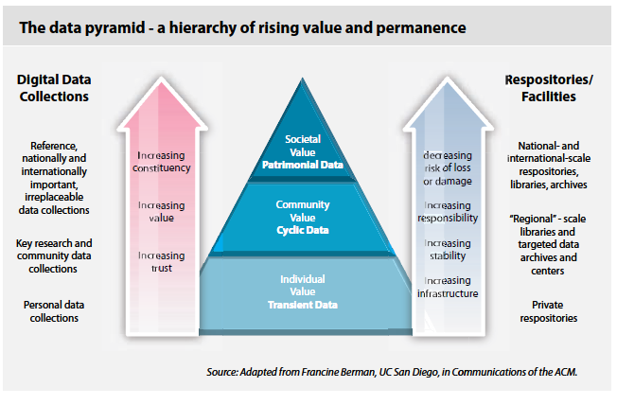
The Data Pyramid

Slide 4
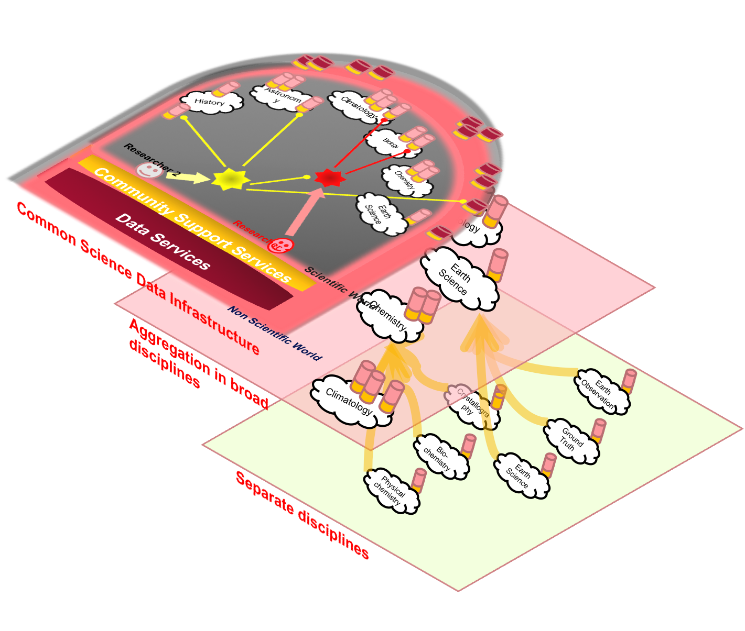
Aggregating and Integrating

Slide 5
An Initial Wish List
Open deposit, allowing user-community centres to store data easily
Bit-stream preservation, ensuring that data authenticity will be guaranteed for a specified number of years
Format and content migration, executing CPU-intensive transformations on large data sets at the command of the communities
Persistent identification, allowing data centres to register a huge amount of markers to track the origins and characteristics of the information
Metadata support to allow effective management, use and understanding
Maintaining proper access rights as the basis of all trust
A variety of access and curation services that will vary between scientific disciplines and over time
Execution services that allow a large group of researchers to operate on the stored date
High reliability, so researchers can count on its availability
Regular quality assessment to ensure adherence to all agreements
Distributed and collaborative authentication, authorisation and accounting“
A high degree of interoperability at format and semantic level
Adapted from the PARADE White Paper

Slide 6
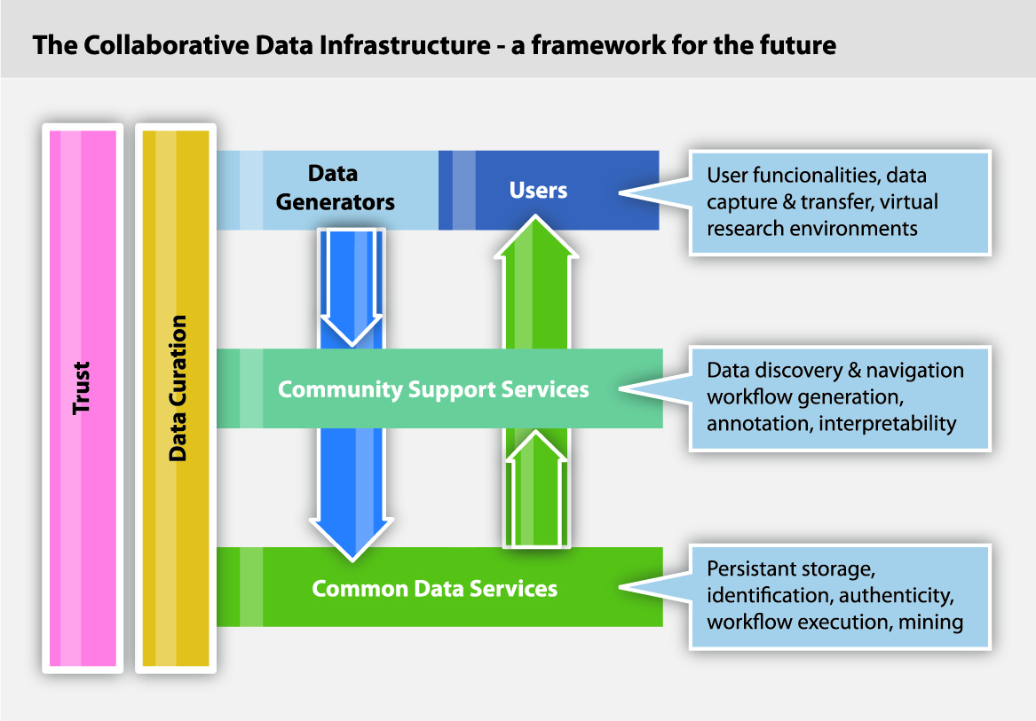
Identity in Data Infrastructures
The “Riding the Wave” report includes eleven challenges to overcome in its vision of a Scientific Data Infrastructure
  From data collection to sustainability
Three of them directly rely on the availability
of an operational identity infrastructure
  Trust
  Security
  Data publication and access
At least other four would greatly benefit
from it
  Usability, diversity,
  new social paradigms, and preservation
  and sustainability

Slide 7
Data and AA Infrastructures
Security, trust and access requirements must become pervasive and dynamically associated with data themselves and their metadata,
  Entities can apply the policies they consider relevant
  Derived datasets generate their security metadata from the origin dataset(s)
  Coherent availability of information across different access patterns
The accuracy of these metadata requires well-established identity services
  Not only people
  Not only through browsers
  Data sources
  Data processors
  Datasets themselves
An Authentication and Authorization Infrastructure (AAI) becomes a key element for the Data Infrastructure
  At all layers in the data pyramid
  In all levels of aggregation and integration

Slide 8
The Ideal State of Several Well-Known Parts
Entities prove their identities at identity providers (IdPs)
  By different means
  Security and usability criteria.
Identity attribute values are stated by attribute authorities (AAs)
  Under control of different organisations and communities
  Communities should be empowered to manage their AAs as they see fit
Identity is transferred to applications by relying parties (RPs)
  They accept data from recognized IdPs and AAs
RPs and applications rely on Policy Decision Points (PDPs)
  Managed by rules defined by data infrastructure operators and dataset owners
  PDP rules are manipulated according to human-friendly mechanisms
A trust framework must be established among the interacting parties
  The foundation of all identity data exchange and application
  A heterarchical model is the only possible one

Slide 9
Don’t Forget the Third A (and beyond)
Accounting and Reputation
Accounting is an essential function to keep
  Audit capabilities: Funding, resource location…
  Security: Incident handling, forensic evidence…
  Usage records: Resource planning, access methods…
  Resiliency: Diagnostics, fault isolation….
Accounting logs are datasets themselves
  Benefit from data infrastructure tools
  Complex querying, aggregation and integration
  And access control
Reputation expresses the value a certain community gives to an entity
Reputation shall come from a web of trust built of several sources
  Formal: Peer reviews, project reports…
  Informal: Social tags, user ratings…
  Infrastructural: Availability, incident reports…
Reputation becomes, in essence, a special type of accounting record
  Similar characteristics
  And a relevant attribute source

Slide 10
Keep It Simple. Let It Happen
Avoid technical and administrative overheads
  Do not reinvent the wheel in several shapes
  Take very careful steps into additional formalizations
  Experience shows how overcomplicated proposals have been sidestepped
Take advantage of existing trust links in the scientific community
  And of its specific characteristics
  Build on strong foundations
Take the outer worlds into account
  Governmental infrastructures
  Commercial initiatives
  Other environments: professional associations, NGOs…
Make the whole system sustainable
  Sustainability is by definition opposite to perpetual growth

Slide 11
A Few Immediate Challenges
Expanded user authentication
  edu + (com + gov)
  Multiple sources of identity data
Applicable authorization
  Policy engines available to users and communities
  Interpretable rules
Reliable accounting
  Common operational baseline
  Accounting data as metadata
Reputation support
  Formal and informal records
For humans and non-humans
  Any entity needs an identity
Transparent integration with any other infrastructure
  Network, computational,…
  Make composition simple
Keep It Happening

