Slide 1
Humanities requirements: DARIAH
AAA Study Workshop,
Brussels, 12 July 2012
Ye Cao
Max Planck Digital Library (MPDL)
DARIAH-EU, VCC e-Infrastructure
Notes:
Thank you XX,
It is very first I come to brussels

Slide 2
What is DARIAH?
DARIAH: Digital Research Infrastructure for the Arts and Humanities
One of the few ESFRI research infrastructures for the humanities
DARIAH’s mission
  - To develop, maintain and operate an infrastructure in support of ICT-based research practices
Working with communities of practice
  - To ensure that best practices, metholodological and technical standards are followed
Notes:
DARIAH’s mission
To enhance and support digitally-enabled research across the humanities and arts
-To develop, maintain and operate an infrastructure in support of ICT-based research practices
To support researchers in using ICT-enabled methods to analyse and interpret digital source materials
Working with communities of practice
To bring together individual state-of-the-art digital humanities and arts activities across Europe
To preserve, provide access to and disseminate the research that stems from these collaborations
-To ensure that best practices, metholodological and technical standards are followed

Slide 3



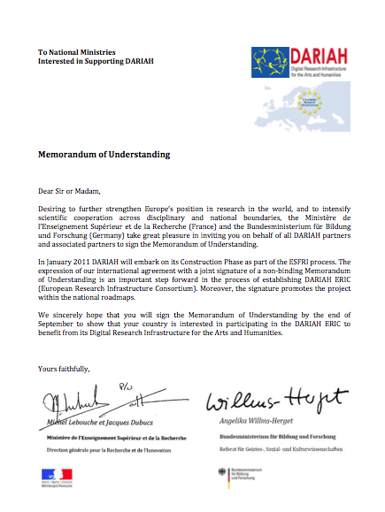



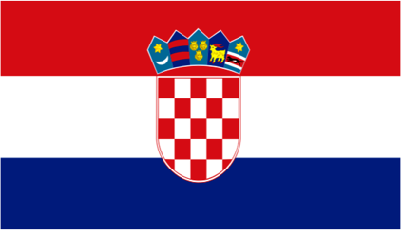


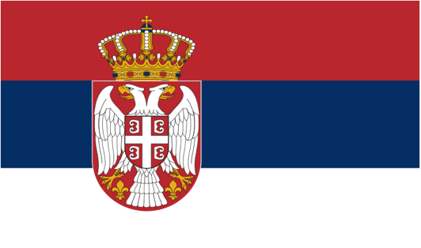
Countries participating in DARIAH
Austria
Croatia
Denmark
France (Host Country)
Germany (Coordinator)
Greece
Ireland
The Netherlands (Coordinator)
Slovenia
Serbia
Notes:
10 countries join DARIAH so far

Slide 4









Coordinating Institutions
Austria: Österreichische Akademie der Wissenschaften & University of Vienna
Croatia: Institut Ruđer Bošković
Denmark: Århus University
France: Le Centre National de la Recherche Scientifique
Germany: Niedersächsische Staats- und Universitätsbibliothek Göttingen
Greece: Academy of Athens - Research Centre for the Study of Modern Greek History
Ireland: Trinity College Dublin
The Netherlands: Data Archiving Networked Services
Serbia: Center for Digital Humanities, Belgrade
Slovenia: Institute of Contemporary History
Notes:
One leading institution in each country

Slide 5

DARIAH collaboration
Affiliated projects
CENDARI, DASISH, EHRI, NeDiMAH
Sibling initiatives
BAMBOO, CLARIN, TEI
Cultural heritage initiatives
Europeana, DC-Net
Technological initiatives
EGI, EUDAT
Notes:
DARIAH collaborate with other humanities projects and initiatives. Especially those Affiliated projects, their activity are closely dependant from the technical background established by DARIAH. So We have a strong collaborative framework with them and listen to their requirements including AAI.
I will describe one user case from affiliated project, EHRI later. EHRI (European Holocaust Research Infrastructure)

Slide 6
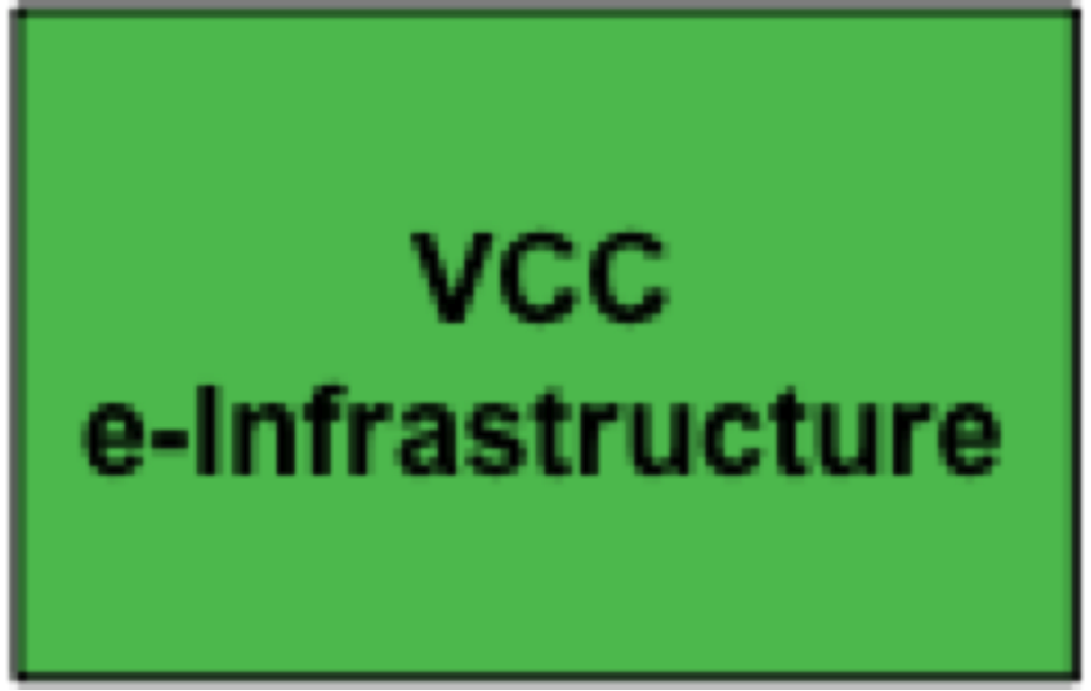



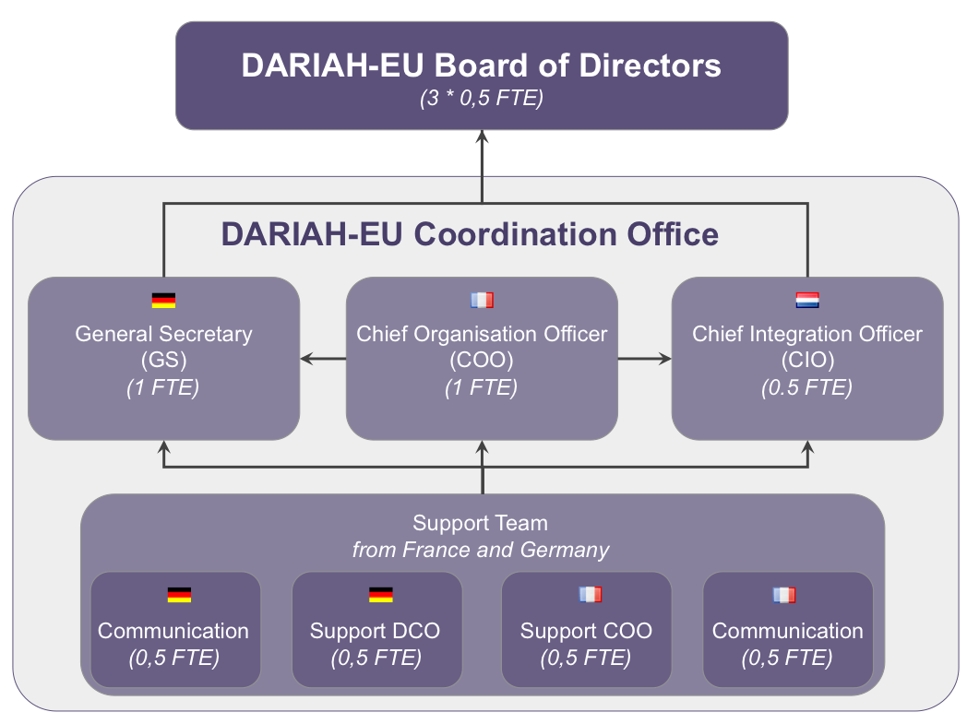
DARIAH Virtual Competency Centres (VCCs)
To establish a shared technology platform for Arts and Humanities research
To expose and share researcher's knowledge, methodologies and expertise
To facilitate the exposure and sharing of scholarly content
To interface with key influencers in and for the Arts and Humanities
Notes:
Basic Structure of DARIAH is its 4 VCCs. These are VCC for …. . Each VCC is lead by two countries

Slide 7
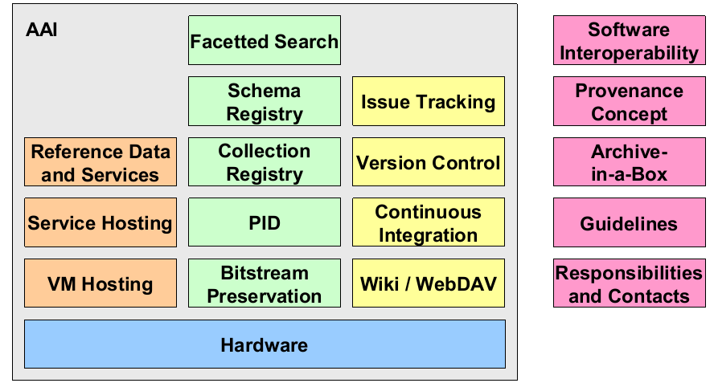
VCC e-Infrastructure
Notes:
This shows architecture of DARIAH e-Infrastuure
AAI is a core service here.

Slide 8
AAI requirements
The AAI service must be easy to use, ideally using their own institutional credentials (if available)
Single sign-on to all (DARIAH) resources, tools and services in an idea world, researchers could use the same credential in any 'academic' context.
Authorisation granularity
  e.g. access to 'sensitive data‘: EHRI (European Holocaust Research Infrastructure)
Notes:
AAI requirements we thought at the beginning of DARIAH project

Slide 9
DARIAH AAI Practice
Current AAI set-up: a first version of an AA infrastructure has been deployed, based on two standards:
• LDAP
– for authentication and authorization attributes
– deploying Open Source Software OpenLDAP
• SAML
– for AAI within a federation
– including Web Single Sign-On feature
– deploying Open Source Software Shibboleth

Slide 10
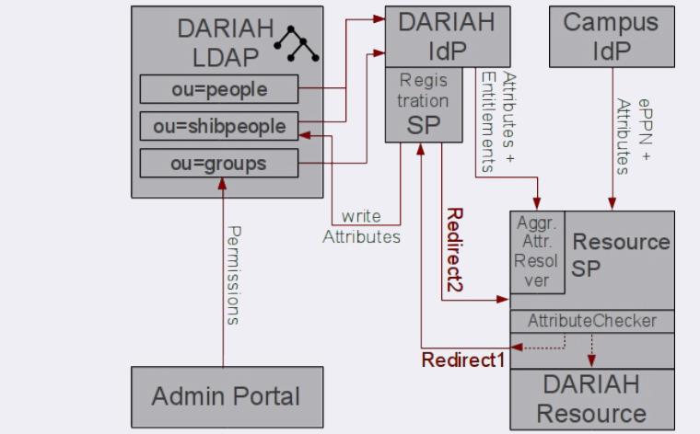
VO Management and FIM in DARIAH
Notes:
Federat-ed Identity Management (FIM)
VO-Manangement is done by SAML attribute aggregation(right down corner): if not enough attr, redirect to Registration page for authorization?
Detailed explaination: Peter‘ help

Slide 11
Current Challenge
– Not every institution signs federation contracts
– Not every Identity Provider releases personal attributes
– Not every resource provider allows anonymous usage
Notes:
Quote:
-The research infrastructures mentioned are EU wide; however as an IDF is not available in every participating country it requires the use of a special identity provider for the ‘homless’. Maintaining such a special identity provider is an additional effort.
-Many identity providers do not expose user-attributes even if the national IDF requires them to do so. because the IdP management does not want to be held responsible for privacy law violations.

Slide 12
A use case
affiliated project, EHRI
  Many project users may not be member of a research institute and some institutions involved may not( yet) be part of a Federation.
  Thus OpenID is seen as a way forward. It could solve the issue of changing affiliations.
DARIAH will take the requirements of the projects into consideration in the development of its AA infrastructure
Notes:
1. Users not belong to institute:
13% are freelancer 20% holders of short term scholarship. I meant it is heavy for EHRI to setup a ID server to host ID for “homeless” user and they expect the lifetime of the EHRI project is very short.
2. Insitute in the project, outside EU doesn‘t have federation
3. Since user may change rapidly, persistent ID is important, currently openID seems better way to do this.
DARIAH should consider requirements of the projects before making proposals

Slide 13
Plan
It is planned to include technologies like OAuth2 and OpenID Connect into the DARIAH SAML based infrastructure
  It is possible to have a SAML based Authentication within an OAuth-Infrastructure
  as well as
  To have an OpenID based authentication in a SAML based infrastructure.
Currently experiments on these technologies are being performed by DARIAH
Main aim is that an application developer only has to support one API for AAI.
Notes:
Clear?
Support Oauth2 to relieve bunden of service provider
Suport openID authenication to be compatible with openID based humanity projects

Slide 14


Questions?
Cao@mpdl.mpg.de
DAASI leads and performs the AAI activities in DARIAH, Contact:
Peter.Gietz@daasi.de
DARIAH-EU Coordination Office
dariah-info@dariah.eu
Notes:
Add Peter contact?

