Slide 1
eScience Requirements
(aka FIM4R)
David Kelsey (STFC-RAL)
AAA Study Workshop, Brussels
12 Jul 2012

Slide 2
Overview
Some background
FIM4R workshops and our paper
Communities and Requirements
Will show agreed common requirements rather than concentrate on individual communities
Nothing on accounting (but EGI and others do have requirements)

Slide 3
About me
Head of Particle Physics Computing Group at STFC-RAL
Many roles in Security, AAI, IdM etc
  Including EGI, GridPP, WLCG, IGTF, SCI, FIM4R

Slide 4
Why does “Science” need all this distributed data and computing?
A recent example (CERN 4 July 12)
  2 slides (ATLAS & CMS)

Slide 5
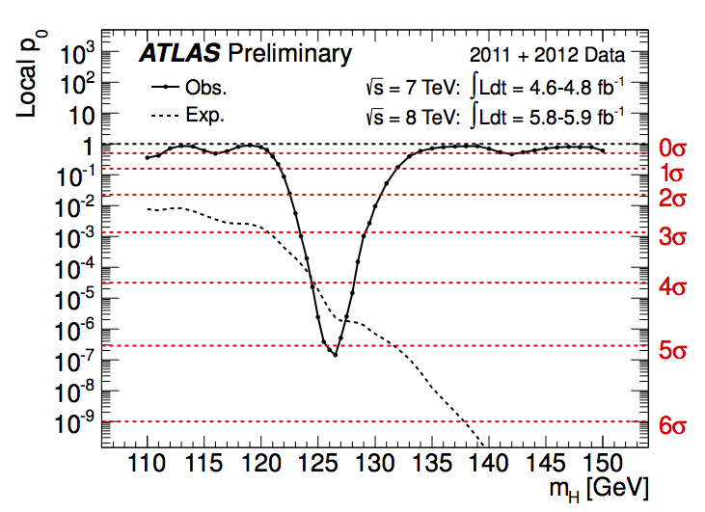
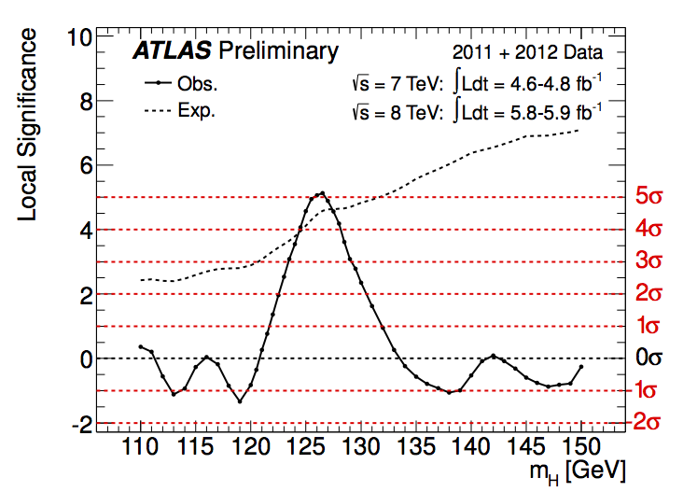
Combined results: the excess
5σ
Expected
from SM
Higgs at
given m_{H}
Expected
from SM
Higgs at
given m_{H}
Maximum excess observed at
m_{H} = 126.5 GeV
Local significance (including energy-scale systematics)
5.0 σ
Probability of background up-fluctuation
3 x 10⁻⁷
Expected from SM Higgs m_{H}=126.5
4.6 σ
Global significance: 4.1-4.3 σ (for LEE over 110-600 or 110-150 GeV)

Slide 6
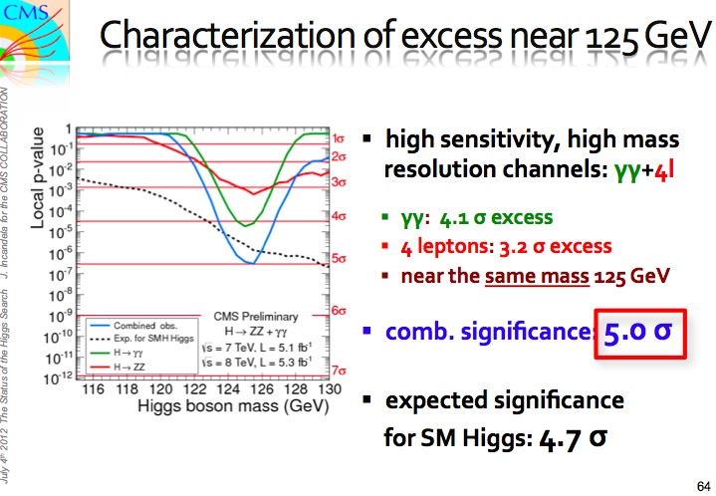

Slide 7
Speedy analysis of so much data only possible because of the success of WLCG, EGI, OSG and other related infrastructures
  Including the Grid AAI !!
  Not forgetting the accelerator, the experiments, the physicists, the engineers etc etc!

Slide 8
Background
Issue of IdM raised by IT leaders from EIROforum labs during their IT working group meeting in January 2011 at ESA
  CERN, EFDA-JET, EMBL, ESA, ESO, ESRF, European XFEL and ILL
These laboratories, as well as national and regional research organizations, are facing similar challenges
  Scientific data deluge means massive quantities of data
  needs to be accessed by expanding user bases in dynamic collaborations across organisational and national boundaries
“Facebook” generation demands all the tools (work & social) integrate smoothly
Also encouraged by EEF and eIRG
Global problem, not just EU
“Science” changed to “Research” to include Humanities

Slide 9
Federated IdM for Research
(FIM4R)
A collaborative effort started in June 2011
Not just EIROForum. Include many ESFRI projects and providers and infrastructures
  Be inclusive
Involves photon & neutron facilities, social science & humanities, high energy physics, climate science, life sciences and fusion energy
Workshops included participation by HTC and HPC infrastructures, TERENA, IGTF, Geant/eduGAIN, middleware developers …

Slide 10
Workshops (2)
4 workshops to date
  link to Jun 2012 agenda below (other links contained within)
https://indico.cern.ch/conferenceDisplay.py?confId=191892
Prepared a paper that documents common requirements, a common vision and recommendations
  To research communities, identity federations, funding bodies
Paper: CERN-OPEN-2012-006: https://cdsweb.cern.ch/record/1442597

Slide 11
The communities

Slide 12
Common Requirements
User friendliness
  Many users use infrequently
Browser and non-browser federated access
Bridging between communities
Multiple technologies and translators
  Translation will often need to be dynamic
Open standards and sustainable licenses
  For interoperability and sustainability
Different Levels of Assurance
  When credentials are translated, LoA provenance to be preserved
Authorisation under community and/or facility control
  Externally managed IdPs cannot fulfil this role
Well defined semantically harmonised attributes
  For interoperable authorisation
  Likely to be very difficult to achieve!

Slide 13
Requirements (2)
Flexible and scalable IdP attribute release policy
  Different communities and different SPs need different attributes
  Negotiate with IdF not all IdPs – for scaling
Attributes must be able to cross national borders
  Data protection/privacy considerations
Attribute aggregation for authorisation
Privacy and data protection to be addressed with community-wide individual identities
  We need to identify individuals
    E.g. ethical committees can require names, addresses, supervisors to grant access

Slide 14
Operational Requirements
Risk analysis
Traceability
  Audit trails include IdPs
Security incident response
  To include all IdPs and SPs
Transparency of policies
  To gain trust of SPs and users
Reliability and resilience
Smooth transition (from today’s production)
Easy integration with local SP
  SP likely to want to support multiple AuthN technologies

Slide 15
Legal, Policy & Trust
Contracts or SLAs between communities and IDFs must be scalable
  Include maximum number of participants
  Bi-lateral agreements will not scale
Standards of Trust (or Codes of Conduct) similar to IGTF approach is an attractive scalable solution

Slide 16
Common vision statement
A common policy and trust framework for Identity Management based on existing structures and federations either presently in use by or available to the communities. This framework must provide researchers with unique electronic identities authenticated in multiple administrative domains and across national boundaries that can be used together with community defined attributes to authorize access to digital resources

Slide 17
Questions?

