Slide 1



T&I Incubator Test IdP
Sprint demo #4.3 – 1st June 2021
Alan Lewis, Martin van Es, Uros Stevanovic, Andrej Shliamin
Q2 2021
Public
www.geant.org

Slide 2

Background
Test IdPs exist but do not fulfil all the needs of R&E
  Aim: Understand community use cases and requirements
    Identify use cases and review with stakeholders
    Document use cases and map to Test IdP service requirements
A free Test IdP focused on R&E would be highly useful
  Aim: Develop and test deployment of a sustainable service
    Investigate technical approaches and develop a solution
    Create a test deployment and associated policies and evaluate
    Determine how such a service could be sustained
    Plan to handover the service to an identified operator

Slide 3

Assumed requirements
Must be able to support many SPs who are testing
Must be able to establish trust between SP and Test IdP
Must be able to release various attributes including for different entity categories
Must allow various errors types to be triggered
Must provide admin functionality for Test IdP maintainer
Should provide logging functionality
May provide admin monitoring capabilities
May be a member of eduGAIN

Slide 4

Planned activities
Test IdP
Use cases and requirements
Design and Implementation
Test and Deployment
Sustainability and handover
Setup stakeholder meetings
Investigate platforms
Create Test SP(s)
………….
Capture and replay feedback
Create PoC platform
Define architecture
Capture requirements
You are
here
Mar 21
Apr 21
May 21
Jun 21
Jul 21
Aug 21

Slide 5
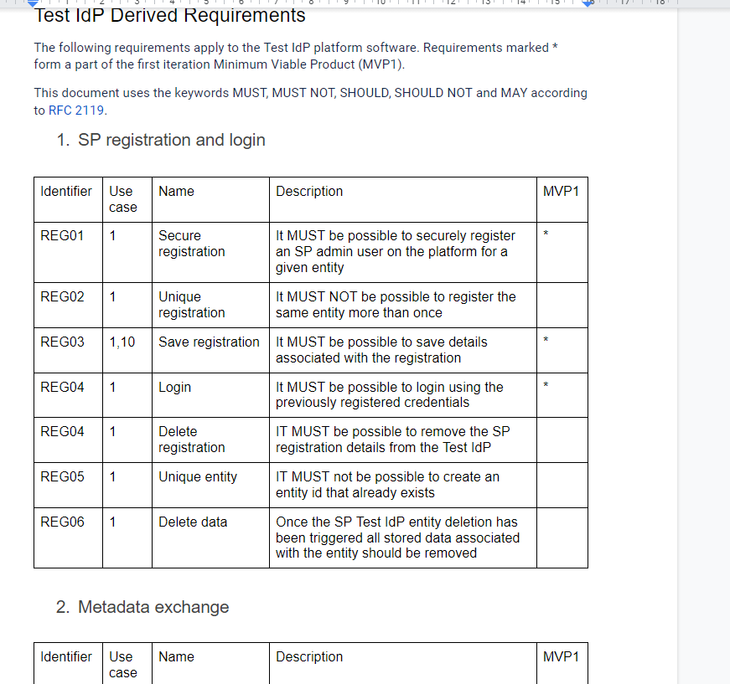
Activities status
Status
Stakeholder feedback summarised and replayed
Technical architecture and approach agreed
SimpleSAML front-end PoC platform created
Back-end SP admin GUI created
Initial set of use cases and scenarios detailed
End-to-end PoC system demo
eduGAIN inclusion resolution
A comprehensive solution is quite hard









Slide 6

Stakeholder feedback
Focus on checking SP before fed./eduGAIN membership
Simplify operation - SPs are not sophisticated
Provide a ‘simple’ and ‘advanced’ mode
Encourage ‘best practice’ and provide guidance
Take account of national and international context
Indicate issues if SP login fails
Assume SAML SP implementation compliance tested
Target user configuration/semantic error types
Consider how differentiated from other test solutions

Slide 7

What can/should we test?
SAML s/w implementation is outside scope
Invalid SP metatdata
Best practices
Successful login flow
Unsuccessful login flow
  Does SP gracefully handle errors returned from IdP
  Missing/Invalid attributes
  SP configuration errors
    Incorrect signing key used
    Bad signature/encryption algorithm

Slide 8

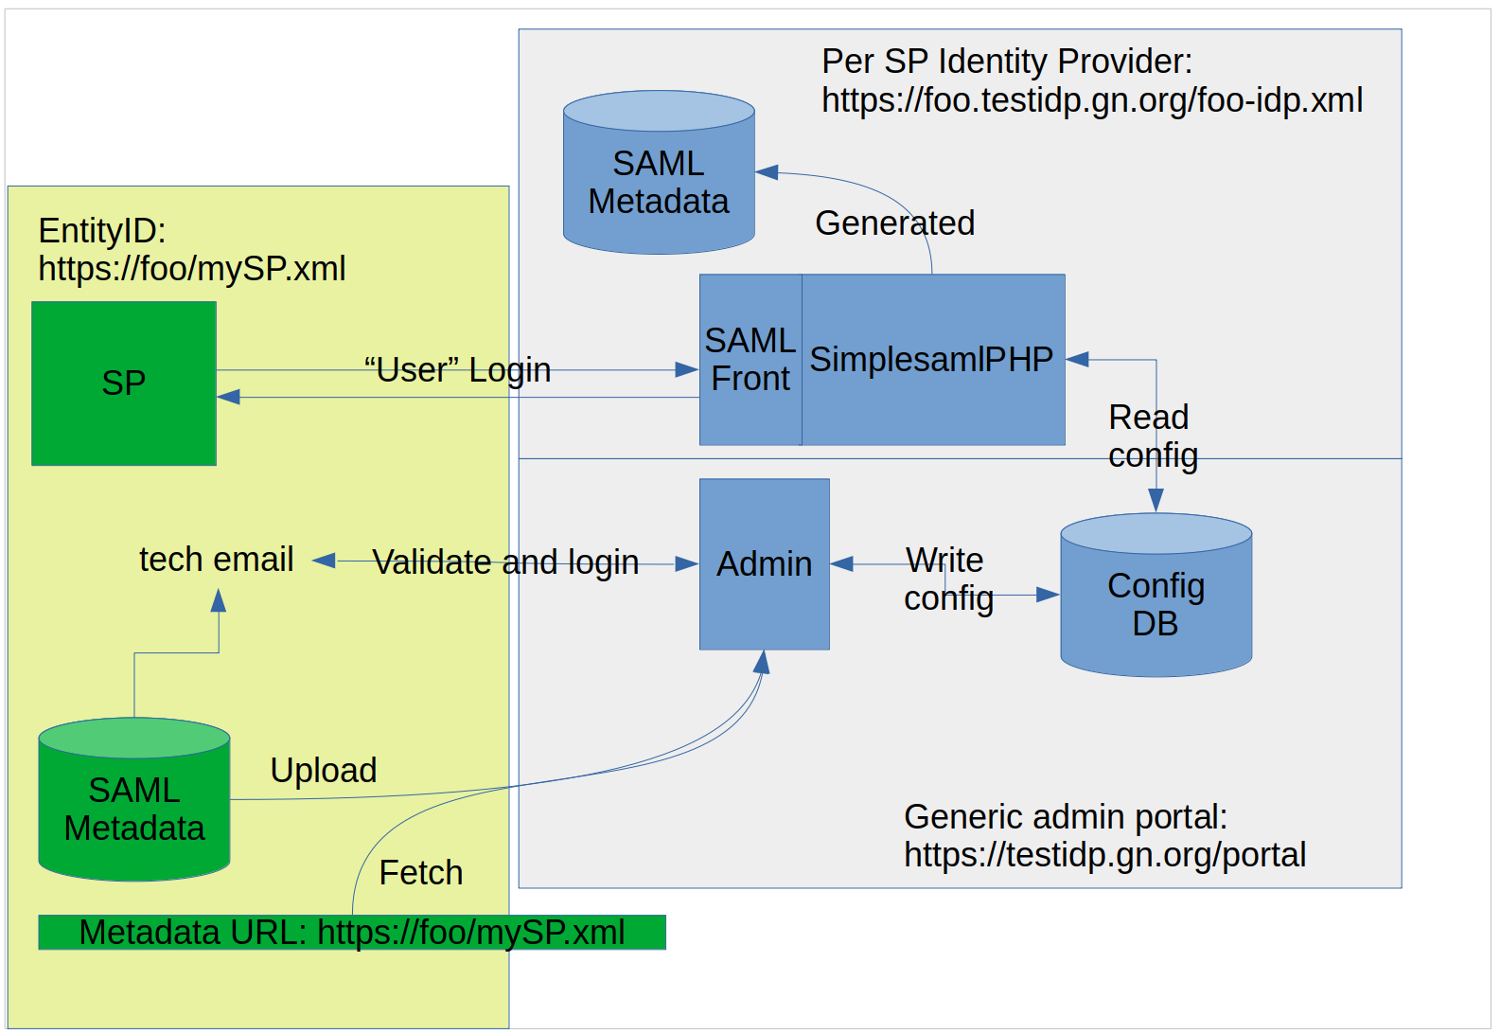
Test IdP proposed architecture

Slide 9

SAML frontend demo
Martin

Slide 10
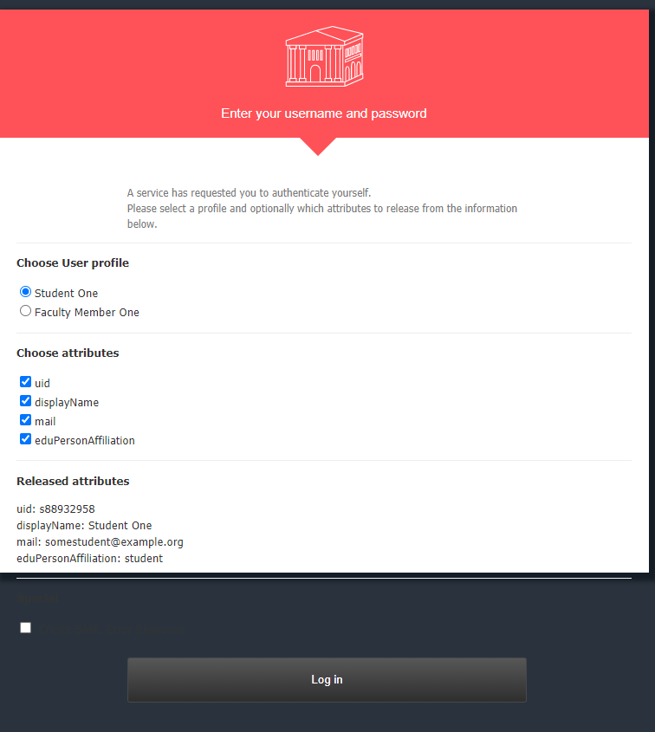
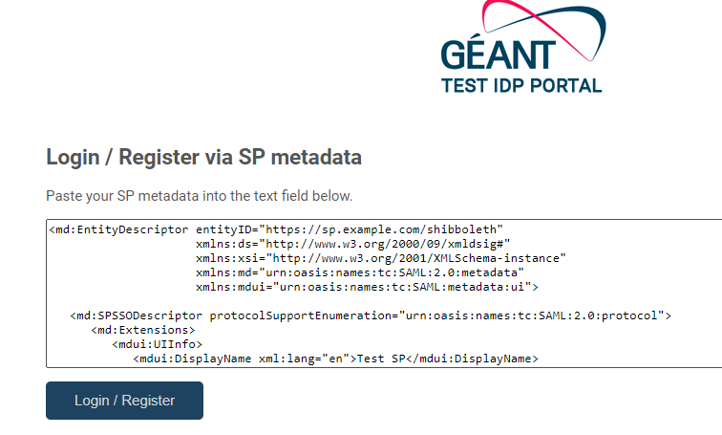

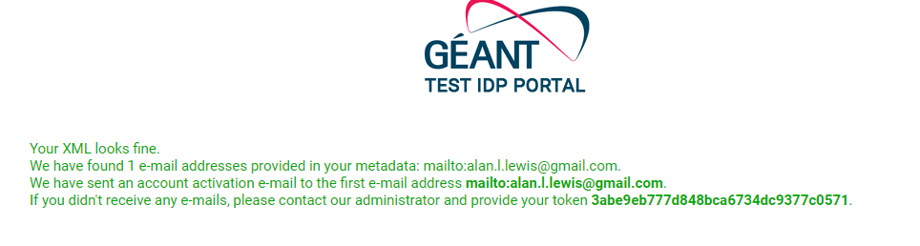

SAML backend functionality
https://testidp.incibator.geant.org/
Token

Slide 11


To eduGAIN or not?
Test IdP must protect against rogue usage
Needs own metadata validation process
May need to provide support to the SP
May require separate ingest scheme
eduGAIN sets baseline requirements
SPs in eduGAIN have had metadata validated
eduGAIN has well defined support process
eduGAIN has a well defined metadata ingest

Slide 12
Open questions
Should the Test IdP be a part of eduGAIN?
Level of security needed for an eduGAIN Test IdP?
Should national federation attributes be included?
Are eduGAIN requirements the lcd for Test IdP?
What types of error should be tested?
How important is encouraging best practice?
What knowledge can we assume about Test IdP users?

Slide 13
Next steps
Iterate Test IdP with additional error cases
Unify front/back end and GUI approach
Provide error logging capability
Build Test IdP admin functionality
Arrange further stakeholder discussions
Investigate potential service costs
Identify a suitable hosting partner

Slide 14

Thoughts, ideas ,questions??

Slide 15

Thank you
www.geant.org
© GÉANT Association on behalf of the GN4 Phase 2 project (GN4-2).
The research leading to these results has received funding from
the European Union’s Horizon 2020 research and innovation programme under Grant Agreement No. 731122 (GN4-2).

