Slide 2

Agenda
Background & Motivation
Requirements
High-level architecture
Activities
Next steps

Slide 3

Motivation
SSH Key Management
Risks of untracked and unmanaged SSH Keys
90% of keys are no longer used [1]
Scalability issues
… “SSH key management can get so complicated that you’ll be best advised to stop using SSH keys” [3]
[2]

Slide 4
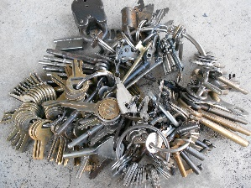
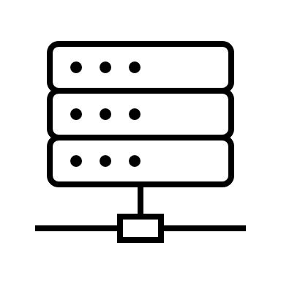

Motivation
Scalability issues:
Improvements:
  Policies
  Rotation
  Remediation
Asymmetric cryptography
SSH

Slide 5




Motivation
Access Tokens!
Asymmetric cryptography
SSH
Request access token
Access userinfo
Identity Provider

Slide 6



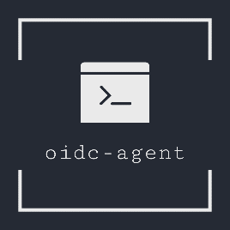

Goals
High-Level: Integrate OIDC with SSH (client-side) under Windows
Port oidc-agent to Windows
Integrate oidc-agent into SSH client Putty
[4][5][6][7][8]

Slide 7
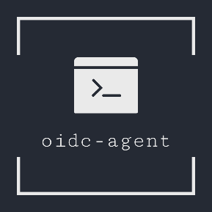


Requirements
oidc-agent obtains/manages access tokens on Windows
oidc-agent must be easy-to-install on Windows
oidc-agent runs as a daemon (Windows Service) providing an API
putty allows to select between ssh-keys and oidc-tokens (pageant VS. oidc-agent)
putty supports authentication&authorization with oidc-tokens against supported ssh-server
putty obtains valid access tokens from oidc-agent
putty provides a simple GUI for oidc-gen

Slide 8


High-Level Architecture
oidc-agent replaces pageant (ssh-agent)
IP
2. OIDC Workflow
1. Obtain the access token
3. SSH
(Refresh the access token)
Putty
MOTLEY_CUE
OIDC-capable
SSH Server

Slide 9
Activities
Requirements and preparation
Port oidc-agent to Windows
Extend putty
Stakeholder meetings
Gather requirements
Familiarizing with the tools
Investigate possibilities
OIDC SSH
Windows Subsystem for Linux 2
Cygwin environment
MSYS2 environment
Define architecture
Discuss/agree with stakeholders
Implement GUI for oidc-gen
Implement extension
…
Agree on high-level architecture
Apr21
May21
Jun21
Jul21
Aug21

Slide 10


Stakeholders
oidc-agent developer @SCC
oidc-ssh developer @SCC
putty developer
Nikhef
T&I Incubator
[9]
[10]

Slide 11

Activities
Requirements and preparation
Port oidc-agent to Windows
Extend putty
Stakeholder meetings
Gather requirements
Familiarizing with the tools
Investigate possibilities
OIDC SSH
Windows Subsystem for Linux 2
Cygwin environment
MSYS2 environment
Define architecture
Discuss/agree with stakeholders
Implement GUI for oidc-gen
Implement extension
…
Agree on high-level architecture
Apr21
May21
Jun21
Jul21
Aug21

Slide 12

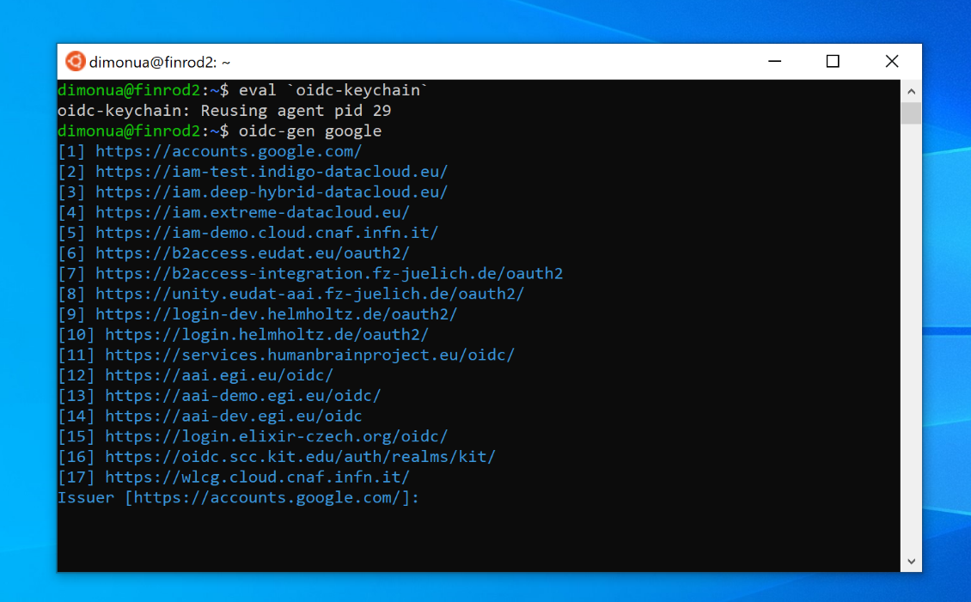
Possibilities to port oidc-agent
Windows Subsystem for Linux 2
GNU/Linux environment
Less overhead than Dual Boot/VM
Not user-friendly (esp. WinEducation)
[11]
Plan B!

Slide 13


Possibilities to port oidc-agent
2. Cygwin Environment
Large collection of GNU tools
POSIX API for Windows
Goals:
  Compile and link oidc-agent sources
    Exclude unnecessary functionalities
    Adapt source code for cygwin environment
    Adapt building procedures
  Run oidc-agent as a stand-alone application
    Distribution/Packaging ?
    cygwin1.dll dependency
[12]
Plan A.1!

Slide 14
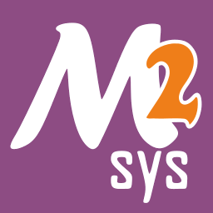
Possibilities to port oidc-agent
3. MSYS2
Tools and libraries for building native WinApps
Native = against Windows APIs
No external dependencies / (ideally) No POSIX emulation layer
Goals:
  Compile and link oidc-agent sources
[13]
Plan A.2!

Slide 15



Possibilities to port oidc-agent
4. Build natively in VisualStudio
Goal: rewrite plattform-dependent code for Windows
Major dependencies are available for Windows too
[14]
[15]
[16]
Plan C!

Slide 16
Activities
Requirements and preparation
Port oidc-agent to Windows
Extend putty
Stakeholder meetings
Gather requirements
Familiarizing with the tools
OIDC SSH
Windows Subsystem for Linux 2
Cygwin environment
MSYS2 environment
Define architecture
Discuss/agree with stakeholders
Implement GUI for oidc-gen
Implement extension
…
Agree on high-level architecture
Investigate possibilities
Apr21
May21
Jun21
Jul21
Aug21

Slide 17
Next steps
Package oidc-agent as a stand-alone app (Cygwin/Msys2)
Investigate and agree on architecture for putty extension
Implement GUI for oidc-gen
  Generate account configurations
Implement putty extension for OIDC tokens

Slide 18

Activities
Requirements and preparation
Port oidc-agent to Windows
Extend putty
Stakeholder meetings
Gather requirements
Familiarizing with the tools
OIDC SSH
Windows Subsystem for Linux 2
Cygwin environment
MSYS2 environment
Define architecture
Discuss/agree with stakeholders
Implement GUI for oidc-gen
Implement extension
…
Agree on high-level architecture
Investigate possibilities
Apr21
May21
Jun21
Jul21
Aug21

Slide 20
References
[1] https://www.ssh.com/academy/iam/ssh-key-management
[2] https://images.app.goo.gl/8CTV52CRGRxJrBRLA
[3] https://goteleport.com/blog/ssh-key-management/
[4] https://images.app.goo.gl/jzgLw2zjqKzwi7cp9
[5] https://images.app.goo.gl/tKo77xxstdu1DUJr5
[6] https://images.app.goo.gl/bUgQzq5YaTPamEXP8
[7] https://github.com/indigo-dc/oidc-agent/blob/master/logo.png
[8] https://images.app.goo.gl/TJy4y5WigecQJ3sU7
[9] https://images.app.goo.gl/rBFwLMwiterHN9Av5
[10] https://images.app.goo.gl/K4QzEyU7Q2P2sqoj8
[11] https://docs.microsoft.com/en-us/windows/wsl/
[12] https://images.app.goo.gl/CBiCK5SqUDRksqt69
[13] https://images.app.goo.gl/M1eHHZSzY1cc9X37A
[14] https://images.app.goo.gl/Jaxk9RcesMzGCcS99
[15] https://images.app.goo.gl/jzXenF4tMquP19HCA
[16] https://images.app.goo.gl/KTBckfa6R4mibR8z9

