Slide 1
Welcome to the GÉANT Community eHealth Task Force BoF @ TNC21 !
Time | Session | Speaker | Goals, Topics covered | mins
14:00 | Opening and Presentation of the eHealth task force work plan | Gabriele von Voigt SC chair | Introduce the SC; Describe the plans for 1+1 year of work | 15
14:15 | EOSC-Life overview | Natalie Haley Instruct-ERIC | Introduce EOSC-Life | 15
14:30 | The EOSC-Life Collaboratory | Frederik Coppens ELIXIR | Introduce the main concepts on the Collaboratory | 10
14:40 | EU funding opportunities for NRENs in eHealth | Mario Reale | Provide short overview on main EU programmes dealing with eHealth | 5
14:45 | WORK PLAN GROUP DISCUSSION ( 15 minutes) | All |  | 50
14:45 | Group Discussion: - Feedback on the proposed work plan: Is the work plan OK, too low profile or too much ? - How can we seek recognition from health organizations that NRENs are essential for increasing Capacity Building for Education and Innovation in Digital Health? | All |  | 15
15:00 | MENTIMETER SESSION ON WORK PLAN AND RELATED MATTERS | All | www.menti.com code: 9025 1859 | 28
15:00 | MENTIMETER session: go to www.menti.com use code: 9025 1859 Or use direct link https://www.menti.com/wzfz8ht2j5 | All – interactive session |  | 28
15:28 | Closing meeting | GÉANT association team | 2-mins wrap up event | 2
AGENDA

Slide 2
The GÉANT eHealth Task Force:
Work plan presentation
Gabriele von Voigt
eHealth Task Force Steering Committee Chair
Leibniz University of Hannover
eHealth BoF @ TNC21
June 25, 2021

Slide 3
Agenda
The GÉANT eHealth Task Force: Overview
Introduction of the Task Force Steering Committee
Mandate we got from the community of the NRENs
Presentation of the eHealth TF work plan for the next 2 years
Short summary on where we stand
Hints for collaboration/coordination with relevant initiatives
Open points to discuss today
Notes:
Goals:
Get to (virtually) know each other
Tell you about where we stand with the TF from the GÉANT and NRENs side
Let you know about the draft plans ahead
Suggest where your contributions and inputs could be focusing
Mention the potential risks and mitigations
Get your first feedback/comments/proposal on 3) ,4) and 5)

Slide 4

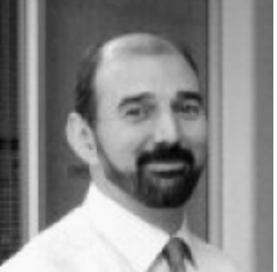
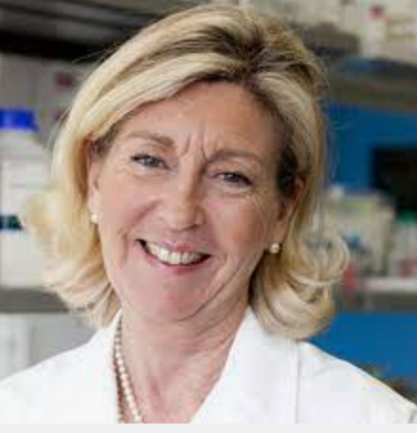
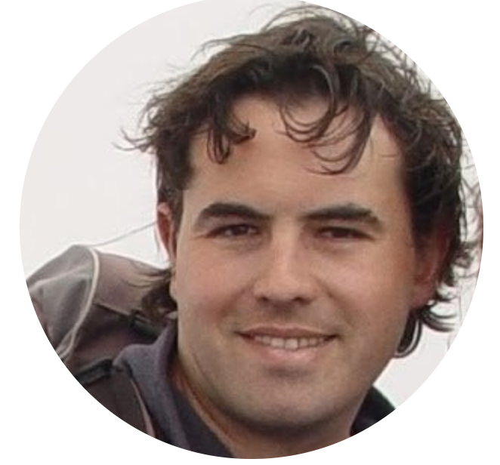

Current Steering Committee members
Prof. Dr. Gabriele von Voigt
Leibniz Universitaet Hannover
Computational Health Informatics DE
Prof. Dr. João De Miranda
Instituto Politécnico de Portalegre (IPP)
CERENA/IST, Universidade de Lisboa PT
Prof. Marialuisa Lavitrano
Università degli Studi di Milano-Bicocca IT
Dr. Gilles Mathieu
Research Engineer at INSERM, French eHealth Institute FR
Prof. Christian Lovis / Uni Geneva
Chairman, Medical Information Sciences, University Hospitals of Geneva CH

Slide 5


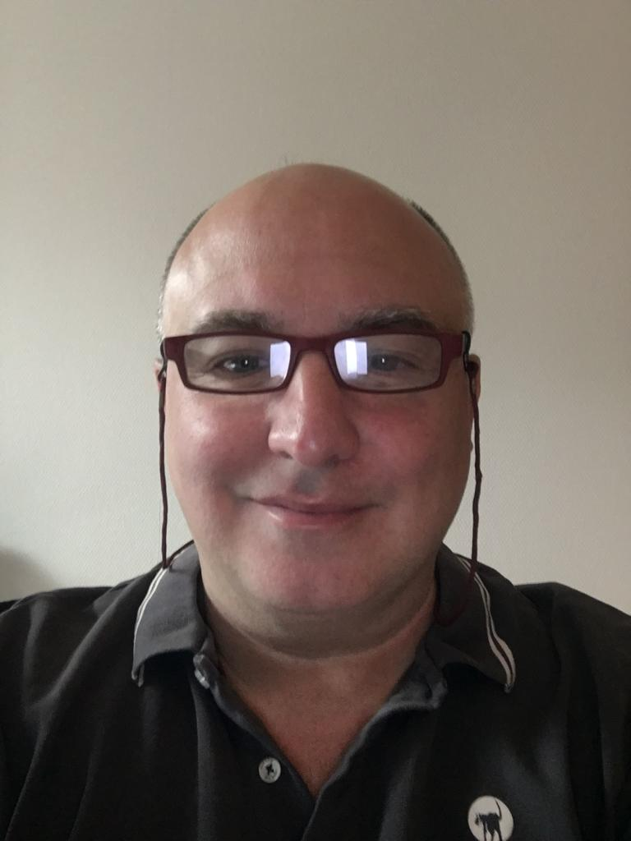
The GÉANT Association support team
Marina De Giorgi / GÉANT marina.degiorgi@geant.org
Leonie Schaefer / DFN schaefer@dfn.de
Mario Reale / GÉANT mario.reale@geant.org
@Covid vaccine
Marina
Leonie
Mario

Slide 6
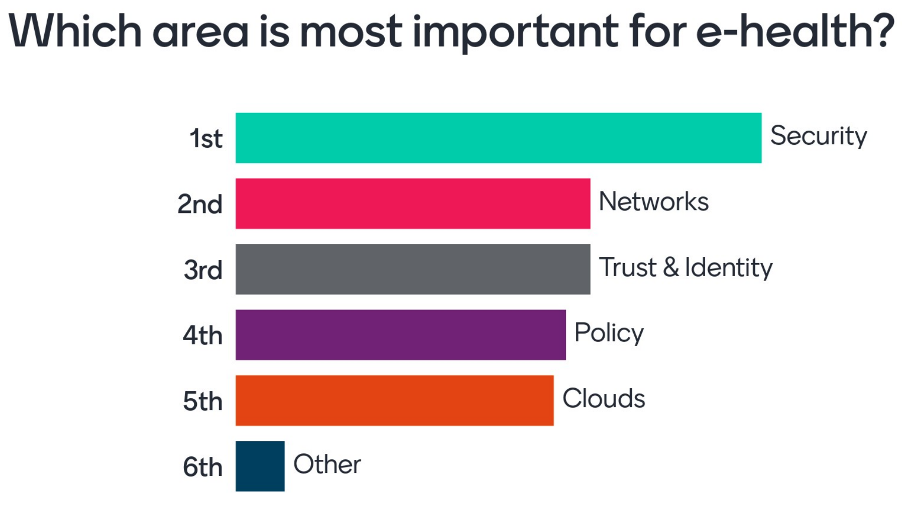
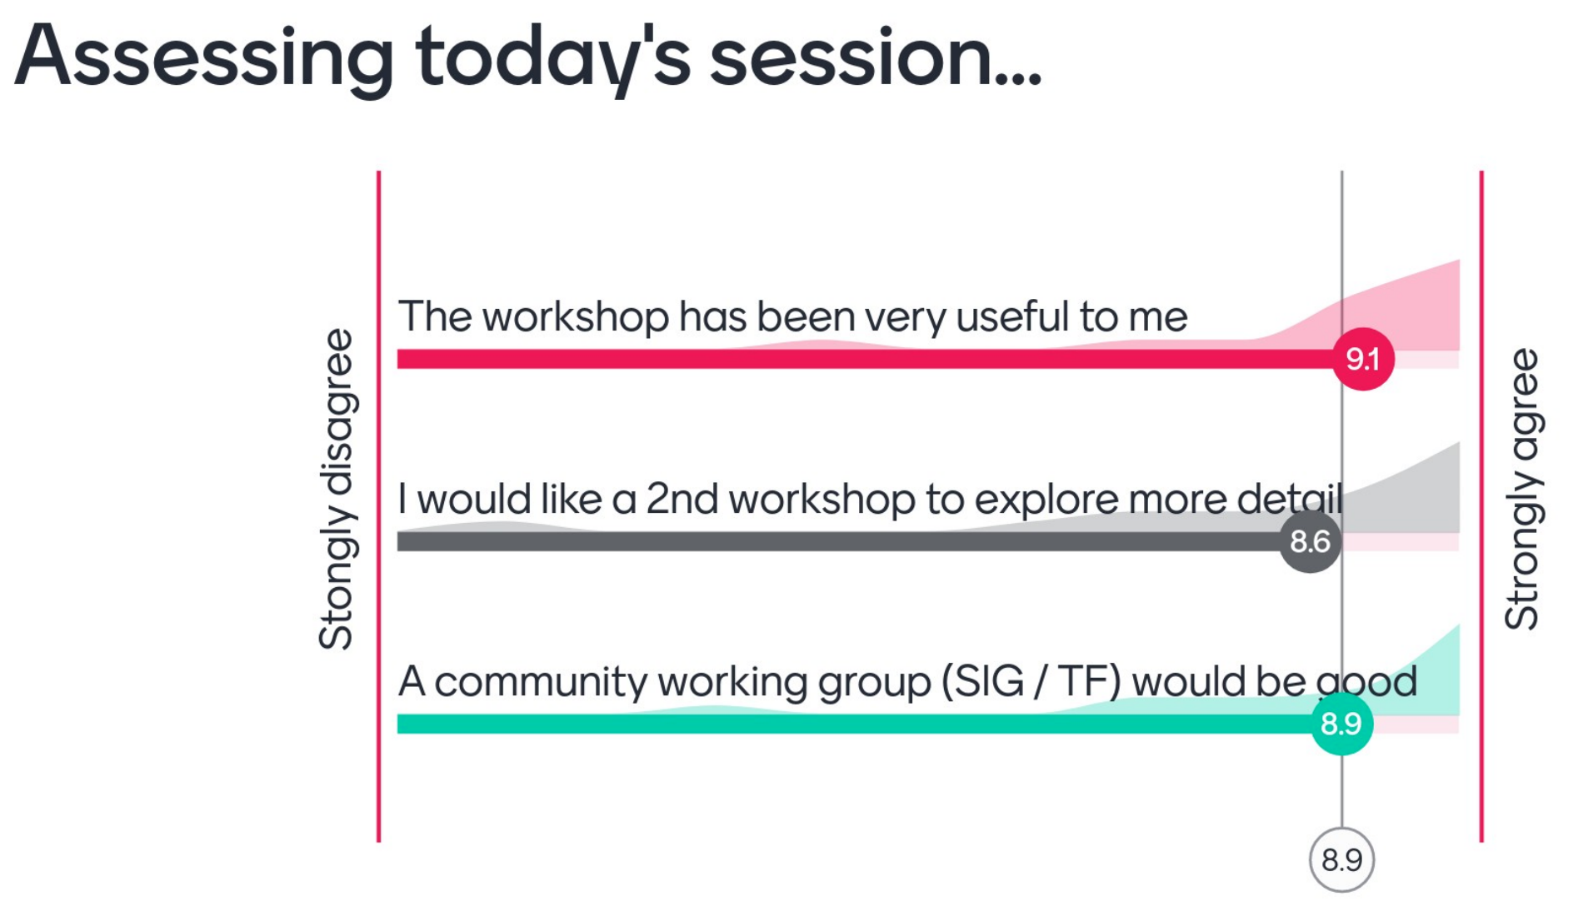
Outcomes of the eHealth baselining event of Jan 27
For further information see https://wiki.geant.org/pages/viewpage.action?pageId=214892682

Slide 7
What eHealth
Support implies for
NRENs
CLOUDS
Support eHealth institutions in the procurement of public or hybrid cloud services
Enhance skills on Security to handle sensitive data:
Training events
Support agile deployment of eHealth applications on container platforms
SECURITY
Provide and share guidance documents on Security Best Practices
Tools and guides on how to anonymize and pseudo-anonymise eHealth data sets
On board of eHealth algorithms & applications on the Cloud
Provide Cloud based AAI / Proxy for Research projects and collaborations
Support eHealth institutions in monitoring their infrastructures
Implement secure and privacy preserving sharing of medical/patient data
Provide Cloud-based IdP for eHealth institutes
Federate eHealth Services (SAML,OIDC)
TRUST &
IDENTITY
Integrate eGov eIDAS identities and eduGAIN ones in accessing eHealth services
Redundant last mile connectivity for eHealth institutions
Ensure key DCs, Data Sets, HPC sites are connected at required b/w
Promote adoption of open and standard AAI protocols on medical devices
Learn about EU Commission regulations, communications, EHDS
Implement L2VPN to interconnect
eHealth sites (VPNs)
VPNs to connect Cloud IdPs to IDM systems on premises
Promote adoption of Entity Categories (e.g. DP_CoCo v1/v2)
NETWORKS
eduroam
adoption by eHealth institutions
Ideas and suggestions coming from the first community baselining event on eHealth - Jan 27 2021
Review NRENs AUPs to be able to fully support handling eHealth data
Share information on existing repositories of Health data and corresponding data access policies
POLICY

Slide 8
What mandate did we get from the NRENs
Following GÉANT eHealth baselining event of Jan 27
Work for establishing a GCP Task Force on eHealth to
Generate synergies while supporting the eHealth community
  Variety of approaches and levels of support within the community
  Leveraging the whole stack of managed services (network, T&I, cloud )
Respond to the common need to
  Acquire additional skills on required data access and data management policies
  Enhance the capabilities to properly manage security due to handling sensitive data
Increase the shared knowledge on EU-related plans, regulations and communications
Focussing on 3-4 concrete objectives to achieve in the first year

Slide 9
Overview of work plan items – current status

Slide 10
Work Item 1: Initial gap analysis report
Initial report on needs and gap analysis from the first community eHealth baseline event
Goal: | Wrap up the outcomes of the first eHealth baselining event (Jan 27) Highlight on the requirements expressed by the community to enhance support to eHealth Identify a path for the TF work, with key elements to focus upon, as requested by the NRENs
Expected Target Audience | NRENs eHealth contacts and NRENs eHealth community
Benefit at large: | A clear benchmark of core activities based on gap analysis made available to the Steering Committee
Deliverable: | Written report (3-4 pages)
Due: | Month 2

Slide 11
Work Item 2: eHealth data locations
Key eHealth data sets/repositories locations report
Goal: | Locations of exploitable eHealth data sets and repositories in the NRENs domains and how access them ? Current connectivity, protocols, policy,... Is any of these of fundamental importance for pan-European medical research projects ?
Expected Target Audience | NRENs’ and GÉANT network planning teams; NRENs eHealth contacts; NRENs eHealth Community at large
Benefit at large: | Possible relevant data sets poorly connected identified; option provided to NRENs to plan network corrective measures, coordinating with GÉANT when/where needed (e2e circuits if required by their users)
Deliverable: | Written comprehensive report
Due: | Month 12

Slide 12
Work Item 3: Security and Privacy Training
Organization of 1. GÉANT joint security and privacy training for eHealth
Goal: | Train eHealth professionals from the community on security and privacy
Expected Target Audience | eHealth professionals from the community of NRENs
Benefit at large: | Extend the domain of security and privacy in the area of eHealth; Effectively secure data and connected institutions; further enhance level of trust towards NRENs and GÉANT in ensuring connected institutions are protected and compliant to required policies.
Deliverable: | Training
Due: | Month 10

Slide 13
Work Item 4: White paper
White paper on required baseline services for eHealth, including EU funding opportunities and NRENs’ position on new project on eHealth
Goal: | Required baseline services and tools for eHealth incl. an assessment analysis of EU-based funding opportunities and NRENs’ position on the proposal of a new project (involving all willing NRENs) on eHealth to cover the identified gaps
Expected Target Audience | NRENs eHealth contacts, NRENs and GÉANT User Engagement Teams, NRENs management
Benefit at large: | A clear snapshot of the NRENs’ position on submitting a specific project on eHealth; An overview of the existing funding opportunities
Deliverable: | Written Document (GÉANT community white paper)
Due: | Month 12

Slide 14
Work Item 5: eHealth Community Cloud Workflow
Implementation of a reference eHealth data analysis workflow on the GÉANT Community Cloud platform (GCF)
Goal: | Implementation of a reference eHealth data access and analysis workflow using the GÉANT CCF (Community Cloud Flow)
Expected Target Audience | GN4-3 Cloud activities; NRENs cloud teams; eHealth research infrastructures and initiatives
Benefit at large: | Hands-on contribution to the work plan: proving the actual applicability and responsiveness of the GÉANT Community Cloud in the domain of eHealth and liaise/collaborate with key Research Infrastructures in eHealth
Deliverable: | Running reference eHealth workflow on the cloud - demo
Due: | Month 24

Slide 15
Timelines
May 18
First
Meeting SC
June 10
Revised
Workplan
Formal
Submission
to GCC
June 25
BoF @ TNC21
Call for
Volunteers
From the NRENs
August 1
TF
Operational
First 1 Year period
Starting
Expected
TF
approval
by GCC

Slide 16
Risks and mitigations for the eHealth TF workplan implementation
Risk name | Risk description | Possible causes | Mitigation
Not enough NRENs contribution | Insufficient NRENs buy-in | NRENs just do not have enough free manpower to commit | Clear estimate of available manpower Synergies with other initiatives
“I like the idea” (but go ahead without me) | Lack of NREN committed volunteer manpower | Wrong perception on the opportunities | Target communications on opportunities
Isolation | Insufficient coordination with relevant bodies and ongoing community activities on eHealth and with other GN4-3 tasks | Lack of key contacts; Missing perceptions on opportunities by external proj. or initiatives | Proactive seek to establish periodic updates/catch-up with initiatives(e.g. EOSC-Life)

Slide 17
Possible cooperations and
future plans

Slide 18

EOSC-Life and eHealth TF common ecosystem
EU
Commission DGs
EOSC-Future
EOSC
Regional clusters
EOSC-Life
EOSC
ESCAPE
SSHOC
ENVRI
PANOSC
WP5 access
GÉANT
WP4 policies
eHealth TF
WP2 tools & WFs
WP3 User Part Eng
WP7 cloud storage
WP4 Cloud
WP1 data
Stakeholder
RIs
Stakeholder
NRENs
ELIXIR
BB-MRI
ECRIN,..
GRNET
SURF
JISC, ...
Stakeholder
Research Institutions
Uni A
Uni B
…
…
Stakeholder
Research Institutions
Uni X
Uni Y
Users
Users
Notes:
Design and implement a new joint EOSC-Life demonstrator with GÉANT involving the GN4-3 Cloud activities - namely the GÉANT Cloud Flow
Implement on the GCF platform a relevant eHealth workflow for the EOSC-life community (ELIXIR, BB-MRI, ..)
Jointly implement engagement and dissemination activities to extend the domain of available resources for GCF
Common dissemination actions: e.g. GÉANT eHealth TF disseminating on EOSC-Life Open Calls
Collaboration on the sensitive data policies, EOSC-Life WP4 toolkit
GN eHealth TF will establish its internal governance, outreach and engagement model: exploit synergies
AAI : LS-Pilot and LS-AAI login

Slide 19

Current status of the eHealth TF: formal initial steps
Propose the creation of a Task Force or a Special Interest Group
Create a proposal for Steering Committee and Chair persons
Create the proposed ToR or Charter document
Approach GEANT member NRENs to ask for their support
Send an email to the GCC gcc@lists.geant.org to ask for the official confirmation and approval to create the TF/SIG
Currently the GCC is evaluating our request,
should meet in one week from now and discuss it

Slide 20
Next Steps
Gather your comments to the work plan TODAY !
  Feedback to the GCC if required
Get the TF approved and started
Get your (NRENs’) commitment on the implementation of the work plan:
  Who is available to do what ?
  Who will be responsible for work items 2-5 ?

Slide 21
How to structure NRENs participation
NRENs officially nominate eHealth contacts
  to represent them in the Community and the Task Force and
  for the TF to be able to reach out to specific persons in the NRENs each time needed
TF organizes periodic meetings with NRENs delegates to onboard their updated requirements and gather their feedback on the ongoing work plan
Any other ideas ?

Slide 22
Collaborative tools
Wiki on
https://wiki.geant.org/display/EHE/eHealth+-+Home
Mailing list
e-health@lists.geant.org
Please get in contact
if you also see the importance of the eHealth TF
Thank you for your attention!

