Slide 1
BUILDING A DIGITAL
SPACE FOR THE LIFE
SCIENCES
Dr Natalie Haley, WP3 Co-Lead

Slide 2
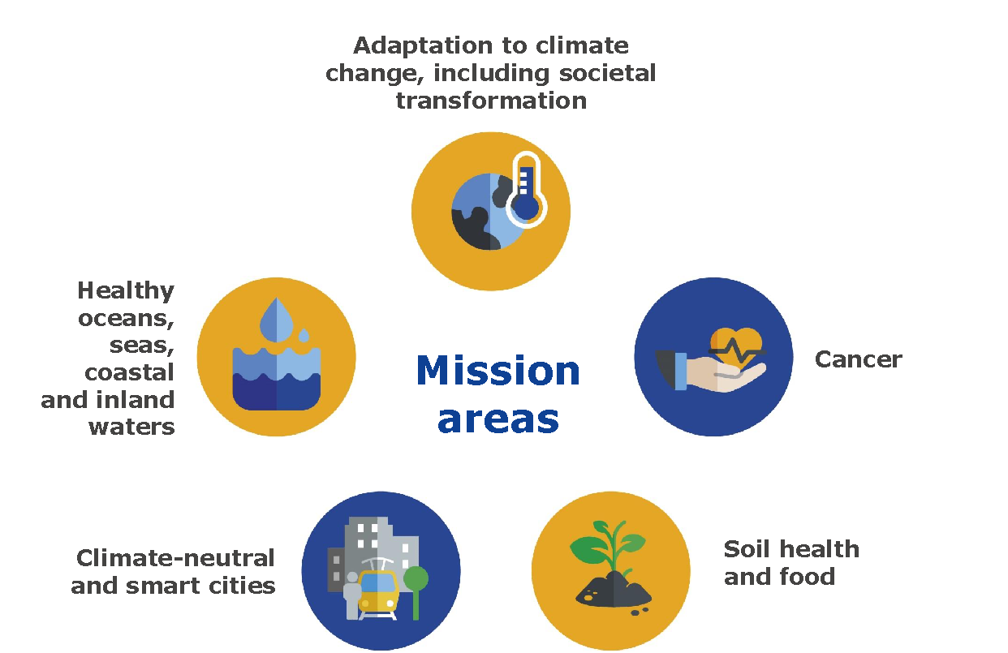

Creation of knowledge by connecting digital life science data will transform our societies and allow us to address major challenges facing humanity
Notes:
For example – we had a call before summer for datasets; work to publish the first cohort of FAIR RI data resources in the cloud is now underway
And
Released guideline documents on FAIR, secure data access with mapping of national capabilities
Several training events and hackathons to build capacity in RI’s for federated, cloud-based analytics in our tools work-package

Slide 3
EOSC-Life Consortium
13 ESFRI Health and Food Research Infrastructures
  47 Partners and 17 linked 3rd parties
  Sourcing e-Infrastructure services from EOSC (Cloud, AAI, … )
4 year Project, 26 M€

Slide 4
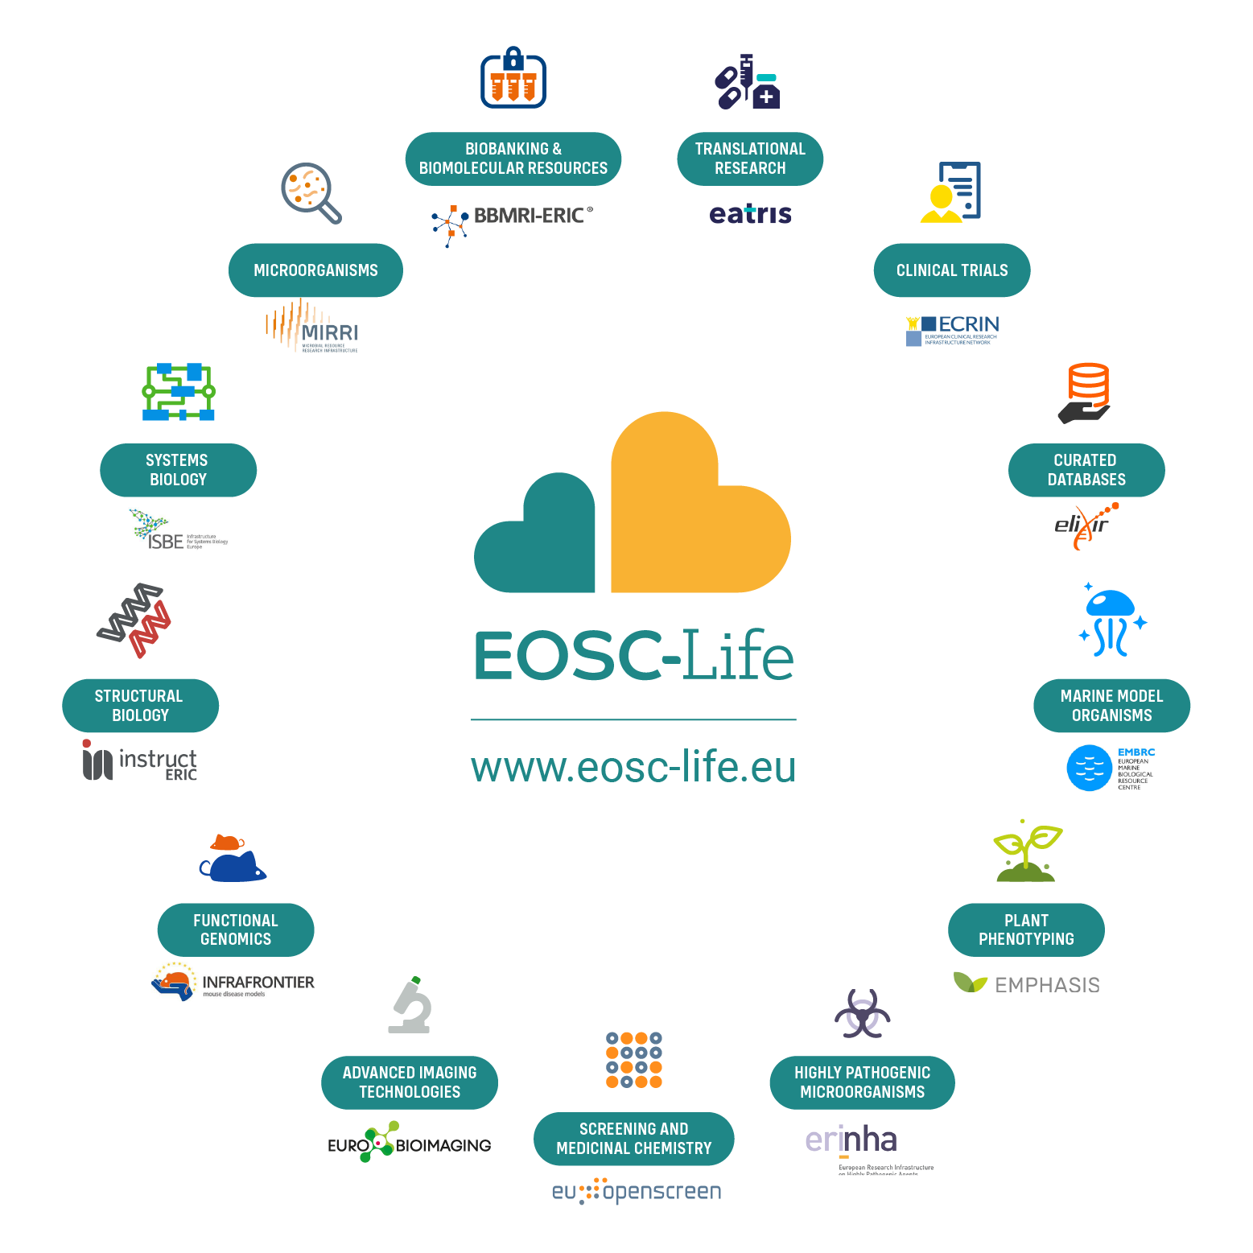
EOSC-Life: an open collaborative space for digital biology in Europe
Establish EOSC-Life by publishing FAIR life science data resources in EOSC
Provide the policies, guidelines and processes for secure and ethical data reuse
Populate an ecosystem of innovative life-science tools in EOSC
Enable data-driven research in Europe by connecting life scientists to EOSC via open calls for participation
Notes:
For example – we had a call before summer for datasets; work to publish the first cohort of FAIR RI data resources in the cloud is now underway
And
Resleased guideline documents on FAIR, secure data access with mapping of national capabilities
Several training events and hackathons to build capacity in RI’s for federated, cloud-based analytics in our tools work-package

Slide 5
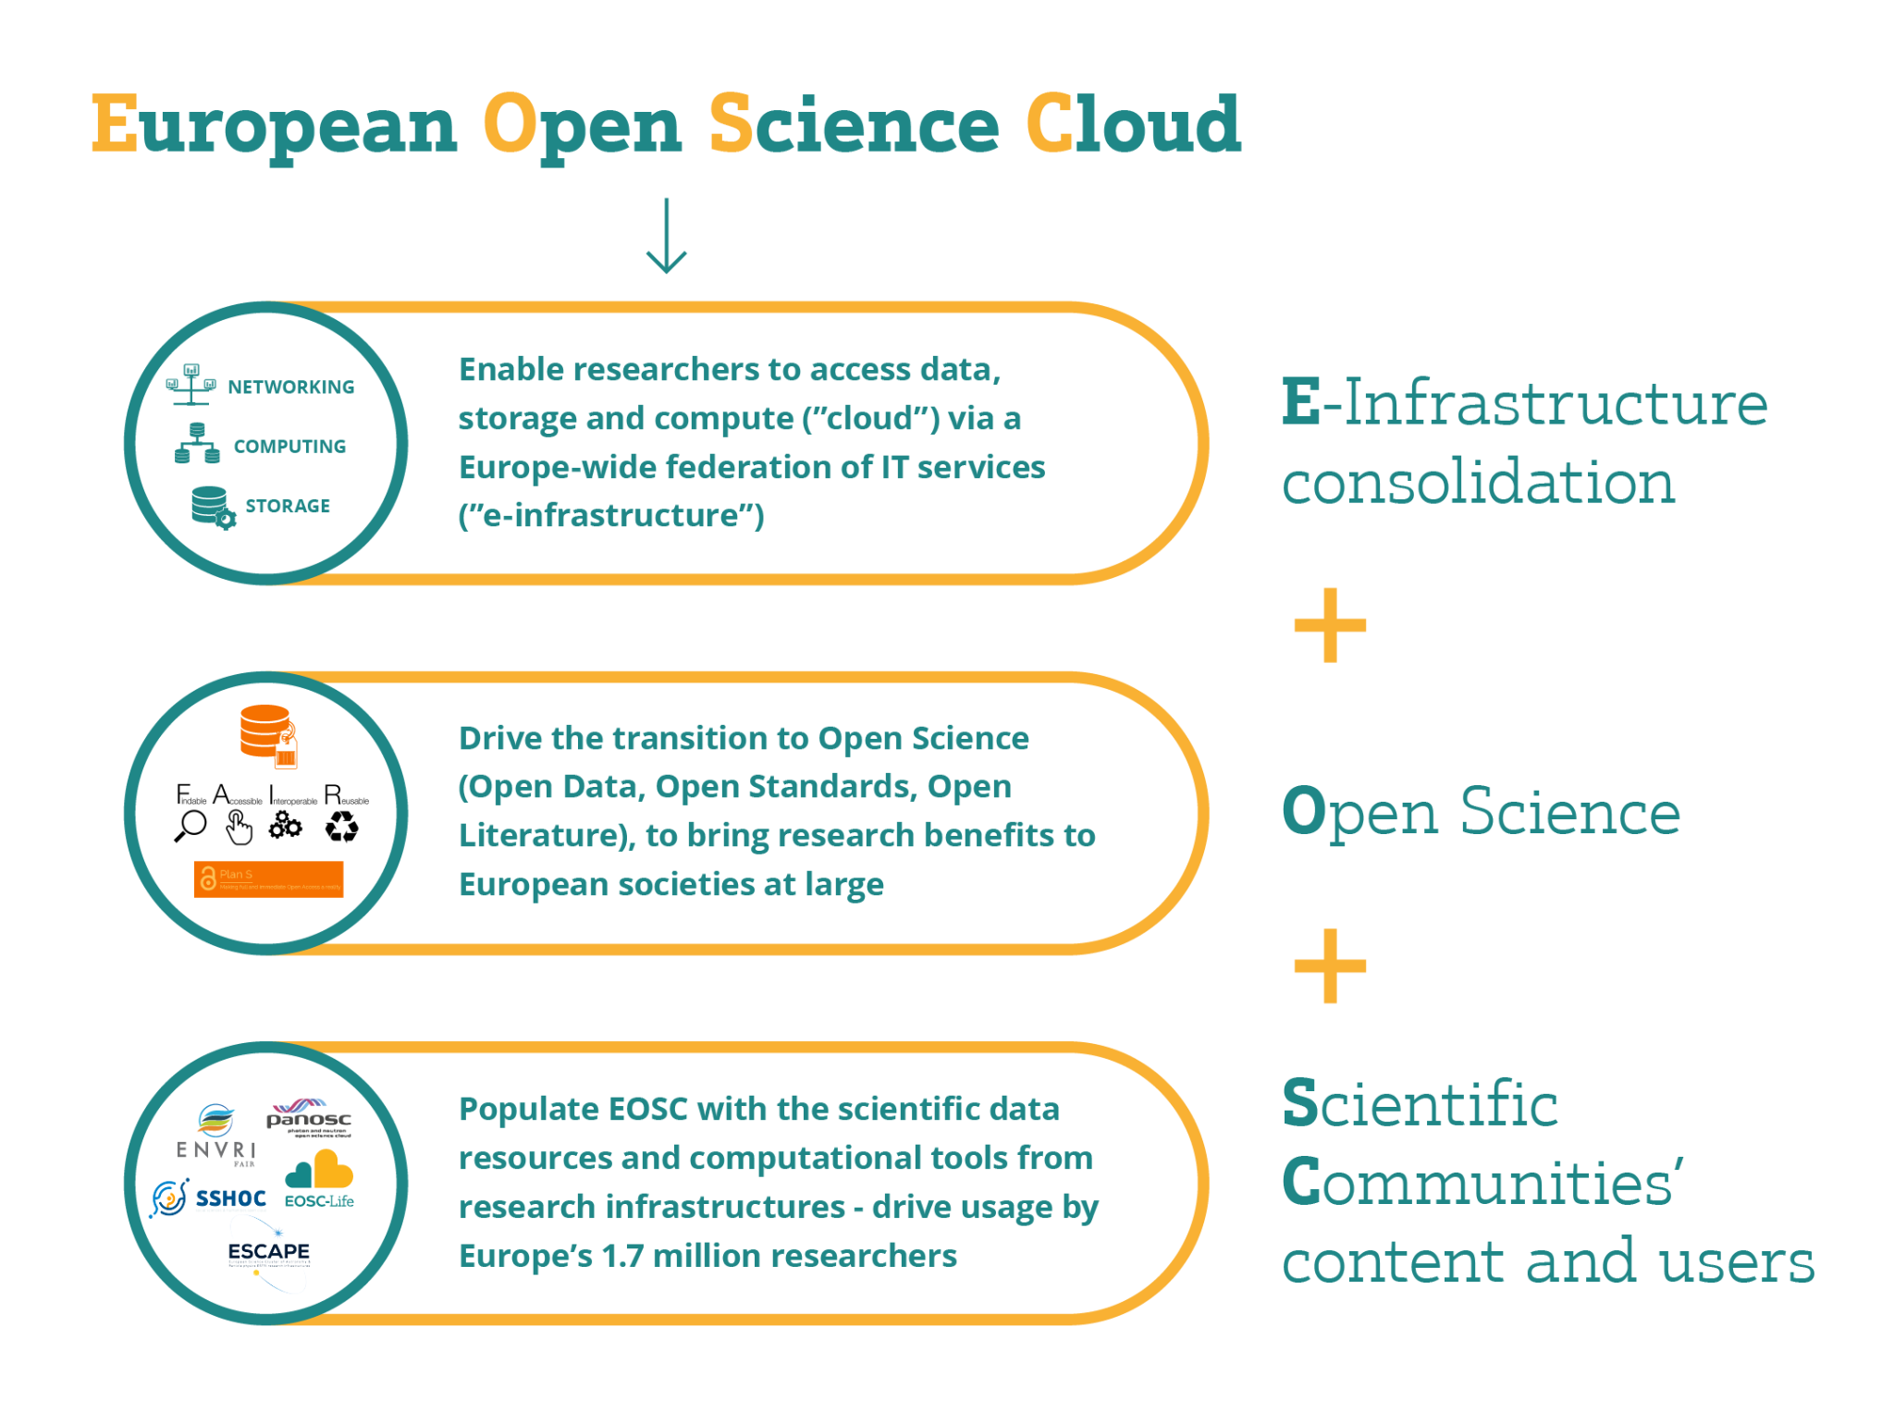

Slide 6

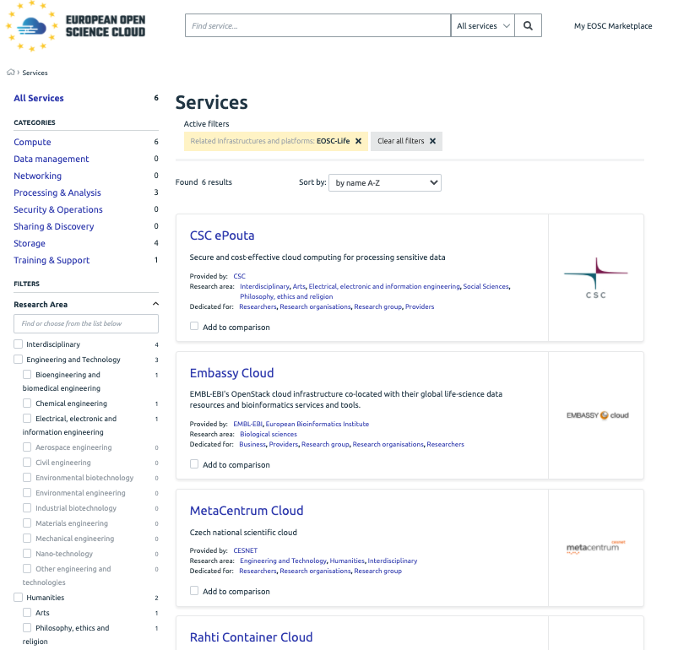
EOSC-Life help develop EOSC and EOSC partnership
Co-create and integrate EOSC federating core

Slide 7
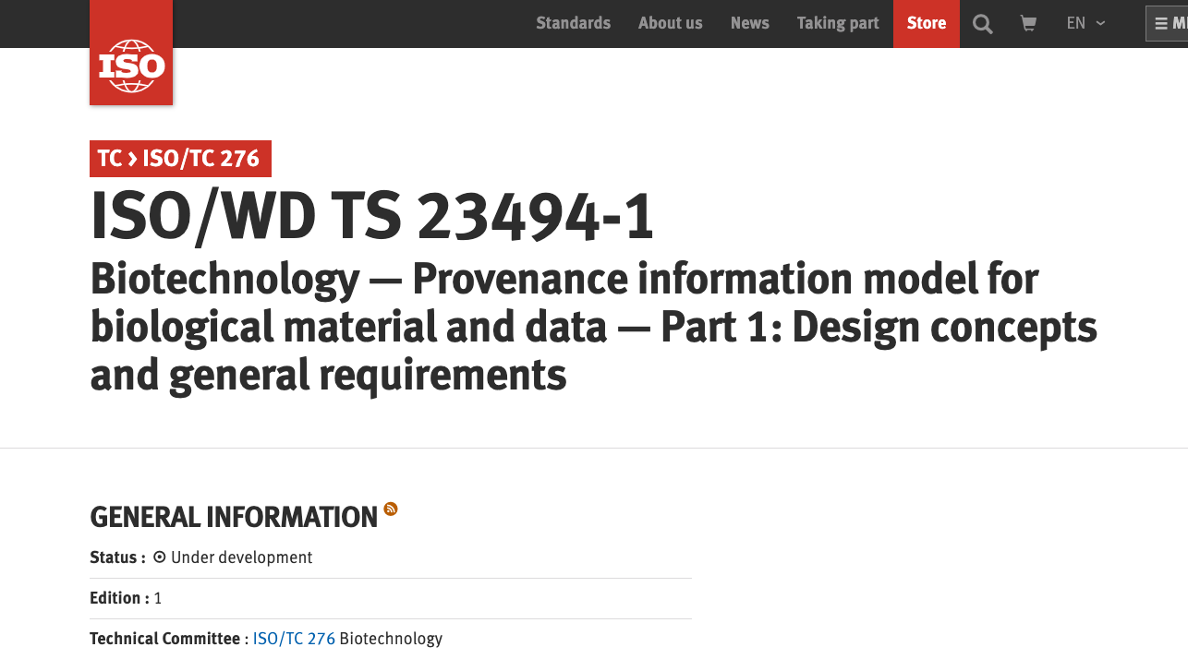
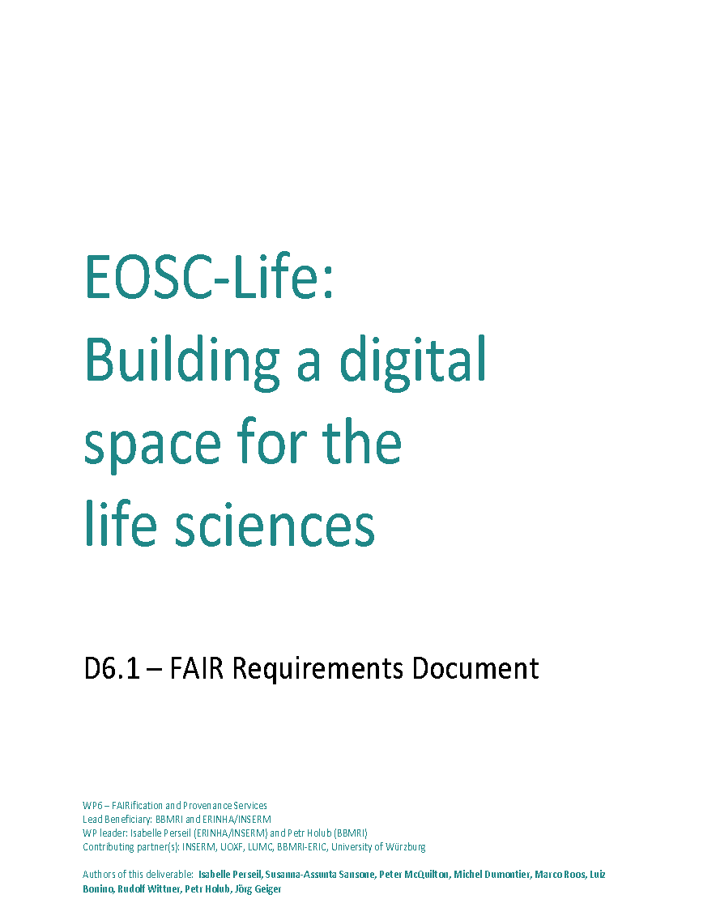
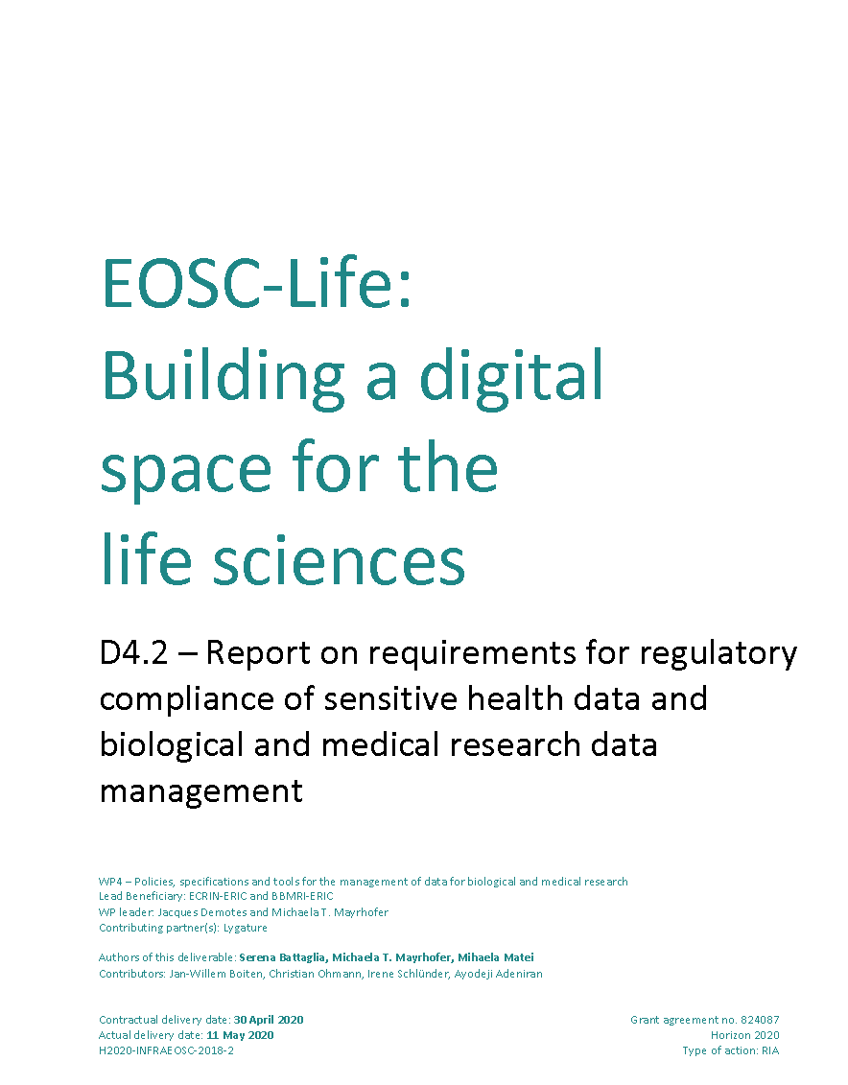
EOSC-Life help develop EOSC and EOSC partnership
Open Science as default –
create, adapt and adopt policies

Slide 8
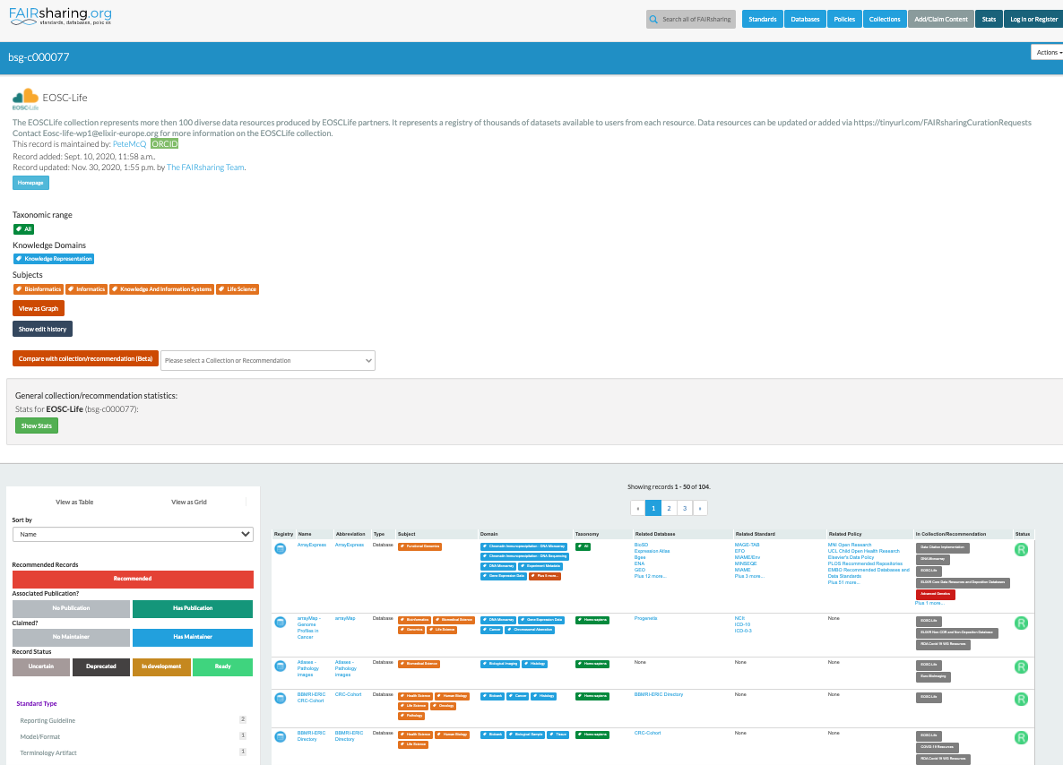



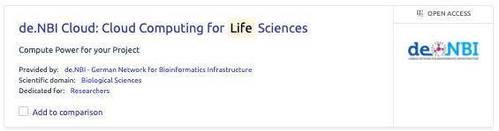
EOSC-Life help develop EOSC and EOSC partnership

Slide 9



EOSC-Life – additional COVID-19 actions contribute to European COVID-19 Platform
COVID-19 data
Repository for COVID-19 Clinical Trial Data
COVID-19 data
COVID-19 data
Data Integration components for European COVID-19 Data Portal - https://www.covid19dataportal.org/

Slide 10
Examples of project activities relevant to the eHealth BoF
Regulatory landscape analysis
Toolbox for sharing of sensitive data
Demonstrators and open calls in sensitive data
Training activities

Slide 11
WP4 Landscape analysis
Task 4.1 Regulatory compliance of sensitive health data and biological and medical research data management: policies, code of conduct, national implementation, de-identification
The first step of the landscape analysis (desktop research) has been concluded (D4.2).
The second step of the landscape analysis (semi-structured interview guide – national experts) is ongoing.
            - National experts from 21 EU countries have been identified and contacted.
        - Greece, France, Germany, Finland, Ireland, Hungary, Italy, the Netherlands, Norway, Poland, Portugal, Slovakia, Spain, Czech Republic, Belgium, Sweden, Switzerland interviews are completed/scheduled (including follow-up interviews)
Preliminary results:
research = qualitative, investigative (no single country expert has complete overview; “snowballing” between legal/ethical and technical experts to answer our questions)
national electronic health record (EHR) strategies (e.g., FI) vs. regional, scattered approaches (e.g., SE)
diverging definitions of EHR, strategy (if any, often “in the making”) vs. implementation
different speeds & priorities across Europe (e.g. north-south, genomics-in health care, EHDS)
A report will be provided and used to inform D4.5 “Public database inventorying the national health databases and registries and describing their access procedures for reuse for research purposes”

Slide 12
The EOSC-Life Toolbox for sensitive data sharing
The aim of the EOSC-Life Toolbox for sensitive data sharing is to provide guidance to:
          - researchers, who are sharing data or wish to share data in the future
      - researchers, who are requesting data for secondary use
Scope of the Toolbox:
Only secondary use of data is considered; in case of primary use only those aspects related to future reuse of the data will be considered.
The content of the Toolbox will not be developed de novo and is driven by
1. existing data, recommendations, procedures, best practices, and links to software (tools) to support data sharing and reuse relevant for sensitive data management in a cloud environment (e.g. EOSC);
2. guidelines and other useful resources drafted in the context of EOSC-Life
The design and content is driven by 6 RIs: ECRIN, EATRIS, BBMRI, EMBRC, ERINHA, Euro-BioImaging
Notes:
Where exactly we stand now: We decided that we needed to turn practical so instead of providing an additional set of recommendations for sensitive data sharing we are working on developing a toolbox that will not create resources de novo but provide pointers to guidelines/recommendations/good practices/tools already existing.
So far we have provided the general design and scope of the toolbox, a categorisation system that has been refined through a pilot study of tagging 110 resources by RI experts (and that will be the initial toolbox content) and an early demonstrator of the toolbox management of resources.
More details here:https://docs.google.com/presentation/d/1mWbG3QbHbMNR3gH_3L6NwyRa1TE06Gtz/edit#slide=id.gca5f557cbf_0_50 (e.g. the considerations of its technical implementation, process for the refinement of the categorisation system through the pilot study etc.)
There are other WP4 activities going on at the moment that can be mentioned if you see fit as « work in progress »:
- a report on data standards for observational and interventional studies, and on interoperability between healthcare and research data (Steve Canham has a presentation about this topic next week at the EATRIS Summerschool)
- a report on national health databases and registries with description of the access procedures for reuse for research purposes

Slide 13
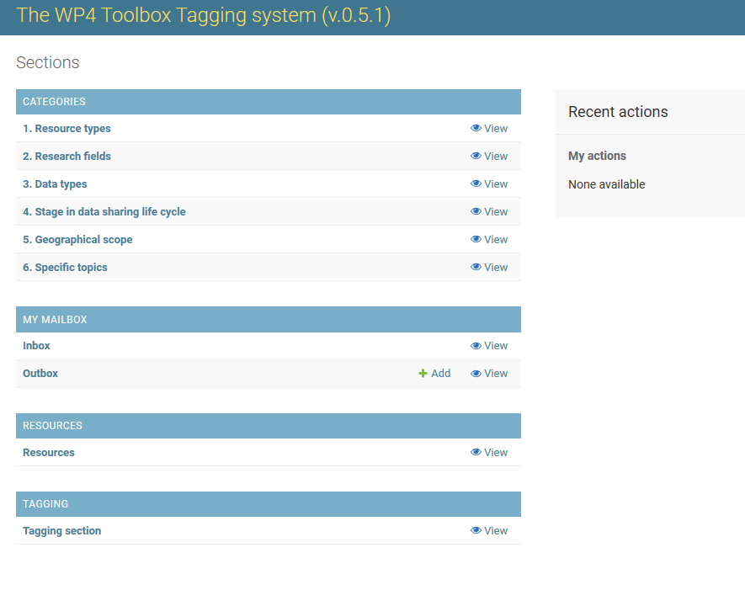
The EOSC-Life Toolbox for sensitive data sharing - status
Categorisation system developed and approved by the participating RIs; it includes 6 dimensions: Resource types, Research fields, Data types, Stage in data sharing life cycle, Geographical scope and Specific topics.
A pilot study including tagging 110 selected resources as initial content for the toolbox is ongoing using a demonstrator developed within EOSC-Life.

Slide 14



















D7: Accessing human sensitive data using WfExS
(Workflow Execution Service backend, dashed lines represent ongoing or future flows)
a pair of public and private keys are generated used with Crypt4GH
Materialize
(in a secure gocryptfs FUSE mount point)
1
2
Clone workflow repo or
RO-Crate workflow (raw or from WH)
or
workflow files at a GA4GH TRSv2 service
Workflow repository
CWL/Nextflow engine
Inputs + Reference files
Containers
...and others
3
Generate from inputs
6
Upload
Generate from provenance
Launch
Gather
4
Execution provenance
5
https://github.com/inab/WfExS-backend
https://www.eosc-life.eu/d7/
Notes:
WfExS (which could be pronounced like "why-fex", "why-fix" or "why-fixes") project aims to automate next steps:
Set up the working directory. If the work has been requested to be secured, an encrypted gocryptfs filesystem is created, and its key is encrypted using GA4GH crypt4gh.
Fetch and cache a workflow from either:
A GA4GH TRSv2-enabled WorkflowHub instance (which provides RO-Crates).
A GA4GH TRSv2 (2.0.0-beta2 or 2.0.0) enabled service. Currently tested with Dockstore and WorkflowHub in degraded mode.
A straight URL to an existing Research Object as an RO-Crate in ZIP archive describing a workflow.
A git repository (using this syntax for the URI)
A public GitHub URL (like this example).
Identify the kind of workflow.
Fetch and set up workflow execution engine (currently supported Nextflow and cwltool).
Identify the needed containers by the workflow, and fetch/cache them.
Fetch and cache the inputs (when it is allowed), represented either through an URL or a CURIE-represented PID (public persistent identifier). The sources could be under controlled-access.
Execute the workflow in the working directory (which could be encrypted).
Optionally describe the results through an RO-Crate, and upload both RO-Crate and the results elsewhere in a secure way (still being developed).
This development is relevant for projects like EOSC-Life or EJP-RD.

Slide 15

Sept- Dec 2020
~ 120 consultation requests
22 Dec 2020
72 submitted proposals
January 2021
70 proposals in technical evaluation
February 2021
61 proposals in scientific review
March 2021
15 shortlisted proposals
April
2021
8 funded projects

Slide 16
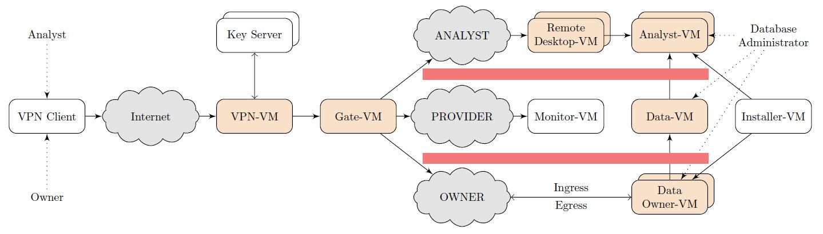

PID 13888 - Open Source Secure Data Infrastructure and Processes for Life Sciences (OSSDIP4LIFE)
Andreas Rauber, TU Wien, Martin Weise, Martin Krajiczek, Dietmar Winkler, Tomasz Miksa, Niki Popper
OSSDIP is an open-source high-security data visiting platform developed by TU Wien.
In this EOSC-life project OSSDIP will be adapted to the needs of selected data owners in the life sciences, extending its functionality to support more flexible data analytics. This platform will allow data owners to provide:
highly selective access (data visiting)
to specific (fine-granular or aggregated) subsets of data
for identified individuals
for limited periods of time
to answer precisely defined questions accepted by the data owner
Notes:
Secure sharing of sensitive data from the data owner to research experts is extremely challenging due to privacy reasons, but also due to the massive risk involved in sharing commercially sensitive data. To address this issue, the team from TU Wien will be extending OSSDIP to

Slide 17
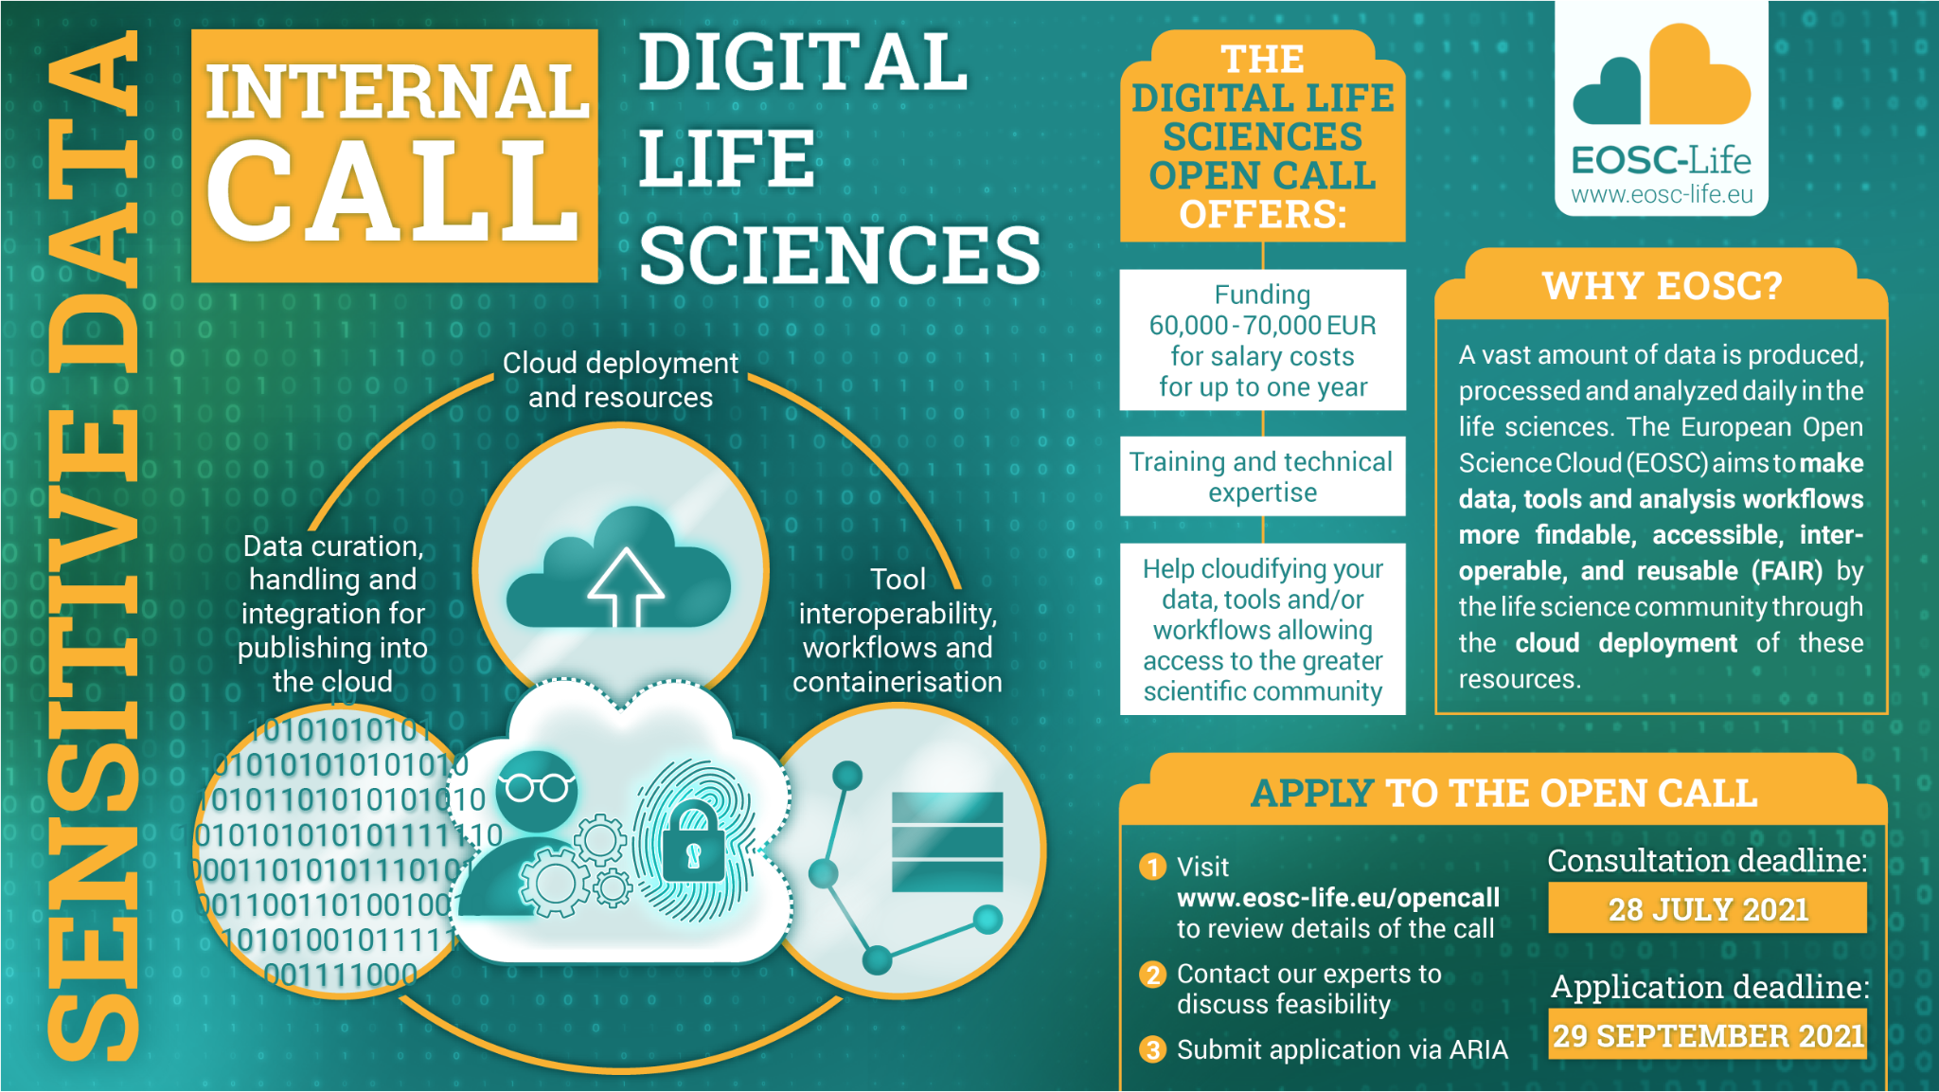
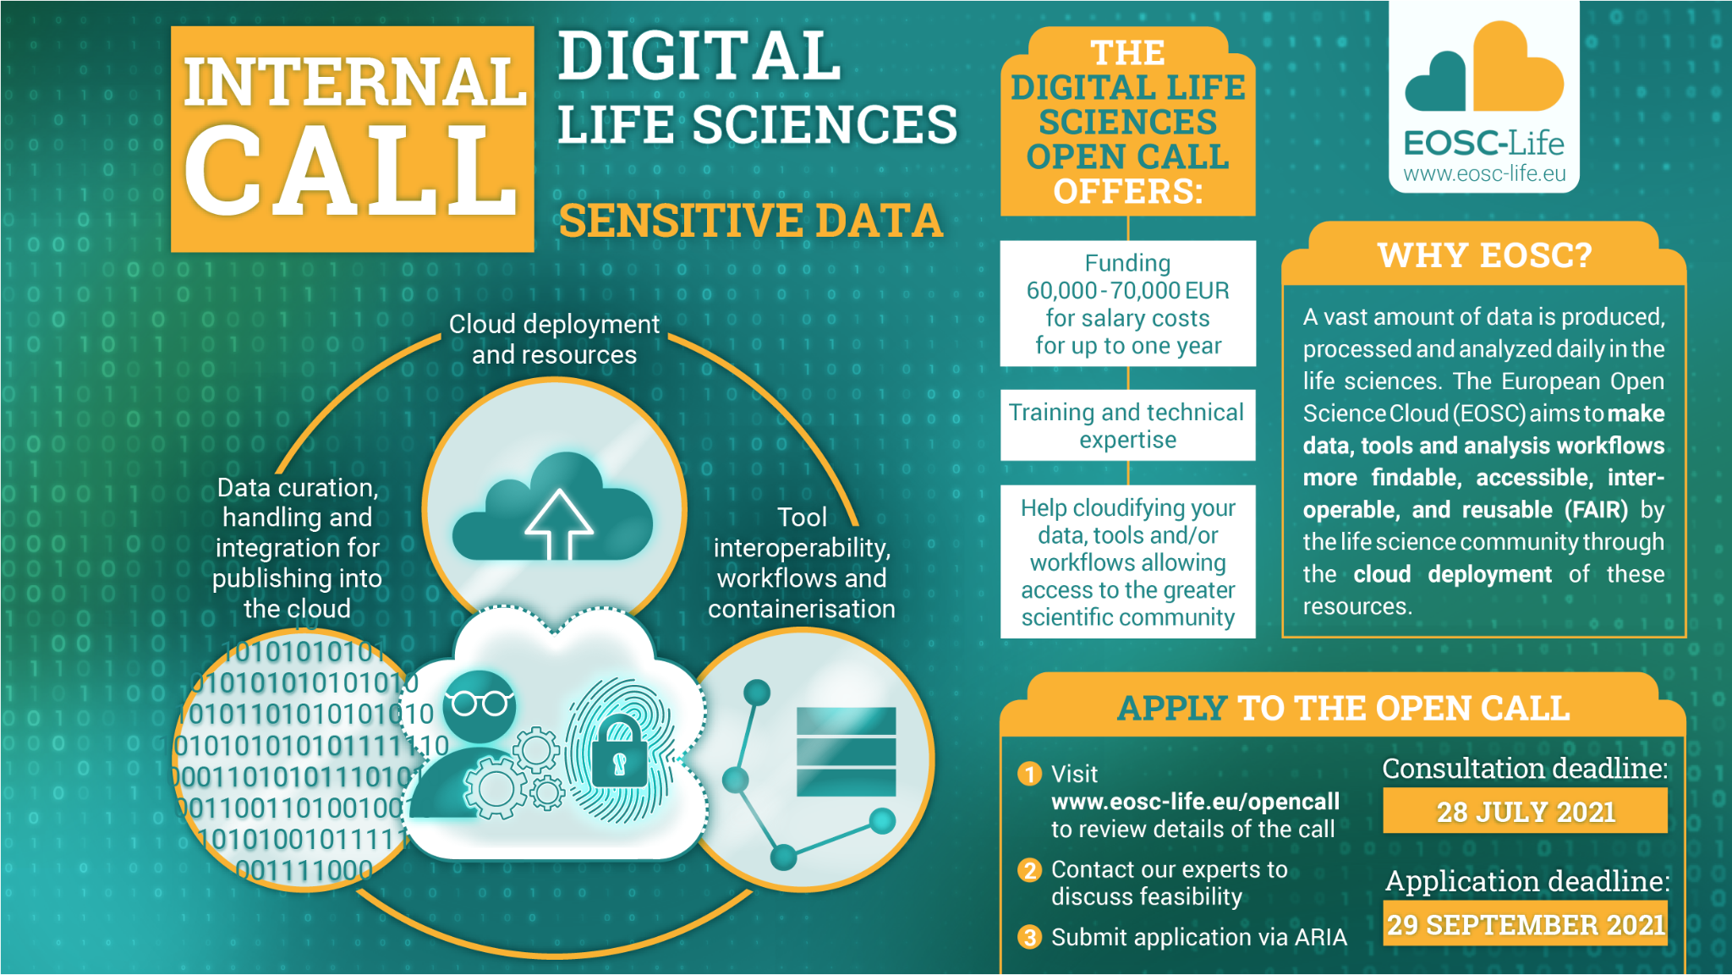

Slide 18
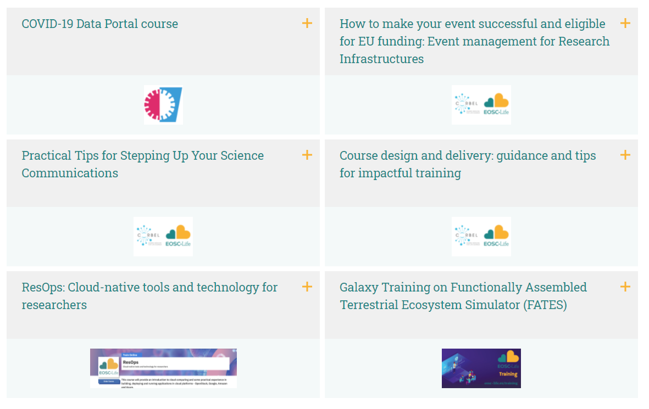
Training
Webinars & e-learning
E-learning under development
EOSC-Life for dummies
COVID data portal submission
Reproducibility
MICHA quick tour
Introduction to FAIR principles
https://www.eosc-life.eu/services/training/
Notes:
Focus at the moment on creating e-learning courses

Slide 19
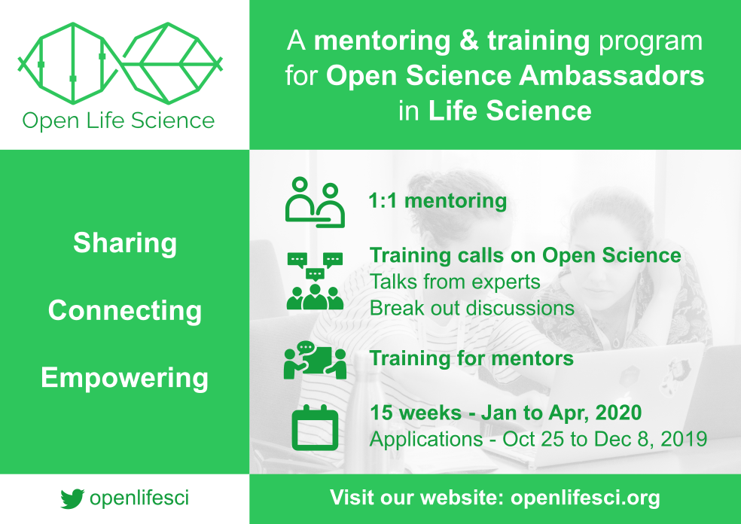
OLS-4 Timeline
Application period 15 June - 15 July 2021
OLS-4 Q&A Webinars Week of 5 July 2021
Cohort announcement mid-August 2021
OLS-4 Cohort begins mid-September 2021
OLS-4 Cohort ends January 2022
OLS-4 period: Sep 2021 - Jan 2022
Apply individually or in team to join the cohort
Join the program

Slide 20
WP9 Remote training series
An informal series to support transferring face-to-face training to remote delivery
Monthly on Friday 11:00 -12:00 CET, open to all EOSC-Life RIs, ESFRI projects, e-infrastructures and their national node institutes
Shared document with announcements and upcoming topics
Upcoming sessions:
Regular series will resume in September
02.07.2021 - 1-day workshop on hosting hybrid events (see next slide)
Planned
Accessibility Please suggest speakers and relevant topics
Previous sessions available on an unlisted YouTube playlist
Highlight useful experience with specific tools or software
Lessons learned from remote events
Always looking for speakers and suggestions for new topics!
Want to be kept informed? Email Daniel Thomas López
dthlopez@ebi.ac.uk

Slide 21

EOSC-Life Hosting Hybrid events workshop
With COVID-19 pandemic, remote events are now successfully organised, but some aspects of face-to-face events are difficult to replicate in virtual events, e.g. networking, engagement. Hybrid events could be a solution, but experience for its organisation is scarce.
Audience:
Anyone organising events; EOSC-Life beneficiaries, RIs (Hub & nodes), ESFRI cluster projects will be prioritised
Aim of the workshop:
Many organisations will out of necessity look at organising hybrid events. In this workshop we will discuss experiences, challenges and approaches that could be taken.
We hope to improve interaction among EOSC-Life RIs (hubs and nodes) when organising hybrid events
  Knowledge sharing approach
  Highly interactive
  Check programme here
  Registrations closing soon!
For questions or registration contact:
Daniel Thomas López
dthlopez@ebi.ac.uk
Notes:
EOSC-Life ‘Hosting hybrid events’ workshop:
Programme: https://www.eosc-life.eu/news/workshop-hosting-hybrid-events/
Registration form: Email Daniel Thomas López dthlopez@ebi.ac.uk

Slide 22
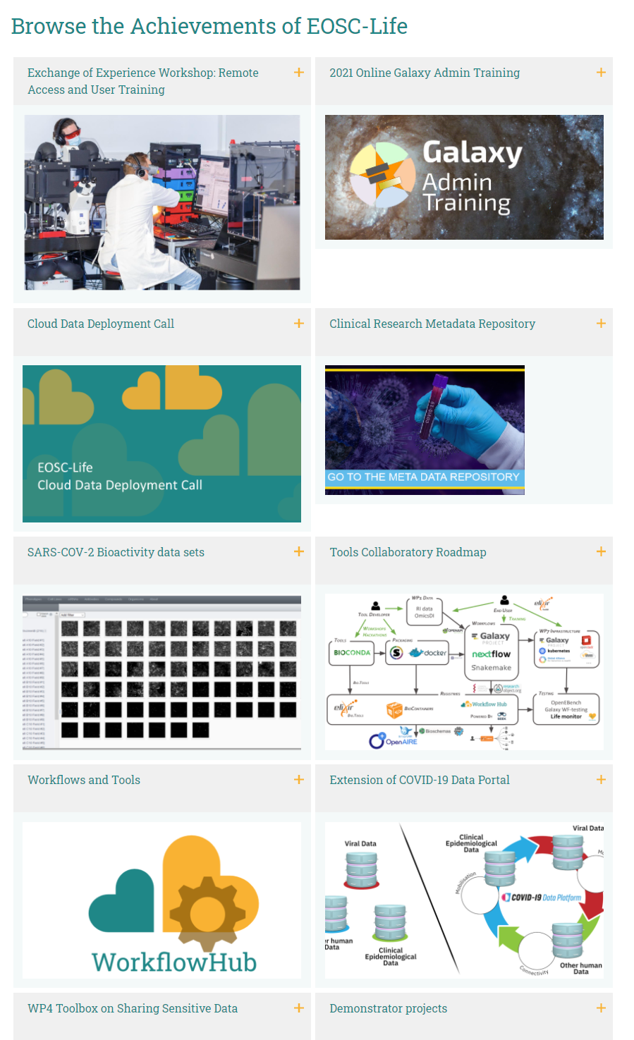
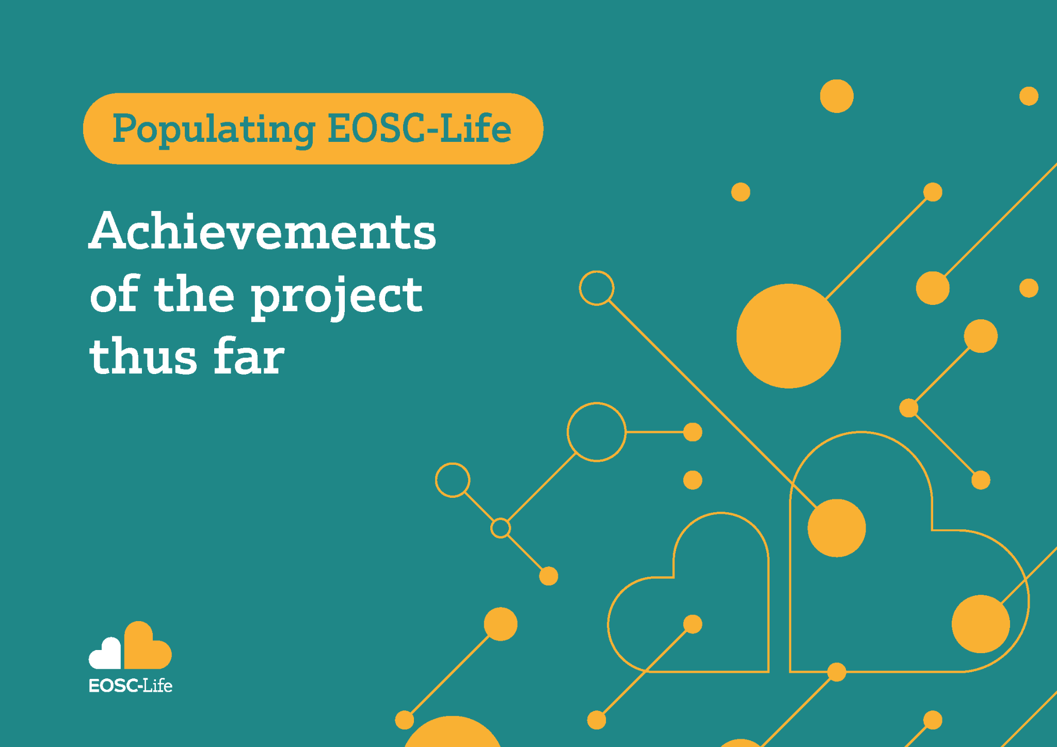
Thank you!
Learn more about EOSC-Life outcomes through our….
Achievements brochure published March 2021
Achievements page on our website: eosc-life.eu/achievements

