Slide 1
EOSC-Life Workflow Collaboratory
EOSC Services for Life Science
Cross-cutting services
Frederik Coppens, ELIXIR, VIB, Belgium
Carole Goble, ELIXIR, IBISBA, The University of Manchester, UK

Slide 2

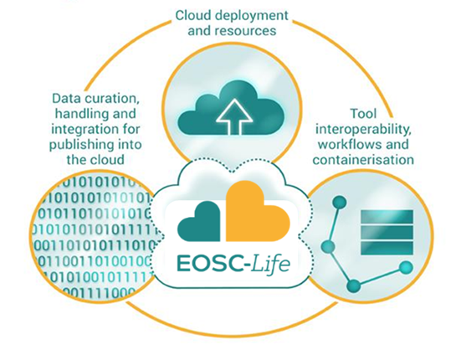


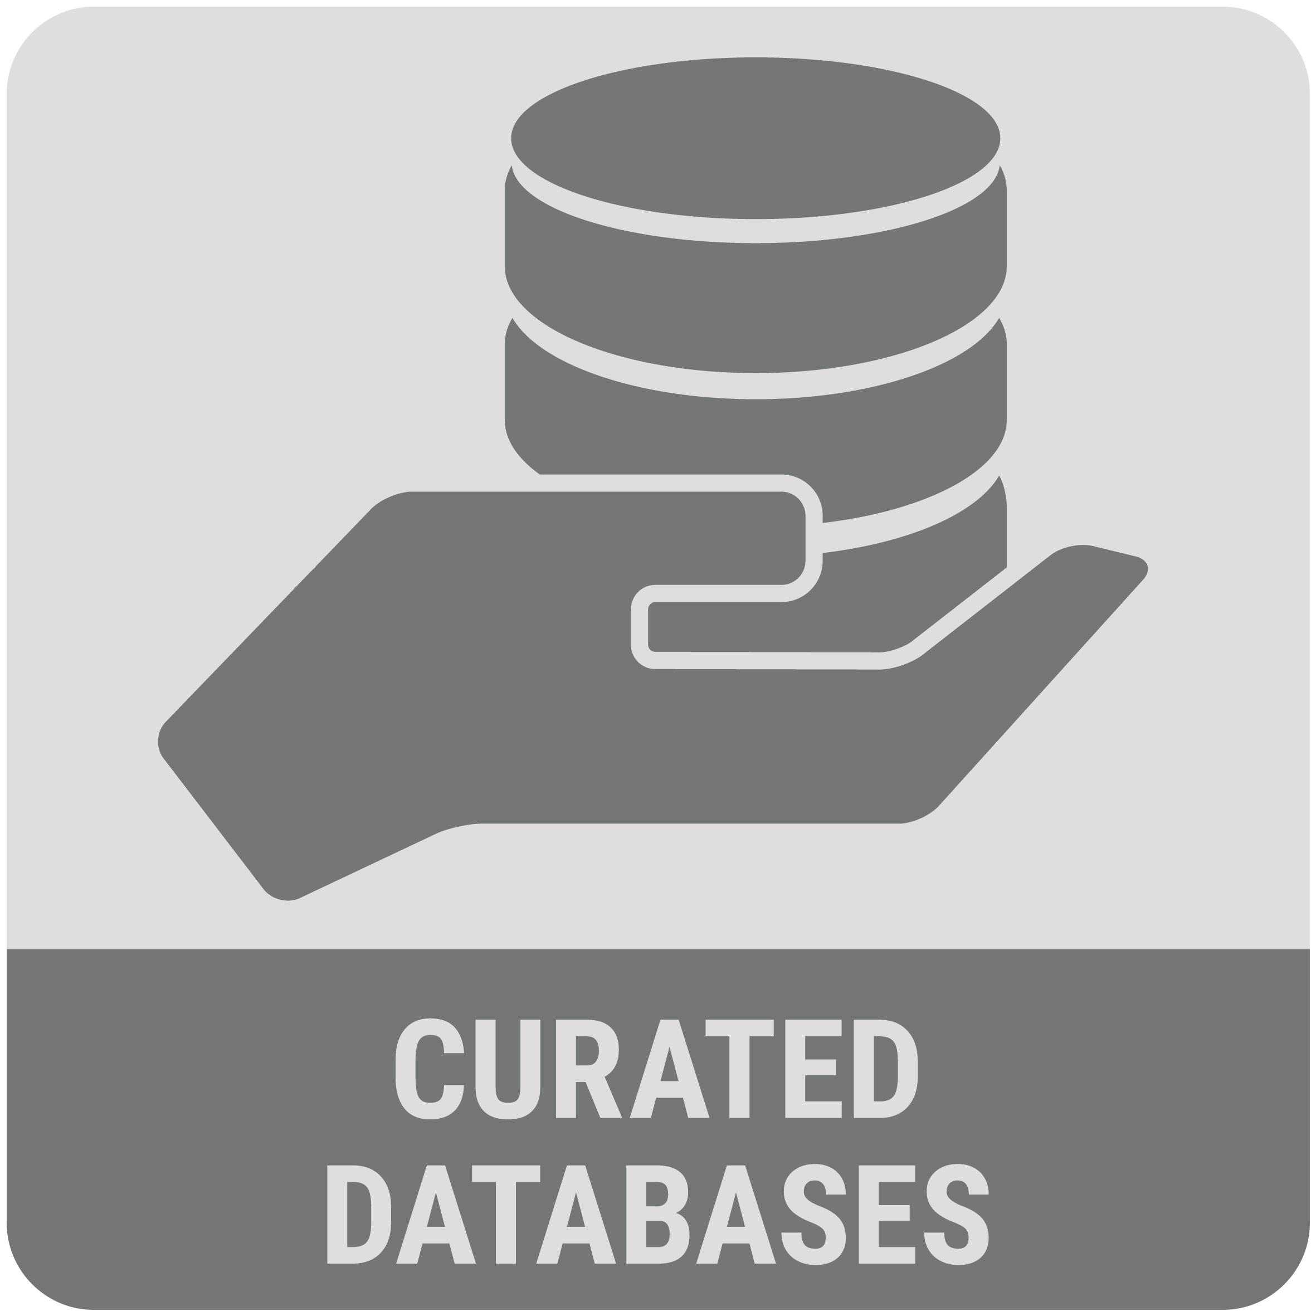







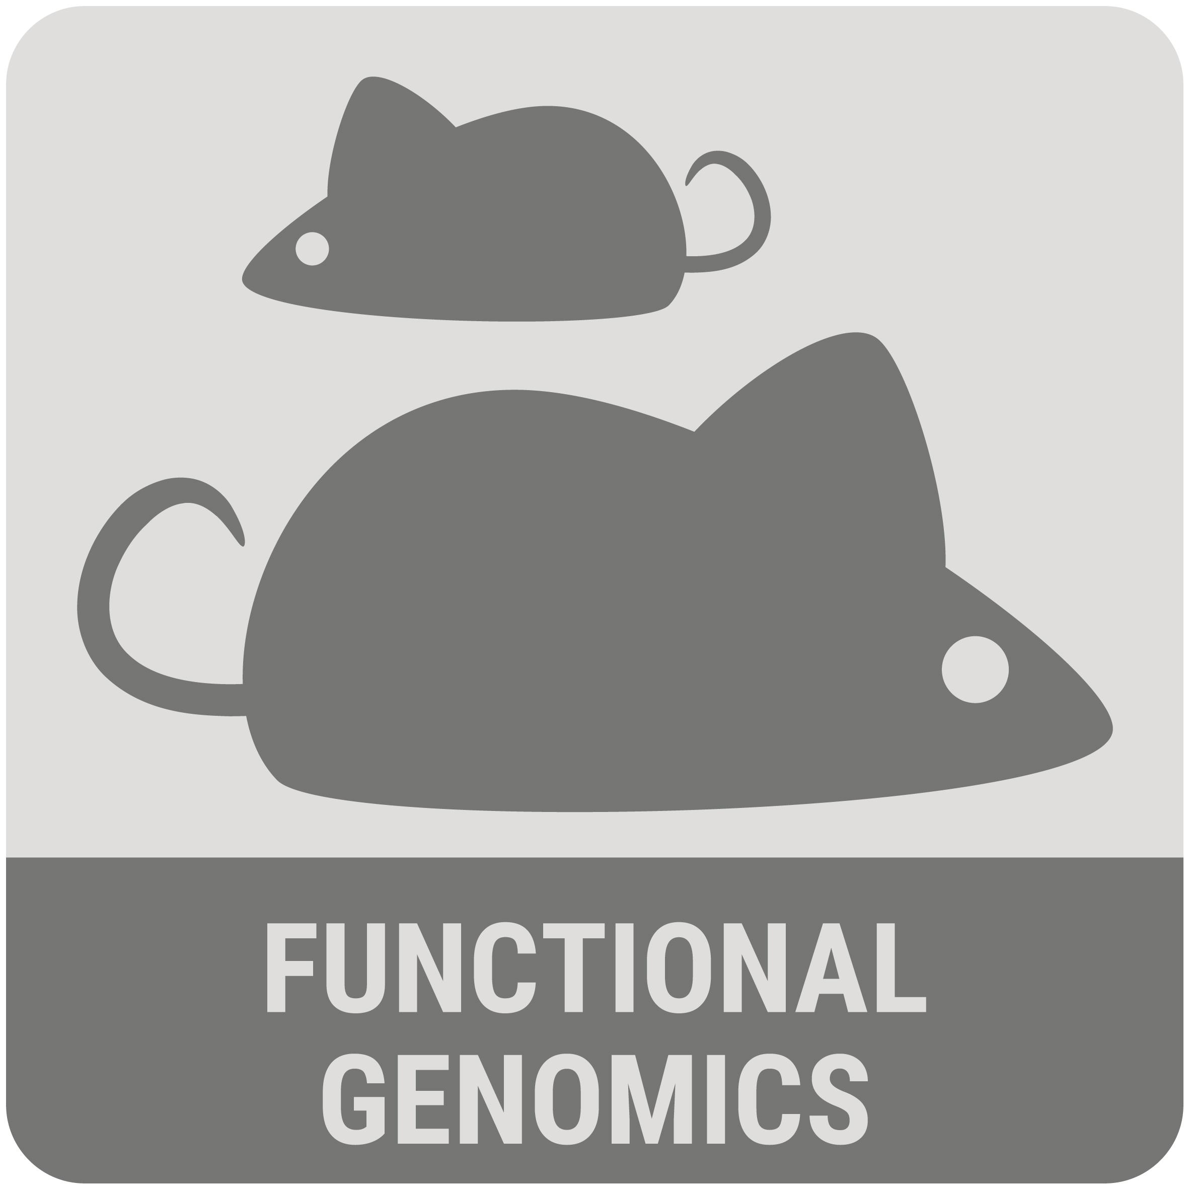
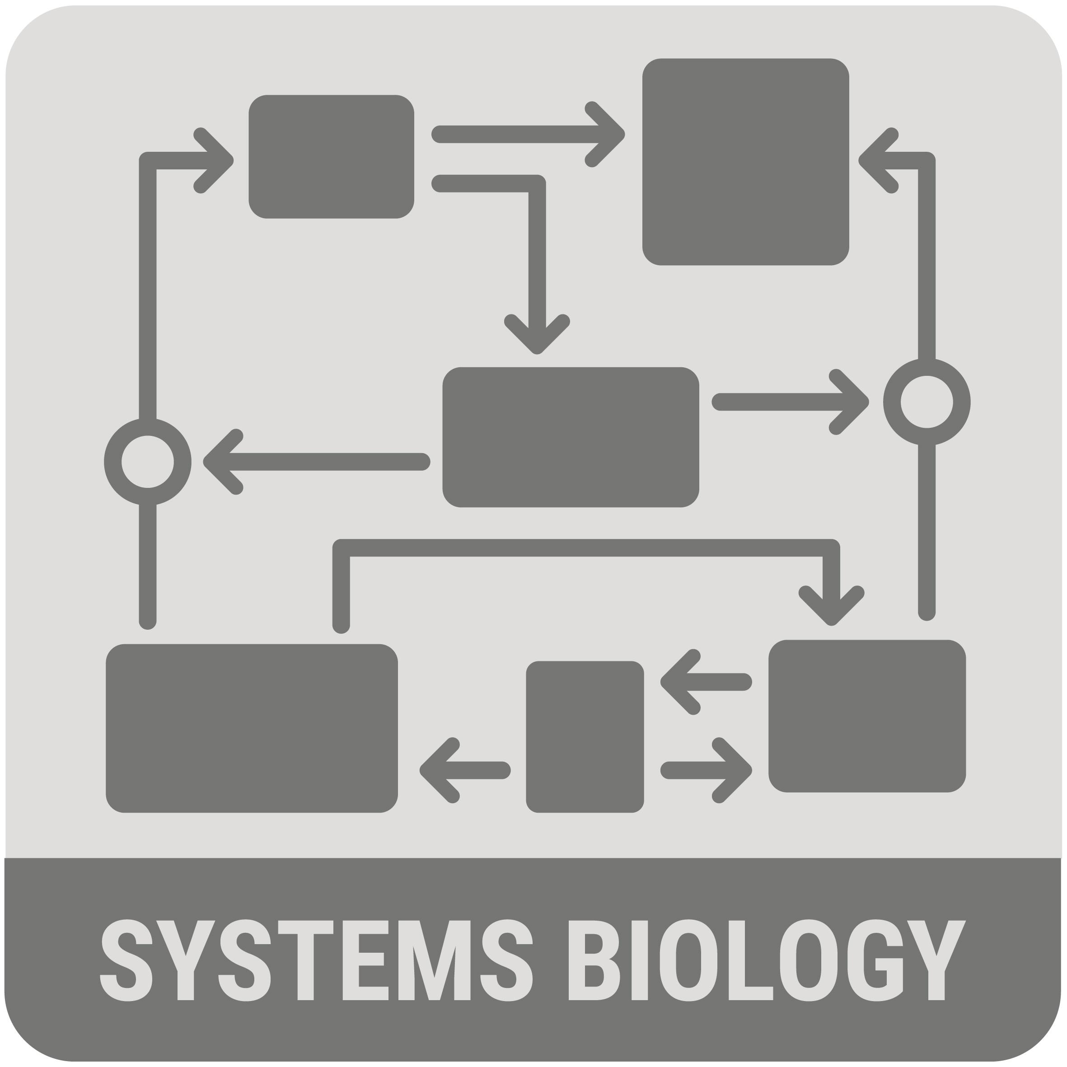


Pan-national digital space for bioscience data and methods
Aggregate workflows across the community
Tools and Workflow Collaboratory
Using and sharing data, tools and workflows in the cloud
A Data & Method Thematic Commons

Slide 3
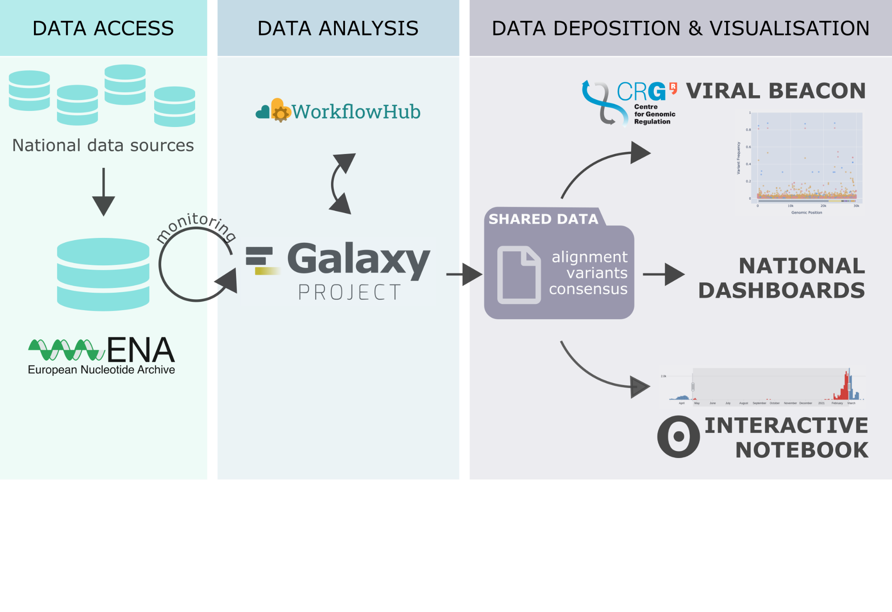
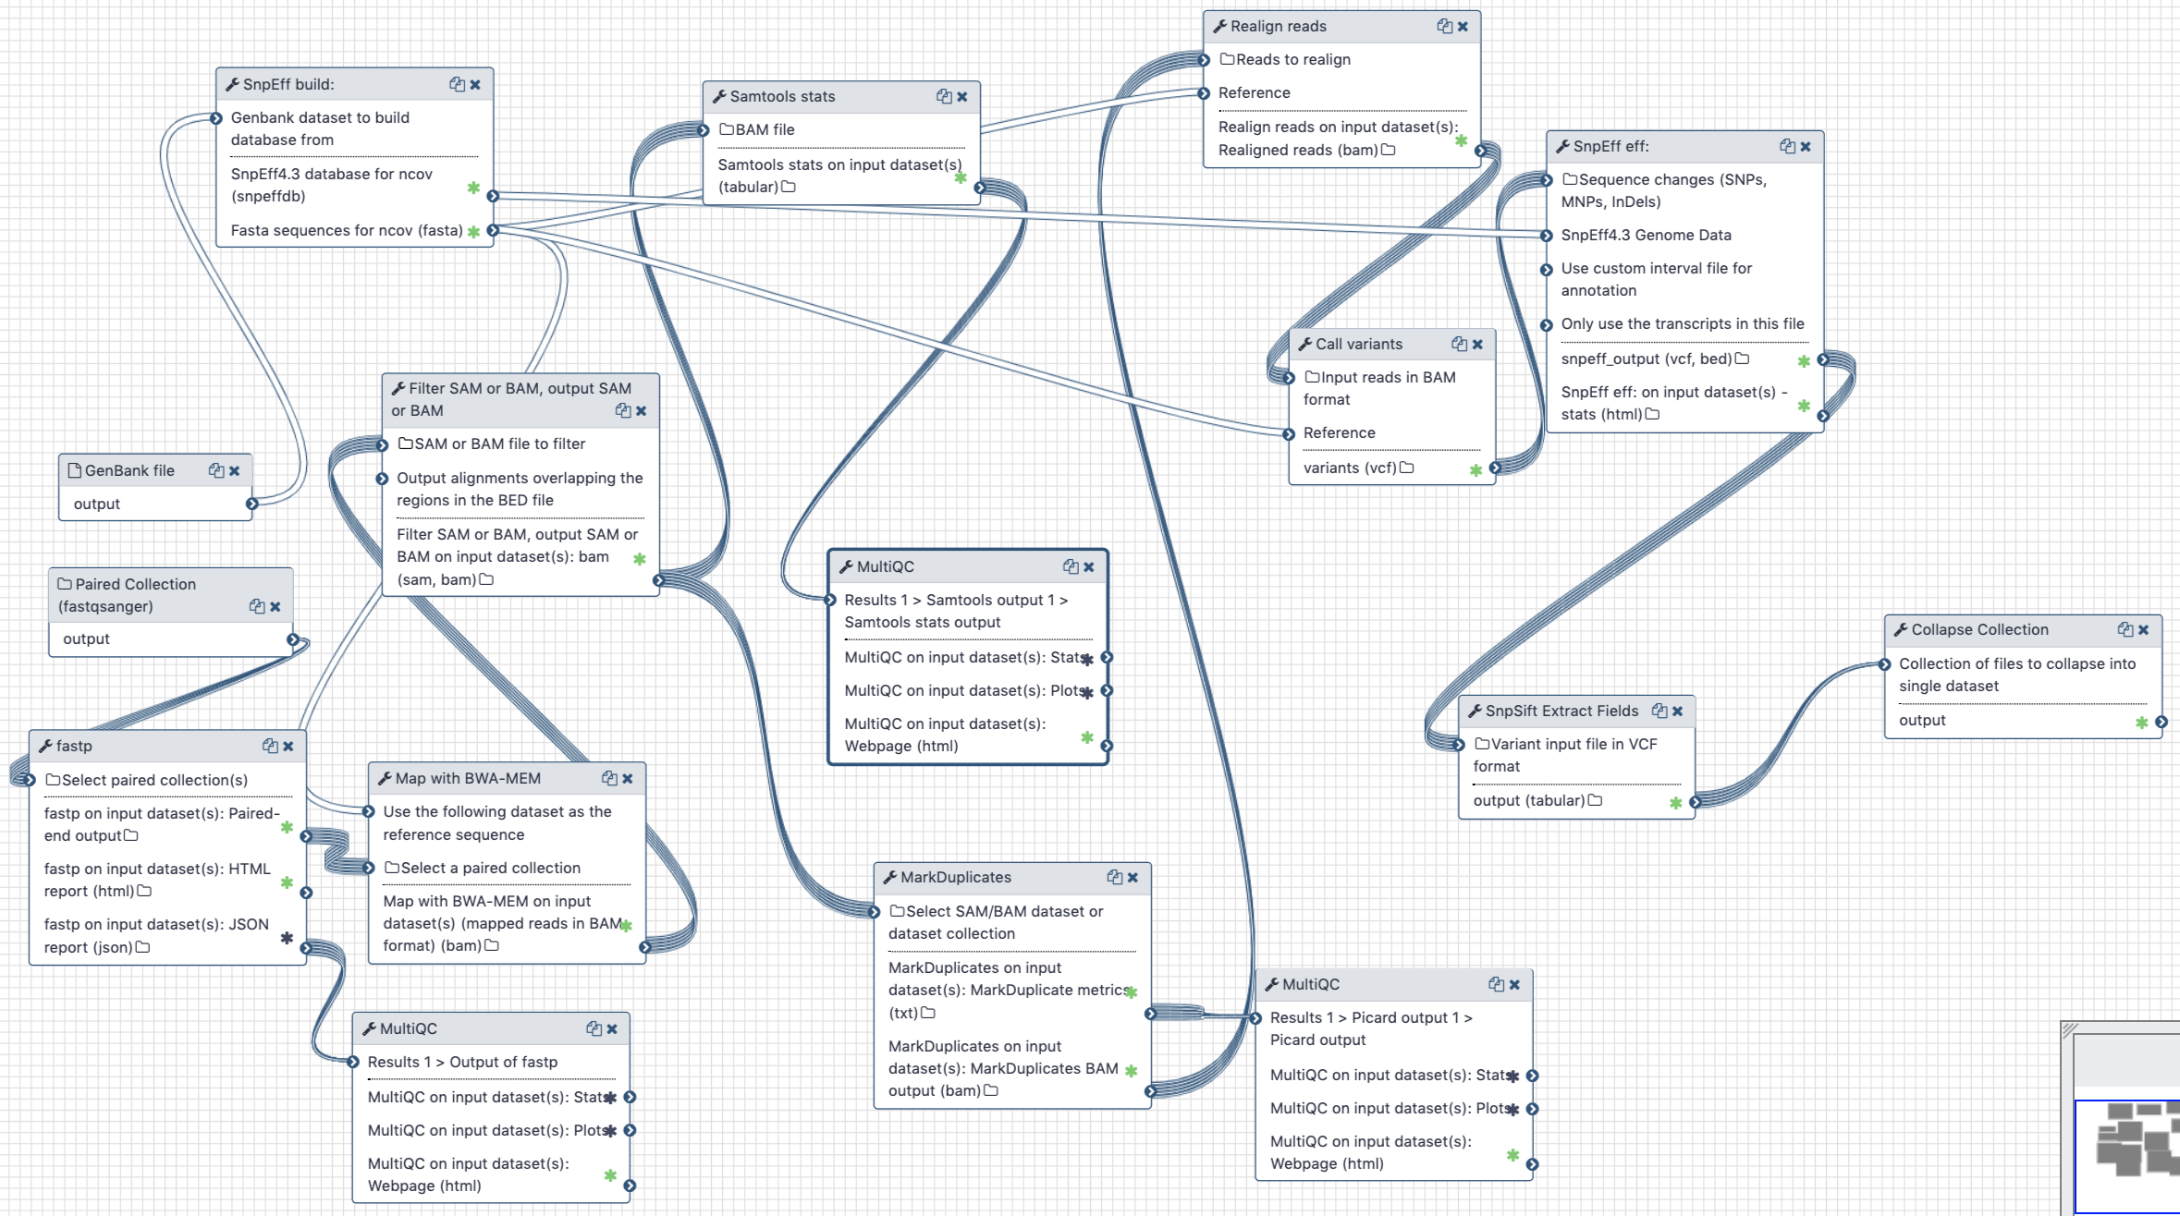

Example: SARS-CoV-2 pre-processing, monitoring, analysis
EOSC as a means to an end
Automated monitoring of structured data from the COVID-19 Data Portal
Managed central service and deployable infrastructure
Scalable via access to a global distributed compute network
Data quality
Uniformly analysed data for downstream analysis & visualisation
Facilitate submission of data to public archives (ENA, EVA)
https://covid19.galaxyproject.org
https://covid19beacon.crg.eu
https://covid19.galaxyproject.org/dashboard

Slide 4
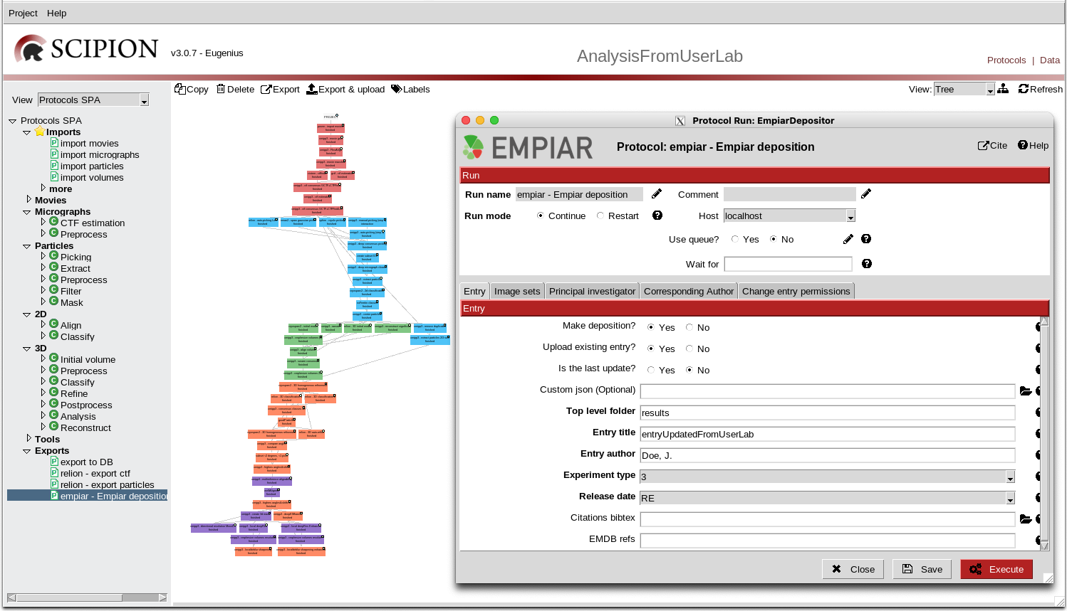
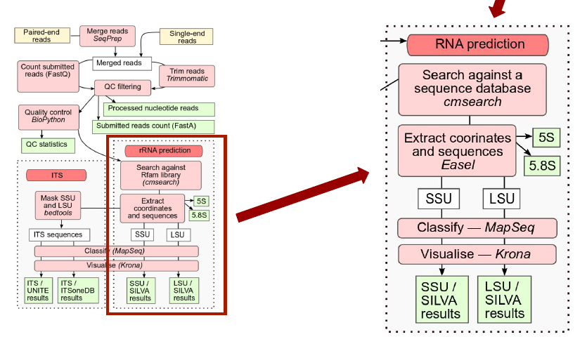
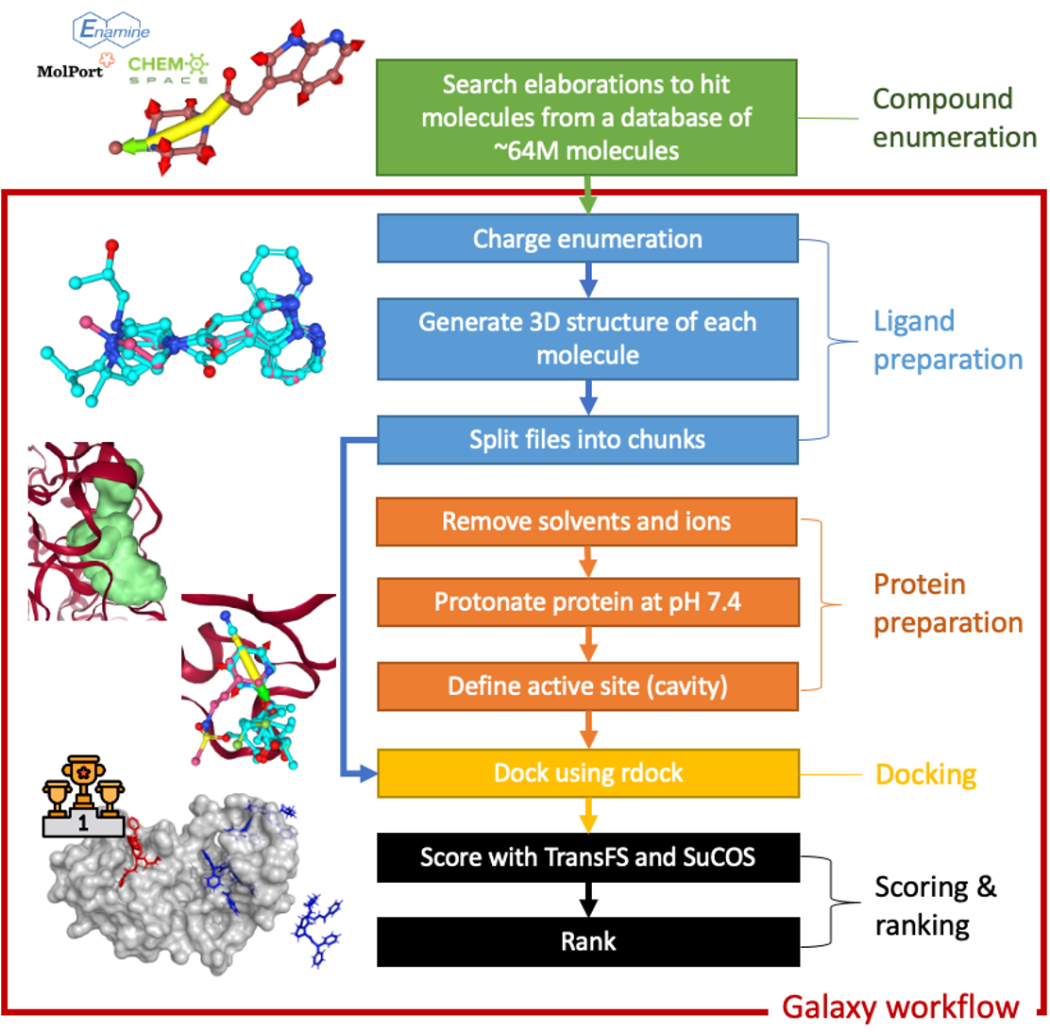



Workflows across the EOSC-life stakeholders
CryoEM Image Analysis
Metagenomic Pipelines
Drug Discovery
Workflows as entrypoint for end users
Bringing EOSC to the tools researchers already use

Slide 5























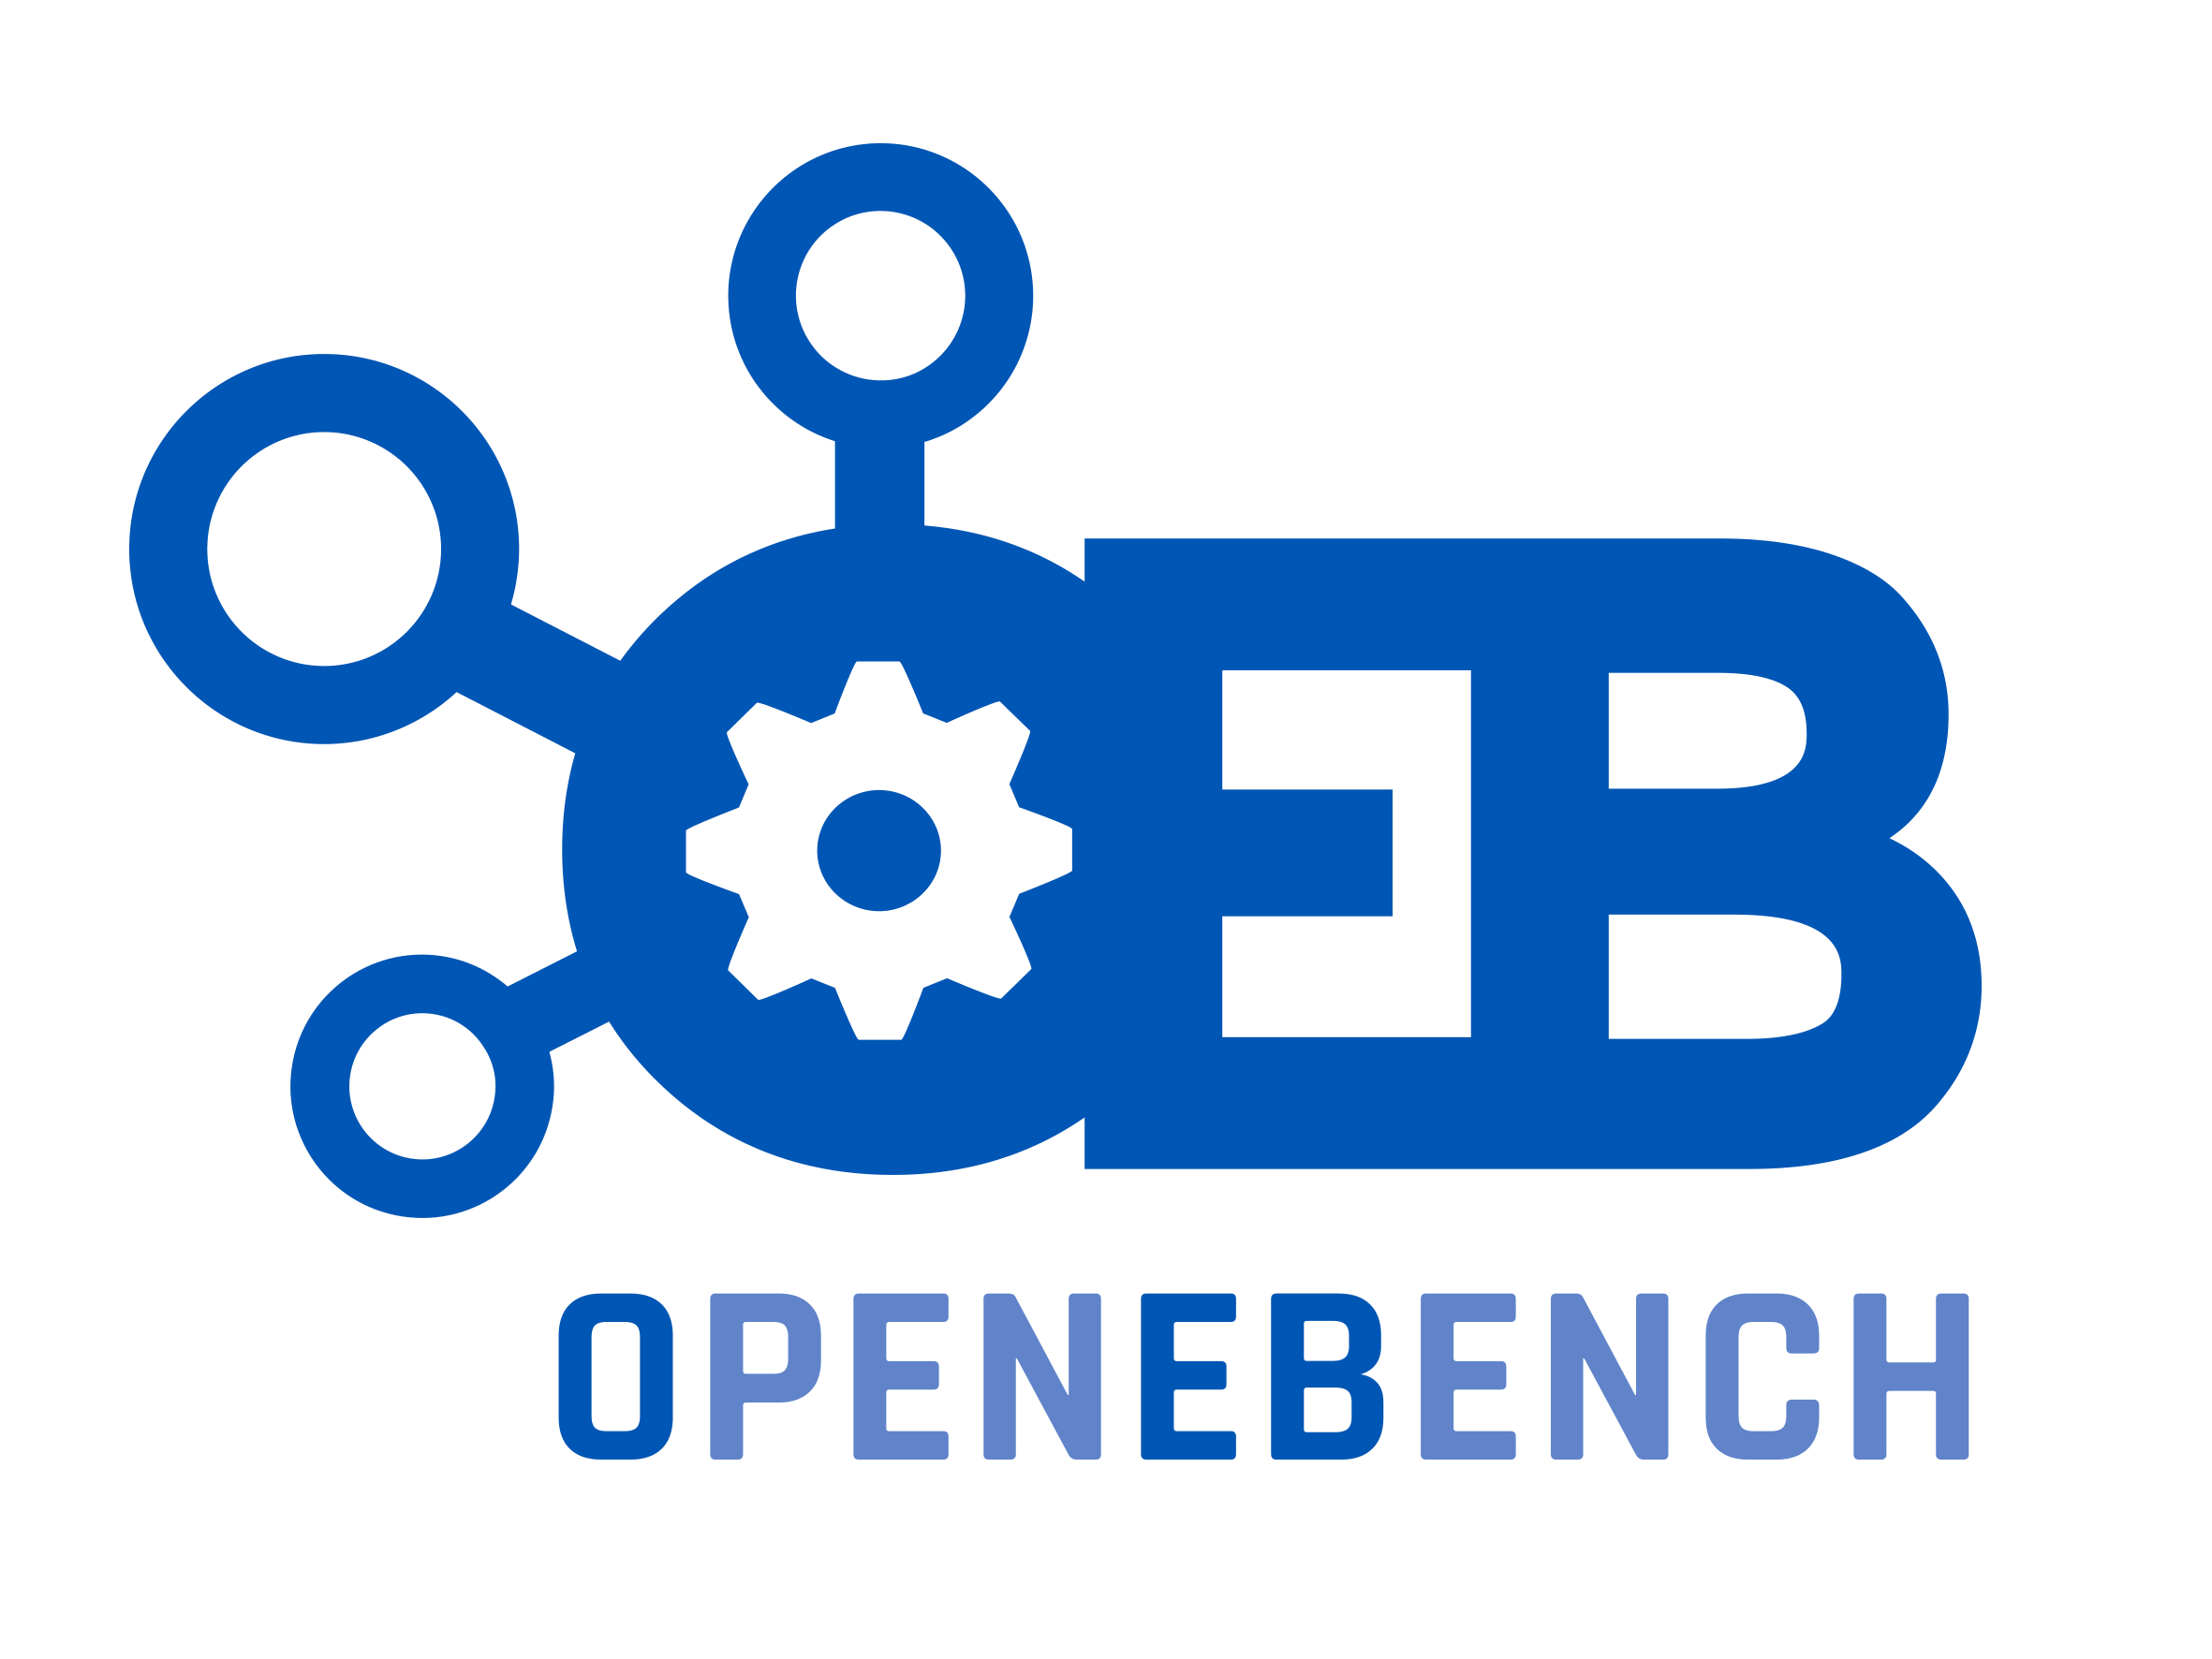

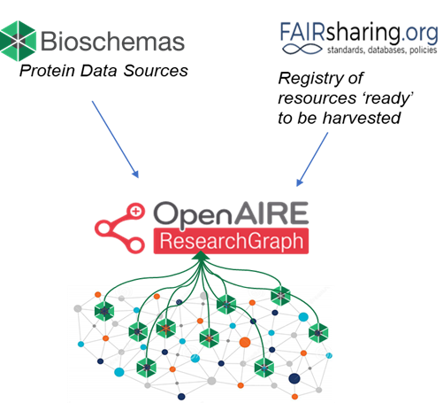

Need from Users, Developers and Infrastructure administrators
Drive the ELIXIR & EOSC-Life Tools ecosystems : workflows are first class objects
Data
Various data sources
Tool Developer
End User
Sys Admin
Authentication
Infrastructure
Tools
Workflows
Cv
Containers
…
Wf Repos
Registries
Testing
BioContainers
Bio.Tools

Slide 6











Implemented and running! Real use! Co-designed with EOSC-Life users.
Cross-cutting, horizontal services and technologies serving non-bio stakeholders
Thematic data, tools, ontologies, and digital object outputs : develop and implement FAIR Data
Services
Technologies & Techniques
Across disciplines
Workflow Platform
32K users, 40K workflows
Metadata standards for describing workflows and tools
Life Sciences
Remote computation sharing across Europe and Australia
Earth Science
FAIR Digital Research Object for exchanging workflows & data & service interoperability
Biodiversity
Workflow Registry
System agnostic
Standardised description of a workflow
EOSC Services
Workflow Testing and Monitoring services
Secure federated processing of sensitive data
EOSC Interoperability Framework

Slide 7
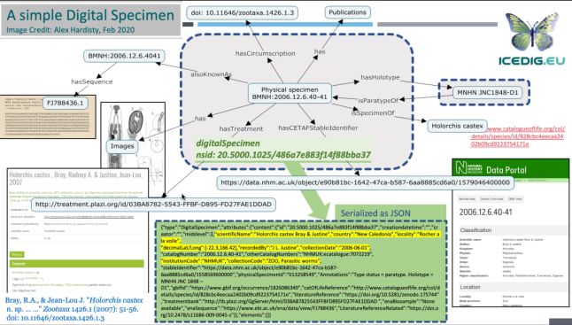
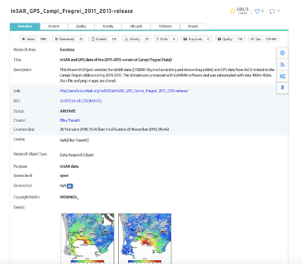
Cross RI Work. We are co-creating EOSC – practical and real use case driven
Research Object-based services can help to connect resources available via other EOSC services and related RIs
Specimen Data Refinery
Natural History Collection Digitalisation Pipelines
Earth Science Data Cubes
& the EOSC-Life Workflow Collaboratory
Not just workflows accessing and analysing data across disciplines
Not just the workflows available as managed methods across disciplines
But the infrastructure and technologies themselves
Notes:
Community specific support : towards FAIR workflows
Community standards, tools and infrastructure

Slide 8



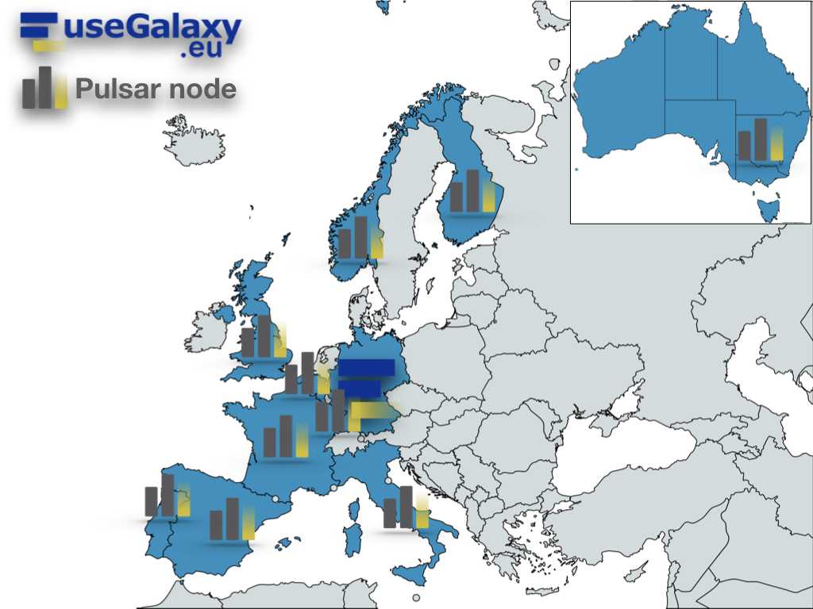

An ecosystem supporting distributed analysis through interfaces
Based on standards and proven technologies
Compatible / adaptable to sensitive data context
Local HPC
or Cloud resources
Distributed
Tool Registry Service API

Slide 9



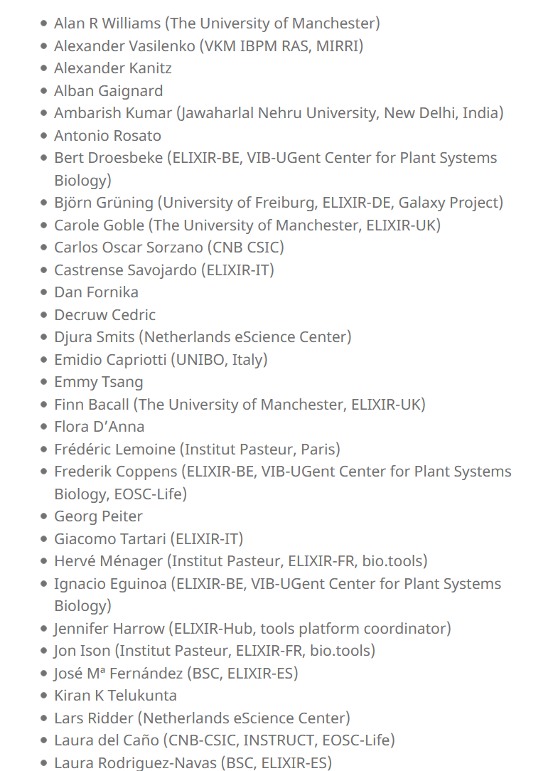
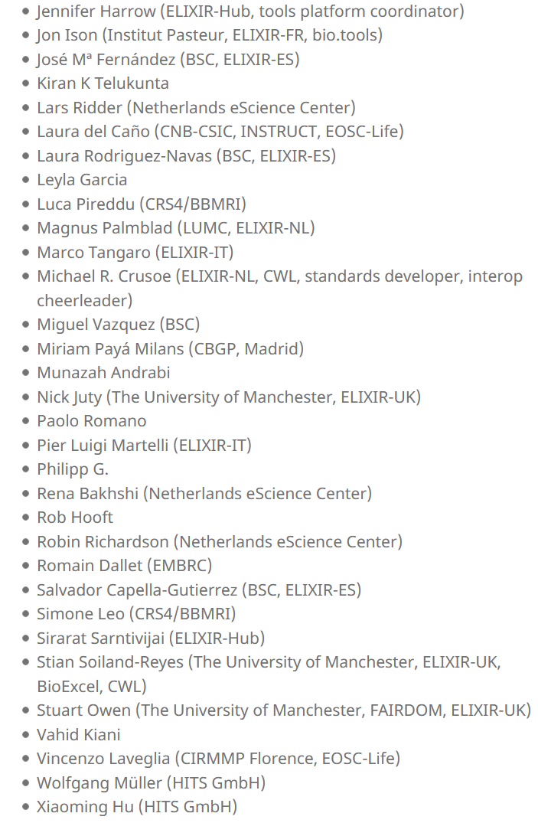





WorkflowHub Club : a open community effort
Perpetual open development
Project Governed as an Open Community
Join us on
https://about.workflowhub.eu/community/
Notes:
Exemplar of how we run these kind of projects, with the community
Governance through community meetings : WorkflowHub Club

Slide 10
Take EOSC to the user's tools.
Avoid reinvention: embrace community activities driven by the community.
Be inclusive : Build it in isolation and make people come is not a good or inclusive strategy
Notes:
EOSC is hell bend on showing its clever underware plumbing. but if it really works then noone will care or notice
because it is just "the data", "the tool", "the registry" you use. and who knows or gives a shit about the AAI or store
the plumbing IS interesting to plumbers
EOSC services need to target plumbers and EOSC love needs to target those who need plumbing

Slide 11
EOSC is a means to an end, where the end is research
EOSC is research underware the urge to expose the underware, however proud you are of it, should be resisted
Make it support the communities and “just there”

Slide 12
Links
EOSC-Life https://www.eosc-life.eu/
RO-Crate https://www.researchobject.org/ro-crate/
WorkflowHub https://workflowhub.eu/
Galaxy Europe https://galaxyproject.eu/
Bioschemas https://bioschemas.org/
Common Workflow Language https://www.commonwl.org/
Notes:
Australian BioCommons https://www.biocommons.org.au

Slide 13
Thank you
Notes:
So the brief talk should highlight how the EOSC-Life Workflow Collaboratory has used generic (horizontal) tools/services and thematic data, services, tools (both within and across the thematic domains)
Your session
See most updated version on: https://www.eoscsecretariat.eu/eosc-symposium-2021-programme
9:00 - 10:45 Engagement and cross-fertilisation between Research Infrastructures and the EOSC ecosystem Chair: Suzanne Dumouchel, Huma-Num (CNRS) & Director, EOSC Association/ ESFRI
9:00 - 9:10 Setting the scene: requirements and priorities for ESFRI and the RI communities for the next period and how to get added value from EOSC · 9:00 - 9:05 The ESFRI Task Force on EOSC - Mirjam van Daalen, Paul Scherrer Institute and ESFRI TF Chair
· 9:05 - 9:10 EOSC Association activities on communities' engagement and EOSC added value for them - Suzanne Dumouchel, Huma-Num (CNRS) & Director, EOSC Association
9:10 - 9:25 How RIs will work with and benefit from EOSC - Rudolf Dimper, The European Synchrotron (ESRF) & PaNOSC/ExPaNDS
9:25 - 10:05 Lightning community paradigm talks - SSHOC - The SSH Open Marketplace with SSHOCing tools & services - Jennifer Edmond, Director, DARIAH & SSHOC
- EOSC-Life - The EOSC-Life Workflow Collaboratory - Carole Goble, University of Manchester & EOSC-Life
- Multidisciplinary collaboration between marine and nutrition research communities - Sara Pittonet, Trust-IT Services & Coordinator, Blue-Cloud and/or Karl Presser, Premotec & FNS-Cloud TBC
- ESCAPE - Expanding EOSC participation by a factor of a thousand: citizen science in the EOSC, - Stephen SERJEANT, Open University & ESCAPE
- Researcher Engagement: Visions, needs and requirements for (future) research environments - Katharina Flicker, TU Wien & EOSCsecretariat.eu
10:05 - 10:35 Panel Discussion: Cross-fertilisation between research infrastructures, thematic communities, and EOSC Co-chairs; Suzanne Dumouchel, Huma-Num (CNRS) & Director, EOSC Association & Mirjam van Daalen, Paul Scherrer Institute and ESFRI TF Chair
Panel: - Niklas Blomberg, ELIXIR & EOSC-Life
- Ron Dekker, CESSDA ERIC & EOSC Future
- Rudolf Dimper, The European Synchrotron (ESRF) & PaNOSC/ExPaNDS
- Tiziana Ferrari, EGI Foundation
10:35 - 10:45 Wrap up - Suzanne Dumouchel, Huma-Num (CNRS) & Director, EOSC Association/ ESFRI

