Slide 1


eHealth funding opportunities in 2021- 2027
June 25, 2021
Mario Reale
Input from Edit Herczog, Senior EU Liaison Adviser
www.geant.org

Slide 2
Agenda
MFF 2021- 2027:
  Horizon Europe, Pillar II, Cluster 1
  DEP programmes for interoperability
  EU4Health

Slide 3
MFF 2021 – 2027*
*budget always refers to 7 years allocation

Slide 4
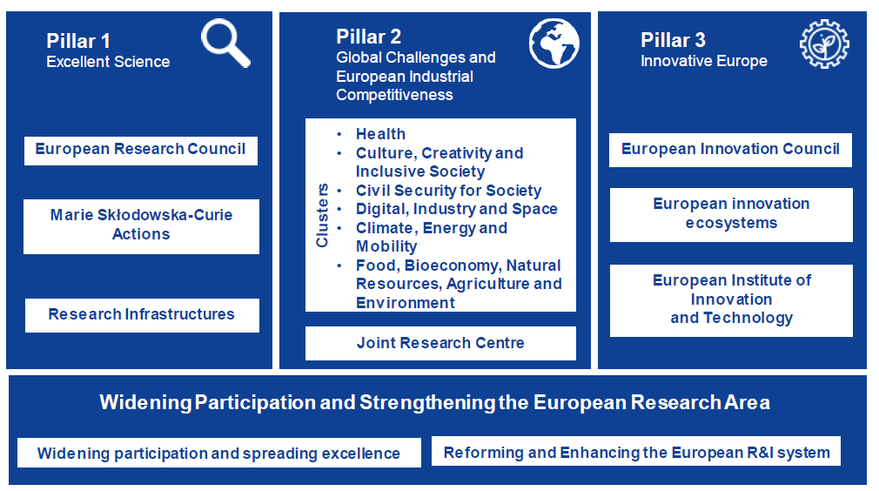
Horizon Europe – The key EU Programme for Research and Innovation

Slide 5
Horizon Europe
Horizon Europe is the EU’s key funding programme for research and innovation with a budget of €95.5 billions Euro
It tackles climate change, helps to achieve the UN’s Sustainable Development Goals (for Health: SDG3: good health and well being) and boosts the EU’s competitiveness and growth.
EU published in 2019 orientations towards first strategic plan for HE (Dec 2019)
Work Programme 2021-2022 for Cluster Health just published (June 15, 2021):
https://ec.europa.eu/info/funding-tenders/opportunities/docs/2021-2027/horizon/wp-call/2021-2022/wp-4-health_horizon-2021-2022_en.pdf
Notes:
Horizon Europe is the EU’s key funding programme for research and innovation with a budget of €95.5 billions Euro
It tackles climate change, helps to achieve the UN’s Sustainable Development Goals (for Health: SDG3: good health and well being) and boosts the EU’s competitiveness and growth.
EU published orientations for HE: About Health (cluster 1)
-
- Healthy citizens in a rapidly changing society: citizens stay healthier throughout the life course due to improved health promotion and disease prevention, and supported by healthier behaviours and lifestyles
Effective health services to tackle diseases and reduce the burden of diseases: patients can rely on effective health services to tackle their diseases, as well as to reduce the burden of diseases on them, their families and communities;
Improved access to innovative, sustainable and high-quality health care: health systems are able to provide timely access to affordable health care services of highquality to everybody while being environmentally and fiscally sustainable;
Work Programme for Cluster Health just published:
https://ec.europa.eu/info/funding-tenders/opportunities/docs/2021-2027/horizon/wp-call/2021-2022/wp-4-health_horizon-2021-2022_en.pdf
EU published orientations for HE:
Investments in research and innovation, in particular concerning health (Cluster 1) will target and contribute to the following impacts: • Healthy citizens in a rapidly changing society: citizens stay healthier throughout the life course due to improved health promotion and disease prevention, and supported by healthier behaviours and lifestyles; • Effective health services to tackle diseases and reduce the burden of diseases: patients can rely on effective health services to tackle their diseases, as well as to reduce the burden of diseases on them, their families and communities; • Improved access to innovative, sustainable and high-quality health care: health systems are able to provide timely access to affordable health care services of highquality to everybody while being environmentally and fiscally sustainable;

Slide 6
WP 2021-2022 Health: Destinations
Staying Healthy in a rapidly changing society
Living and Working in a health-promoting environment
Tackling diseases and reducing diseases burden
Ensuring access to innovative sustainable and high-quality health care
Unlocking the full potential of new tools, technologies and digital solutions for a healthy society
Maintaining an innovative, sustainable and globally competitive health-related industry

Slide 7
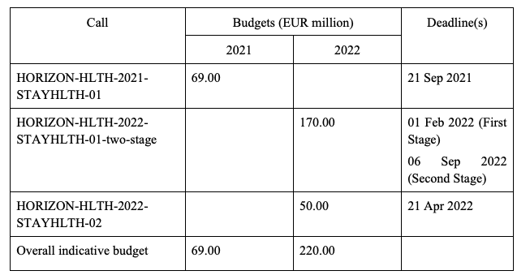
Calls for Destination 1: staying healthy in a rapidly changing society
HORIZON-HLTH-2021-STAYHLTH-01
Topics | Type of Action | Budget MEuro | Exp EU cont.per proj. | Exp.# projects | Topics | Deadline
HORIZON-HLTH-2021-STAYHLTH-01-02 | RIA | 60 | 10 | 6 | molecular and neurobiological understanding of mental health and mental illness | Sept 21, 2021
HORIZON-HLTH-2021-STAYHLTH-01-03 | CSA | 3 | 3 | 1 | Healthy Citizens 2.0 - Supporting digital empowerment and health literacy of citizens | Sept 21, 2021
HORIZON-HLTH-2021-STAYHLTH-01-04 | CSA | 3 | 3 | 1 | A roadmap for personalised prevention | Sept 21, 2021
HORIZON-HLTH-2021-STAYHLTH-01-05 | CSA | 3 | 3 | 1 | Mobilising a network of National Contact Points (NCPs) for the Health Cluster | Sept 21, 2021

Slide 8

Health related ESFRIs/ ERICs
Human Brain project
[..]
HERA incubator for COVID-19 variants: https://ec.europa.eu/info/news/eu-invest-eu150-million-research-counter-coronavirus-variants-2021-feb-17_en
€2.405 mio (for RI WP overall, includes GNx too…)
~ 2.4 Billion Euros: for whole Pillar 1 – budget here not only Health related

Slide 9

European Partnerships: Links to EPA information: https://bit.ly/pillar-2-epas
EU–Africa Global Health Partnership
European Partnership for Health Innovation
Assessment of Risk from Chemicals (PARC)
ERA for Health
Transforming health and care systems
Personalized medicine
European Partnership on Rare Diseases
One Health / Antimicrobial Resistance (AMR)

Slide 10
European Partnership Agreements within Horizon Europe – Pillar 2
8 EPAs within 40 European Partnerships dealing with eHealth
7962 Millions Euros for the eHealth cluster
https://ec.europa.eu/info/research-and-innovation/funding/funding-opportunities/funding-programmes-and-open-calls/horizon-europe/european-partnerships-horizon-europe/candidates-european-partnerships-health_en
They have an associated SRIA : Strategic Research and Innovation Agenda
Implications for us on what Health EPAs requirements will be on
  Hybrid data (public research + wider public + (private sources)) – relations with Health Data Space
  Trust & Identity & GDPR
  Data sovereignty due to Big Pharma involvement
EPA strategy currently under discussion in GPPC

Slide 11
Digital Europe Programme
The Digital Europe Programme (DIGITAL) is a new EU funding programme Digital Europe is a new programme of the European Commission focused on building the strategic digital capacities of the EU and on facilitating the wide deployment of digital technologies.
Focused on bringing digital technology to businesses, citizens and public administrations.
Planned overall budget of €8.2 billion, it will shape and support the digital transformation of Europe’s society and economy.
The programme will boost investments in supercomputing, artificial intelligence, cybersecurity, advanced digital skills, and ensuring a wide use of digital technologies across the economy and society, including through Digital Innovation Hubs

Slide 12
DEP: Digital Europe Programme
In the Communication “Enabling the Digital Transformation of Health and Care in the Digital Single Market”, the European Commission has identified three main priorities:
Enabling citizens to access and securely exchange their health data across the EU;
Advancing research, personalised medicine and disease prevention through shared European data infrastructure;
Promoting the use of digital tools to empower people to look after their health, stimulate prevention and enable feedback and interaction between users and healthcare providers.
Notes:
In the Communication “Enabling the Digital Transformation of Health and Care in the Digital Single Market”, the European Commission has identified three main priorities:
Enabling citizens to access and securely exchange their health data across the EU;
Advancing research, personalised medicine and disease prevention through shared European data infrastructure;
Promoting the use of digital tools to empower people to look after their health, stimulate prevention and enable feedback and interaction between users and healthcare providers.
DEP will support the implementation of these three priorities through a variety of actions:
It will contribute to the creation of the European Health Data Space, by creating a pan-European digital infrastructure facilitating access to cancer images, as well as to a multitude of genomic datasets across Europe for use by clinicians, researchers and innovators with the ultimate aim of more precise and faster clinical decision-making, diagnostics, treatments and predictive medicine that will benefit citizens, healthcare systems and economy.
DIGITAL will support the use and deployment of AI by creating large-scale Testing and Experimentation Facilities in Health to provide a real-world environment to test and validate state-of-the-art AI and robotics technologies in the healthcare domain.
Strengthening Cybersecurity in Health facilities across the EU and the use of HPC for Health will be supported by dedicated actions, as well as the creation of a sustainable ecosystem for Digital Twins in Health and the promotion of Digital Transformation of Health and Care.

Slide 13
DEP : The European Health Data Space
DEP will contribute to the creation of the European Health Data Space: for more precise and faster clinical decision-making, diagnostics, treatments and predictive medicine that will benefit citizens, healthcare systems and economy:
a pan-European digital infrastructure facilitating access to cancer images
access to a multitude of genomic datasets across Europe for use by clinicians, researchers and innovators
use and deployment of AI by creating large-scale Testing and Experimentation Facilities in Health
to provide a real-world environment to test and validate state-of-the-art AI and robotics technologies in the healthcare domain.
[..]

Slide 14
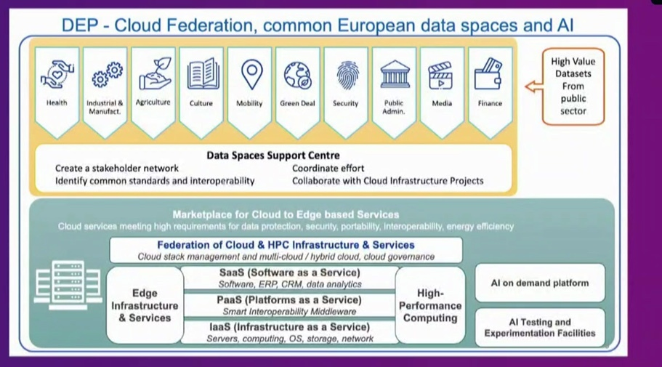
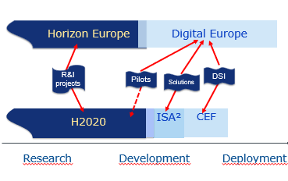
Digital Europe Programme – scale up and roll out of digital solutions
DEP Pillars:
High-performance Computing
Artificial Intelligence
Cybersecurity
Advanced digital skills
Deployment, best use of digital capacities and interoperability
€1 072 217 000
The Health Data Space financing has been moved from DEP to EU4Health.
CEF 2014 – 2020
Building blocks: EBSI, eID, eDelivery, eSignature
Digital Service Infrastructure: eHealth (Patient Summary , ePrescription (and eDispensation))
Notes:
6 Million Euros under DG-Connect
Research are related to EOSC
Data are mixed: Data Lakes and Interoperabiolity: drive the data to the EuroHPC
Will allow the different originated data, municipal and research and private companies, and research have. To be interconnected and all have. The right to go EuroHPC and this is financed. Through the Digital Europe Programme
2 major priorities for the data lakes: Health (Destination Health). and Climate/Oceans (Destination Earth)
Destination Earth and Destination Health are moving faster than the others.
GPPC currently using a. new methodology. To asses the status of advancement of these partnerships and work items: EU Readiness Level
DE has technical
DH : national sovreignity and sensitivity of data. Under the national sovreignity
COVID 19 is a good example of the need to move beyond the national scale” the national systems have to be easy. Interoperable

Slide 15
EU4Health Programme
EU4Health programme for a healthier and safer Union EU4Health is an ambitious and dedicated funding programme for 2021-2027 that will ensure a high level of human health protection and pave the way to the Health Union.
EU4Health will invest €5.3 billion with the following main objectives:
  Improve and foster health in the Union:
  Strengthening the capability of the Union for prevention, preparedness and response to cross-border health threats
  Supporting actions complementing national stockpiling on essential crisis relevant products
  Training a reserve of medical, healthcare and support staff Improve and foster health in the Union
  Protect people in the Union from serious cross-border threats to health
  [..]

Slide 16
EU4Health: Health branch on DEP spawned as a specific, independent Programme.
Specific objectives – Art. 4
f) strengthening the use and re-use of health data for the provision of healthcare and for research and innovation, promoting the uptake of digital tools and services, as well as the digital transformation of healthcare systems, including by supporting the creation of a European health data space;
Artificial programme. It basically takes on the health related aspects of the DEP programme. However, DEP is still relevant.
€2 446 000 000 in current prices + 2 900 000 000 in 2018 prices : more than 5 Billion Euros
It just published
https://ec.europa.eu/health/sites/default/files/funding/docs/wp2021_annex_en.pdf
Overview of budget for COVID-related calls
Notes:
DEP decides the Data Lakes,
EU4HEalth has its independent budget. Protected budget for Health: 5+ Billions Euros.
EU4Health : ruoles and calls are totally similar to the Digital Europe Programme

