Slide 1

Training and engagement 2022
Dr Sara King, Training and Engagement Lead
1 February 2022
Notes:
Hi, I’m Sara King and I’m the Training and Engagement Lead at AARNet, Australia’s Academic Research Network. As the network provider for Australia’s universities and research institutions, AARNet’s aim is to support all researchers to maximise their use of the available technologies and the supporting network capabilities. Training is one of the ways we currently do this.

Slide 2


Network
CloudStor & SWAN
Big data transfers
Cyber security
Research collaborations
© AARNet Pty Ltd | 2
Notes:
A little bit about AARNet:
AARNet’s national network spans the continent with geographically diverse Network Access Point sites in all Australian capital cities. The network also delivers substantial capacity to rural, regional and remote locations.
We provide CloudStor, which is AARNet's file sync, share and storage service. SWAN is the ‘Service for Web-based Analysis’, which is a Jupyter notebooks hosting site.
AARNet enables researchers to access data at extremely high speed to accommodate big data transfers.
We offer cyber security services to provide Australian universities with all the capabilities they need to manage cyber security incidents.
Our network supports cross-institutional research collaborations, virtual labs, imaging, sequencing, and the transport and storage of huge datasets.

Slide 3
Workshops
CloudStor Clinic
Support materials
Demonstrations
SWAN online forum
© AARNet Pty Ltd | 3
Notes:
Our training is focused on demonstrating the services we provide, such as CloudStor and SWAN, understanding networks and data movement. We see this as a kind of ‘infrastructure literacy’, a term that encompasses the practical knowledge needed to transfer, store and manage research data (of any size) in complex scenarios.
Recently AARNet expanded from face-to-face workshops to a multi-modal suite of options designed to meet current needs and expectations. In addition to more traditional in-person training sessions we are building on the following:
Online workshops
CloudStor Clinics
Webinars and researcher demos
YouTube ‘How-to’ instructional videos
Live and recorded demonstrations
Knowledge Base improvement
SWAN online forum

Slide 4
Train-the-trainer workshops
Empowering users
Who are the workshops for?
These workshops are targeted to research support staff in a train-the-trainer style so participants such as librarians, eResearch analysts or faculty research support staff can reuse the content to train researchers.
Workshop topics
Introduction to Jupyter Notebooks
Network Know-how & Data Handling
Active Data Management with CloudStor
More information and bookings: news.aarnet.edu.au/aarnet-train-the-trainer-workshops/
Notes:
The workshops are open and free to all AARNet member universities. They are approximately 3 hours duration and are delivered by me online via Zoom or in-person in accordance with COVID-19 restrictions (currently limited to South Australia). The duration can be altered to meet the local needs of the group.

Slide 5
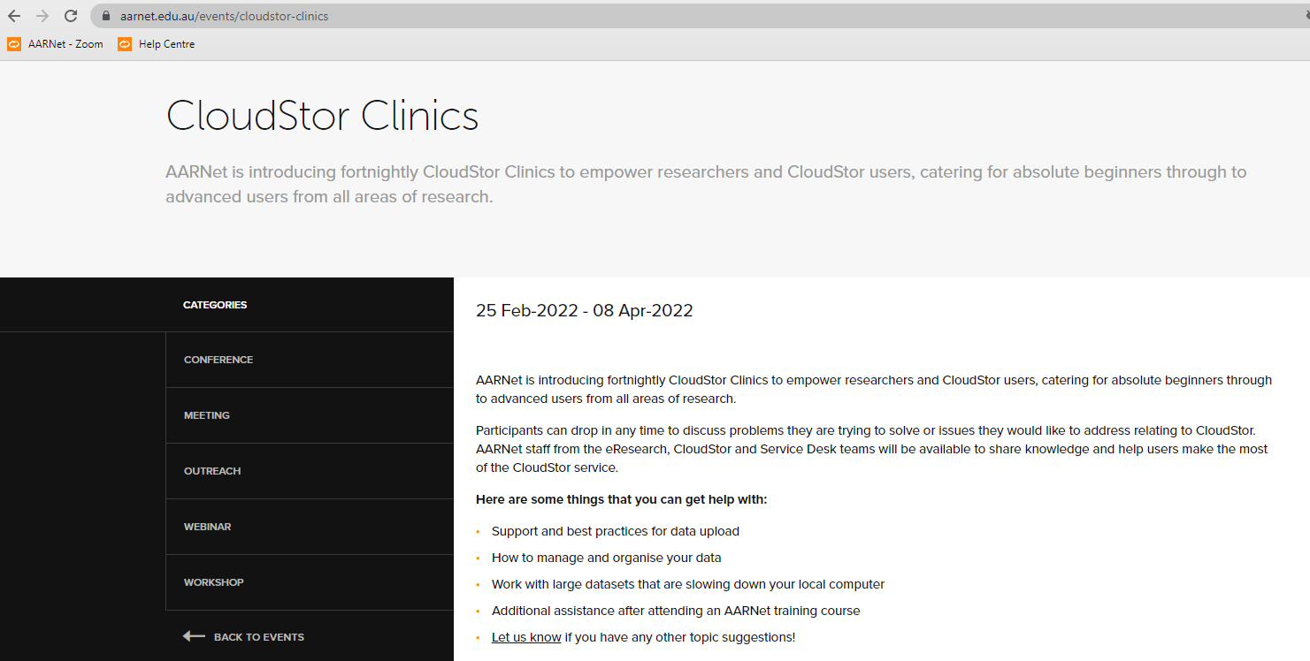
CloudStor Clinics
Fortnightly drop-in sessions
Notes:
AARNet has introduced fortnightly CloudStor Clinics to empower the research support community, researchers and CloudStor users, catering for absolute beginners through to advanced users from all areas of research.
Participants can drop in any time to discuss problems they are trying to solve or issues they would like to address relating to CloudStor. AARNet staff from the eResearch, CloudStor and Service Desk teams are available to share knowledge and help users make the most of the CloudStor service.

Slide 6
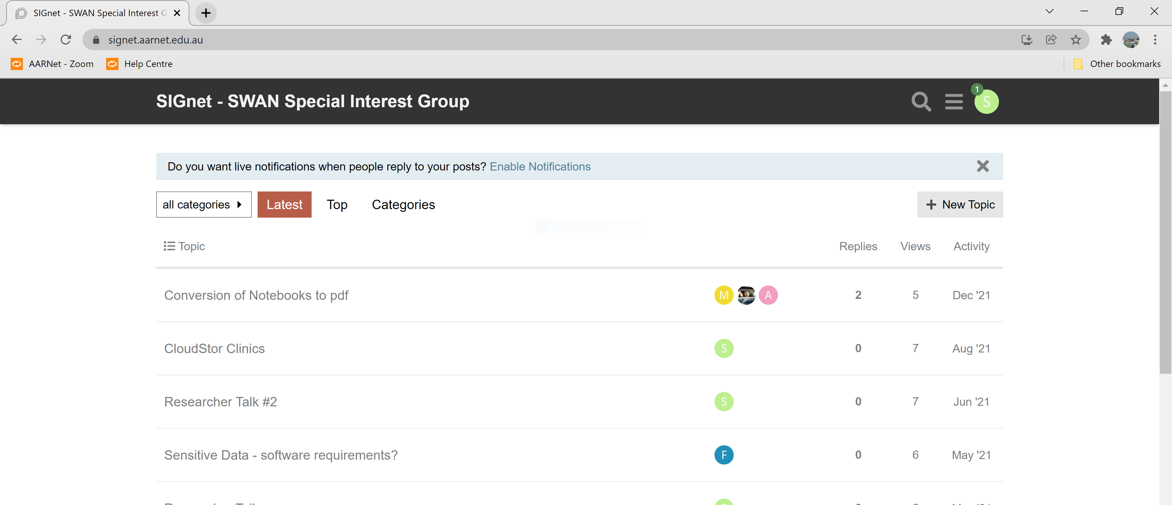
SWAN forum
SIGnet – the SWAN Special Interest Group
Notes:
The purpose of SIGnet - short for the ‘SWAN Special Interest Group Network (also the word for a baby swan) - is for researchers to help each other use SWAN efficiently to accelerate quality research in Australia. SIGnet aims to address the need for building knowledge and expertise in handling research data using Jupyter Notebooks. On the forum you’ll find answers to frequently asked questions about SWAN and a community of users to collaborate with to solve shared or unique data handling problems.

Slide 7
Plans for 2022
Suggestions welcome!
Researcher demos – live and recorded
Conversion of workshop materials to ARDC workshop template
Inclusion of workshop materials to OER Commons; DReSA
Redevelopment of CloudStor Knowledge Base
Sample workflows, self-guided tutorials and instructional videos
Stay in touch:
AARNet News news.aarnet.edu.au/subscribe/
Twitter @AARNet
YouTube @AARNEtvideo
LinkedIn linkedin.com/company/aarnet
Notes:
For 2022 we have a great line up of different activities and approaches to our training and engagement for the research support community and researchers.
Researcher demos – live and recorded
Publication and sharing of workshop materials as open access resources, sharing in the OER Commons; and Australia’s local digital skills training portal DReSA
Redevelopment of CloudStor Knowledge Base
Sample workflows, self-guided tutorials and instructional videos
You can stay in touch with us via the various social media channels shown here or contact me directly.

Slide 8

Thank you
sara.king@aarnet.edu.au
Notes:
Here’s my email address and thank you very much for your time.

