Slide 1
CSC Training and Events (and more)
SIG MSP and SIG MARCOMMS joint meeting
21st March, 2022
Tiina Leiponen, CSC Training
Harri Kuusisto, Funet

Slide 2



CSC customer training and events in figures
participants
7253
courses and events in total
121
Webinars 72 ( zoom)
training days
234
average score
8,73
NPS>80

Slide 3
Comparative view of 3-year stats
8,7

Slide 4
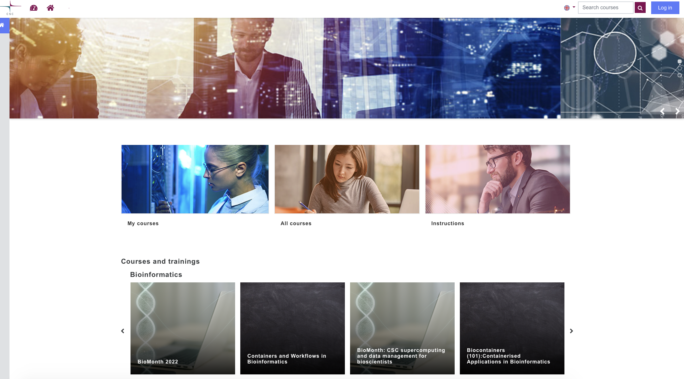
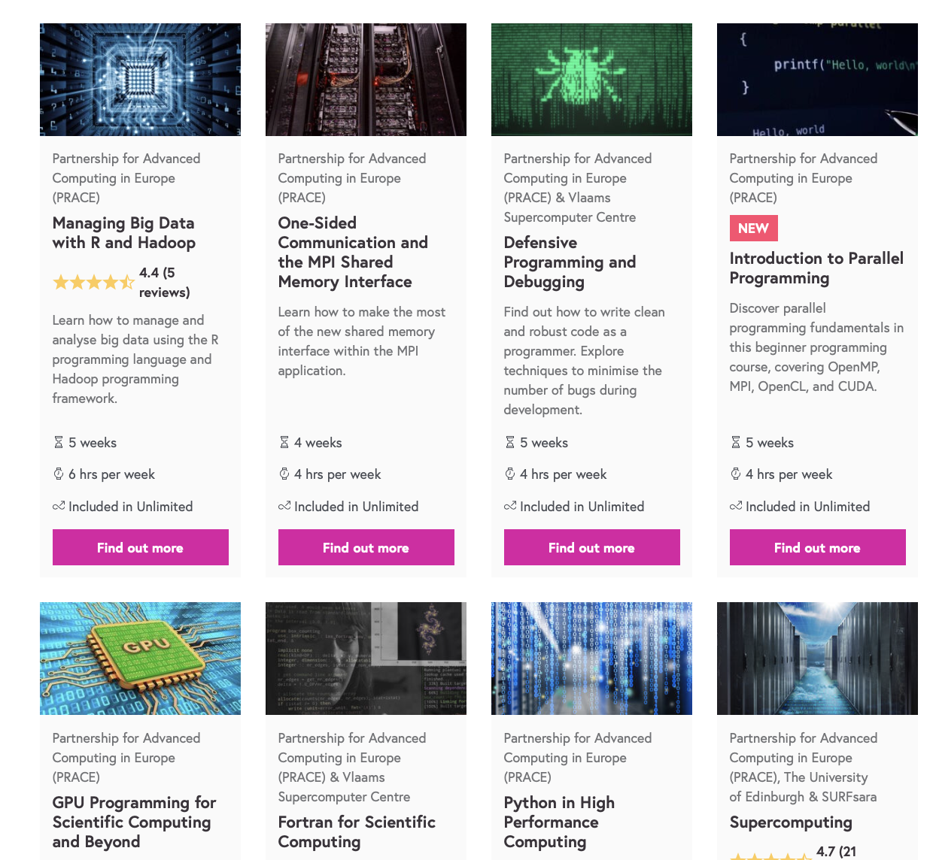

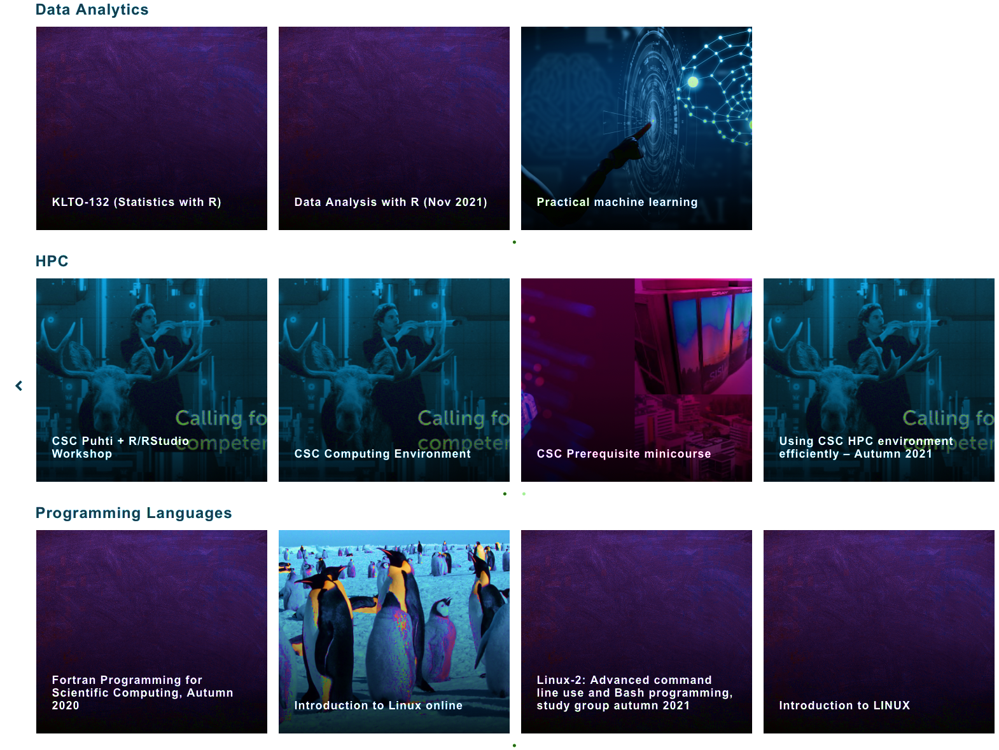
CSC e-learning experiences and highlights
At summer 2019 CSC opened own Moodle LMS based e-learning
system called e-Lena with Haka-federated login https://e-learn.csc.fi
2019 September → 2022 : Total 57 e-learning online courses
  HPC, Data analytics, Bio Science tool training
  (CSC, LUMI, EuroCC, PRACE, ELIXIR)
  Internal training: induction, management, HR, IT security, communication etc.
  Registration AAI via Haka federation (HEI), VIRTU (Gov.), ELIXIR
PRACE MOOCs: 9
  CSC is one of the 14 PRACE Training Centres (PTC) since 2012 with total 200+ training days
Kajaani UAS &CSC collaboration: New Elements of Supercomputing course in English and Finnish https://edukamu.fi/elements-of supercomputing

Slide 5
NEW hybrid models and collaboration possibilities ->(2022)
Keywords and hot topics: Hybrid courses, events, streaming, recording, editing, marketing, learning, event platforms, integration to zoom, training event data analysis
PRACE HPC course transfer pilot done 2021 between GÉANT GLAD and CSC Moodle
Aiming to
  increase understanding and ability to exchange and share materials/courses/services with collaboration partners and university users/customers
  Ability to share also training materials produced in collaboration
Develop Services training via AV-products
  use of shared learning platforms/trainers/training for trainers/presenters/open learning materials (CSC, PRACE, EuroCC, GÉANT, universities)
  Better customer experience by simplifying/unifying the website jungle, portals

Slide 6
Funet services in product life cycle stages
Haka
federated ID
This slide is from Sep 2019 (SIG MSP & MARCOMM joint meeting)
Certificate
eduroam
VOLUME
Lightpaths
Zoom
Campus Network
as a service
Router as
a service
Secondary
connections.
Tiimi
Adobe
Connect
Extra
connections
Campus Network
ftp.funet.fi
Eduuni
Filesender
Zoom
eduroam
proxy
Video
Panopto
*aaS
Etuubi
Kaltura
Stream
*aaS
LMS
eduVPN
LMS
Video
Panopto
eduVPN
Backup
INTRODUCTION
GROWTH
MATURITY
DECLINE ?
MCU
TIME

Slide 7

Training/marketing/communication needs vs. service product life cycle stages
VOLUME (Usage/Euros/”Importance”)
Introduction…
Testing…
Piloting…
Marketing…
How to…
Problems…
Needs to fulfill..
Development…
Advanced...
Experienced…
Users know how to…
Sharing practices…
What next…
Need access to…
Old but used data…
Expectations…
=> Publishing NREN Service reports is marketing.
=> NREN tech people talking to university tech people is marketing.
INTRODUCTION
GROWTH
MATURITY
DECLINE
TIME

Slide 8
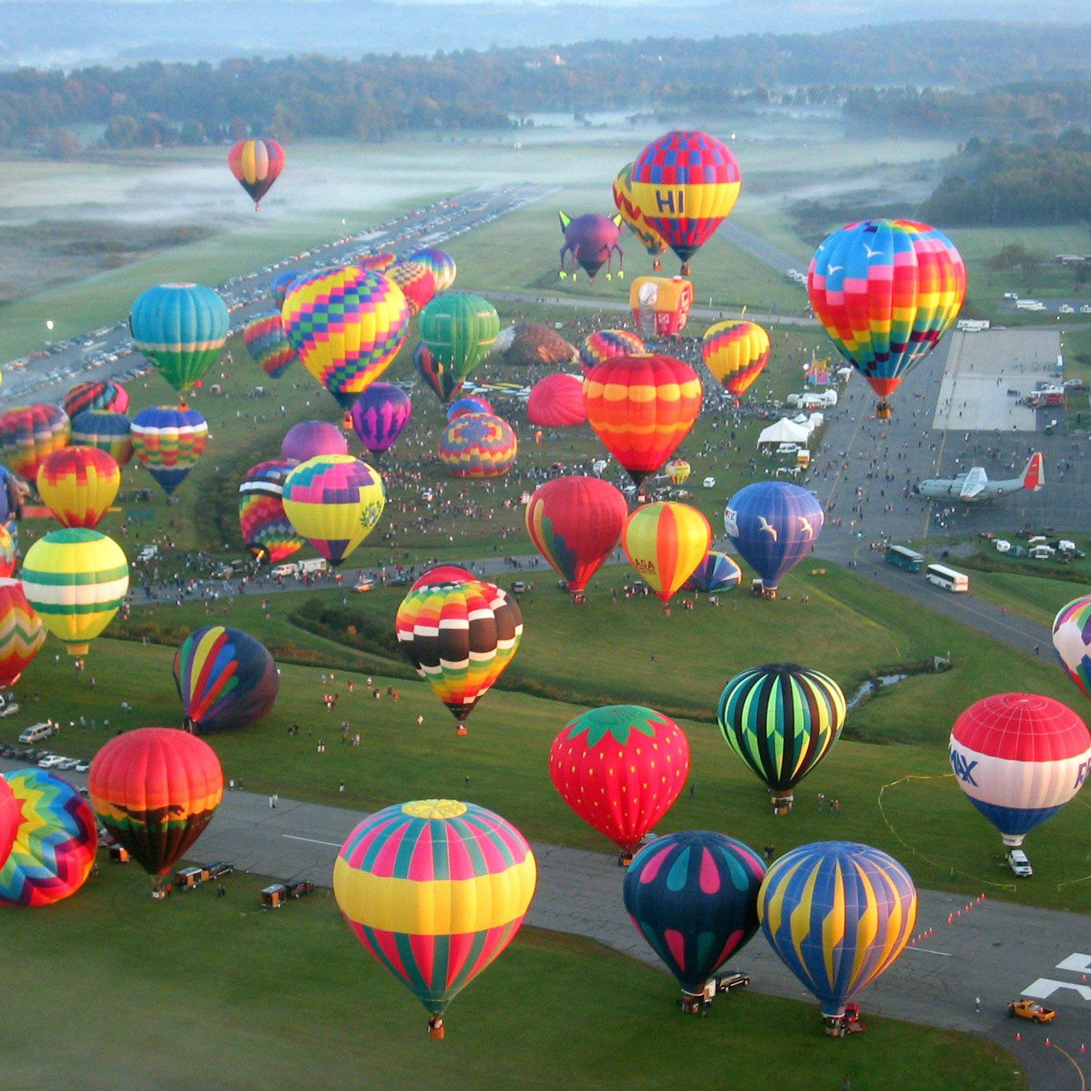
THANKS!
FOR MORE INFORMATION ON CSC TRAINING AND EVENTS :
Tiina . Leiponen @ csc . fi
customer experience and training manager
FOR MORE INFORMATION ON FUNET NREN (Finnish national research and education network) OPERATED BY CSC:
Harri . Kuusisto @ csc . fi
Funet development manager

