Slide 1
Training experience and challenges at ARNES
Tomi Dolenc, ARNES
SIG-Marcomms & SIG-MSP 2022 Spring Meeting, 21-Mar-2022

Slide 2
“Offering training is a way that some NRENs make themselves known to new audiences, raise awareness of what an NREN is, or increase visibility of the NREN brand. Training can also support products that are offered and expand the uptake of service offerings. But training is also a product or service in its own right, needing a place in the NREN strategy? and in the marketing communications support activities.”
Notes:
I realized, reading this intro in the agenda, thet I can relate to everything written here, although it would be an overstatement to call it a strategy; but the path to this understanding was anything but straightforward, and I’d like to talk about that.

Slide 3
The value of trainings was long neglected
Healthy assumptions: how to serve users
  Support & knowledge transfer – Yes
  Helpdesk, consultation – friendly, extensive
  Teach them to fish (limited scale)
Trainings out of consideration
  No resources (no people)
“Presenting the service” = “PR”
  “our Service is the best”
  ... and if you don't understand it or can't use it right,
  it's b'cos you're lazy or incompetent
To teach »stupid users« the usefulness of the Service requires insight, skills and patience
Notes:
From the very beginning – and I believe it was the same with many NRENs – we have praised ourselves for being very helpful to our community; we were ready to share our knowledge, and would sometimes spend unproportional time explaining the technology to our clients or partners, teaching them to fish for themselves; but it was not training. You might sometimes call it 1:1 training, but it doesn’t scale very well; We did presentations of our services, but regared them more as “promotion”; you now,... Ont he other hand,

Slide 4
Trainings in the community or through projects
90‘s – „Computer Literacy“ (for schools)
Basic internet services
Use in education
Basic security
2008-2013 – “e-education”
Advanced users – “trainers” – visiting schools
Hands-on workshops (evangelists of services)
Other interest groups
Libraries
Museums
Universities
Sleeping beauties
Missed opportunity?
Arnes contributed its expertise
lectures & workshops
“Train the trainers”
... every project has its end.
Notes:
Meanwhile, the trainings sprouted in the community of users, sometimes encouraged by project funding from the Ministry and led by National Institute for Education
These people were like evangelists of our services, We were thankful for that
but
We did not have people to run around schools and do workshops/lectures, but we could train the trainers, so they would invite us to their events.
Universities – nothing in the system that would encourage trainings; lower agility. But, as it turned out 20 years later, very much the same needs...

Slide 5

MOOC on “Safer internet use”
started as a guerilla pet project
WHY? TO COPE WITH DEMAND
Derived from “Safer Internet” workshop for schools
BASICS OF INTERNET SAFETY
Basic security, privacy, digital and media literacy (content and source evaluation), online fraud, phishing, bullying...
FOLLOWS DIGCOMP
Methodology help from didactics experts; OpenBadges
TARGET: SCHOOLS
Twice per year, since 2014
Updating the content, following trends
Adult audience (teachers).They keep coming back.
Adaptation for children to use in classrooms.
Notes:
Arnes has long been a partner in national Safer Internet Centre, and we would give lectures & workshops to very different target groups.
The guy who started it – some colleagues from Marcomms will remember Domen – basically asked permission to do it in his overtime or even free time.
Very popular, strong visibility
We have learned a lot.

Slide 6


A stroke of luck (2018-2020)
(2013-2015: project “E-schoolbag”)
NIE developed interactive textbooks. ARNES developed some services; + hands-on workshops
SIO-2020: A task to build infrastructure
Wireless networks @schools. Eduroam.
... but some € for E-services&E-content
What e-content can we deliver, of use to teachers?
MOOC from workshops
To put our services to some good use. We had learned from E-education experience

Slide 7
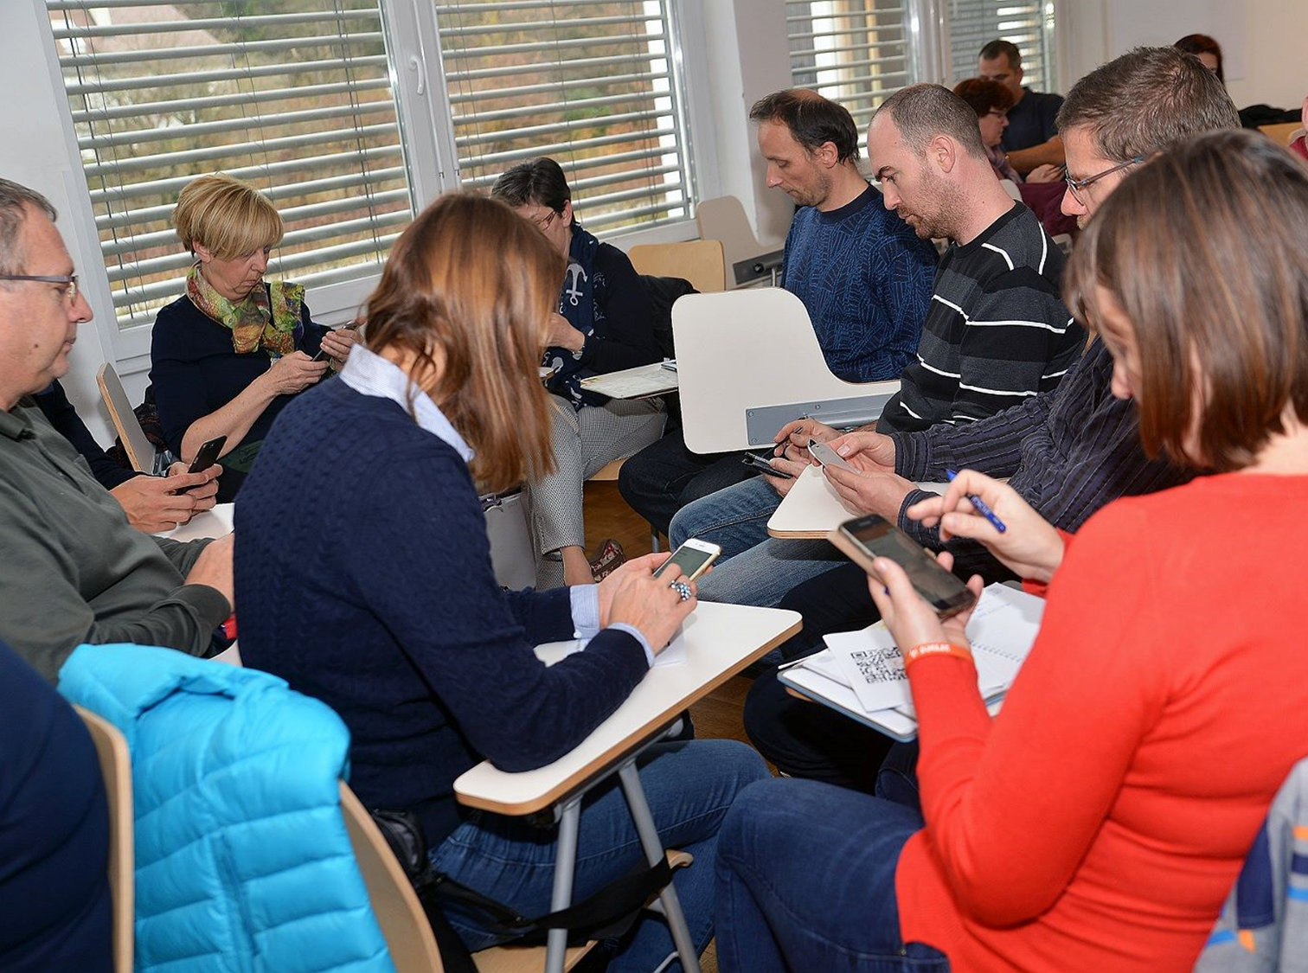
Pandemic & distant education:
Trainings absolute game-changer!
LIVE WORKSHOPS AT SCHOOLS
Up to 35 per day, full staff
>500 over the summer 2020 (>700 in 6 months)
MOOCs
900 teachers in a single Moodle course
Key services, new functionalities
WEBINARS
Practical advice by teachers; >66.000 views
SPECIFIC ISSUES
Intellectual property rights online
Notes:
Sure, rebuilding our services so they could take the demand was in focus
But the problem out there was that masses of people with very low experience in using these services were suddenly totally dependent on them!
Everybody wanted to use “virtual classrooms”, to learn about videoconferencing, Moodle, publishing to the school website...
And that’s where the lucky project really showed its value

Slide 8

A stroke of reality (2021)
Despite high popularity and demand...
MoE encourages us to continue good work...
... all trainings were cancelled
... but failing to secure the funding, they urge us to reduce support for schools.
Competence conflict
Who should carry out trainings for teachers?
WE HAVE LOST COMPETITIVE ADVANTAGE
Meanwhile, Microsoft
2022: A New Hope
Prospects for funding & projects
Notes:
All of what I’ve just described took place in 2020 (first year of pandemic). Slovenia entered 2021 with all schools closed, and demand for support & trainings was high; and the Ministry was happy too, because they could show some good work. For all that, we were convinced there would be no problem finding some unimpressive sum (order of magnitude 100.000€) to continue what we were doing. Well...
Microsoft!

Slide 9


And now for something completely different:
Competence building for HPC
EARLY YEARS: GRASSROOT COMMUNITY
Scientists + IT enthuziasts (Grid/HPC)
ARNES invited to join in
Own cluster, building & sharing knowledge
NATIONAL NETWORK - SLING
Workshops, exchange of good practice
NATIONAL COMPETENCE CENTRE
Central point of contact for HPC
Collect HPC training offers
WE’D LIKE TO OFFER MORE!
High demand from the community
Looking for personnel...
Notes:
We are looking for engineers who would have the desire and skills/talent to transfer their knowledge to others

Slide 10

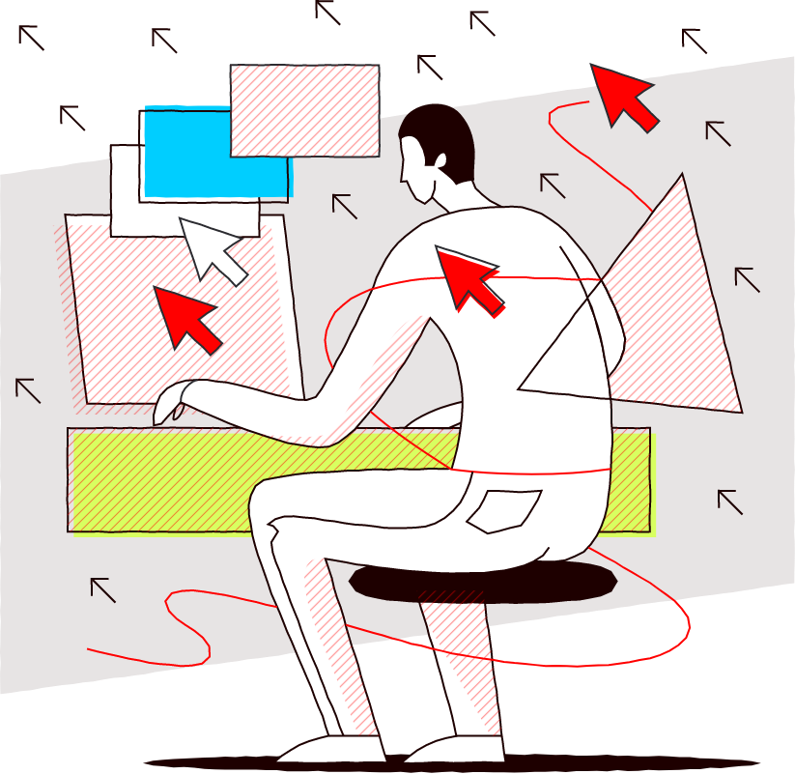
“Safe in your office”
Short online course
Part of the infosec awareness activity by SI-CERT
Increase of incidents/risk
Popular demand
MOOC for better reach
Adapted to different roles within organisation
Notes:
Separate funding

Slide 11
Today, we* believe that training is an essential part of service uptake & support, and should evolve in parallel with the service, providing a constant feedback loop in both directions.
Strategy? We are slow learners. But now at least we’re hiring.
Projects?
Notes:
Microsoft

Slide 12
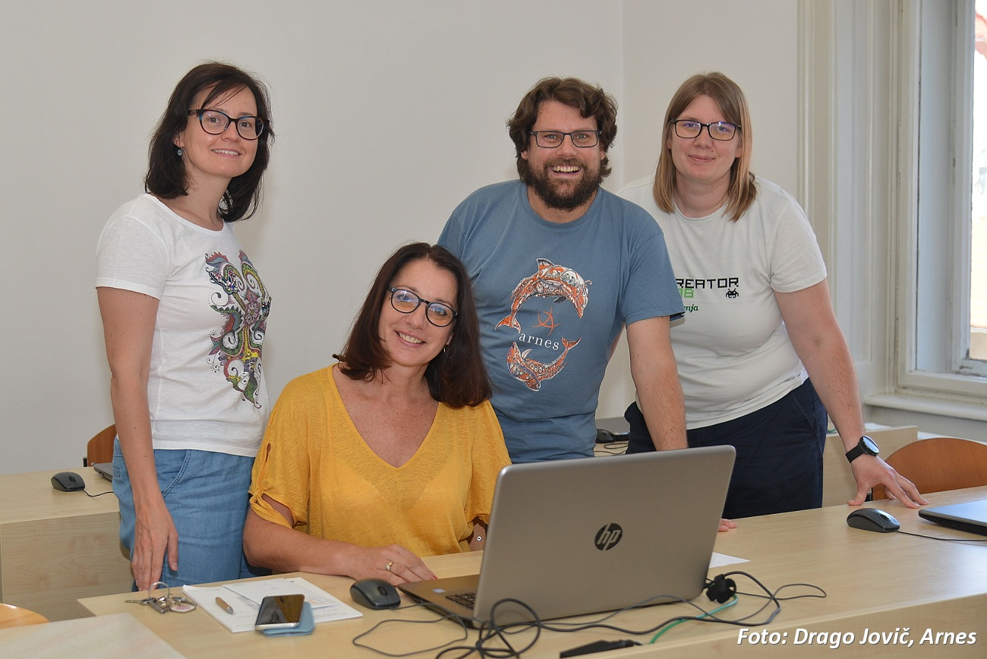
Engage the community!
Evangelists of good practice
ACTIVE USERS
with abilities to develop good practice and transfer knowledge through peer exchange
BETTER SUITED TO USER’S NEEDS
Good accumulation of feedback
ENCOURAGE COLLABORATION
We are in a good position to act as a cohesive element
Notes:
Why are they smiling? They like us and we are paying them for their effort

Slide 13
But you will also need your own team and support throughout.
Notes:
To do it properly, you need the whole team – managers through engineers to the educators. We don’t have enough educators! We‘re hiring some right now.

