Slide 1
TNC22 Update
What, where, how, when, who
Rosanna Norman
Sig-Marcomms online
22 March 2022

Slide 2



Where and When

Slide 3
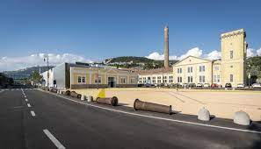
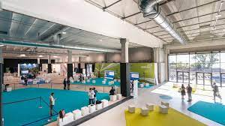
Location
TCC. Trieste Convention Center

Slide 4


Branding

Slide 5

Deadlines
25 April 2022

Slide 6
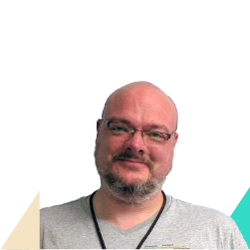
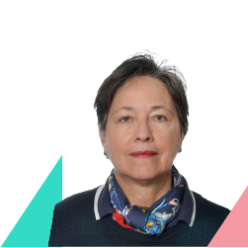
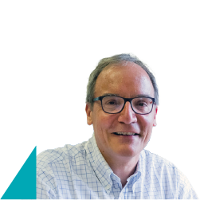
Keynote Speakers
Filippo Giorgi Italy
Monique Morrow USA
Niall Murphy Ireland

Slide 7
Programme
Monday, 13 June
Side Meetings
Tuesday, 14 June
Opening Plenary - Lightning Talks (plenary) - Parallel sessions
Wednesday, 15 June
Parallel sessions – Plenary – Lightning Talks (plenary) – Parallel sessions
Thursday, 16 June
Parallel sessions - Closing Plenary - BoFs
Friday, 17 June
Side Meetings

Slide 8
Social Events Programme
Monday, 13 June
Opening reception
Kick Off Party
Wednesday, 15 June
Conference Dinner

Slide 9

Top Tip
If you are coming to TNC22
book your hotel ASAP!

Slide 10
Contacts
www.tnc22.geant.org
tnc@geant.org

Slide 11
rosanna.norman@geant.org

