Slide 1
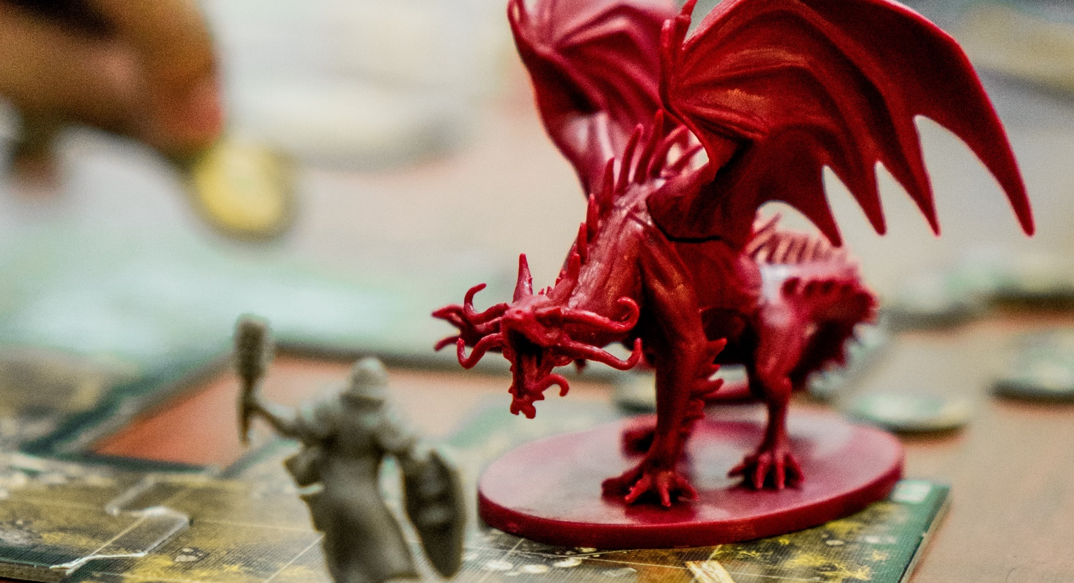
Update Claw and CM readiness report
Charlie van Genuchten, SURF

Slide 2

CLAW2021

Slide 3
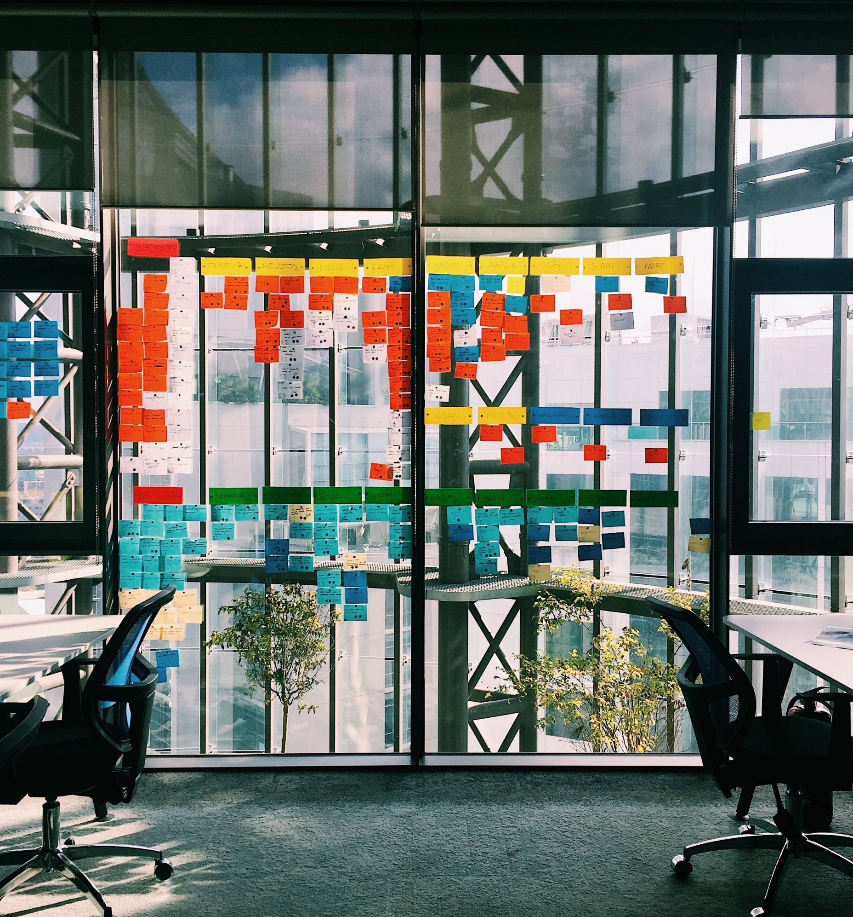
Themes
Crisis Communication
Prioritization (Technical Workshop)
Stress Management

Slide 4
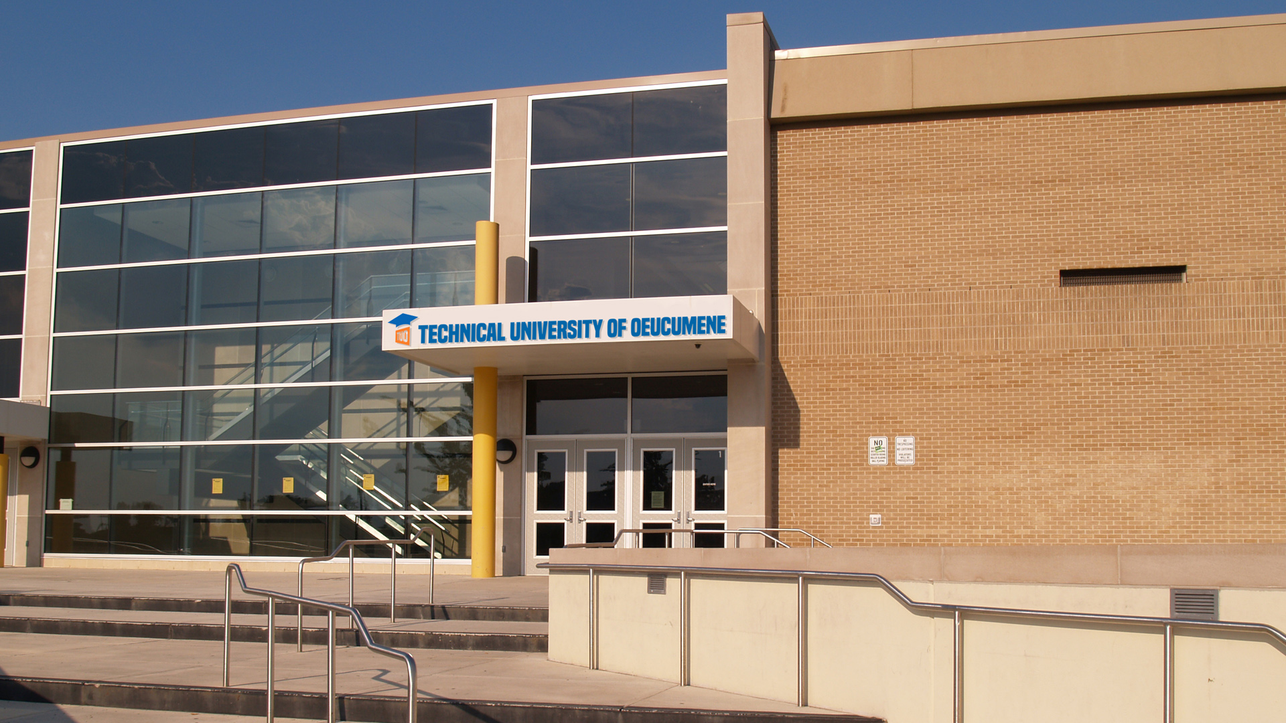

Slide 5
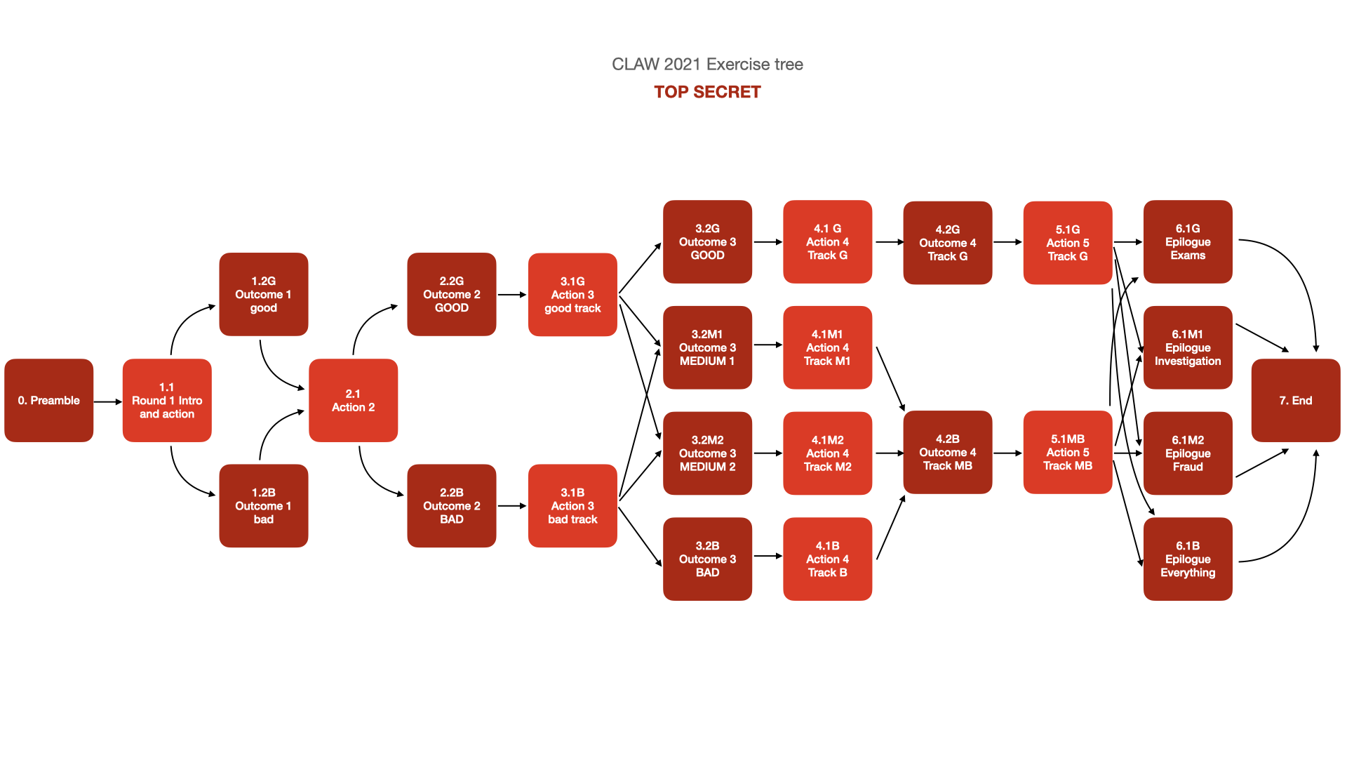

Slide 6
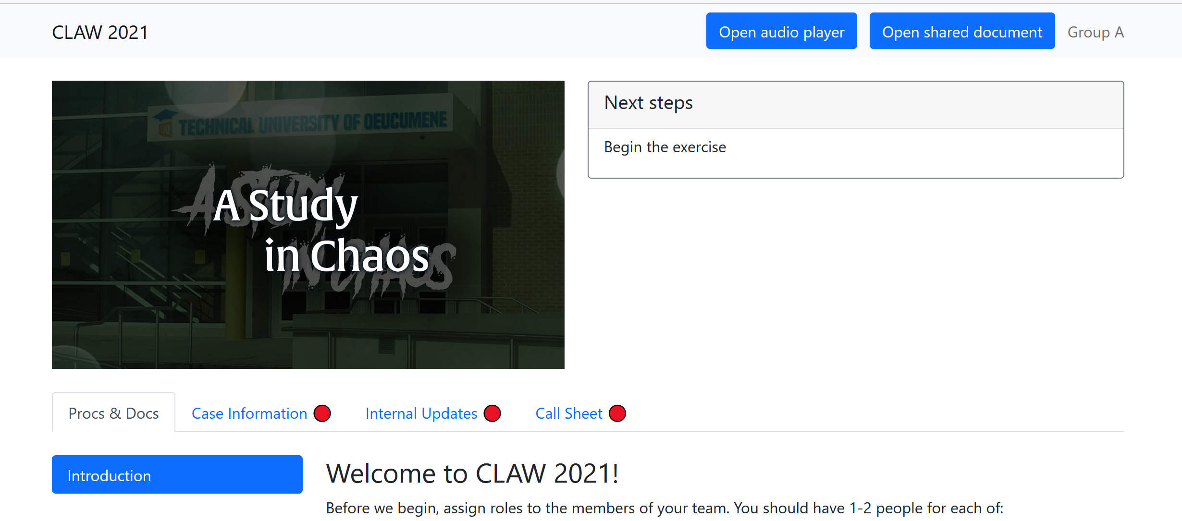
Info Tool

Slide 7

Crisis Management Readiness Report
Goal: survey + interview 20 NRENs
Talked to:
  CARNET
  DFN
  FCCN
  GRNET
  RESTENA
  SUNET
  Harno
  RedIRIS

Slide 8
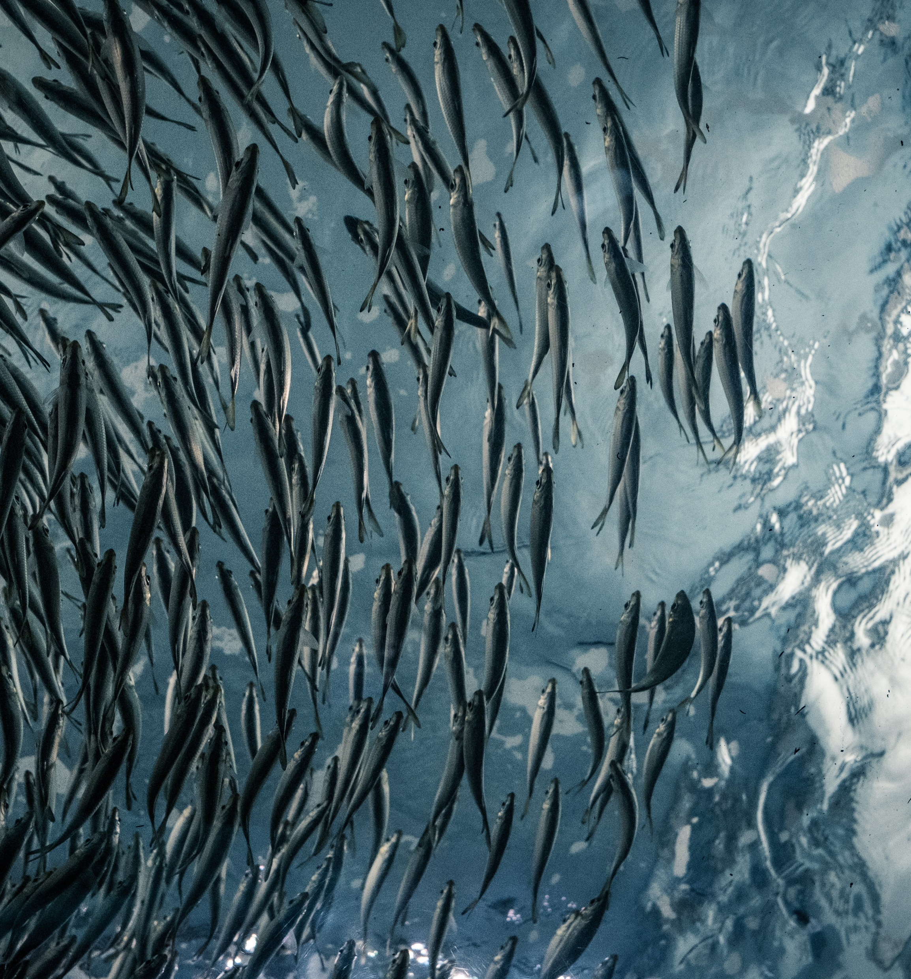
Preliminary Results
Most NRENs have some form of CM plan
A lot of the plans on paper driven by ISO27001
  Most of the time only for parts of the organization
Smaller NRENs seem to have the advantage
Crisis exercises for the own organization still rare

Slide 9
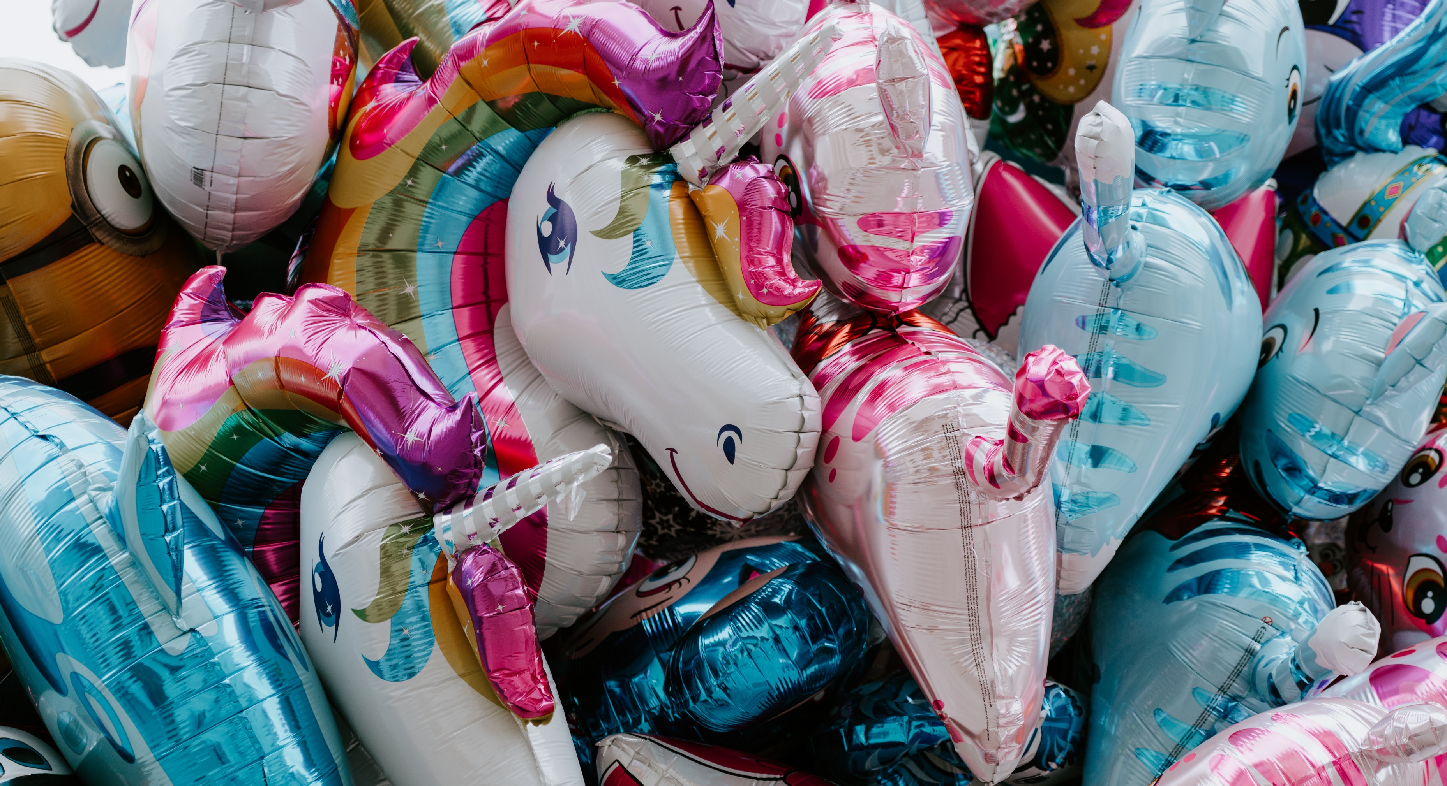
Still looking for more NRENs to interview!

Slide 10
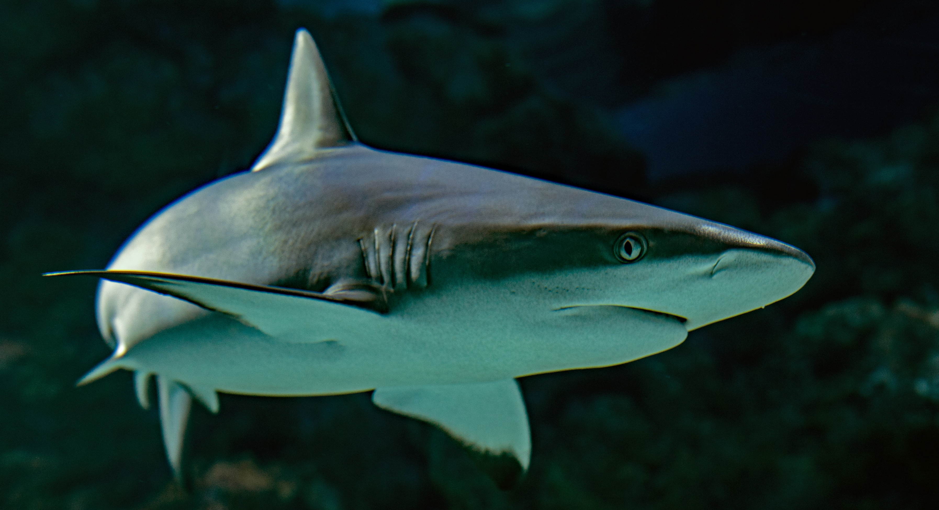
Get in touch for CM readiness report
And/Or see you at CLAW2022
Charlie van Genuchten
Charlie.vangenuchten@surf.nl
www.surf.nl

