Slide 1



GÉANT Educational Activities and Services
Gyöngyi Horváth, GÉANT
GÉANT General Assembly
24 November 2020
© GÉANT Association
As part of the GÉANT 2020 Framework Partnership Agreement (FPA), the project receives funding from the European Union's Horizon 2020 research and innovation programme under Grant Agreement No. 856726 (GN4-3).

Slide 2
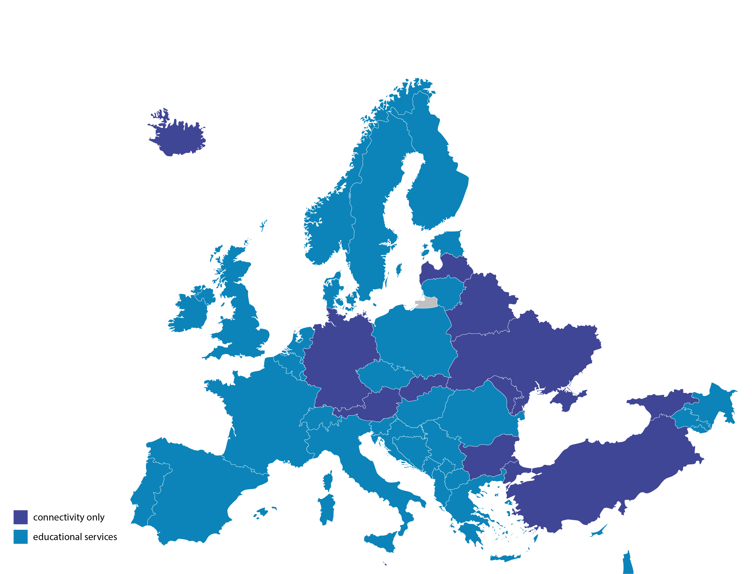
GÉANT NRENs educational services
Notes:
Connectivity: 43 NRENs
Additional edu services: 31
Only connectivity: 12

Slide 3
Strategic positioning for GÉANT regarding Education
Focus ∙ Innovate · Evolve
Facilitate the GÉANT community and represent it in international organisations
Making tools available for the GÉANT community
Operating tools and services for the GÉANT community
GÉANT’s role in Student mobility
Data stewardship

Slide 4
Questions to the GA:
Is this the right direction for GÉANT?
What are your priorities regarding this?
Is there anything else to add to the list?
Go to: www.menti.com and use code: 78 12 29 7

Slide 5
Objective
GÉANT’s position towards the “E”
Setting the course – how ambitious do you want GÉANT to be?

Slide 6
Current landscape
What are the challenges and opportunities
NRENs educational services
Trends & opportunities
COVID-19
Impact
GÉANT edu portfolio
Strategic direction

Slide 7
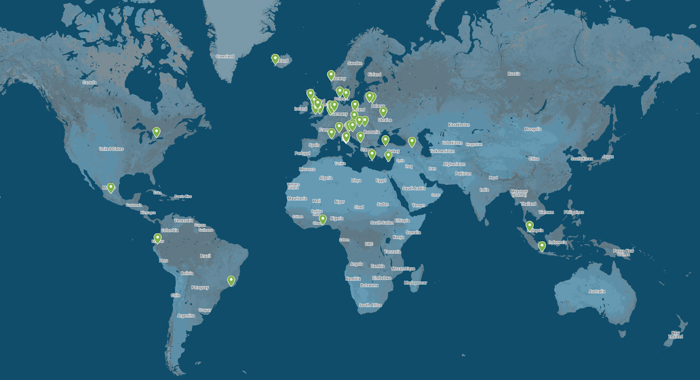
Facilitate the GÉANT community and represent it in international organisations
TF-EDU
Case for NRENs

Slide 8



GÉANT making tools available for the GÉANT community
Coordinate development
Joint procurement
TRUST
IDENTITY
ACCESS

Slide 9


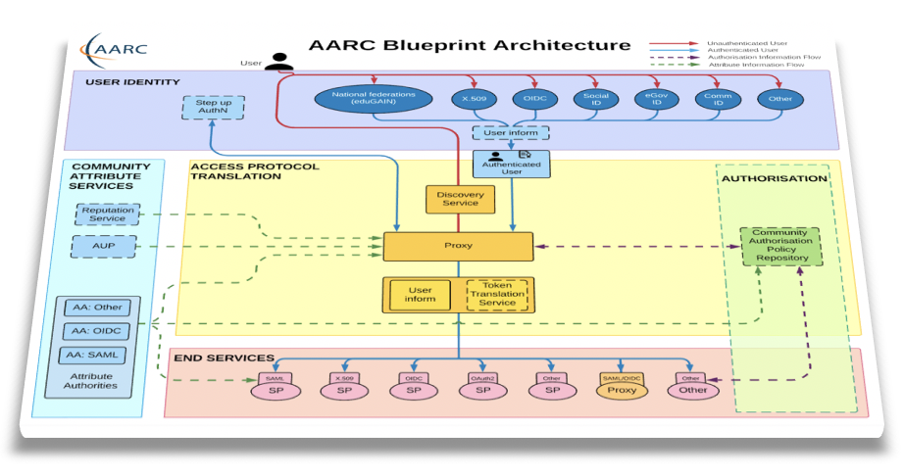



GÉANT operates tools and services for the GÉANT community
EduTEAMs
Up2U
Supporting virtual teams and sharing resources
Offering a validation service based on “studentness”

Slide 10





GÉANT’s role in Student mobility
EduID
Interoperability for European Student card
Microcredentialling
eduroam
Widening scope with OpenRoaming

Slide 11
Data stewardship
Interoperability
eduOER
European Education data lake

Slide 12
Questions to the GA:
How do you see the role of GÉANT in creating tools for the Education communities?
What direction should GÉANT take towards education related tools operation and services?
What should the role of GÉANT be in Student mobility?
How do you see the role of NRENs and GÉANT related to data stewardship?
Are there other areas that NRENs want GÉANT to focus on?

Slide 13
Thank you
gyongyi.horvath@geant.org
© GÉANT Association
As part of the GÉANT 2020 Framework Partnership Agreement (FPA), the project receives funding from the European Union's Horizon 2020 research and innovation programme under Grant Agreement No. 856726 (GN4-3).

