Slide 1
Feelings Matter:
An Evolution of CANARIE’s Brand & Messaging
Ela Yazdani | Senior Director, Communications
June 17, 2022
TNC22 | Trieste, Italy

Slide 2
People may not remember what you say, but they’ll remember how you make them feel.

Slide 3
A simple concept, but…then comes the practice.
What do they care about?
What’s the minimum amount of information they need?
How will they feel after this encounter?

Slide 4

Why?

Slide 5
To better connect with our community,
by aligning with our core values.

Slide 6
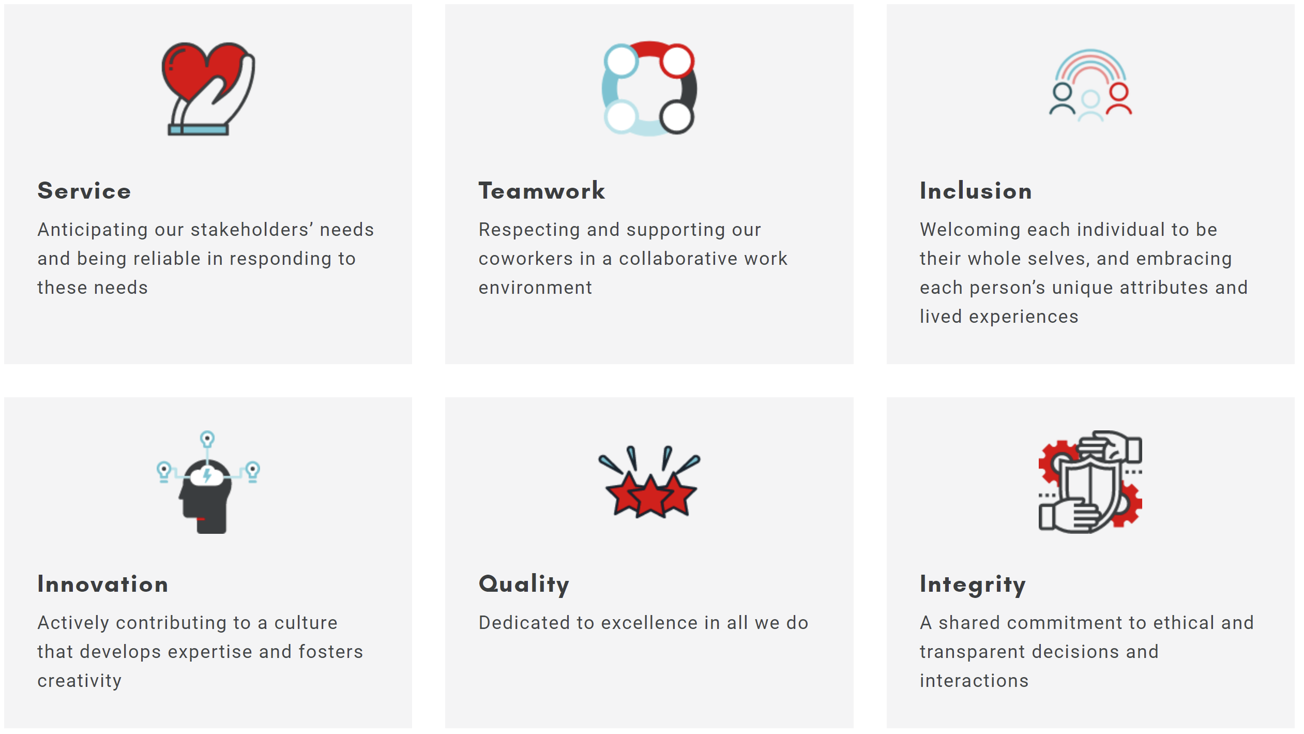
Notes:
Service: We serve our community by making it easy for them to work with us and to WANT to work with us.
Teamwork: When all our departments communicate in a consistent style, it’s easier for us to collaborate on documents and messages.
Inclusion: By using a simpler writing style, we make it easier for more types of people to connect with our message.
Innovation: We use current best practices and styles and evolve with the times. We continue to innovate our style as we learn together.
Quality: We know it might seem nitpicky, but when our written communications are clear, correct, and accurate, it reflects on the quality of everything we do.
Integrity: By expressing ourselves truthfully and in simple terms, we convey that we are trustworthy to the people we serve

Slide 7
Step 1:
SIMPLIFY

Slide 8
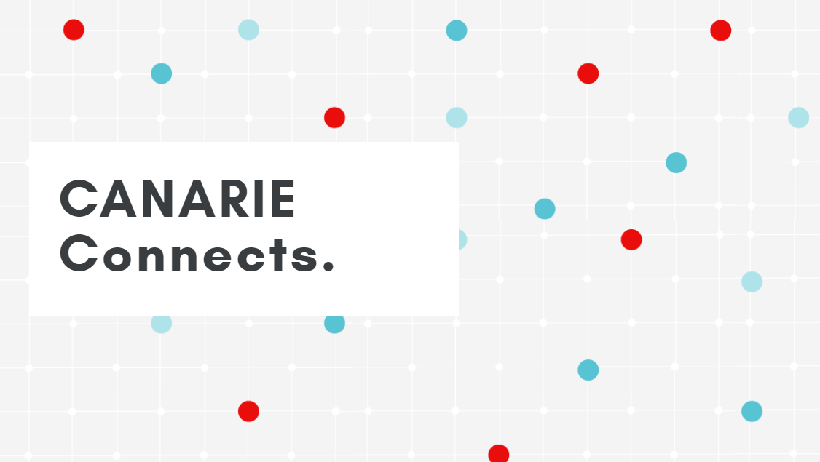

Slide 9

Before and After

Slide 10
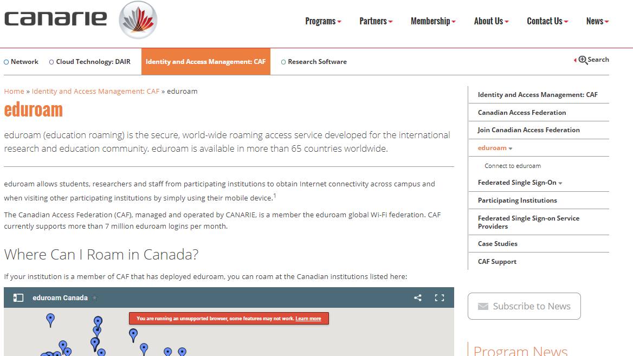
eduroam
2019

Slide 11
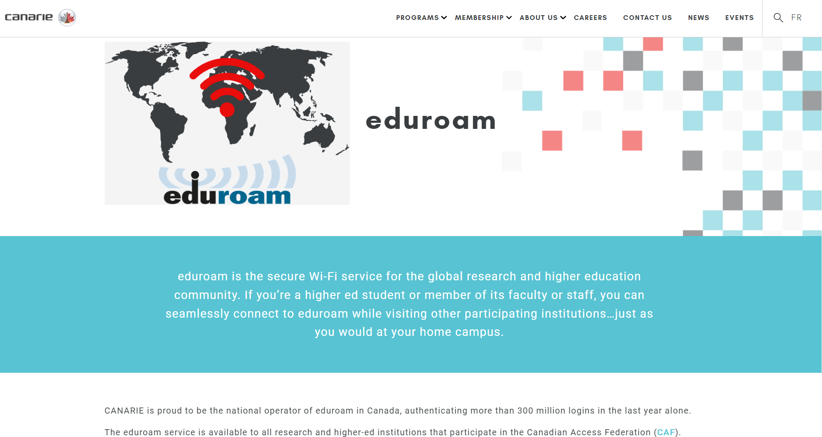
eduroam
2020

Slide 12
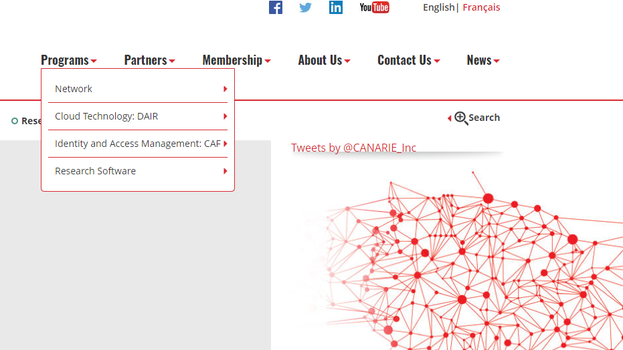
Menus
2019

Slide 13
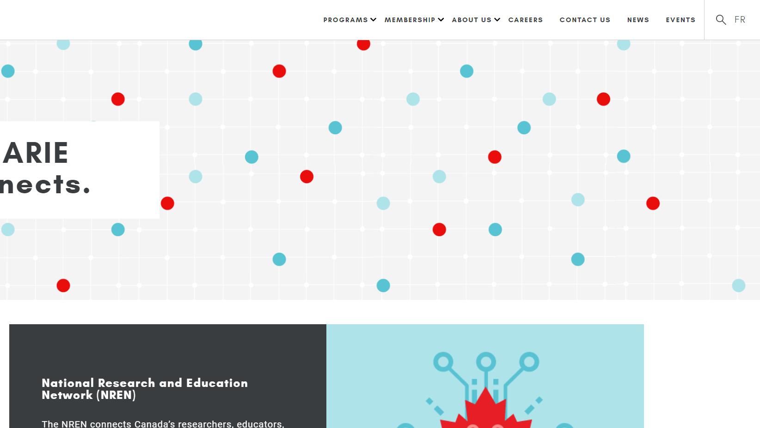
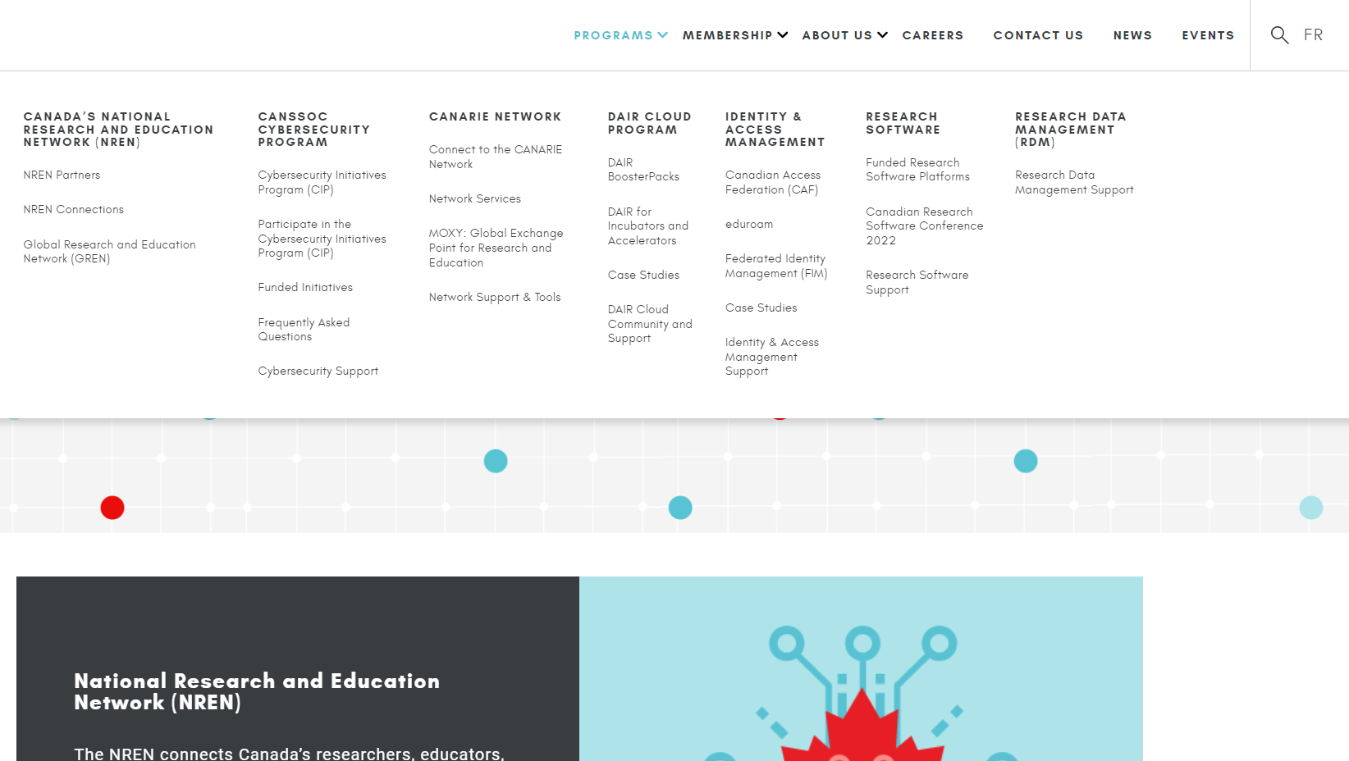
Menus
2020

Slide 14
Step 2:
Promote it to our whole team

Slide 15

Writing Style
Conveys our personality, our character, our culture
Reflects the importance we’re placing on the reader
Most importantly, it reinforces our core values in everything we say.

Slide 17
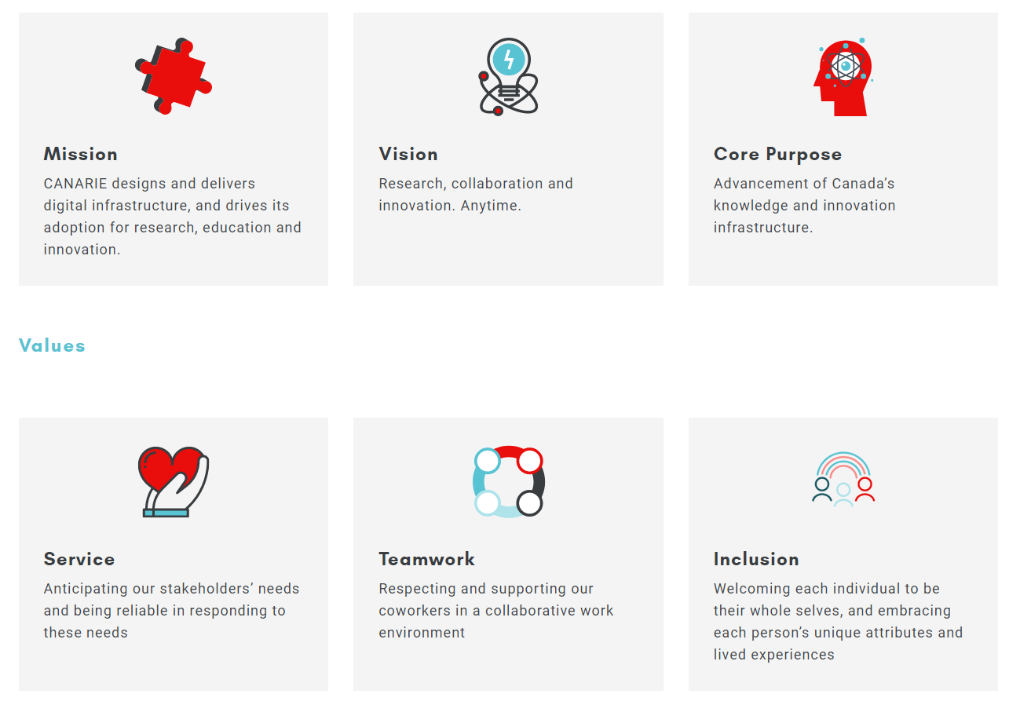
Make it easy and fast to find content

Slide 18
Write in plain, inclusive language

Slide 19
Feelings matter

Slide 20
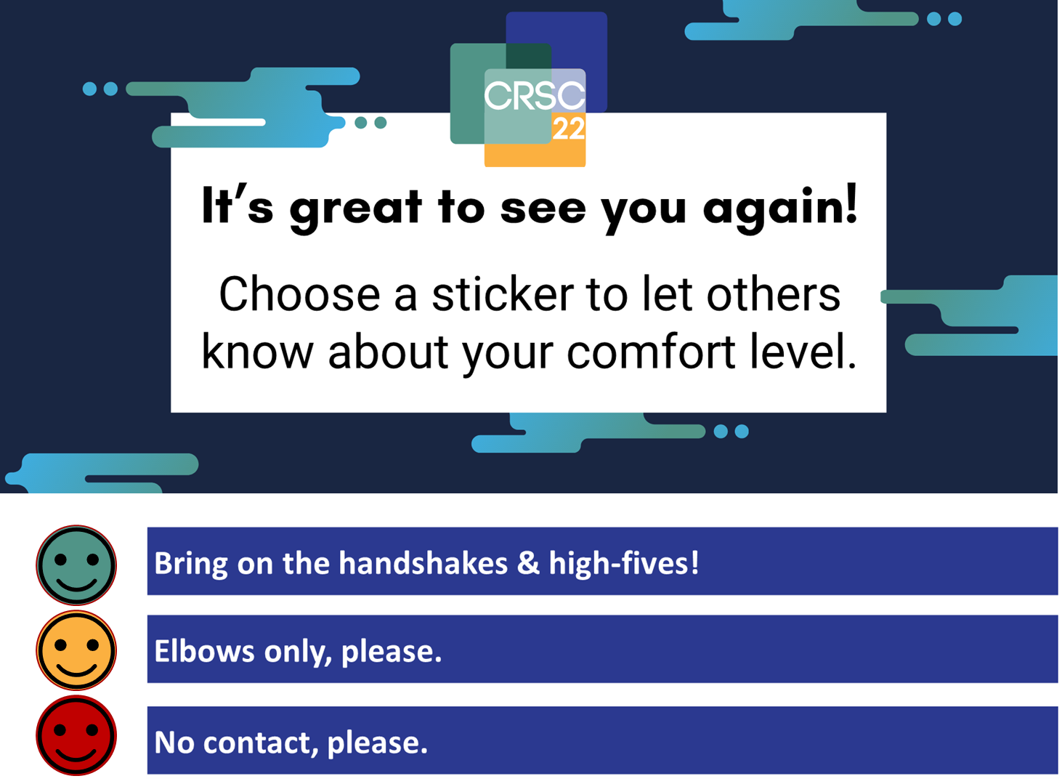
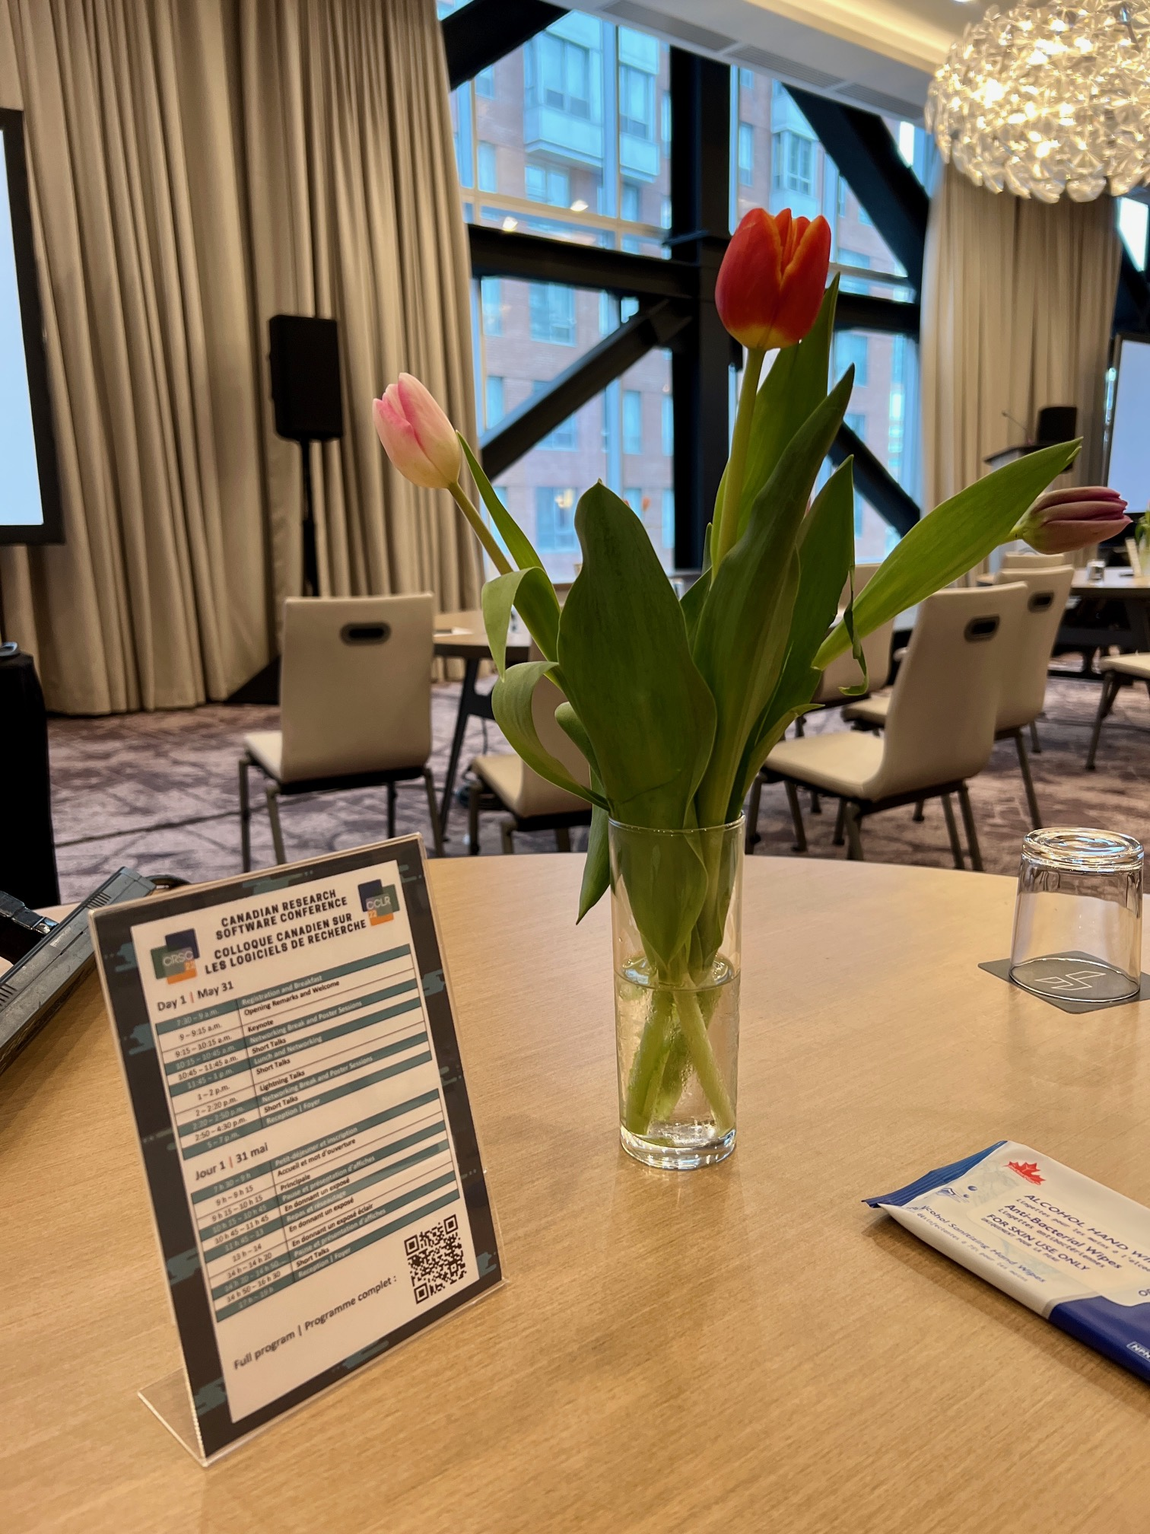

Most recently…

Slide 21
Lessons Learned:
It takes time.
It takes the whole village.
Over time, it becomes part of the culture.
Notes:
Change takes time
It needs everyone Marketing/Comms.

Slide 23
ela.yazdani@canarie.ca

