Slide 1

eduroam.ie redesign & promotion
Barbara Carroll 17/06/2022

Slide 2


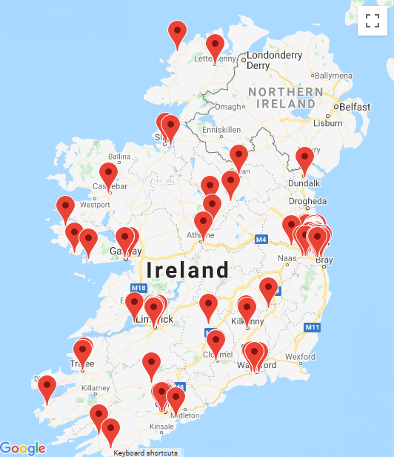
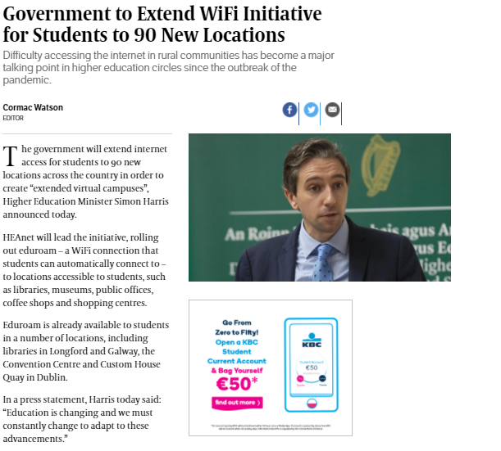
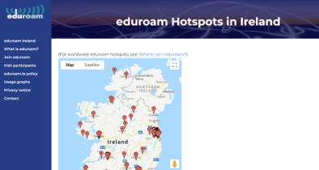
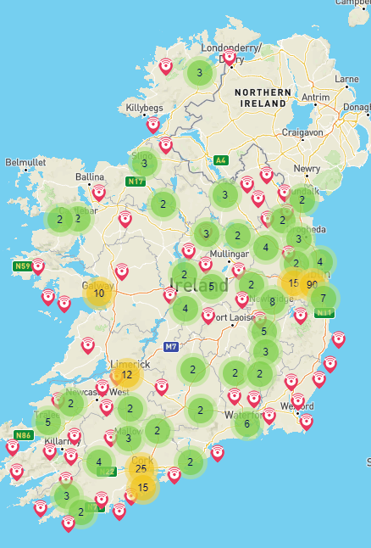
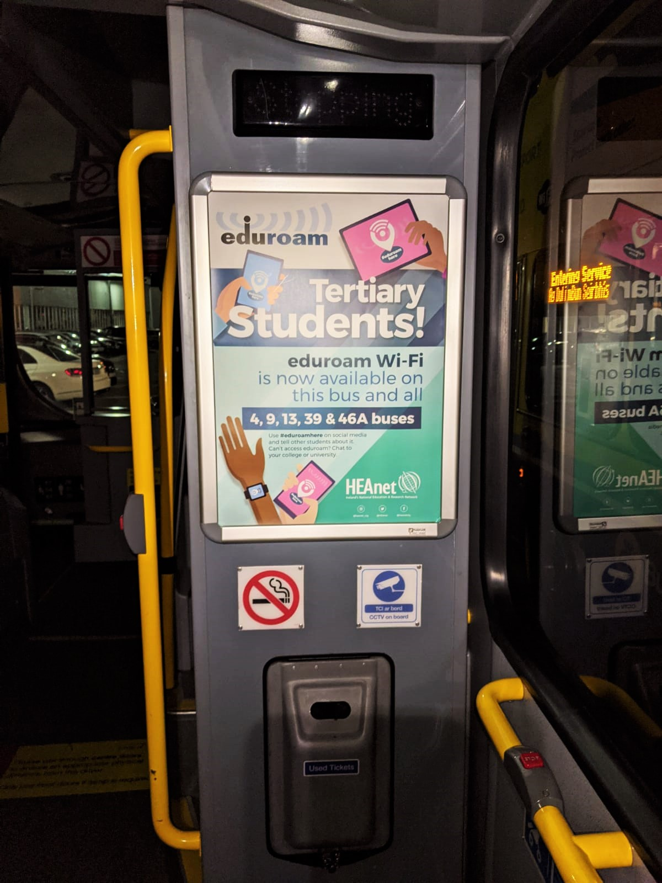

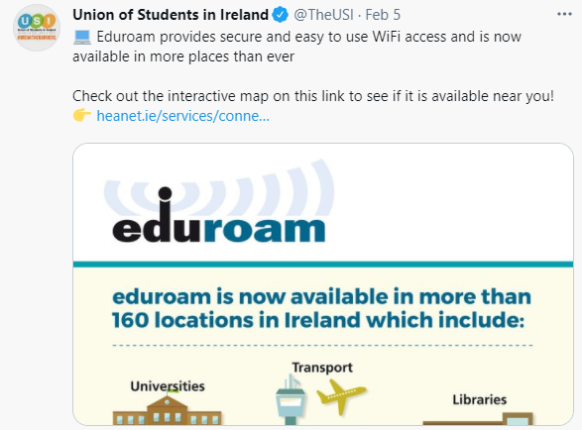
Why eduroam.ie redesign?
3. Raising awareness
User experience
Here is a screengrab from our old website:
2. eduroam Everywhere expansion in Ireland
Among students and potential new Service Providers
2020
2022

Slide 3
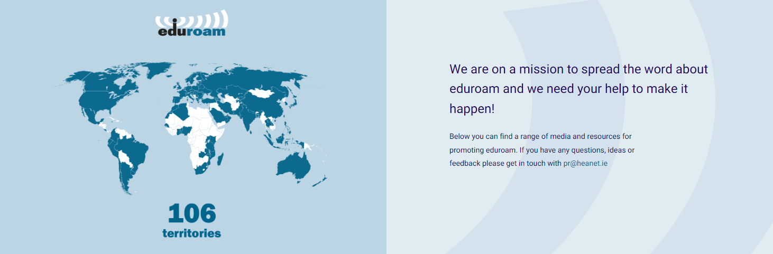
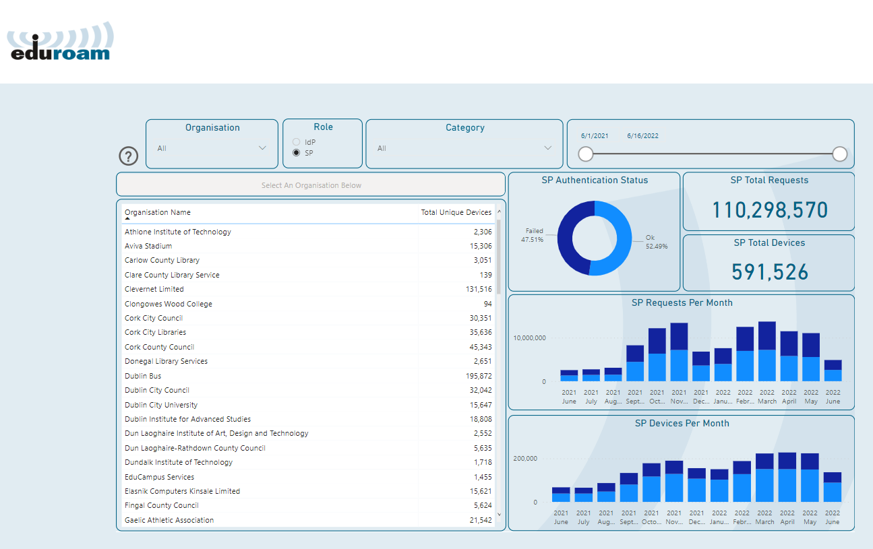
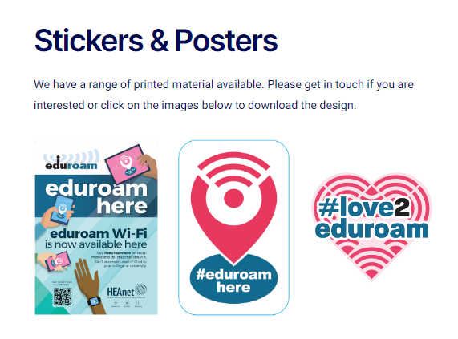
A few highlights
Hotspots map
2. Usage graphs
3. Media and resources
www.eduroam.ie/graphs
Thank you Karl and other GÉANT colleagues

Slide 4
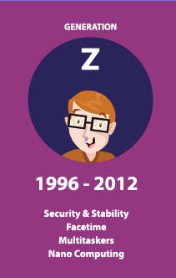
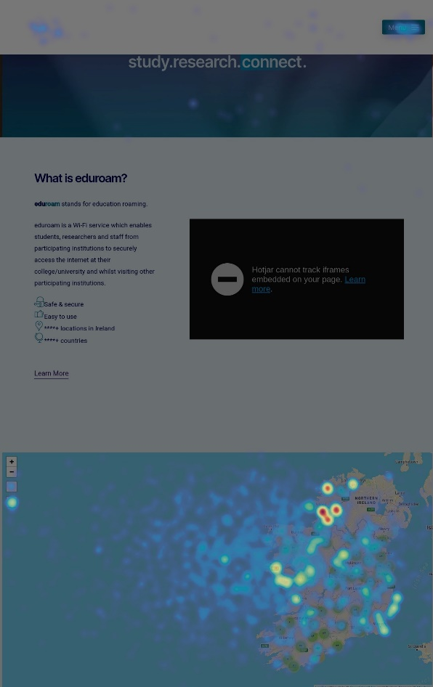
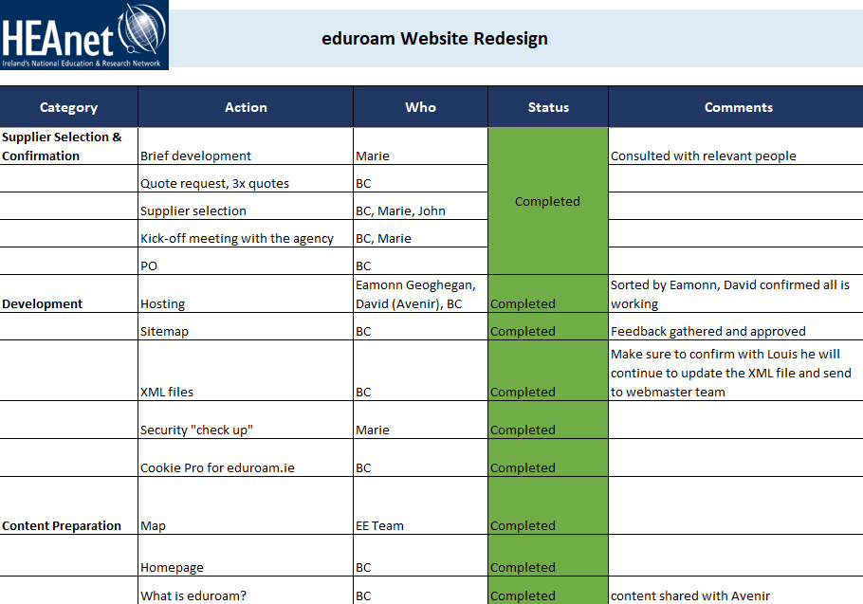

Big Learnings
Ensure marketing is driving the website re-development
Project management skills are a must-have
Agile web development
Unexpected delays may happen

Slide 5






eduroam.ie Promotional Campaign
Start: 21st October 2021
Finish: 30th November 2021
Attract
VIDEO
Encourage Conversation
SPONSORED POSTS
Engage
COMPETITION

Slide 6
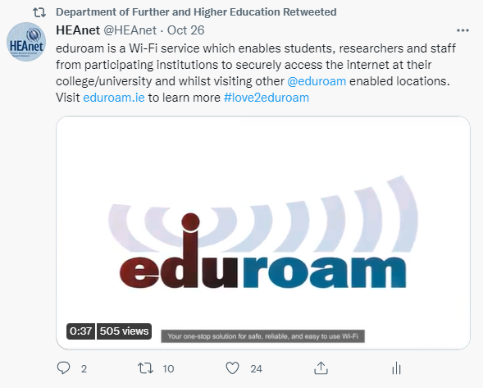
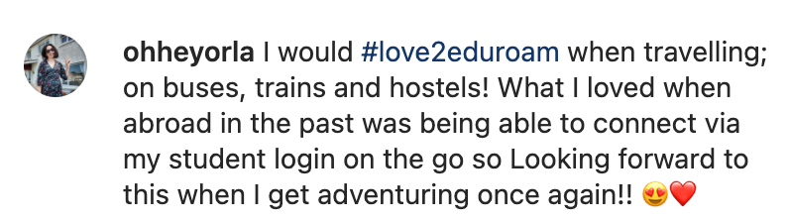
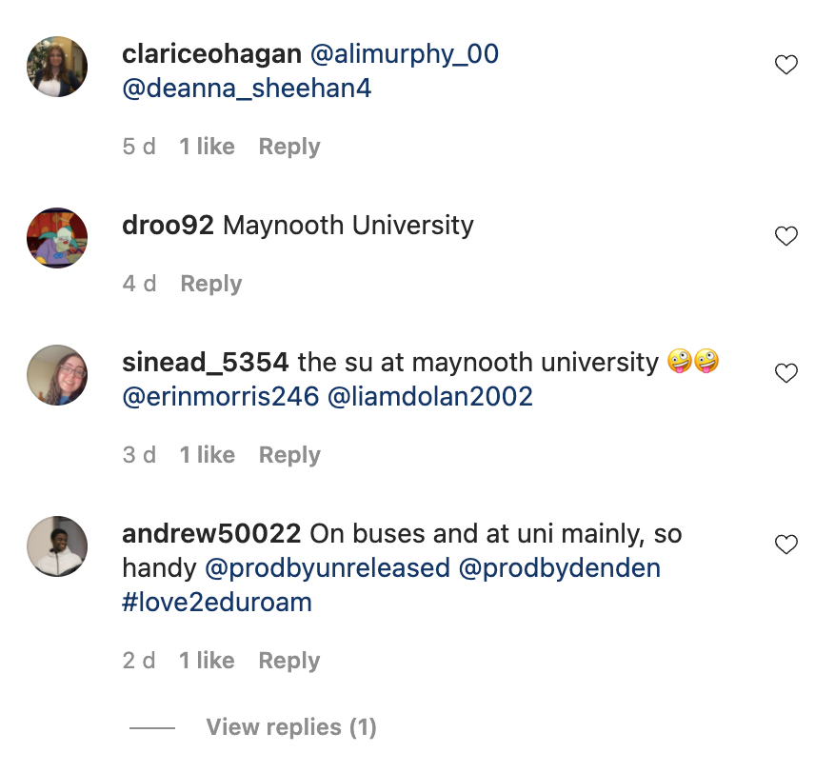
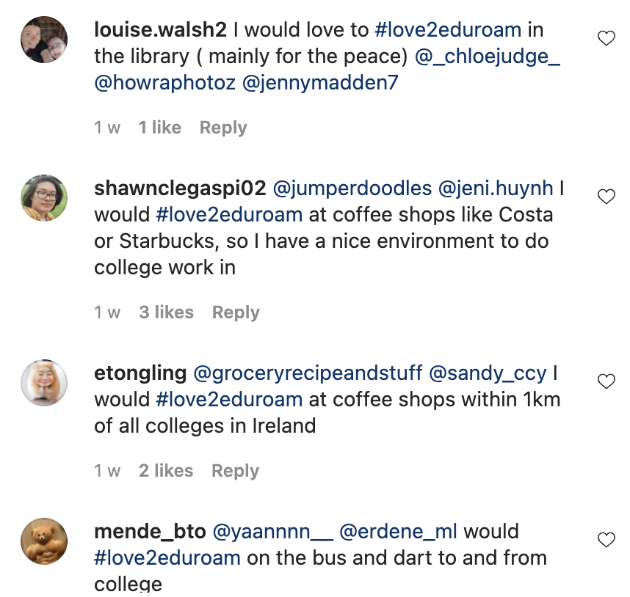
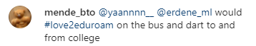


Results Summary
Generated over 800,000 impressions
Reached more than 360,000 people
Attracted over 42,000 engagements
Received over 50 competition entries

Slide 7
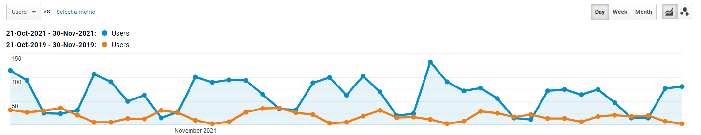
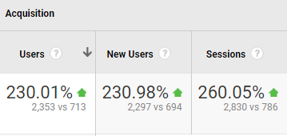
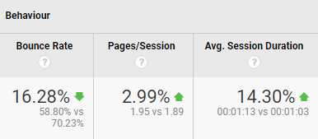
Marketing Works
Google Analytics demonstrates the improvement of the website user experience and awareness.

Slide 8
Thank you
Any questions?
barbara.carroll@heanet.ie

