Slide 1
Introduction to GARR marcomms
An overview
17/06/2022
SIGMARCOMMS - TNC22

Slide 2
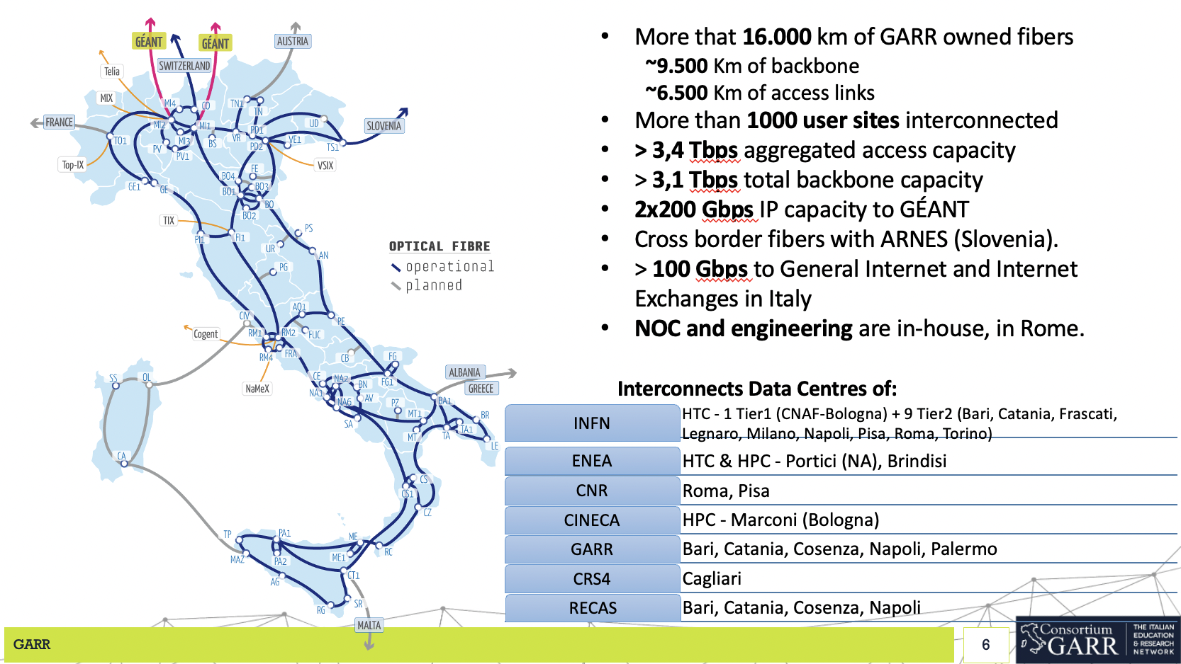

Slide 3
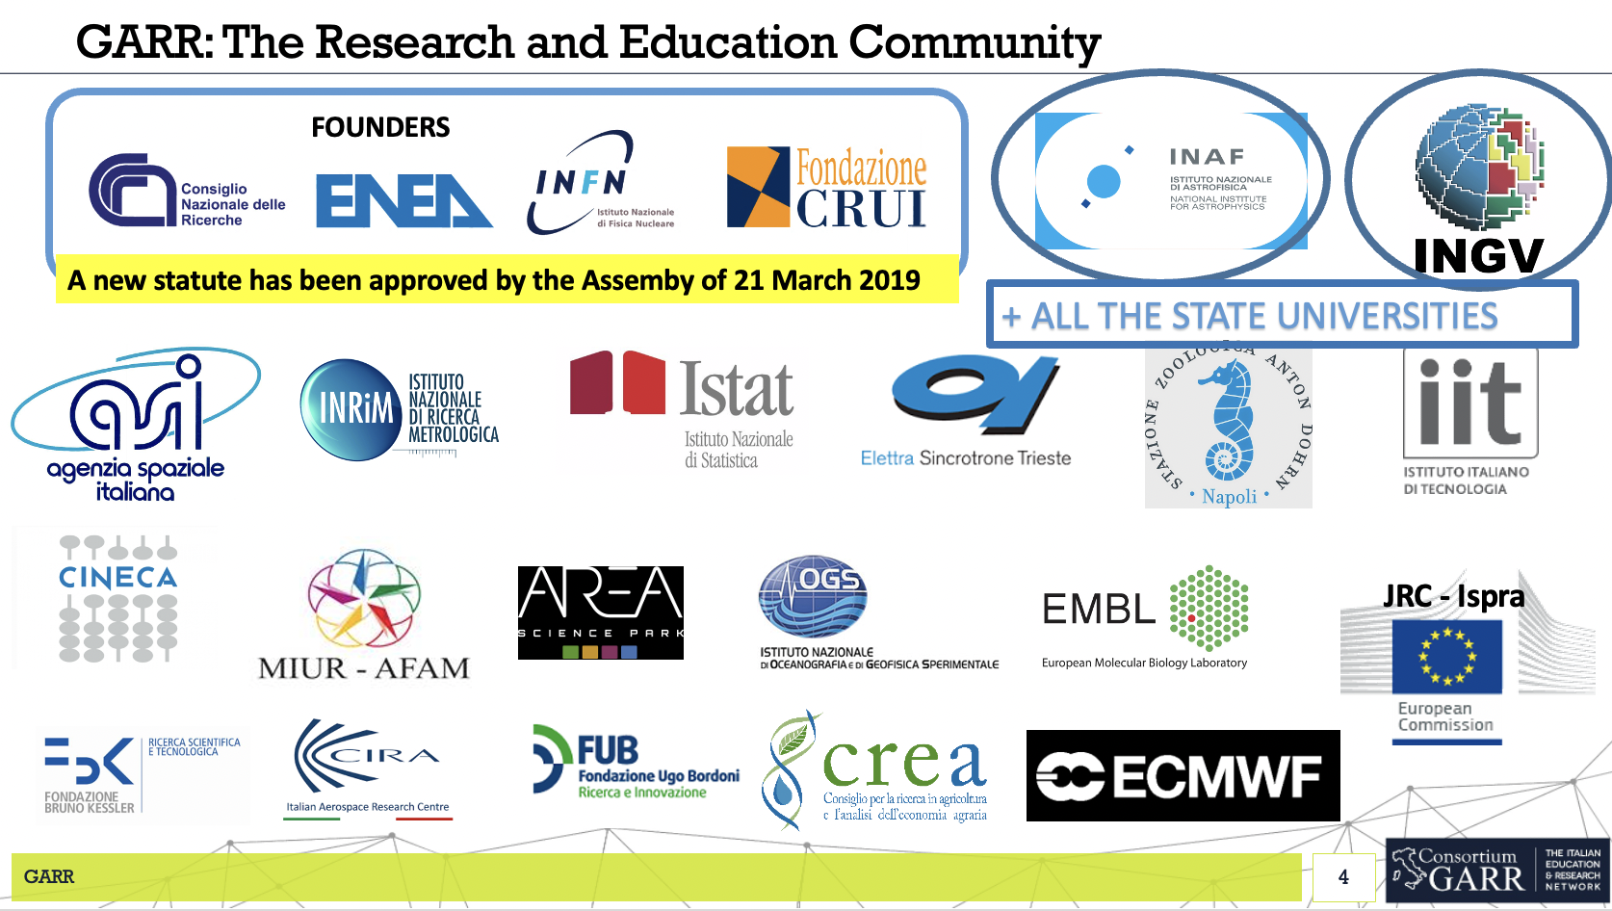

Slide 4
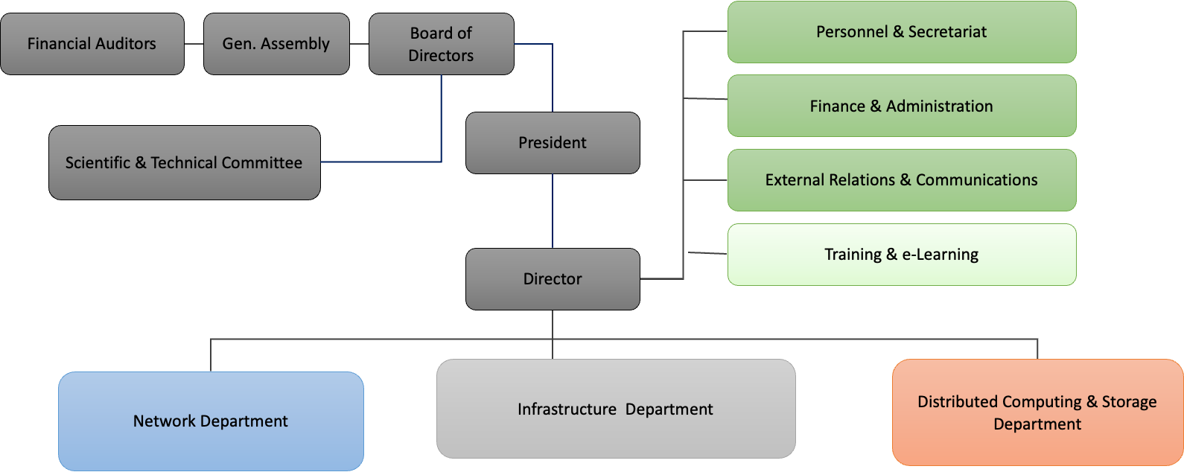
Organisation
•Lightweight organisation
•Staff of about > 75 persons

Slide 5
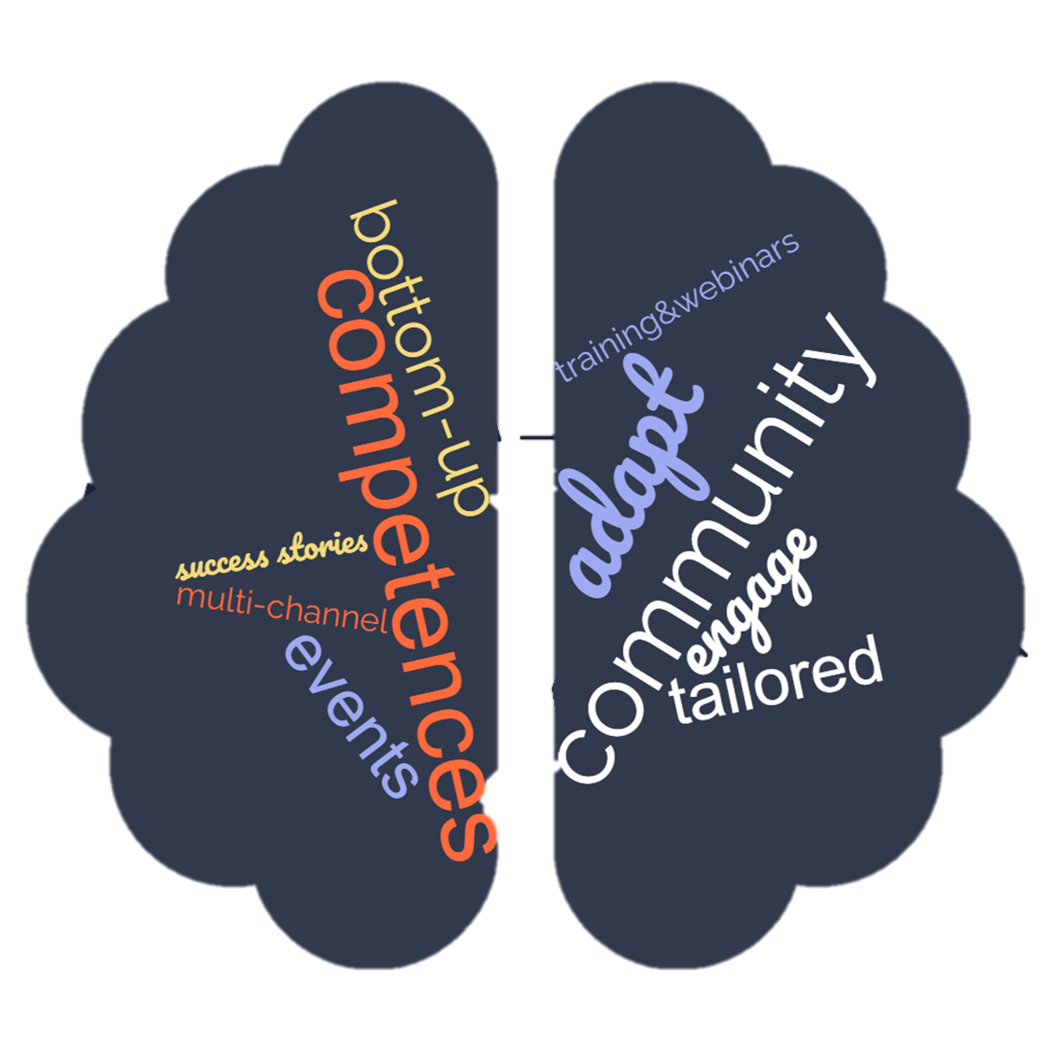
What is important for GARR as an NREN

Slide 6
What do we do?
Our main activities....
event management
social media management
media relations
webwriting
editorial activities
...and some special activities
employer branding
participation to scientific dissemination events

Slide 7






Our tools

Slide 8

Our social media channels

Slide 9
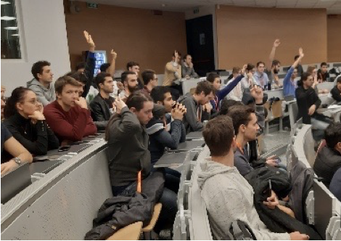
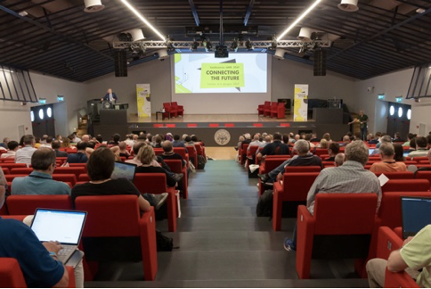
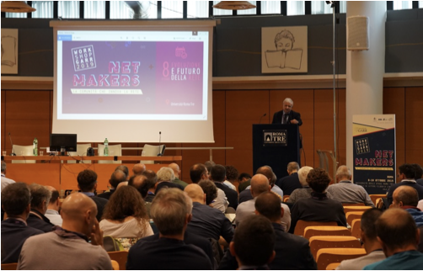

Events in person...

Slide 10
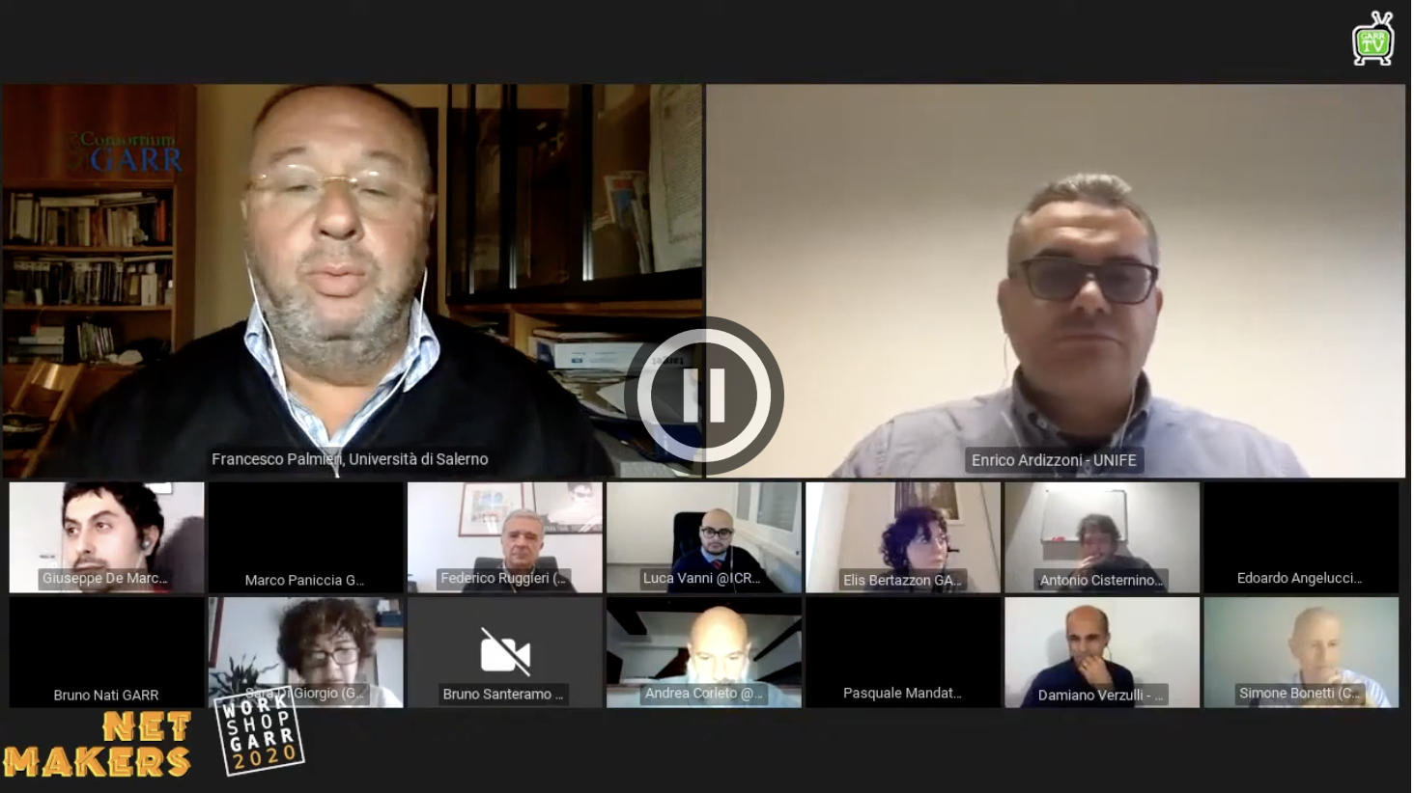
...and online

Slide 11
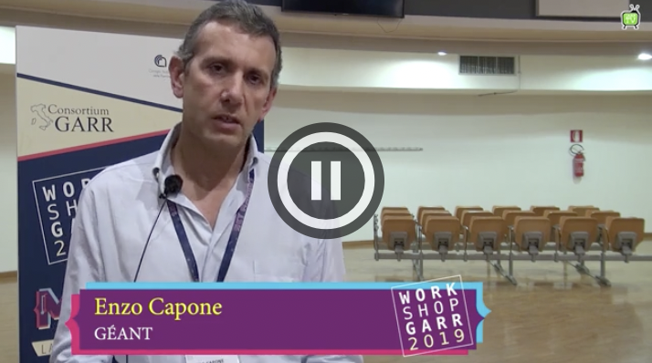
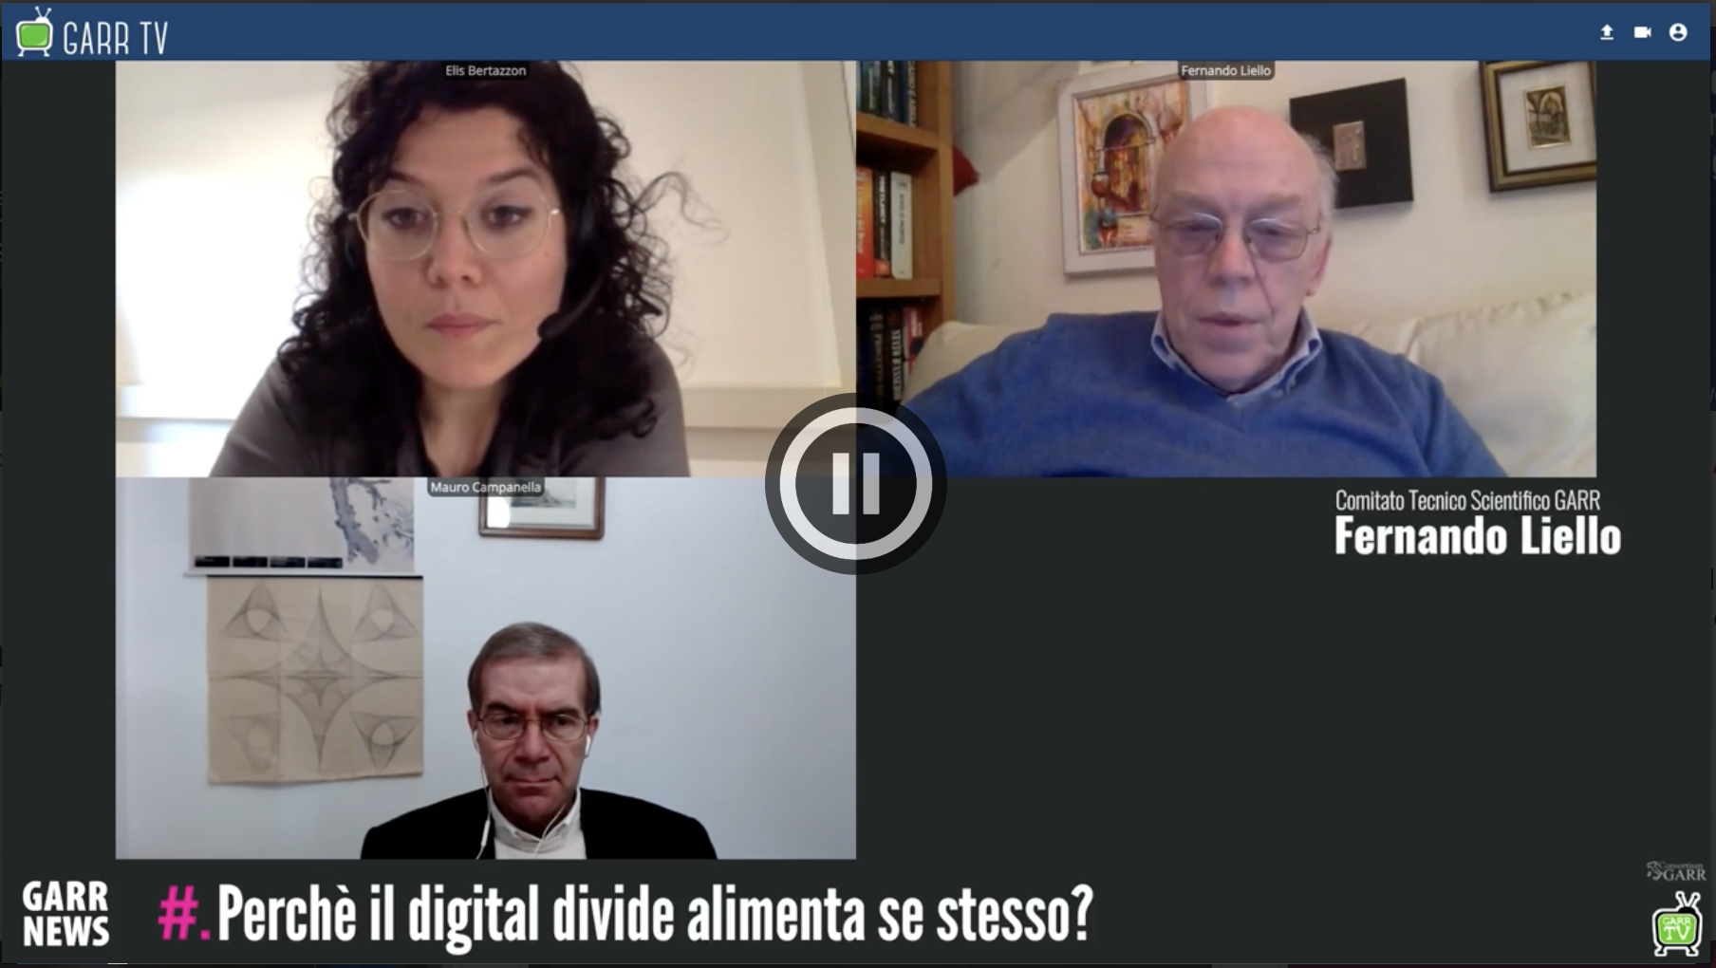
Interviews

Slide 12
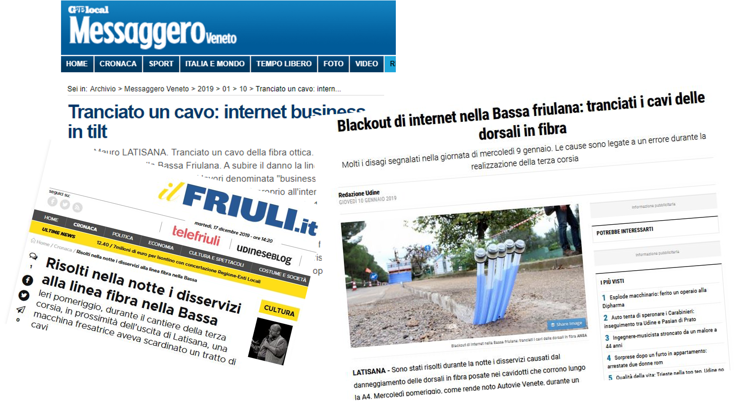
We tell what happens in Italy…

Slide 13

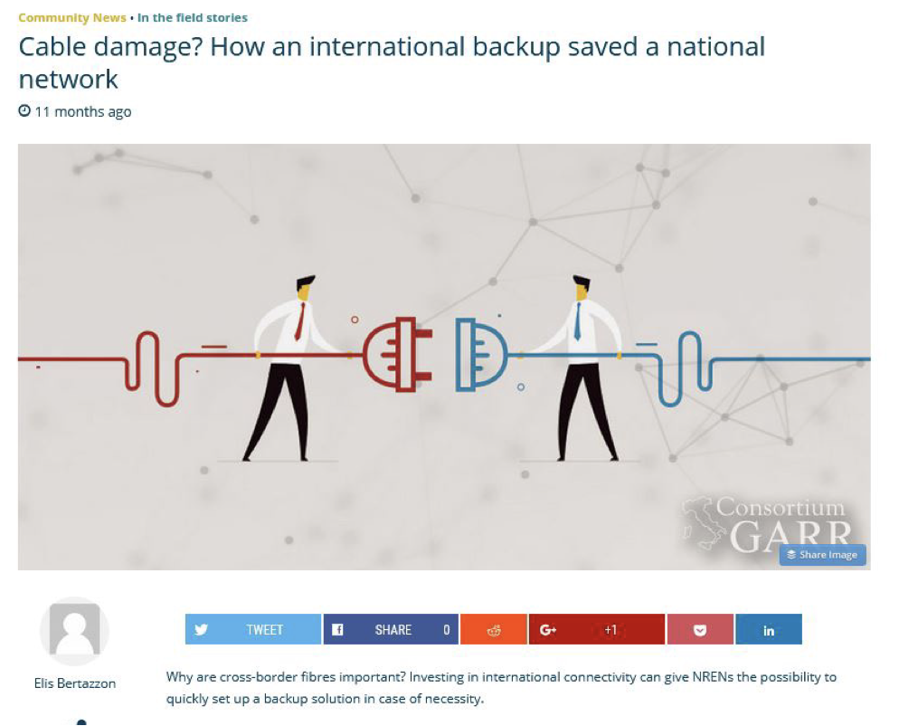
…to the European R&E community

Slide 14
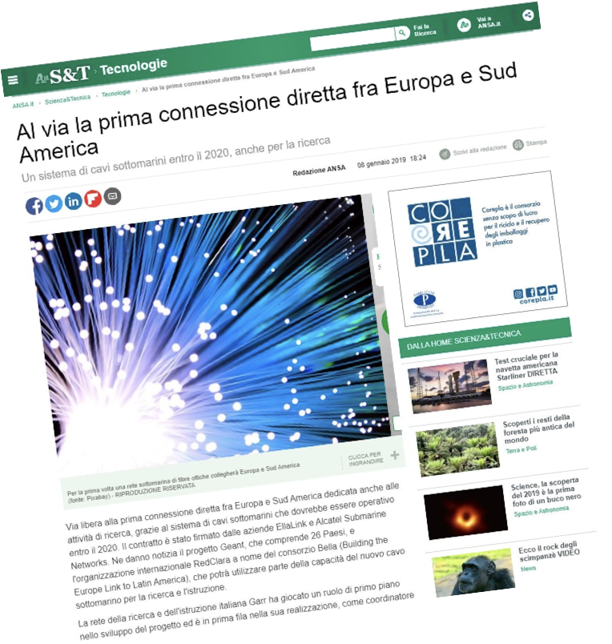
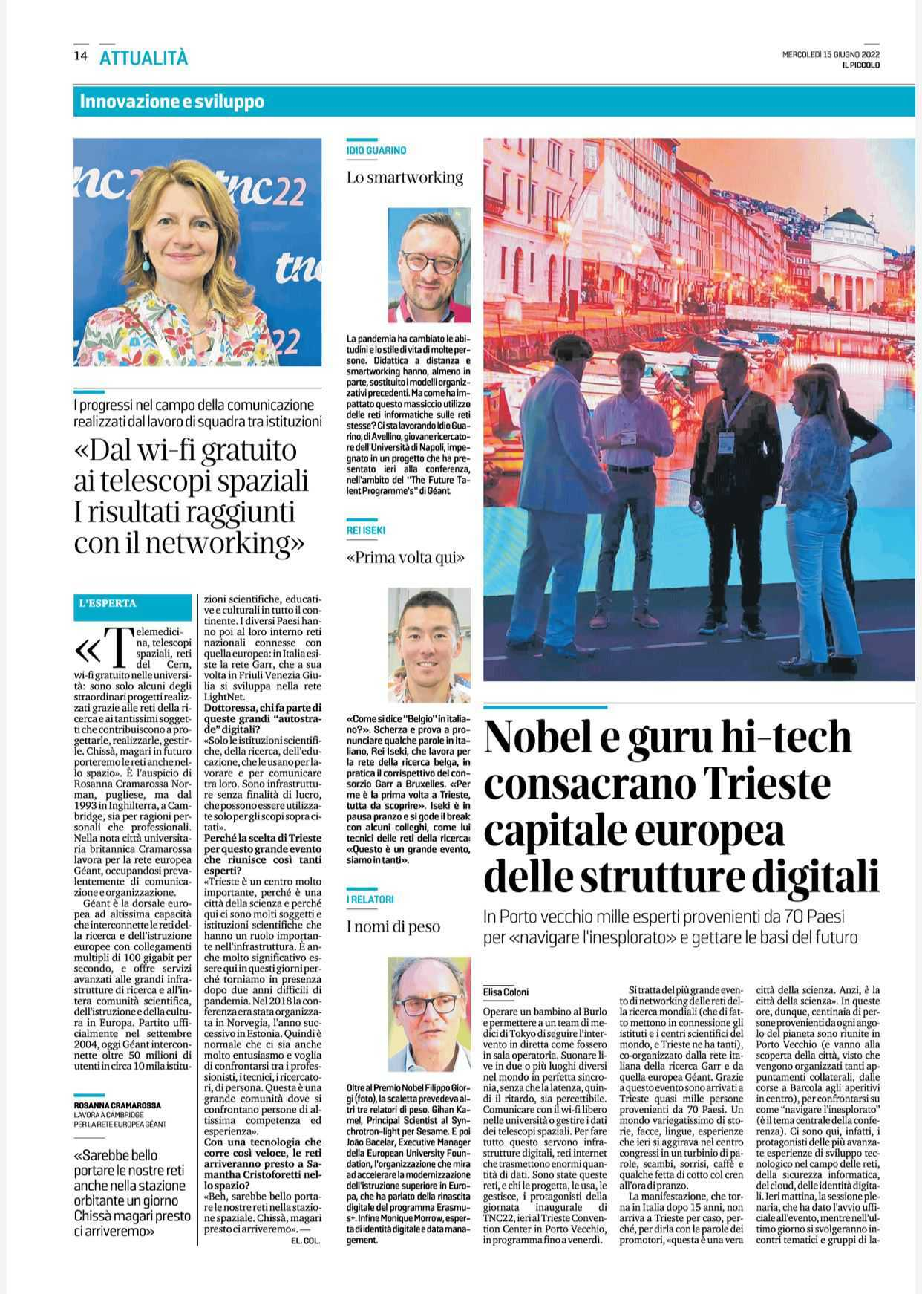
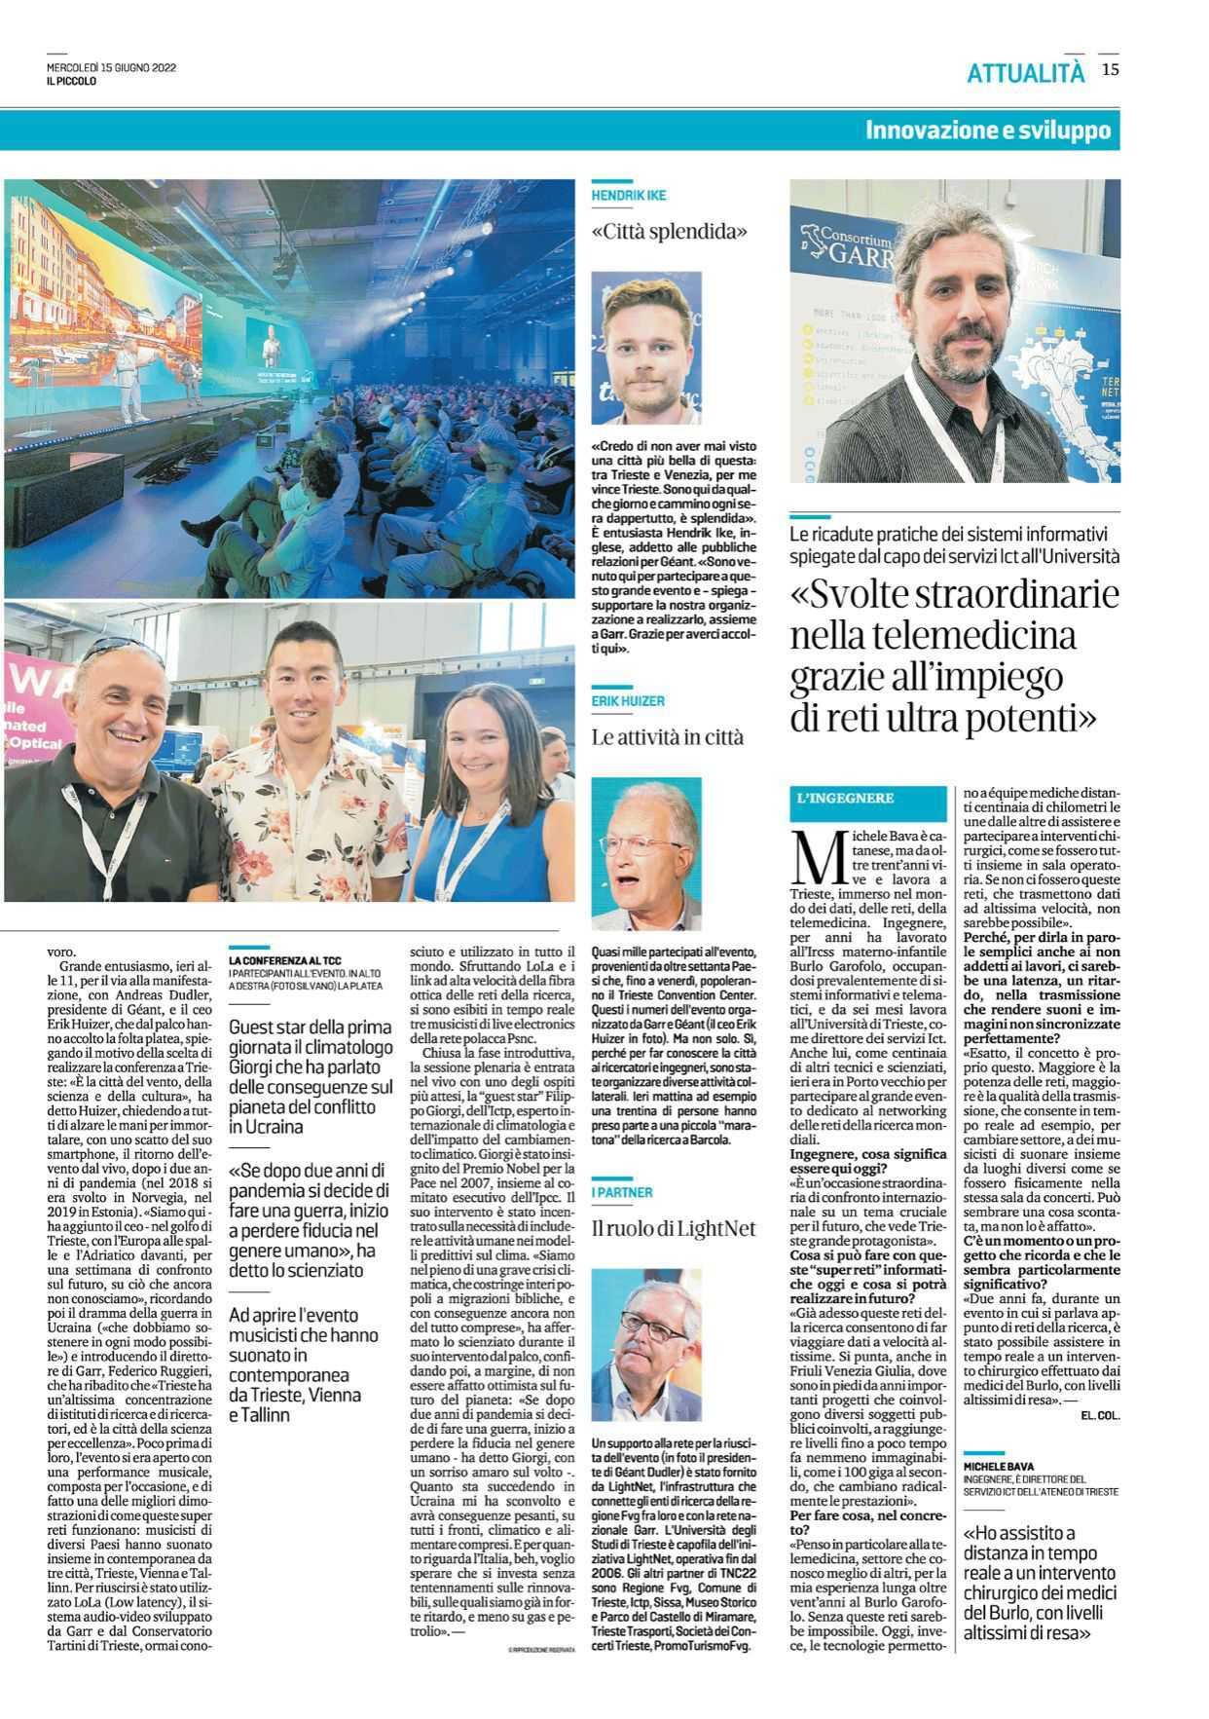
And viceversa

Slide 15
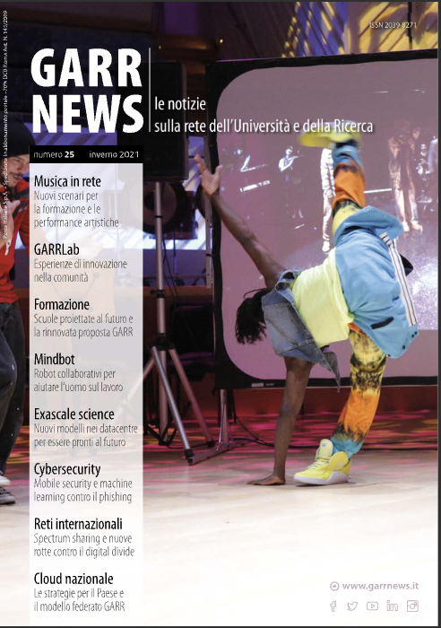
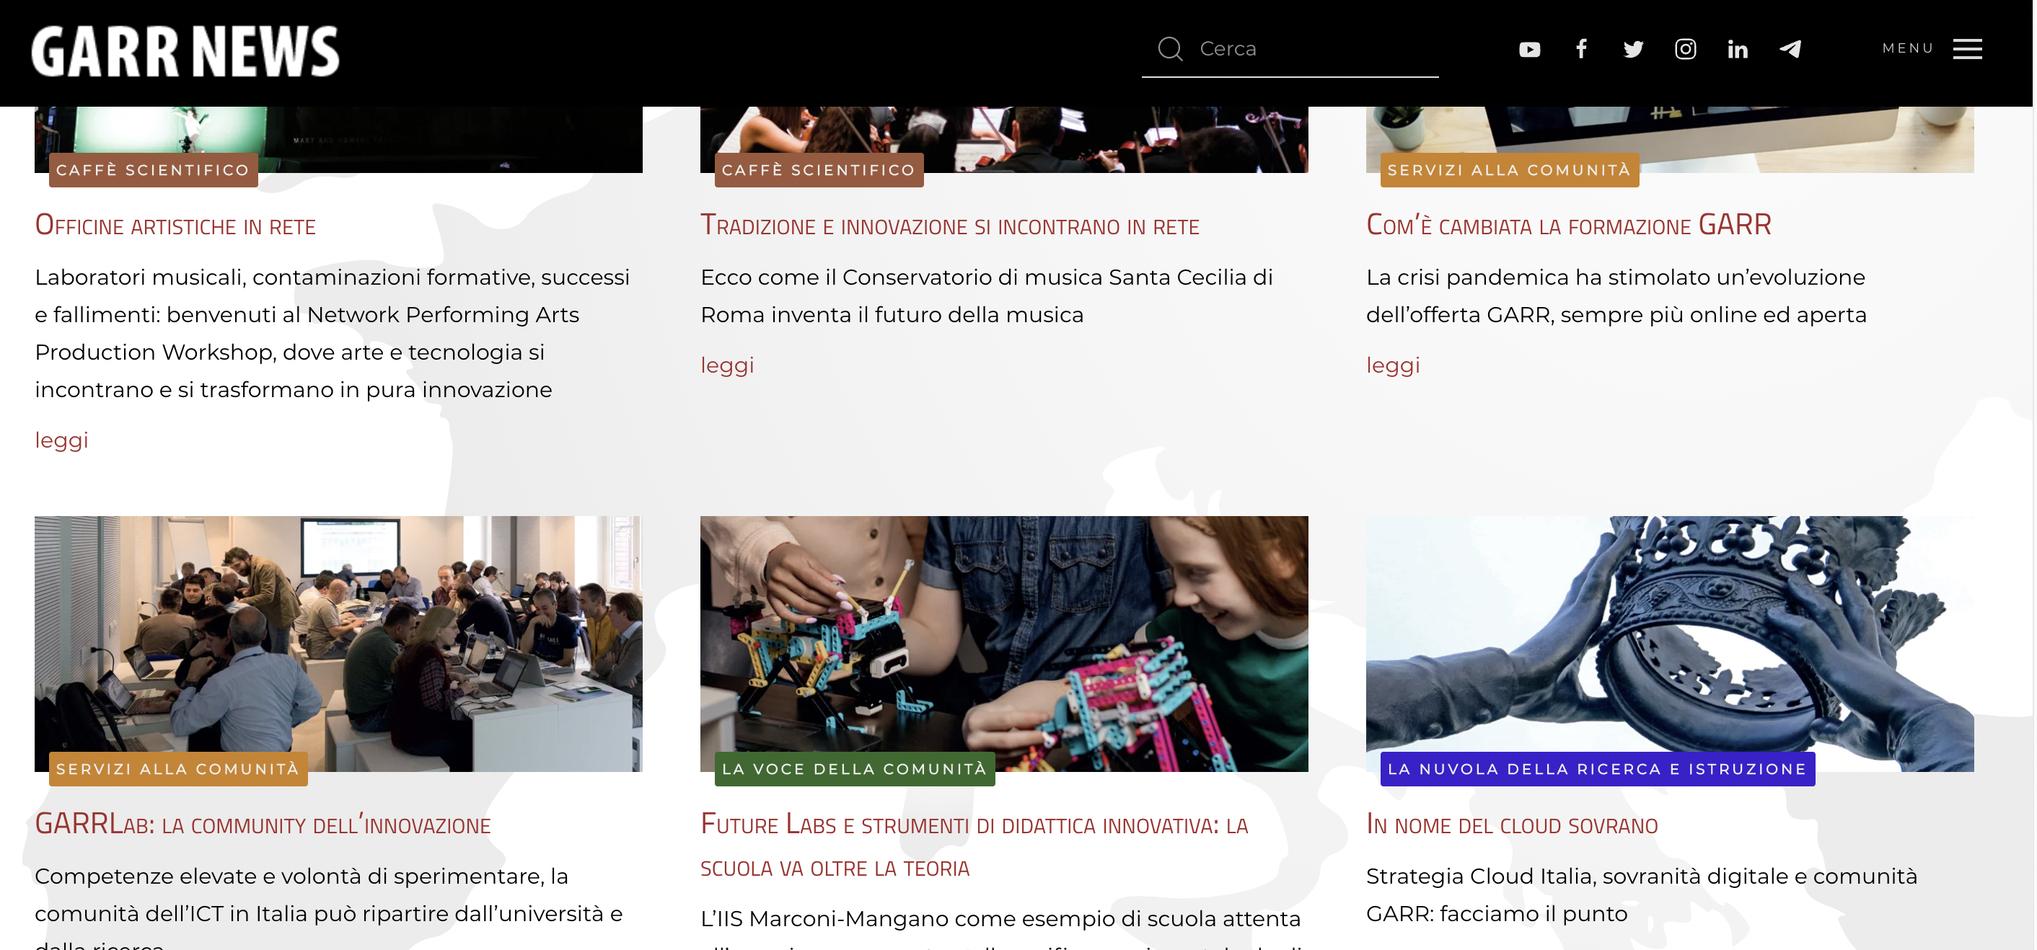
GARR NEWS

Slide 16
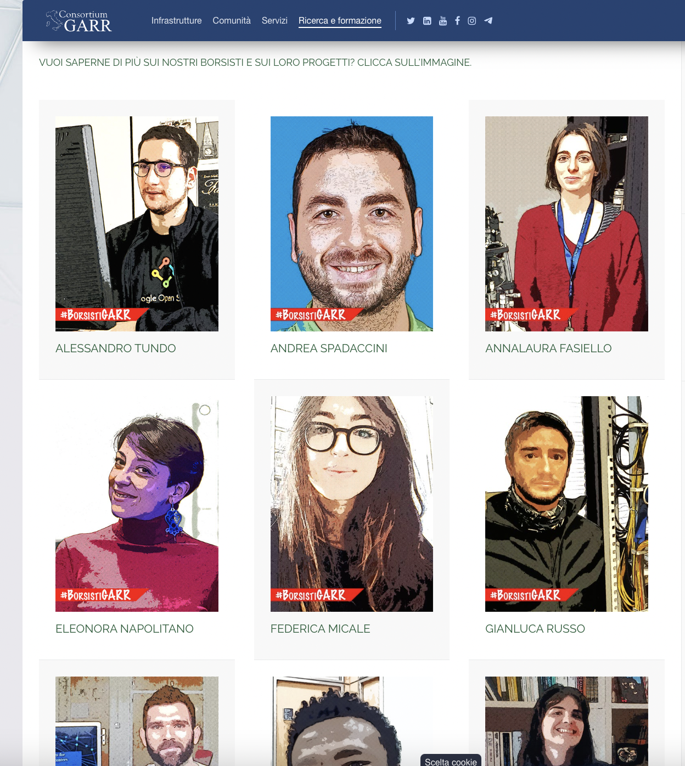
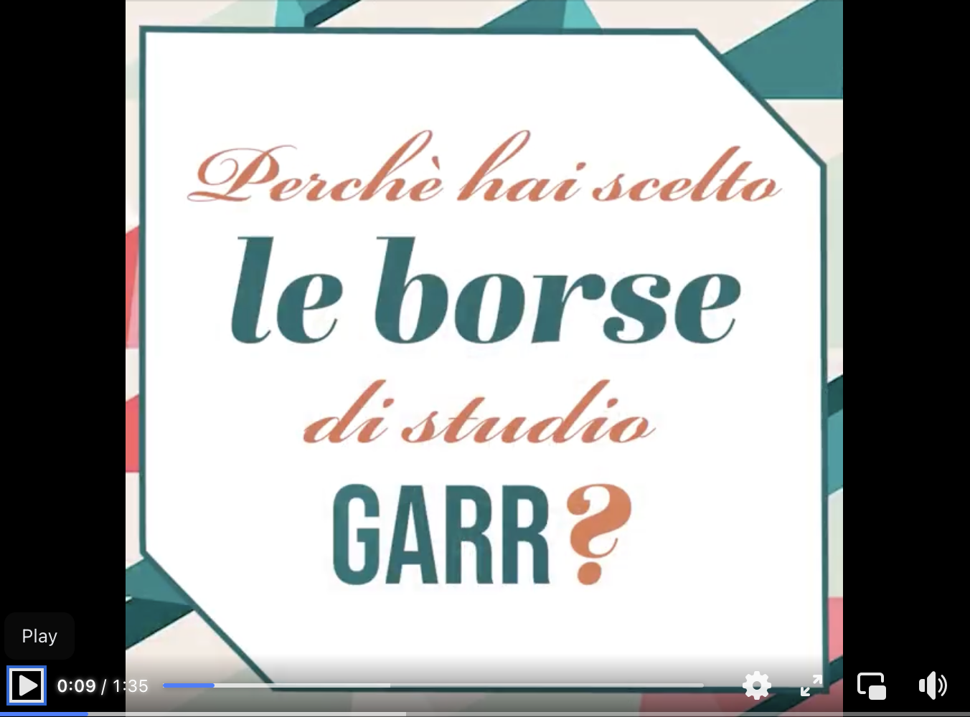
GARR scholarships

Slide 17




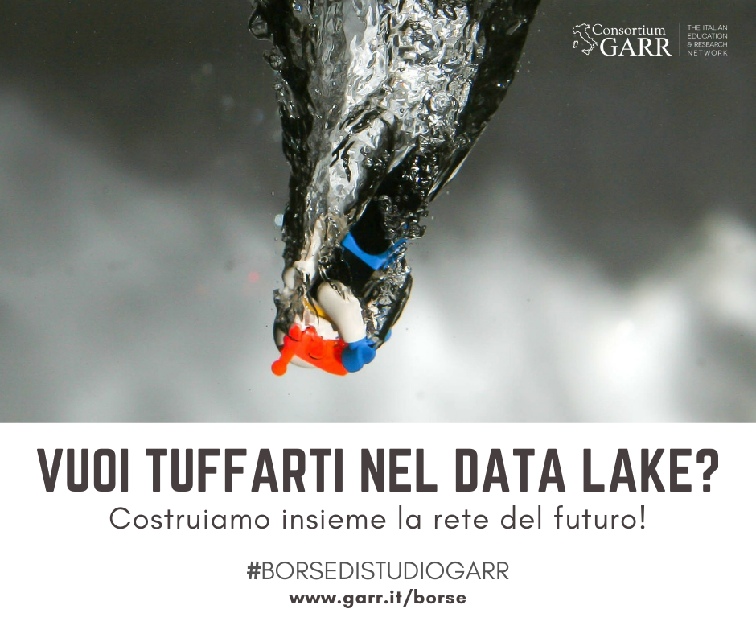
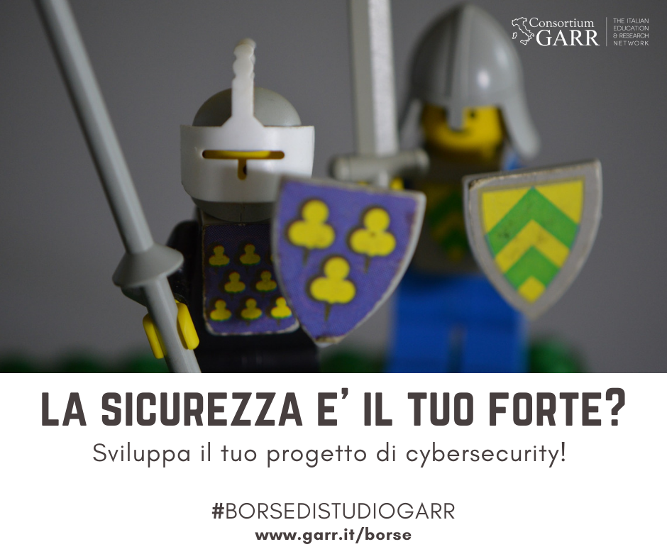




Slide 18
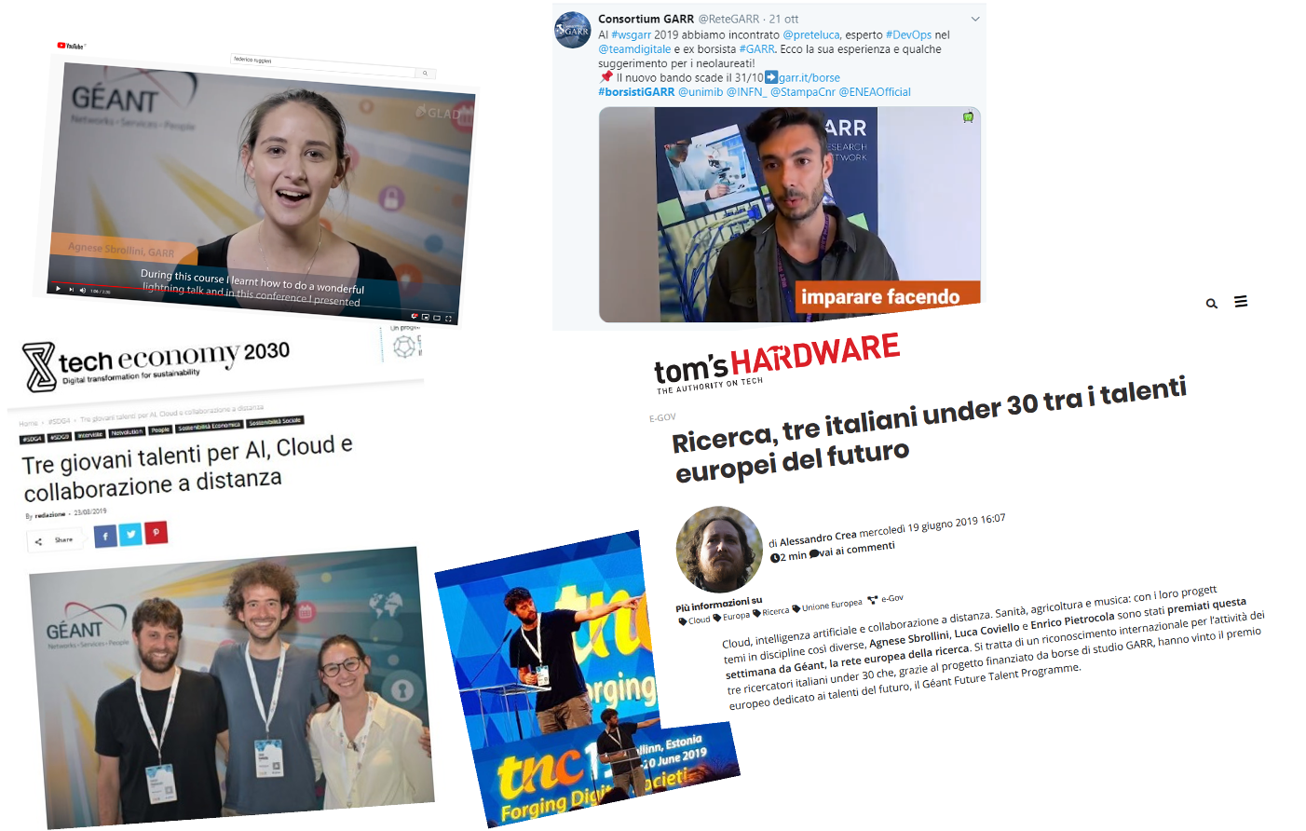
GARR scholarships

Slide 19
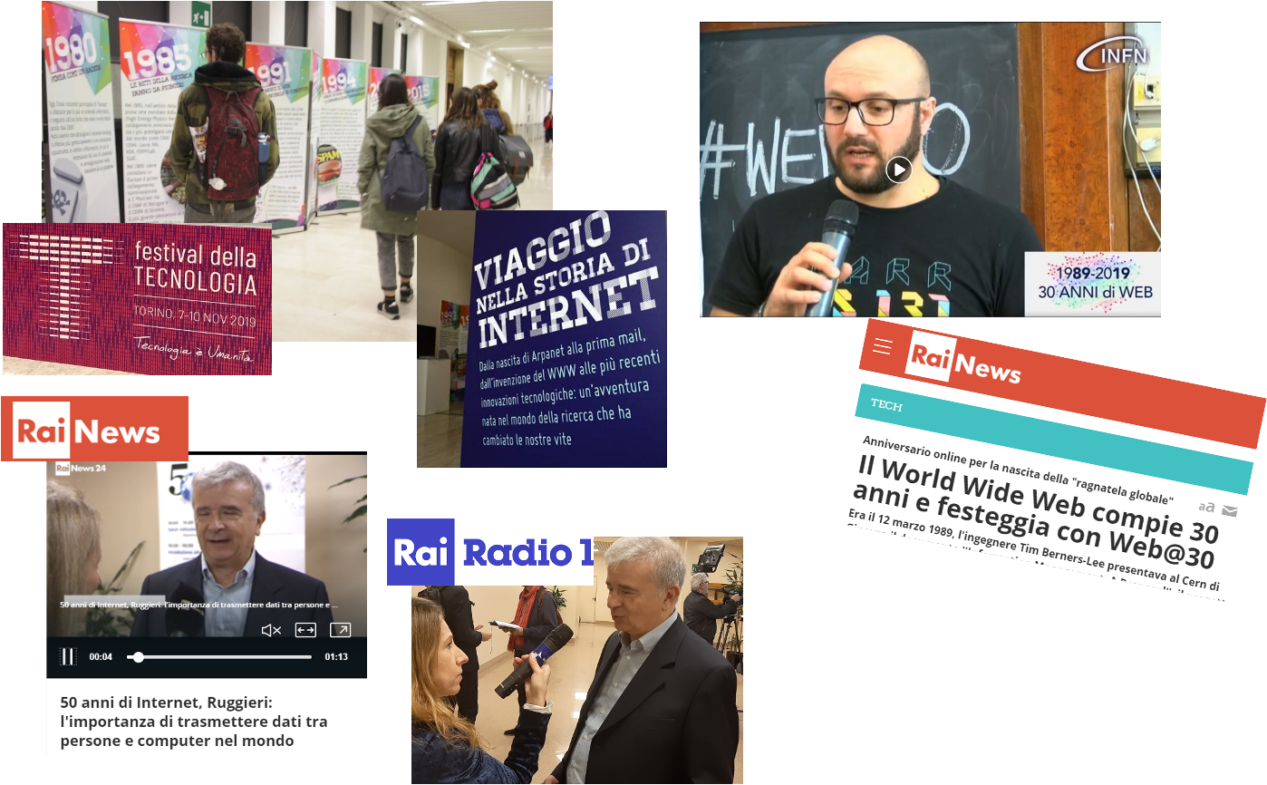
Festivals and public events

Slide 20
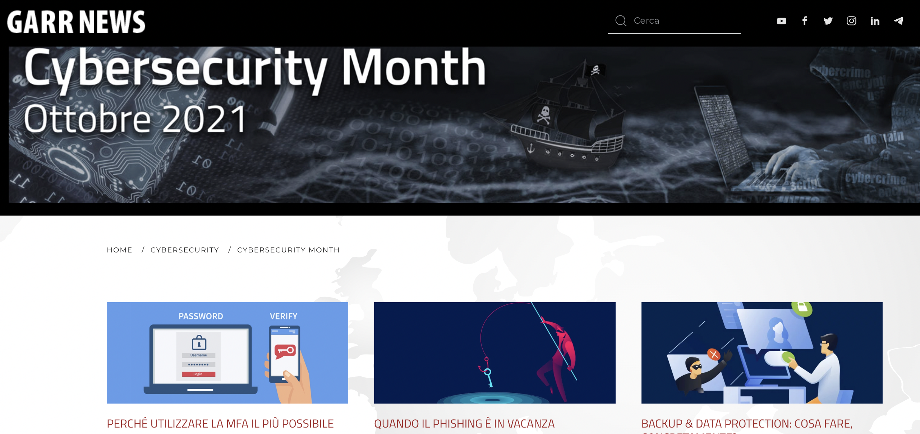
Cybersecurity month

Slide 21
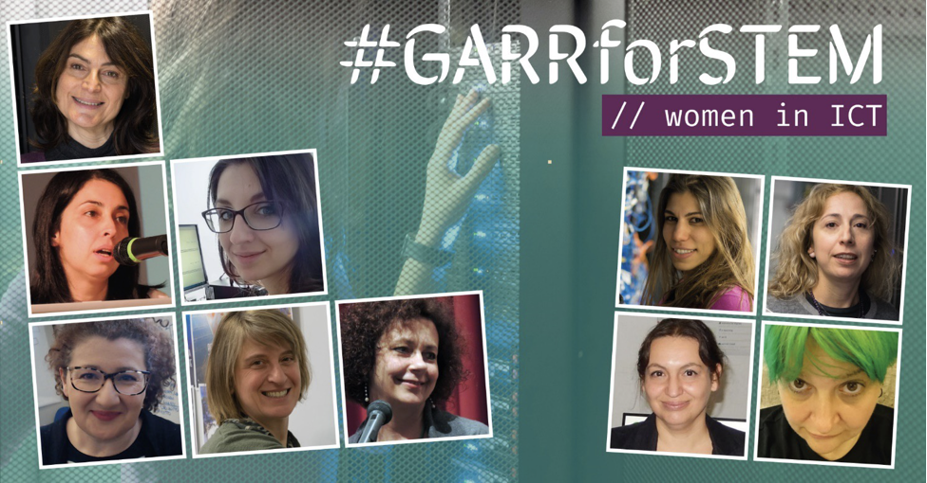
#GARRforSTEM

Slide 22
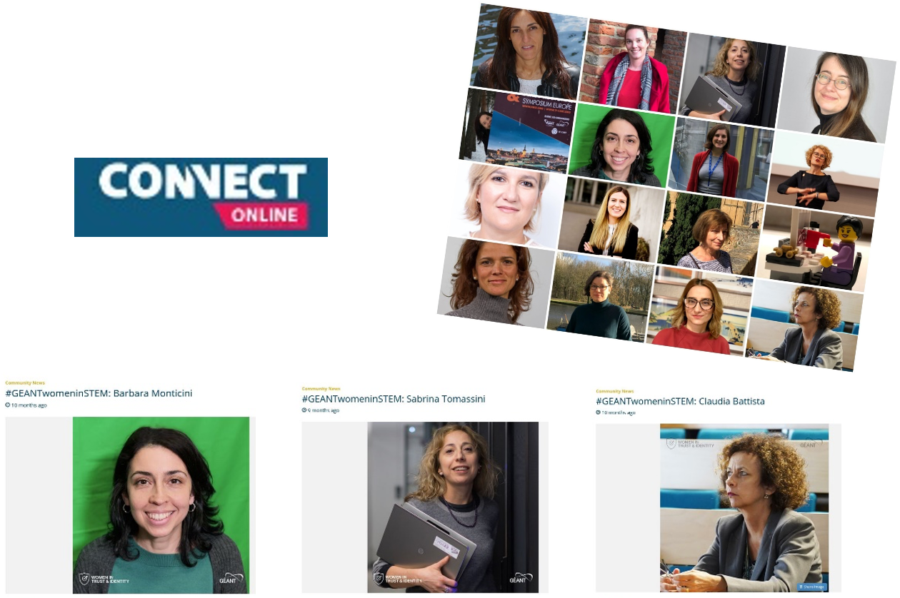

Slide 23

Recruitment campaigns

Slide 24
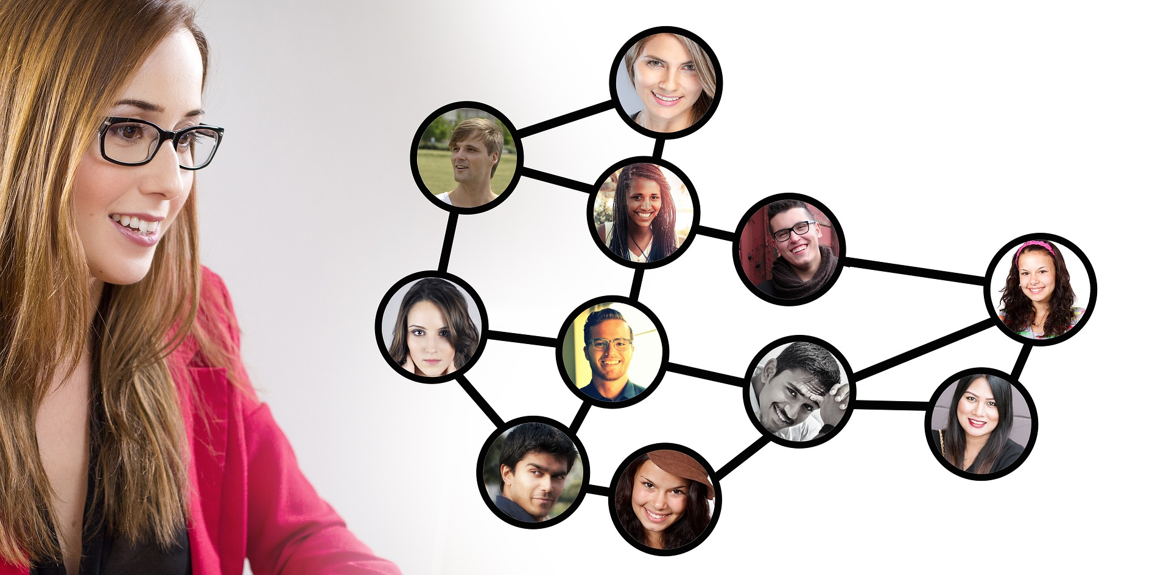
How do we do all that?
and...an incredible community

Slide 25
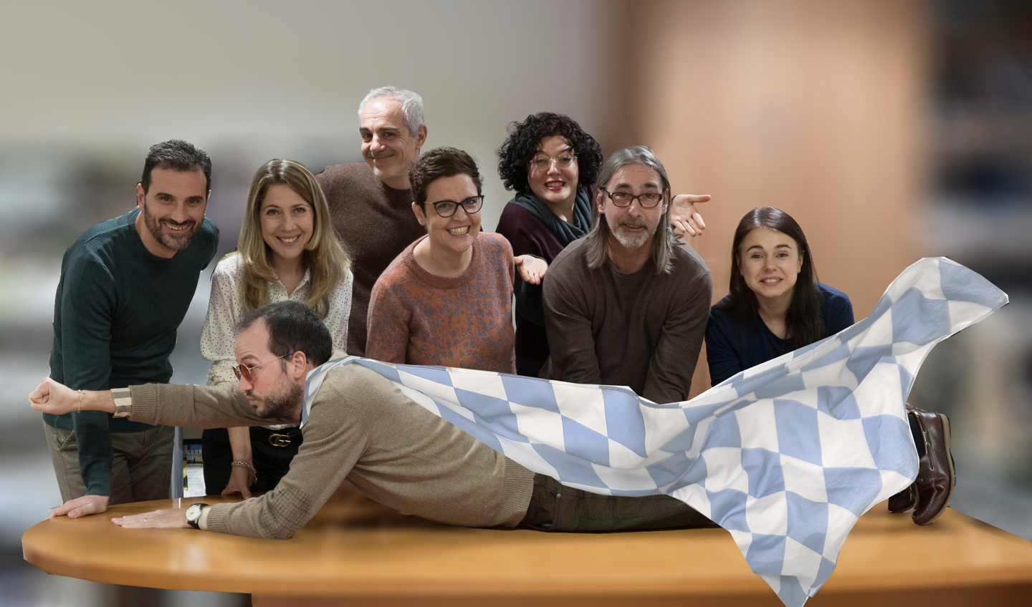
A wonderful team...

Slide 26

…and a synergetic collaboration within the community

Slide 27
Thank you!

