Slide 1

Privacy primer on website compliance
Magdalena Rzaca
GDPR & IPR Legal Advisor, Géant
SIG-Marcomms meeting
TNC – 17.06.22, Trieste
www.geant.org
16/06/2022
1

Slide 2
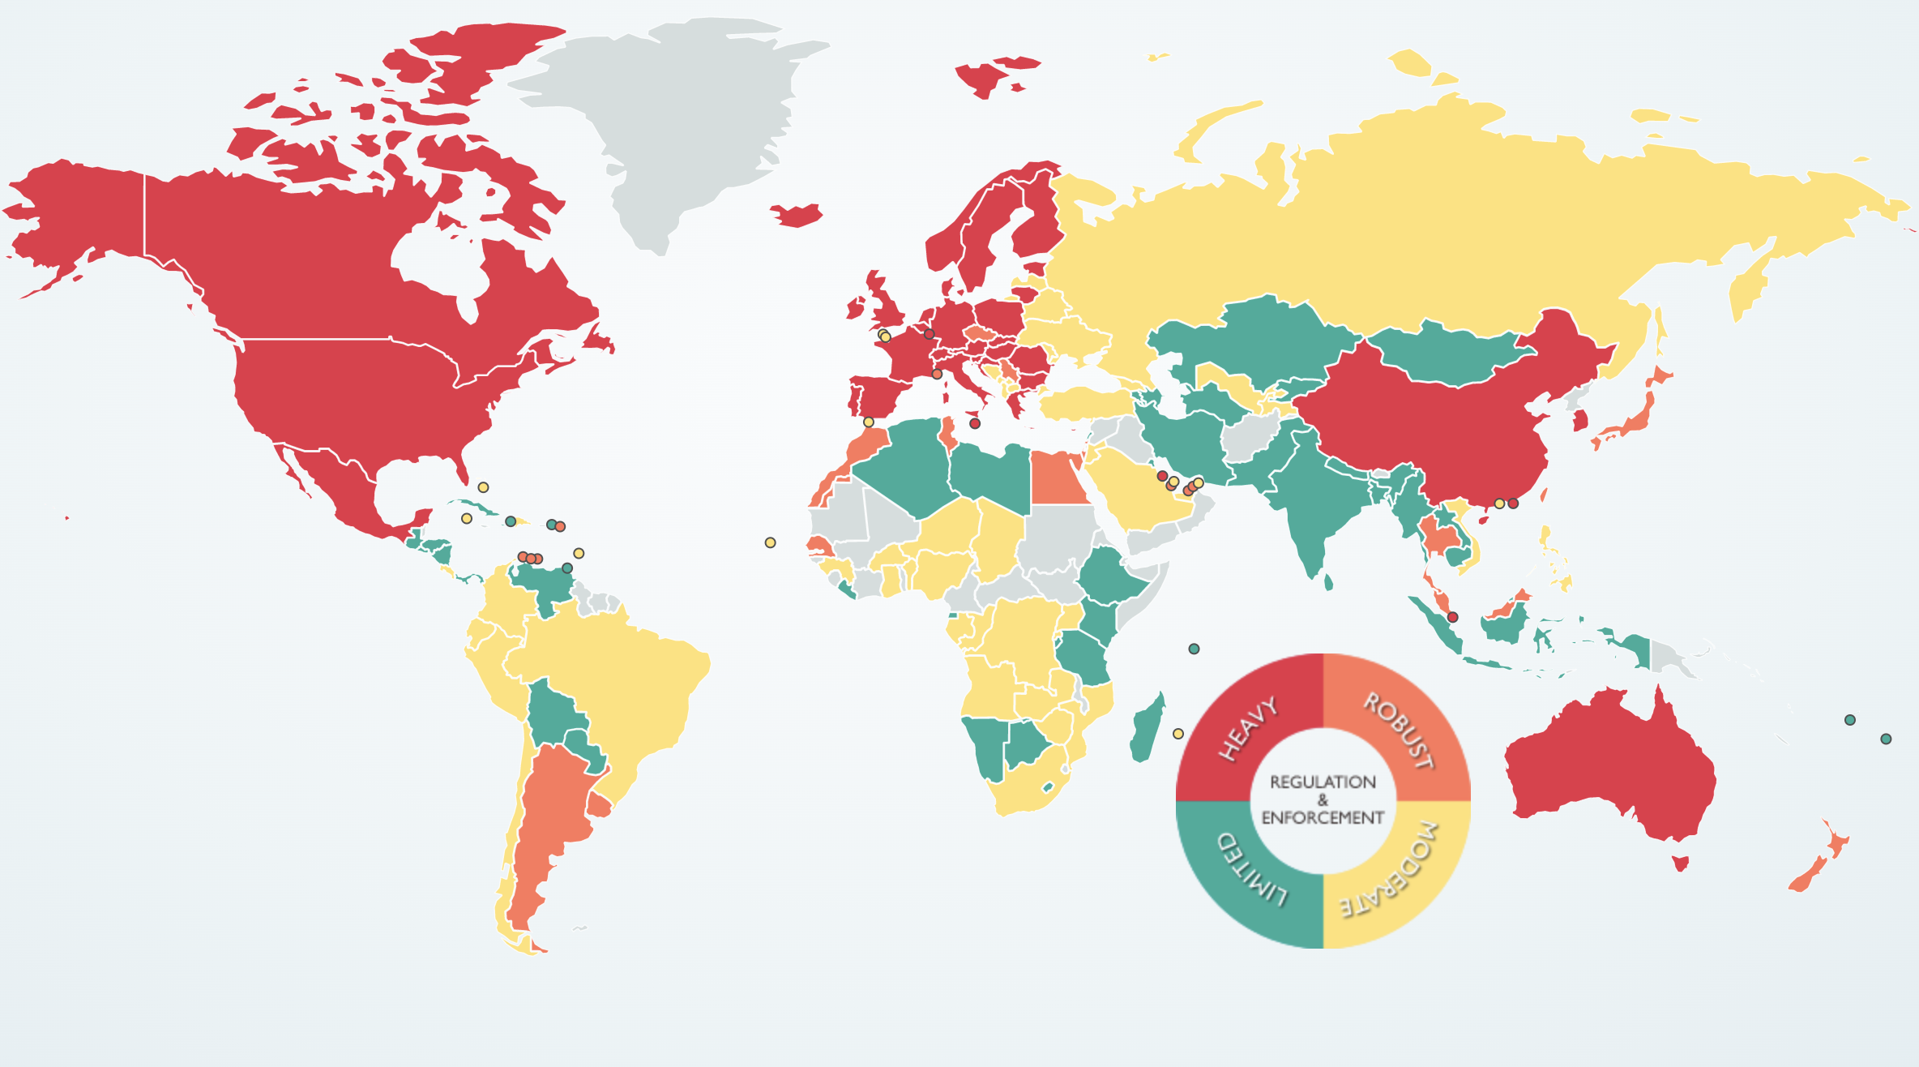
WORLD OF DATA PROTECTION
Source: https://www.dlapiperdataprotection.com/

Slide 3


When GDPR can be applicable?

Slide 4

GDPR TERRITORIAL SCOPE: ESTABLISHMENT CRITERION
Processing of personal data
In the context of the activities of an establishment of a controller or a processor in the Union
No matter where the processing takes place (inside or outside EU)

Slide 5
GDPR applicability cheat sheet
PERSONAL DATA
Yes
No
Is any of those criteria met?
Establishment in the EU?
NOT APPLICABLE
GDPR applicable
Yes
No
Offering goods/services in the EU?
GDPR applicable
Yes
No
Monitoring of the behavior of the individuals in the EU?
GDPR applicable
Yes
No

Slide 6
No matter whether GDPR is applicable or not…
#1 Be transparent
What personal data are you processing for your website? For what purposes?
Where it is stored? Who has access to it?
Is the website dedicated to minors?
#2 Reflect how data is processed in privacy notice on your website
Inform your website visitors about how their personal data is processed and what rights do they have
#3 Secure your website
SSL certificate

Slide 7

Cookies
Add a cookie banner and get explicit consent for non-essential cookies
Allow users to manage their preferences

Slide 8

Why privacy is important?
Trust
Reputation
Money

Slide 9

Q & A session

Slide 10


Thank you very much!
magdalena.rzaca@geant.org
www.geant.org
© GEANT Limited on behalf of the GN4 Phase 2 project (GN4-2).
The research leading to these results has received funding from the European Union’s Horizon 2020 research and innovation programme under Grant Agreement No. 731122 (GN4-2).

