Slide 1


Impact.geant.org:
Making science accessible to non-technical audiences
Silvia Fiore
Communications Officer
SIG-Marcomms, June 17 2022
Public
www.geant.org
Notes:
Hello everyone, today I will give a brief overview about the ongoing Women in Stem campaign, which you might have seen on the connect blog and all GEANT social media. Rather than sharing what the campaign is about and how it is doing on social media, I thought of using this time to share with you how we came to this idea and what kind of effort it involved planning and executing it.

Slide 2



The concept
Purpose
Target audience
Content
Showcase
Non-technical
Success stories
Accessibility
NRENs collaborations with GÉANT
Awareness

Slide 3
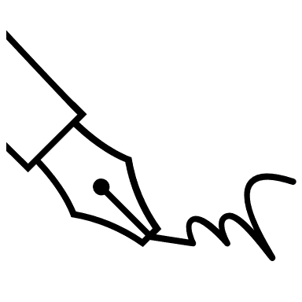


The layout
Graphics
Wordpress
Structure
To simplify complex subject matters
Optimised graphics for lowered page loading times
To simplify searching and grouping of similar subject matters
RSS friendly
Same WP template (herald) for all GÉANT sites
Clear article structure
Consistent headings and page descriptions for optimised SEO

Slide 4
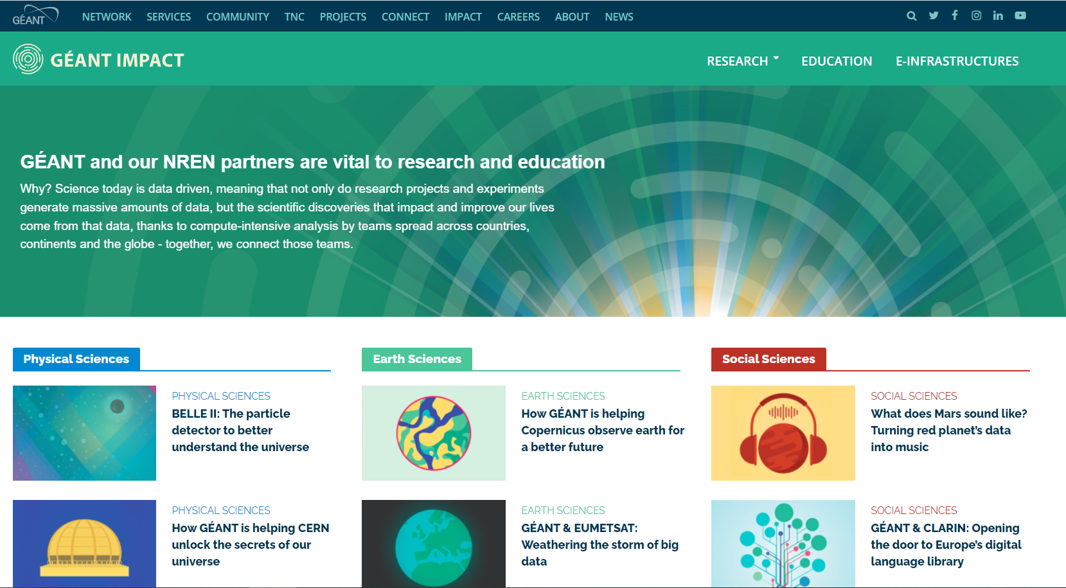

Slide 5
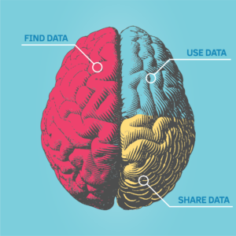
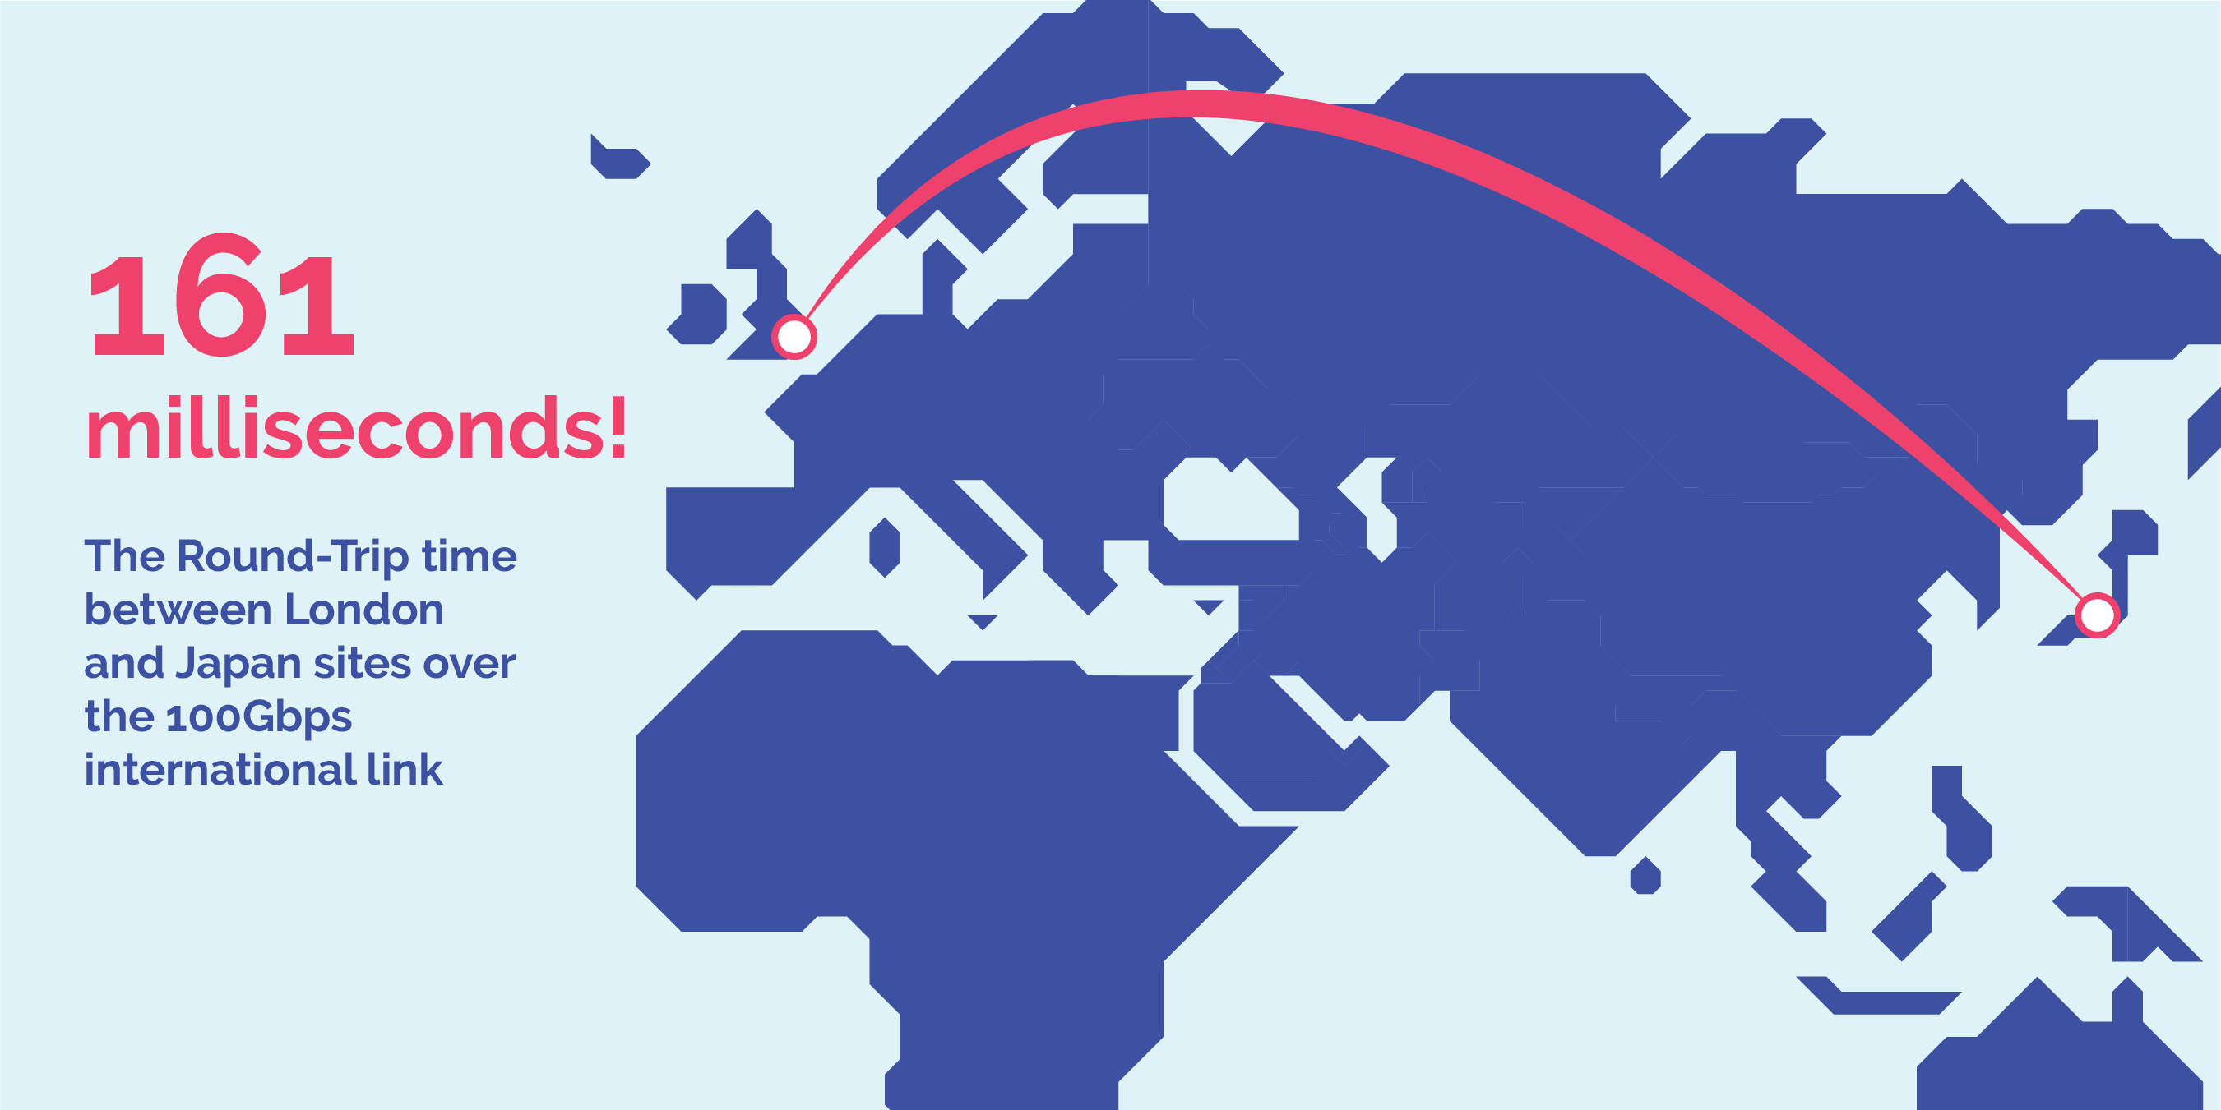
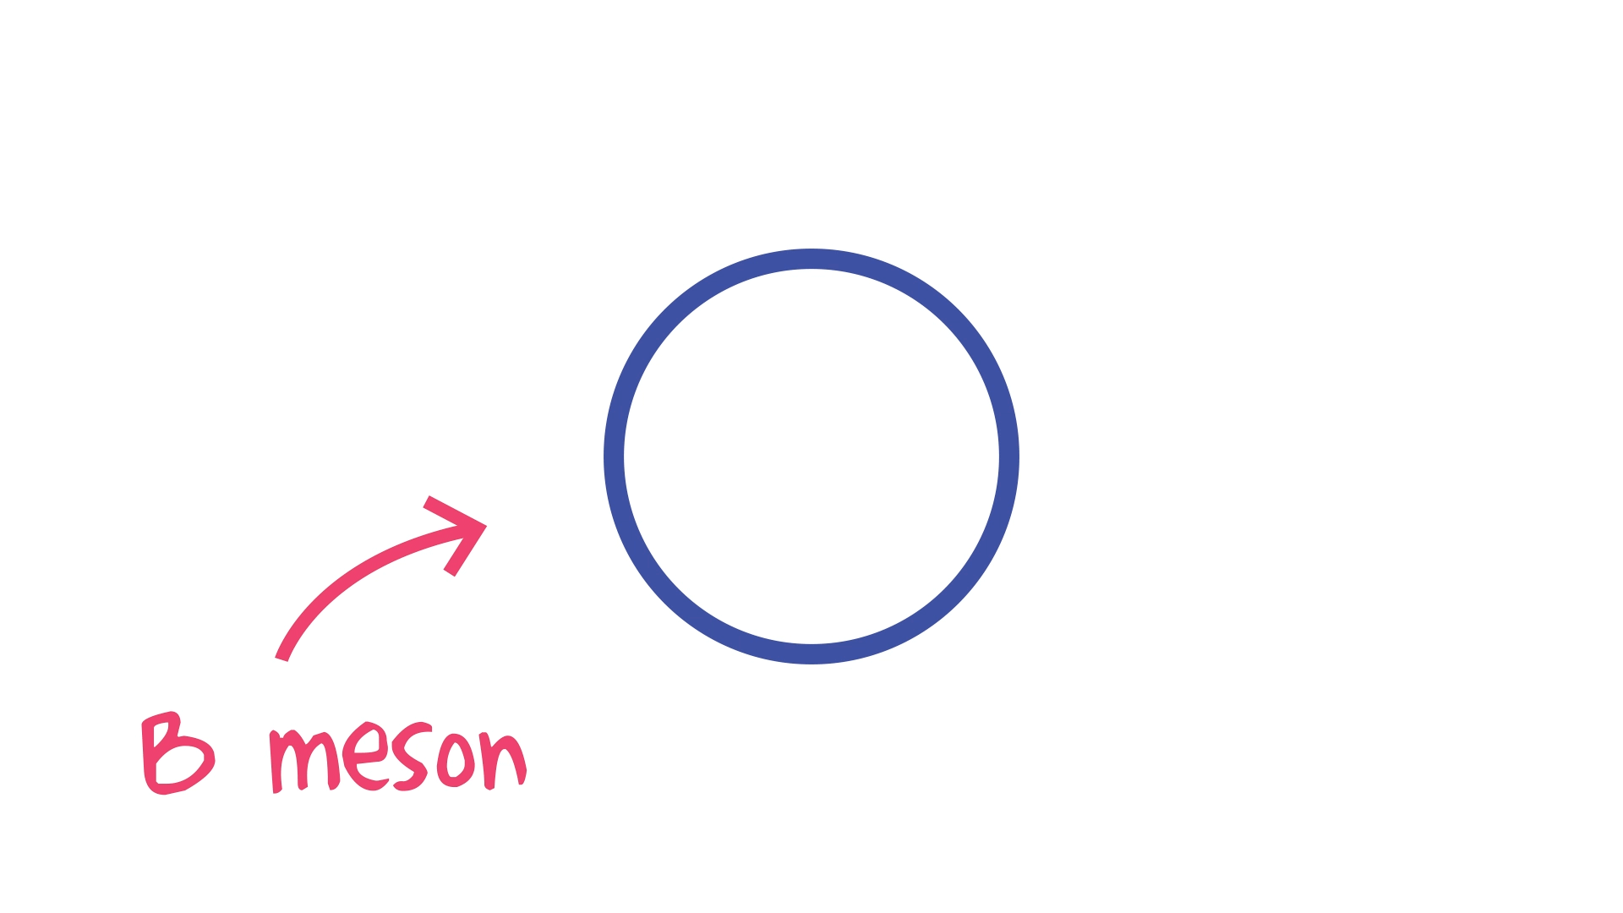
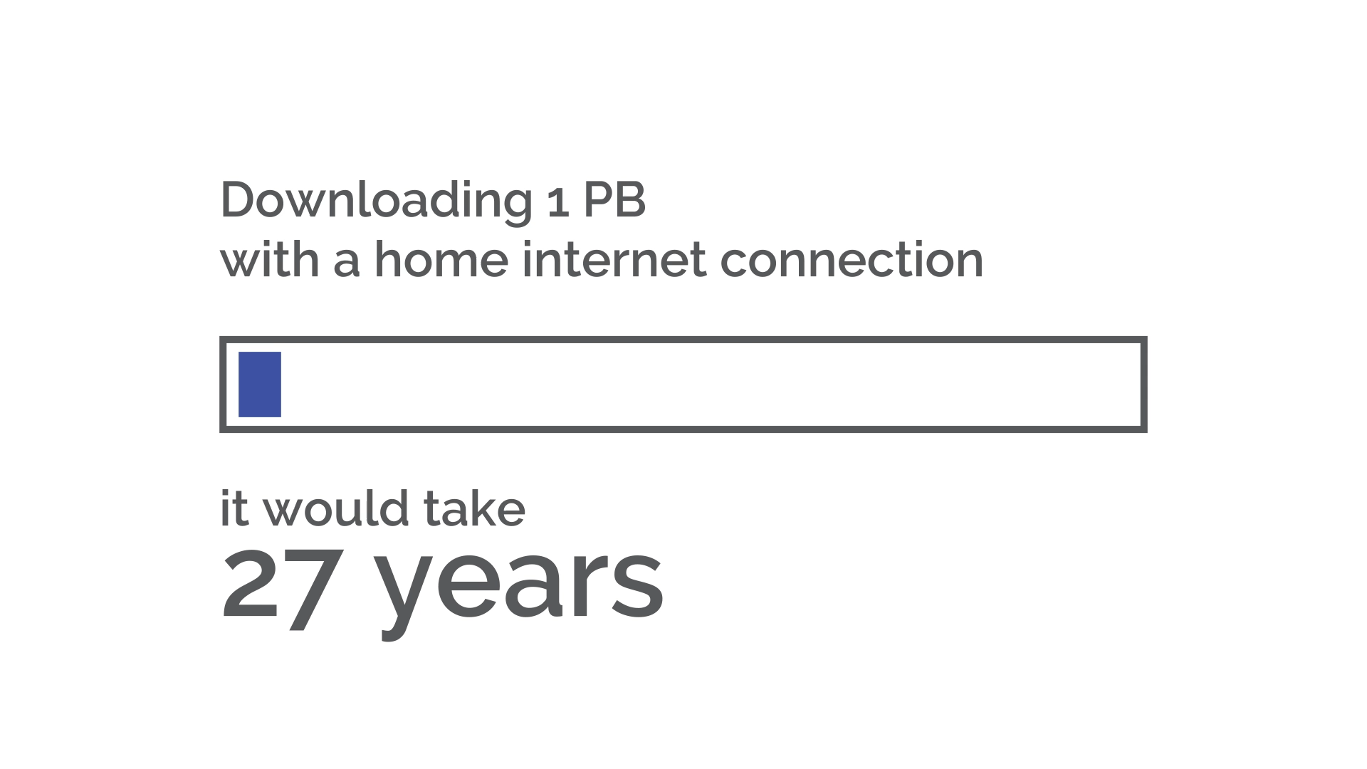

Slide 6

Promotion

Slide 7
Challenges
Slow engagement to source potential stories
Approval process!
We need your stories!
Call To Action

Slide 8

Questions for you
Did you know already about impact.geant.org?
Would you do something different?
Where do you collect and publish your impact stories?
Do you write different stories depending on the target audience?

