Slide 1
GÉANT Trust Broker
Daniela Pöhn

Slide 2
Agenda
Some facts
Motivation
Current status
  Implementation
  I-D
  Orga
Demo

Slide 3
Some facts
GN3plus: OpenCall project
GN4 Phase 1: JRA3 T3
Developer team mainly at Leibniz Supercomputing Centre
Dynamic user-triggered metadata exchange (plus attribute conversion rule repo)
Extensions for Shibboleth (IDP, SP and Centralized Discovery Service)
svn@svn.geant.net/GEANT/TrustBroker
I-D

Slide 4
Motivation
For IDP/SP pair, which
wants to exchange SAML metadata dynamically
  wants to grant the IDP’s users access to the SP’s
    on-demand,
    user-triggered, and
    fully automated
  does not depend on a-priori, non-automatable steps, such as written contracts
  lets the user trigger the exchange

Slide 5
Current status - Implementation
Proof of concept implementation:
  Extensions for Shibboleth IdP, Shibboleth SP
  Extension for Shibboleth Centralized Discovery Service
  http://gntb08.srv.lrz.de:8080/discovery/ttp/index.jsp
In GN4 Phase 1:
  Improve and enhance implementation -> REEP, and error diagnosis, e.g.
  GNTB is technical solution -> organizational solution?

Slide 6
Current status - Implementation
Plans for GN4 Phase 1:
GNTB Enhancement
  REEP/PEER
  Monitoring/Statistics
Prepare the Pilot
  Improve scripts at IDP/SP
  Improve functionalities at TTP
  Nice to have: SimpleSAMLphp
Attribute conversion
  TTP
  Better support for AAs

Slide 7
Current status - Implementation

Slide 8
Current status – I-D
Content of the I-D:
Initiation of the metadata exchange
  IdP Discovery
  Authentication Request Protocol using a TTP
  → only exchange metadata for authenticated users
  Metadata Exchange orchestrated by TTP
Not the metadata exchange itself

Slide 9
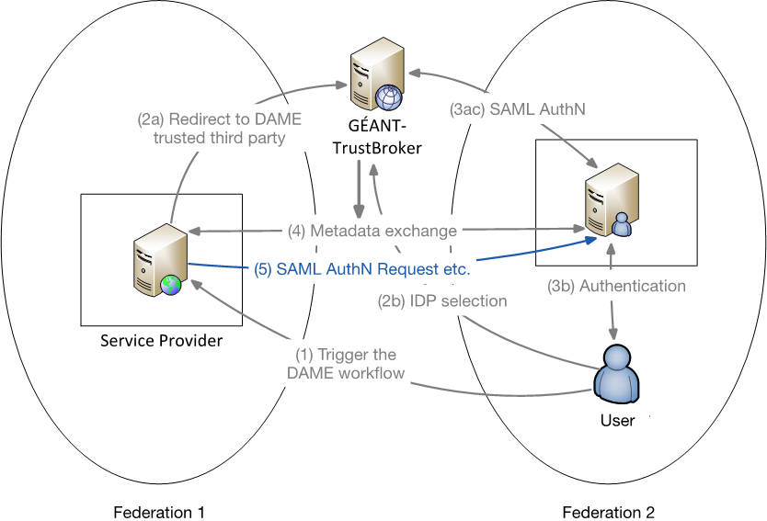
Current status – I-D

Slide 10
Current status – I-D
Last changes:
Clarify “inappropriate usage” scenarios
Reconsider security considerations on SHA-1
Reconsider workflow for lazy sessions
Clarify workflow, if one organization already has the metadata of the other organization
Clarify the actions, if one of the metadata interchanges fails
…
https://datatracker.ietf.org/doc/draft-poehn-dame/

Slide 11
Current status – Orga
GNTB only technical solution
How could it be organized?
Central service
Accept entities / import entities
Accept conversion rules / federational conversion rules
Entity category?

Slide 12

Demo
Setup:
Marina
Sunny

Slide 13
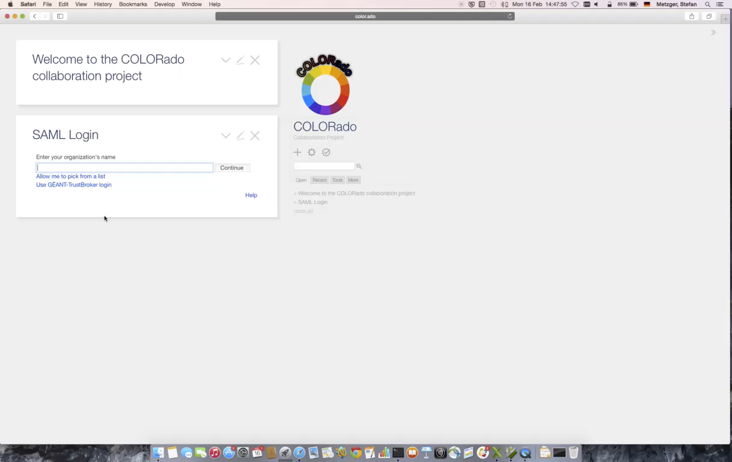
Demo

Slide 14
Trust, but verify.
- Ronald Reagan

