Slide 1

GÉANT SA5
Collaboration européenne
Thomas Bärecke
SA5 T5 team member @ GÉANT project
Software Engineer @ SWITCH
Journée Fédération, Paris
03/07/2015

Slide 2
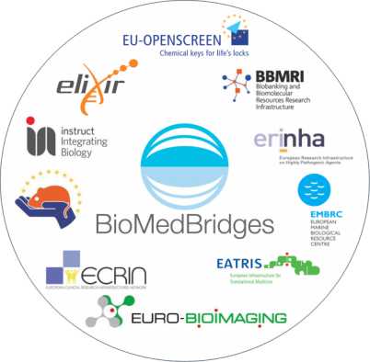






Federated Identity Management for Research
30+ Research Infrastructures in Europe

Slide 3


Common challenges
Attribute aggregation
User
friendliness
Credential translation
Scalable, flexible attribute release
Levels of Assurance
Homeless
users
Bridging Communities
Non-web-browser

Slide 4



GN4 idea management process
JRA3
Trust & Identity Research
SA5
Trust and Identity Service Development
SA4 Application Services Operations

Slide 5
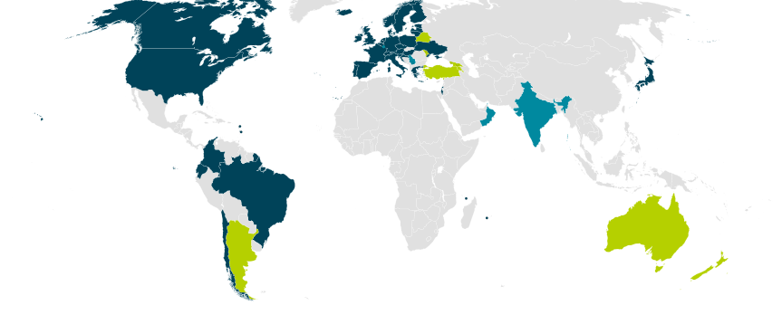
eduGAIN participants

Slide 6
Activity SA5 - overview
eduGAIN
Federation as a Service
Enabling Users
Federation as a Service
VO Platform as a Service
Pilots
Consultancy
SP registration simplification
eduGAIN technical development, inc. portal
Federation development
InAcademia
Harmonisation
Entity Categories
CoCo
Federation Practices
Assurance Business Case
Interoperability
Non web
Moonshot
ECP
New Task
New Subtask/work area

Slide 7
Harmonisation (1/2)
Entity Categories
Support the rollout of “Research and Scholarship” and “Code of Conduct” categories.
Support the creation of “Affiliation” and “Academia” categories.
Code of Conduct
Continue development of non EU / EEA Code of Conduct.
Ensure compliancy with changing Data Protection legislations.
Federation Practices
Establish common Metadata Registration Practice Statement.
Support non-SAML profiles in eduGAIN.
Make recommendations on metadata publication processes.
Assurance Business Case
Cost-benefit analysis for campuses adopting assurance profiles.
Scoping of step-up assurance service options.
Interoperability
Complete STORK-eduGAIN interoperability pilot and eIDAS scoping.
Define service requirements for FedLab offering.

Slide 8
Harmonisation (2/2)
Non Web
Harmonisation
Entity Categories
REFEDS
Code of Conduct
eduGAIN
Federation Practices
AARC
Assurance Business Case
Enabling Users
Interoperability

Slide 9
VO Platform as a Service (starting Nov. 2015)
Phase 1
Membership management
VO specific workflows
Persistent IDs
Account linking
Phase 2
VO specific attribute management
VO specific group management
Data agregation
Phase 3
Step-up as a Service
Services from JRAs, AARC, etc. ?

Slide 10

Enabling Users – initial objectives (2013)
Collaborate with the wider GÉANT project and
with international user communities to increase
usage of AAI infrastructure
Act as an expert partner for large, pan-European projects with AAI requirements
Coordinate a set of two or three projects between GÉANT and user communities, addressing their federated-identity concerns
Provide support such that four GN3plus project
tools/services are AAI-enabled

Slide 11



Enabling Users – Year 1 Collaborations
DARIAH
Humanities and
Social Sciences.
Bring ~ 4 8 services to eduGAIN and help
establishing GÉANT Data Protection Code
of Conduct
ELIXIR
Life Sciences
Access to European Genome Archive (REMS)
and integration of Resource Entitlement
Management System (REMS)
UMBRELLA
Photon/Neutron research
Bridging for Umbrella/eduGAIN. Moonshot pilot to provide SSH login with final goal to remotely control experiments.

Slide 12


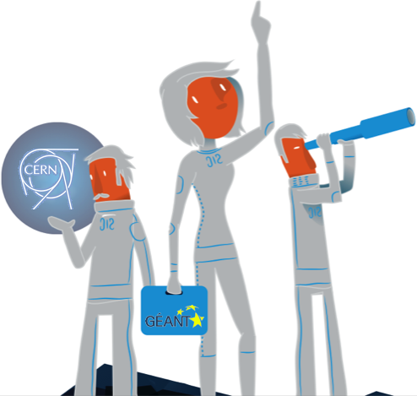

Enabling Users – Year 2 Collaborations
CERN
Connect CERN's ADFS-based web single
sign-on system via SWITCHaai to eduGAIN
Bilateral login now possible.
ESA
"Distributed" organisation in 5
countries.
Pilot project ended early 2015.
First step for ESA joining
eduGAIN via IDEM (IT).

Slide 13
Enabling Users – Main challenges
Missing FIM knowledge
Identity Provider Coverage
Insufficient Attribute Release
Undefined Levels of Assurance

Slide 14
Lessons learned
eduGAIN depends on the federation operators
Requirements often similar, no catch-all solution
AAI/eduGAIN expertise well appreciated
Growing interest in Levels of Assurance

Slide 15
Enabling Users – GN4 objectives
Continued Support and collaborations with research communities
  Work on two new research community use-cases
  We continue to provide basic support and expertise
New in GN4:
"Develop a clear, simple, friendly process through which new Service Providers who aim to deliver service on a pan-European or global scale and who do not have a have a particularly obvious relationship with an individual national federation can publish their metadata via eduGAIN".
Further ideas:
  Comparison of different e-infrastructures (eduGAIN, Moonshot, EGI, EUDAT, STORK)
  Helps research communities make informed choices
  eduGAIN Training event
  Specifically for research communities. Together with other eduGAIN-related tasks.

Slide 16
We are looking for use cases!
If your research community would like to have a first look at eduGAIN, contact us!
If you have advanced eduGAIN use-cases or needs, contact us!
If you see where GÉANT can improve a particular aspect of eduGAIN, contact us!
edugain-integration@geant.net

