Slide 1

VOPaaS
Virtual Organisation Platform as a Service
Niels van Dijk
GÉANT Trust and Identity Service Development
Technical Product Manager, SURFnet, The Netherlands
Internet2 2015 Technology Exchange
Oct 6, 2015, Cleveland

Slide 2

About GÉANT
GÉANT is Europe’s leading collaboration on network and related infrastructure and services for the benefit of research and education, contributing to Europe's economic growth and competitiveness. The organisation develops, delivers and promotes advanced network and associated e-infrastructure services, and supports innovation and knowledge-sharing amongst its members, partners and the wider research and education networking community.
GÉANT has 41 member countries and is owned by its core NREN membership, and also has Associate members including commercial organisations and multi-national research infrastructures and projects.
Almost all members of GÉANT operate Identity Federations and GÉANT operated the eduGAIN interfederation. GÉANT members also collaborate to design and deliver services.

Slide 3
VO Platform as a Service
Goal:
Investigate the conditions that would allow GÉANT to provide services to support Virtual Organisations
  Focus on delivery of Technical services (IAAS or PAAS)
  Out of scope:
    Technical development
    Policy & LOA development
Activities:
  Gather requirements and priorities with/from communities
  Look at existing tools and technologies
  Operations and Market
  Look into delivery model
  Investigate business case & sustainability

Slide 4
Virtual Organisations
Research has evolved into extensive collaborations between networks of researchers in multiple countries.
With the capabilities of the internet to connect not only people but also resources, sciences have evolved into e-Science.
Virtual Organisations (VOs) have emerged as the organisational representation of these networks of people and resources.
Broadly defined, VOs enable groups of people to share a set of resources.
Access to resources (or Services) often needs to be managed, and therefore requires authentication and authorization.

Slide 5
Authentication and Federation
Authentication is the process of confirming an identity: is this the same identity as used previously?
When using Federated Authentication in R&E, the identity is managed at the Home Institution.
The Identity provider (IdP), operated by the Home Institution, allows the authentication towards a Service (or Service Provider)
Identity Federations, such as InCommon or SURFconext, provide trust frameworks between Service Providers and Institutions
Interfederation, such as eduGAIN, emerged because of the need to interconnect National identity federations.
For international collaborations, federated AAI based on eduGAIN looks like an extremely useful infrastructure to build on.

Slide 6
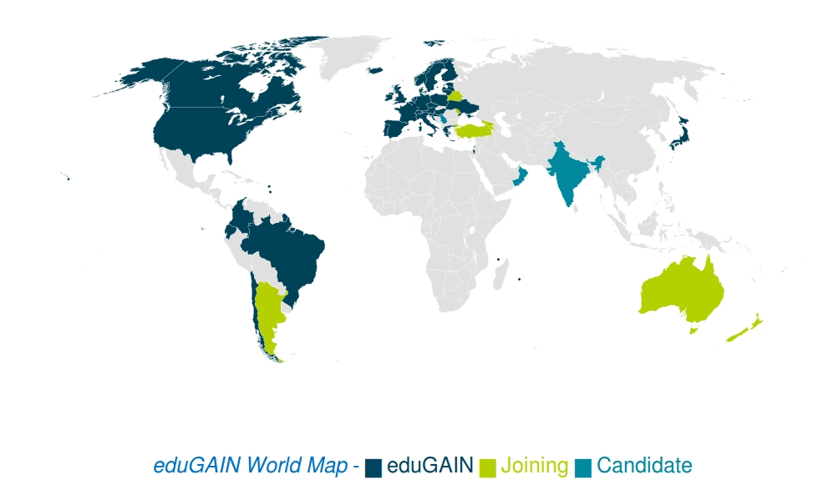
eduGAIN

Slide 7
Authorization
Authorization is about specifying access rights to a Service
To be able to grant access, a Service needs information beyond Authentication
In Identity Federations this information is often conveyed using attributes
Often attributes from the Home Organisation alone are not enough: VO related Services need attribute information in the context of the VO
VOs therefore need to be able to manage and provide attribute and group information towards Services, independently from the Home Organisation

Slide 8
Requirements for building on Federated AAI as a VO
The FIM4R paper (April 2012) was one of the first to articulate collective requirements for using Federated AAI for VOs
Many VOs have chosen to build the AAI infrastructure using the national and eduGAIN infrastructures
Identity Federations and Identity providers are however traditionally focused on Campus use cases, which introduces a number of challenges for VOs in leveraging Federated AAI
The VOPaaS project has performed a survey among several small and large Pan-European VOs to (re-)validate the FIM4R requirements
From the results of this Survey, functional requirements were analyzed,
A number of services were proposed to be put in place to support VOs on a Pan-European level.

Slide 9
VOPaaS Market Analysis
Interviews and desk study conducted with:
  Umbrella (Large neutron and photon facilities)
  CLASSe (Shared IaaS)
  DARIAH (Humanities)
  CERN (High Energy Physics)
  CLARIN (Humanities and social sciences)
  Virtual Campus Hub (eLearning, Renewable Energy)
  ELIXIR (Life Sciences, Bioinformatics)
  GÉANT VAPIRE (NREN collaboration).
Broad NREN/federation participation:
  AMRES, CESNET, DFN/LRZ, GARR, IUCC, NIIF, RENATER, SUNET, SURFnet, SWITCH
Final DRAFT report: https://wiki.geant.org/display/gn41sa5/Market+Analysis

Slide 10
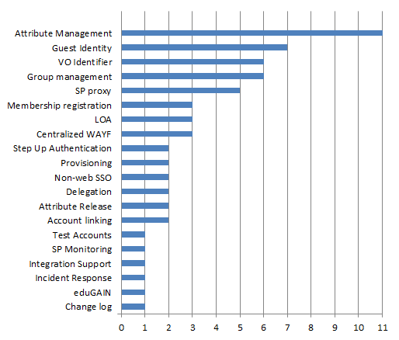
VOpaas Market Analysis Results

Slide 11
Function requirements for VOPaaS
Functional requirements identified
Persistent Identifier - Allow the VO to identify the user even if (s)he changes IdP
VO Membership Registry - To become members of the VO a certain workflow must be followed
‘External’ Identities - Many VO users will not be in eduGAIN
Attribute Management - Attributes beyond the IdP are needed for VO roles and rights, or to provide extra context (e.g. ORCID, Grant number)
Group Management - groups may also be used to define roles and rights
(de)Provisioning – Identity, attributes and groups need to be provided to Services
Service Proxy and Attribute Aggregation – A centralised infrastructure to operate on behalf of the VO Service Providers

Slide 12
Deployment model *
Basic Services
Operated by GÉANT
Also for VOs that are not legal entities
Operated as a (set of) Services
Advanced Services
Operated by GÉANT on behalf of a VO
Somebody – a legal entity - must take responsibility for that data
Operates as per VO applications on VM ‘boxes’

Slide 13
Basic Services
Basic Services
VO Membership service
  registry for VO persistent Identifier
  VO specific Workflows for onboarding
  Limited set of attributes
  Accessible through eduGAIN & extIDp
External Identity Provider (extIDp)
  One persistent (SAML) IdP for many ‘Guest’ Identity Providers, including:
    Social (Google, Twitter, Linkedin, Facebook)
    NREN operated & Commercial Guest IdPs (OpenIDP, UnitedID.org, eduID.se)
    eGOV (STORK)
    BankID
  Provides LOA: eIDAS by default, others upon request from SP
  Available and accessible through eduGAIN

Slide 14
Advanced Services
Advanced Services
(advanced) Attribute Management - Whatever you can come up with
(advanced) Group Management - Groups in groups, etc.
Provisioning - For web and non-web resources, ‘application specific connectors’
Service Proxy and Attribute Aggregation – To have a central point for technology and policy
  Accessible through eduGAIN & extIDp
  Managed by VO operator
  May be delivered as a paid service

Slide 15






Tools
Basic Services
VO Membership service: COmanage
External Identity Provider (extIDp): SaToSa
Advanced Services
Attributes and Groups: HEXAA, PERUN and COmanage
SP Proxy: OpenConext

Slide 16
VOPaaS Future
2015
Market Analysis
Cost Benefit Analysis & Business Model
Deploy pilot platform
Q1 2016
Run pilots with Basic Services, in collaboration with AARC
Support application integrations
2016
Production service for Basic Services
Deploy Pilots for Advanced Services
Possibly: pick up new services as developed within GEANT, AARC or others

