Slide 1
Identity Harmonisation
Nicole Harris
REFEDS Coordinator
GÉANT http://www.aaiedu.hr/dan2015.html

Slide 2
“the voice that articulates the mutual needs of research and education identity federations worldwide”

Slide 3
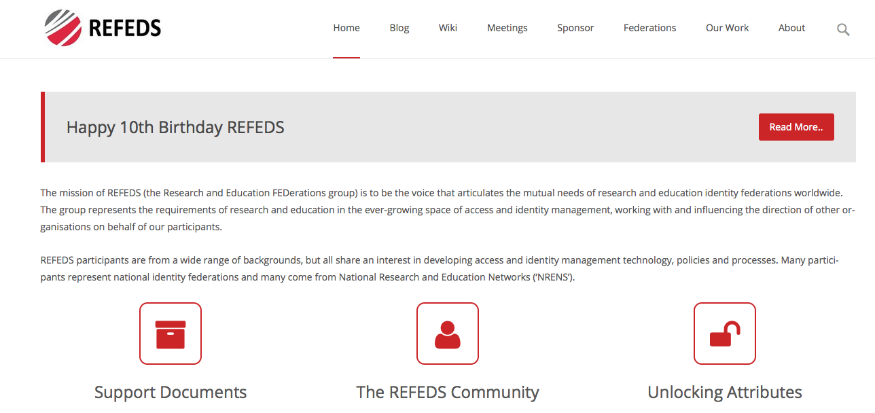
refeds.org

Slide 4
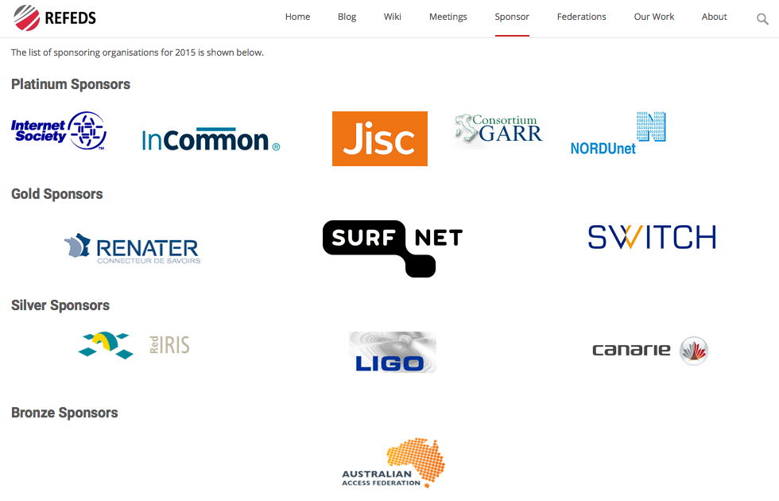
With thanks to our sponsors

Slide 5
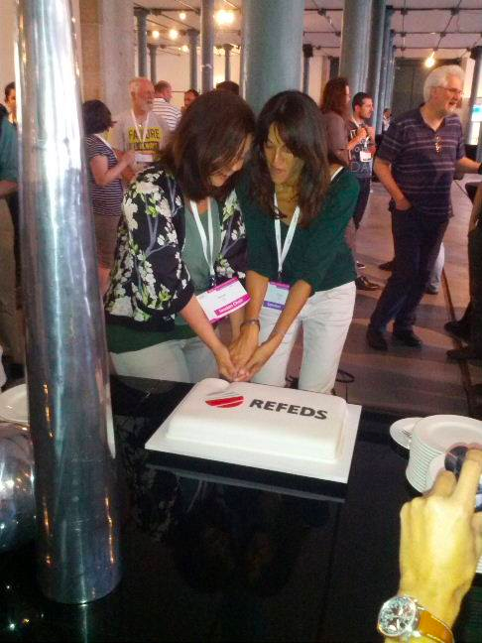

Slide 6
What do we do?
ENTITY CATEGORIES
FIM4R / SIRTFI
FEDERATION TEMPLATES
VIRTUAL ORGANISATIONS
MONITORING
SPECIFICATIONS AND SCHEMAS

Slide 7
What do our users want?
User Friendliness
Homeless Users
Different Levels of Assurance
Community based authorization
Flexible and scalable attribute release policies
Attribute Aggregation & Account Linking
Federation solutions based on open and standards based technologies
Persistent & Unique User Identifiers
User managed Identity Information
Up to date identity information
User groups and roles
Step up authentication
Browser and non-browser based federated access
Delegation
Social media identities
Integration with e-Government infrastructures
Service Provider Friendliness
Effective Accounting
Policy Harmonization
Federated Incident report Handling
Sufficient Attribute release
Awareness about R&E Federations
Semantically harmonized identity attributes
Simplified process for joining identity federation
Best practices for terms and conditions

Slide 8
What’s new from our users?
User Friendliness
Homeless Users
Different Levels of Assurance
Community based authorization
Flexible and scalable attribute release policies
Attribute Aggregation & Account Linking
Federation solutions based on open and standards based technologies
Persistent & Unique User Identifiers
User managed Identity Information
Up to date identity information
User groups and roles
Step up authentication
Browser and non-browser based federated access
Delegation
Social media identities
Integration with e-Government infrastructures
Effective Accounting
Policy Harmonization
Federated Incident report Handling
Sufficient Attribute release
Awareness about R&E Federations
Semantically harmonized identity attributes
Simplified process for joining identity federation
Service Provider Friendliness
Best practices for terms and conditions

Slide 9

https://flic.kr/p/51CKtJ
https://www.flickr.com/photos/foxtongue/

Slide 10
We don’t normally communicate directly with entities, but…

Slide 11
Two Campaigns for 2016
How to use Federations more effectively: https://wiki.refeds.org/download/attachments/6619142/REFEDS.pdf
New Years Resolutions: https://wiki.refeds.org/download/attachments/6619142/Resolutions.pdf

Slide 12

Campaign 1

Slide 13
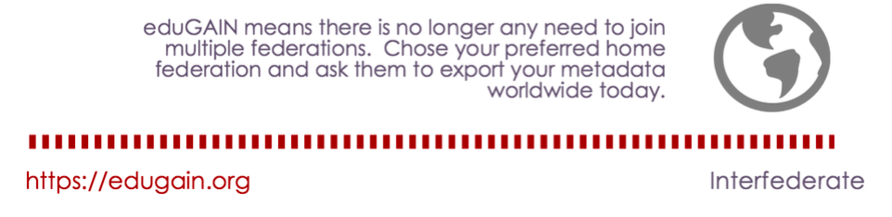

Slide 14
REFEDS? eduGAIN?
REFEDS
eduGAIN
Support for establishing national federations
Enabling federations to interfederate

Slide 15
























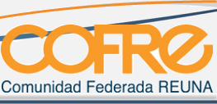












Lots of federations…
Slide 15
Notes:
Federations Missing: eduIDM (Morocco), Oman KID (Oman)

Slide 16
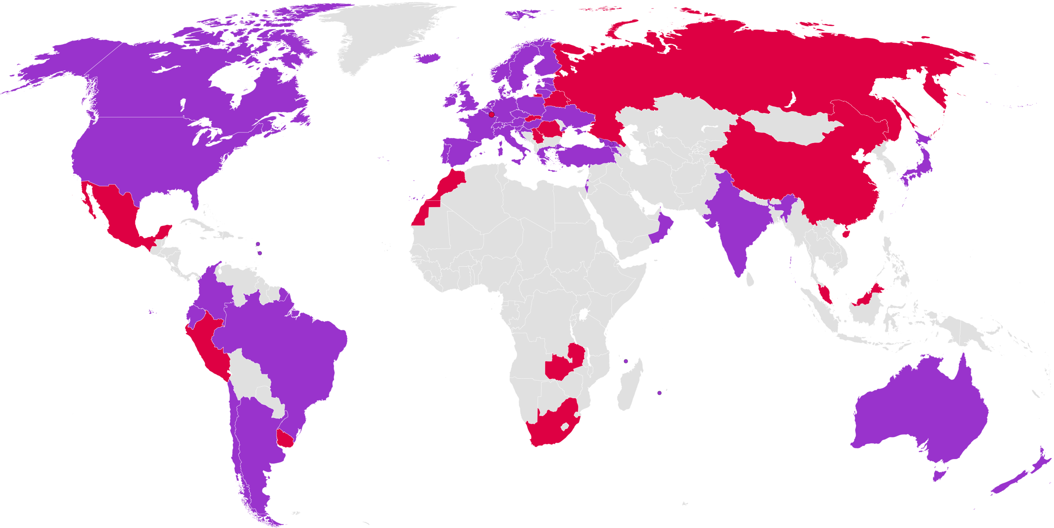

Identity Federations: World Wide
42 Production Federations
Last update April 2015
14 Pilot Federations

Slide 17
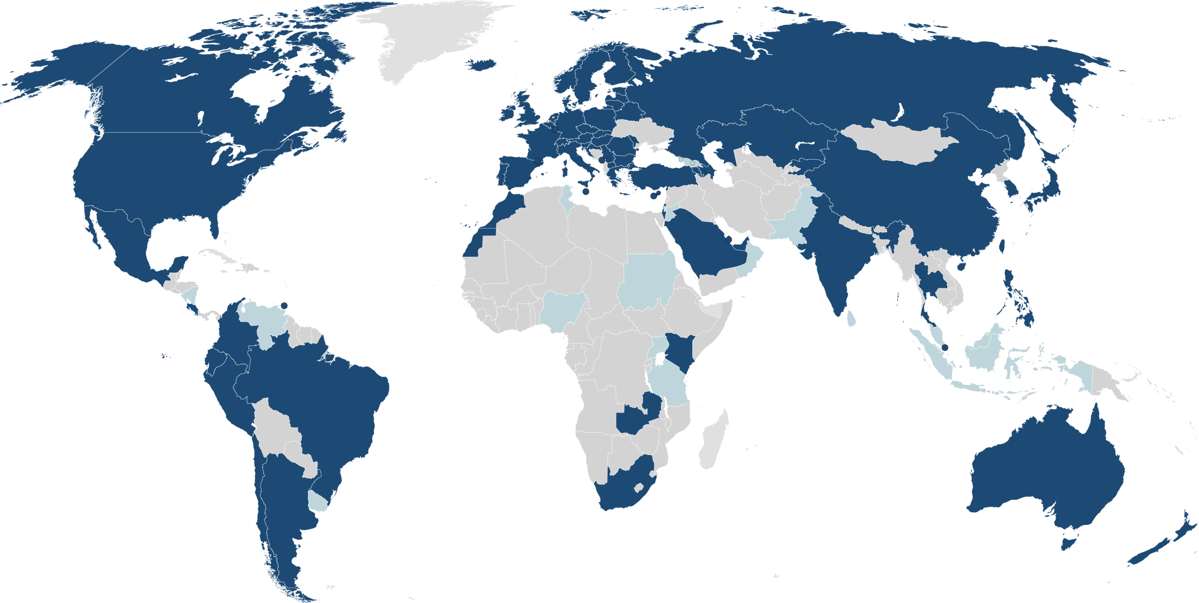
eduroam Federations: World Wide
eduroam (74)
Pilot (16)
:-(
last update June 2015, www.eduroam.org

Slide 18
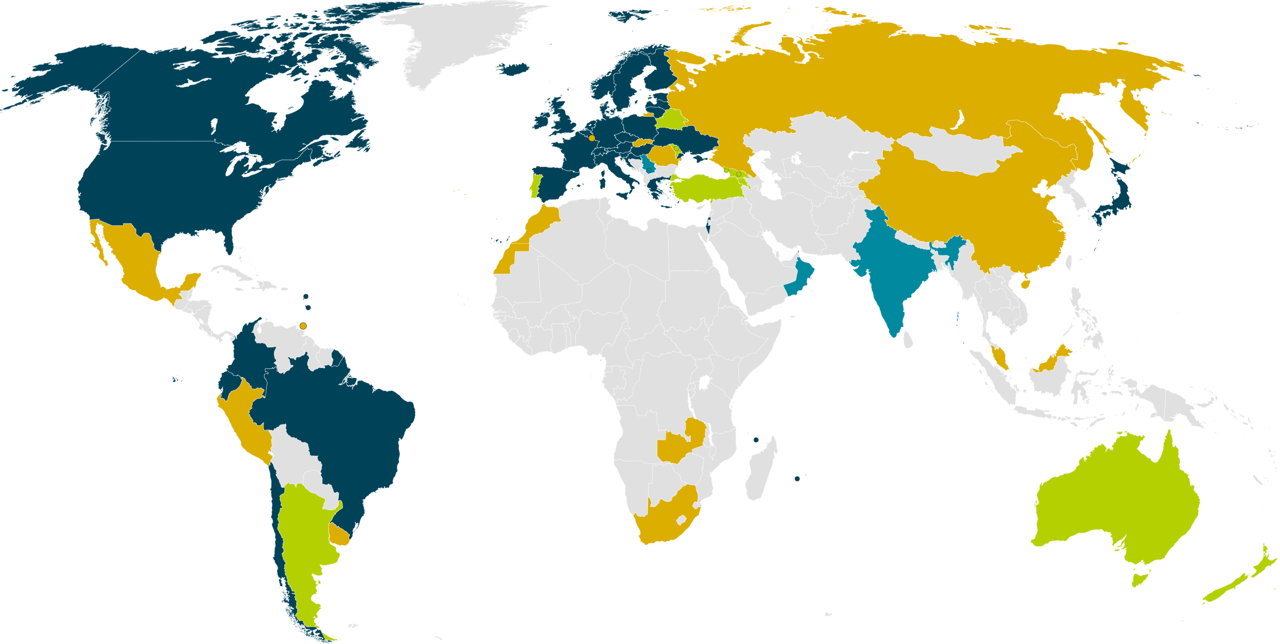
eduGAIN & Federation Status
April 2015
32 eduGAIN Members
9 Joining eduGAIN
3 Candidate Federation
12 Other Federations
Notes:
Big growth in new federations – many have aspirations to join eduGAIN and interfederate.

Slide 19

eduGAIN & Federation Status
June 2015
33 eduGAIN Members
8 Joining eduGAIN
4 Candidate Federation
13 Other Federations
Notes:
Big growth in new federations – many have aspirations to join eduGAIN and interfederate.

Slide 20
eduGAIN & Federation Status
June 2015
33 eduGAIN Members
8 Joining eduGAIN
4 Candidate Federation
13 Other Federations
Notes:
Big growth in new federations – many have aspirations to join eduGAIN and interfederate.

Slide 21
eduGAIN: Some Statistics
  April 2011: Official start of eduGAIN
  Nov 2013: 21 Federations are members (50%) , 5 joining
  Apr 2014: 24 Federations are members (51%) , 6 joining
  April 2015: 32 Federations are members (57%), 9 joining
  June 2015: 33 Federations are members (58%), 8 joining, 4 candidates
  Entities: 1285 IdPs, 961 SPs (2244 in total)
  One IdP can represent for dozens of organisations and services depending on federation architecture => actual numbers are higher
  Whole (academic) SAML landscape:
  56 Federations, 3007 IdPs, 6514 SPs (gathered from metadata)
  Not all of them need to be interfederated, e.g. many internal SPs
  Numbers from June 2015
Notes:
April 2011: Official start of eduGAIN
Nov 2013: 21 Federations are members (50%) , 5 joining
Entities: 147 IdPs, 71 SPs
One IdP can represent for dozens of organisations and services depending on federation architecture => actual numbers are higher
Whole (academic) SAML landscape:
42 Federations, 2424 IdPs, 4772 SPs (gathered from metadata)
Not all of them need to be interfederated, e.g. many internal SPs
Numbers from 6. November 2013

Slide 22
Possible Issues?
“Foreign” Metadata
Different Policies
eduGAIN ties to local policy
Strange Tags in the Metadata
Entity Categories etc
Metadata Aggregation and Stripping
Privacy Concerns
Data Protection in your country?
Review, get advice

Slide 23
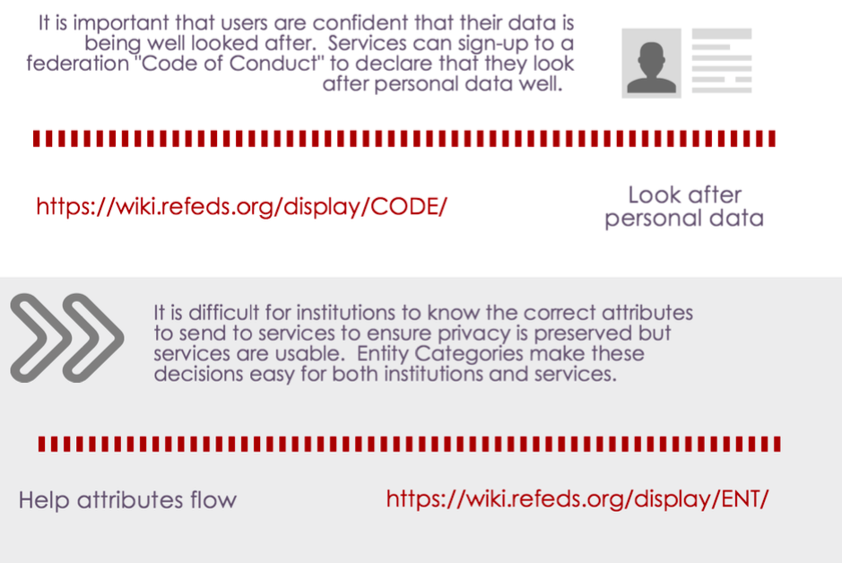

Slide 24
What is an Entity Category?
Entity Categories group federation entities that share common criteria.
obliged to conform to the characteristics set out in the definition of that category.
Can be SP or IdP tagged.
a way to facilitate IdP decisions to release a defined set of attributes to SPs (scaling attribute release policies).
Other use cases (see hide-from-discovery).
Expressed as a SAML Attribute.

Slide 25
Entity Categories?
Helps you tag entities to say certain things about them.
“Hide from Discovery” = don’t display this IdP in your discovery service: https://refeds.org/category/hide-from-discovery.
“Research and Scholarship” = this SP genuinely needs certain attributes to support research activity: https://refeds.org/category/research-and-scholarship.
“Code of Conduct” = this SP is self-declaring that it meets data protection standards IN EUROPE: https://wiki.refeds.org/display/CODE/.

Slide 26
<EntityDescriptor xmlns="urn:oasis:names:tc:SAML:2.0:metadata"
entityID="https://service.example.com/sp">
<Extensions xmlns:mdattr="urn:oasis:names:tc:SAML:metadata:attribute">
<mdattr:EntityAttributes xmlns:saml="urn:oasis:names:tc:SAML:2.0:assertion">
<saml:Attribute
Name="http://macedir.org/entity-category"
NameFormat="urn:oasis:names:tc:SAML:2.0:attrname-format:uri">
<saml:AttributeValue>http://refeds.org/category/research-and-scholarship</saml:AttributeValue>
</saml:Attribute>
</mdattr:EntityAttributes>
</Extensions>
...
</EntityDescriptor>

Slide 27
Can I Release Attributes?
SAFEGUARDS
TRANSPARENCY
IMPACT MANAGEMENT
LEGITIMATE REASONS
BALANCE
CASE BY CASE
https://wiki.refeds.org/display/ENT/Guidance+on+justification+for+attribute+release

Slide 28
Can I Release Attributes?
CONSENT | The data subject has unambiguously given his consent.
CONTRACTUAL | Processing is necessary for the performance of a contract to which the data subject is party.
LEGAL OBLIGATION | Processing is necessary for compliance with a legal obligation to which the data controller is subject.
VITAL INTEREST | Processing is necessary in order to protect the vital interests of the data subject.
PUBLIC INTEREST | Processing is necessary for the performance of a task carried out in the public interest or in the exercise of official authority vested in the controller or in a third party to whom the data are disclosed.
LEGITIMATE INTERESTS | Processing is necessary for the purposes of the legitimate interests pursued by the controller or by the third party or parties to whom the data are disclosed.

Slide 29
7-STEP PLAN
STEP ONE
Check that Legitimate Interests is the best approach.
STEP TWO
Qualify the legitimacy of the request – lawful, clearly articulated, real need.
STEP THREE
Determine whether the processing is necessary to achieve the goal.

Slide 30
7-STEP PLAN
STEP FOUR
Balance the data controller’s needs against the interests of the subjects.
STEP FIVE
Identity safeguards you can put in place (tech design etc).
STEP SIX
Demonstrate (publish) compliancy.
STEP SEVEN
Allow the user to opt-out.

Slide 31
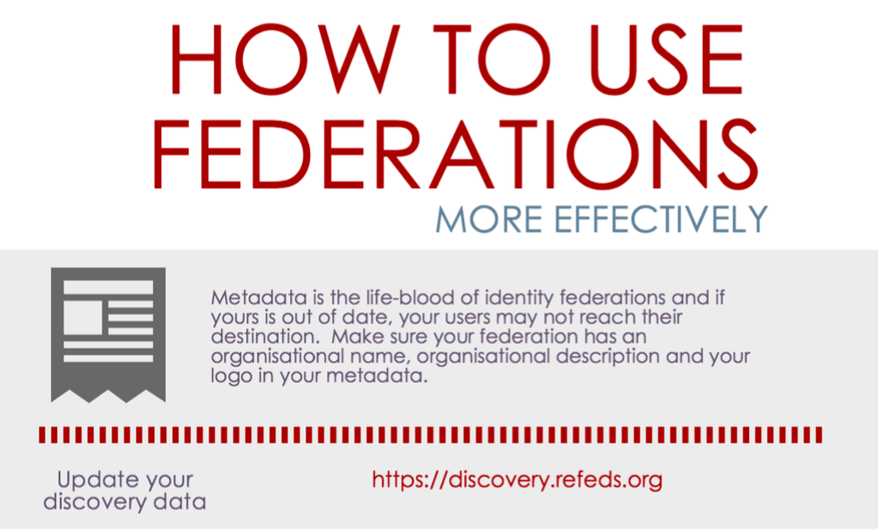

Slide 32
https://discovery.refeds.org/

Slide 33

New Year’s Resolutions

Slide 34
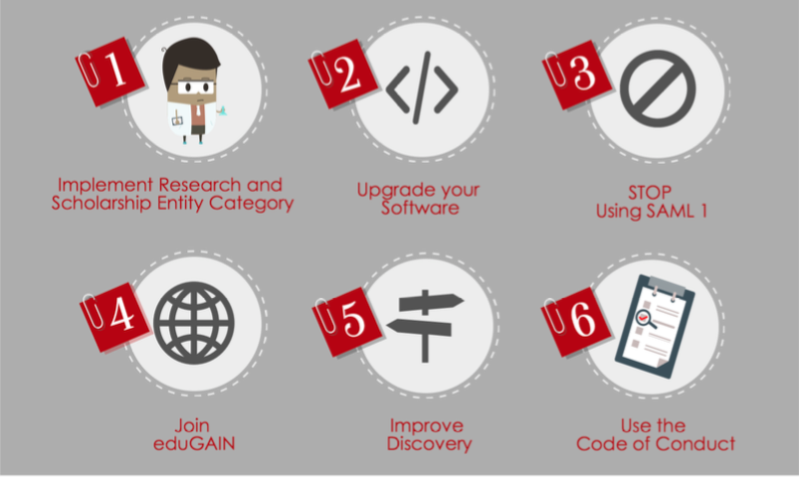

Slide 35
What else?
Help us design our workplan: https://wiki.refeds.org/display/WOR/2016+Work+Plan+Preparation
Participate: https://refeds.org/about/refeds-participants-agreement

Slide 36

https://flic.kr/p/hoMcw
https://www.flickr.com/photos/marcusramberg/

