Slide 1
eduGAIN, REFEDS and the UK
Where are we?
Nicole Harris
Project Development Officer
GÉANT
UK federation meeting
23 June 2015

Slide 2





































Lots of Federations…
Slide 2
Notes:
Federations Missing: eduIDM (Morocco), Oman KID (Oman)

Slide 3
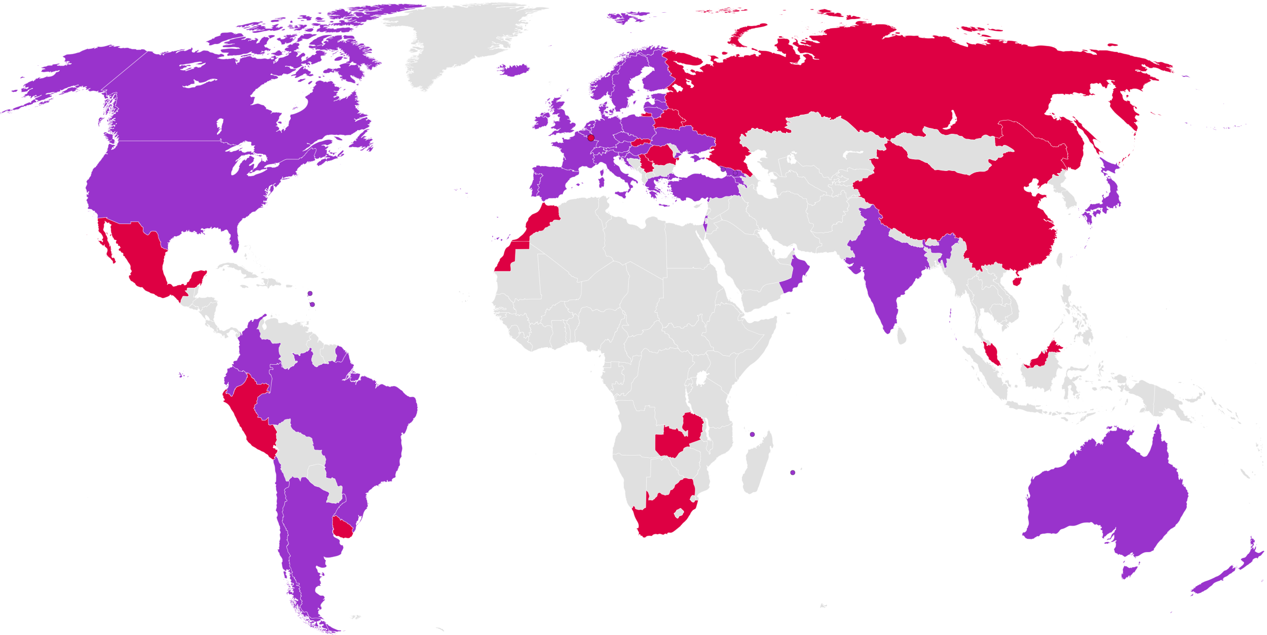

Identity Federations: World Wide
42 Production Federations
Last update April 2015
14 Pilot Federations

Slide 4
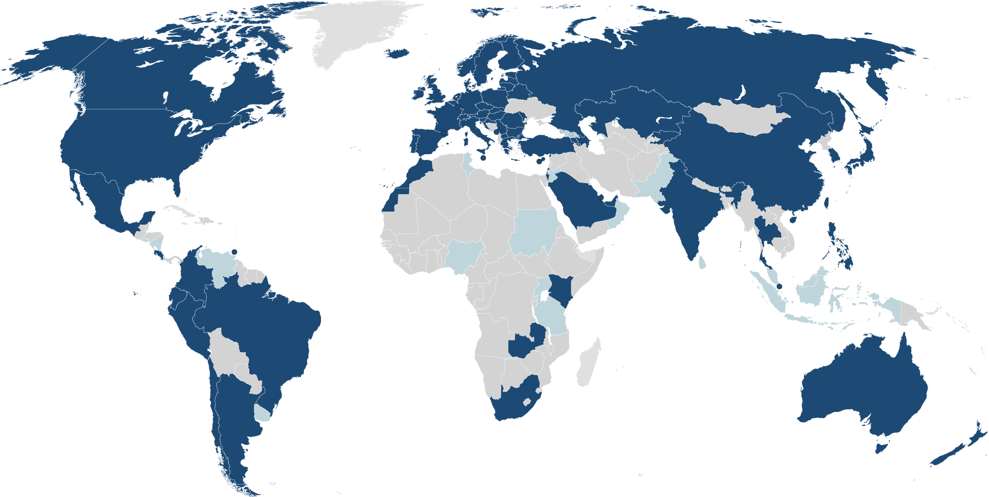
eduroam Federations: World Wide
eduroam (74)
Pilot (16)
:-(
last update June 2015, www.eduroam.org

Slide 5
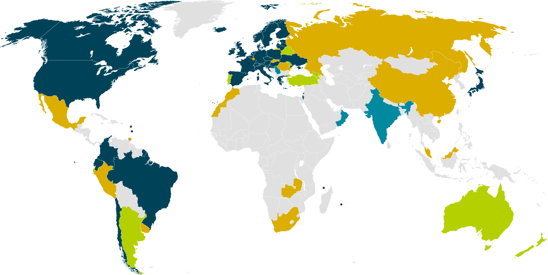
eduGAIN & Federation Status
April 2015
32 eduGAIN Members
9 Joining eduGAIN
3 Candidate Federation
12 Other Federations
Notes:
Big growth in new federations – many have aspirations to join eduGAIN and interfederate.

Slide 6

eduGAIN & Federation Status
June 2015
33 eduGAIN Members
8 Joining eduGAIN
4 Candidate Federation
13 Other Federations
Notes:
Big growth in new federations – many have aspirations to join eduGAIN and interfederate.

Slide 7
eduGAIN & Federation Status
June 2015
33 eduGAIN Members
8 Joining eduGAIN
4 Candidate Federation
13 Other Federations
Notes:
Big growth in new federations – many have aspirations to join eduGAIN and interfederate.

Slide 8
eduGAIN: Some Statistics
  April 2011: Official start of eduGAIN
  Nov 2013: 21 Federations are members (50%) , 5 joining
  Apr 2014: 24 Federations are members (51%) , 6 joining
  April 2015: 32 Federations are members (57%), 9 joining
  June 2015: 33 Federations are members (58%), 8 joining, 4 candidates
  Entities: 1285 IdPs, 961 SPs (2244 in total)
  One IdP can represent for dozens of organisations and services depending on federation architecture => actual numbers are higher
  Whole (academic) SAML landscape:
  56 Federations, 3007 IdPs, 6514 SPs (gathered from metadata)
  Not all of them need to be interfederated, e.g. many internal SPs
  Numbers from June 2015
Notes:
April 2011: Official start of eduGAIN
Nov 2013: 21 Federations are members (50%) , 5 joining
Entities: 147 IdPs, 71 SPs
One IdP can represent for dozens of organisations and services depending on federation architecture => actual numbers are higher
Whole (academic) SAML landscape:
42 Federations, 2424 IdPs, 4772 SPs (gathered from metadata)
Not all of them need to be interfederated, e.g. many internal SPs
Numbers from 6. November 2013

Slide 9
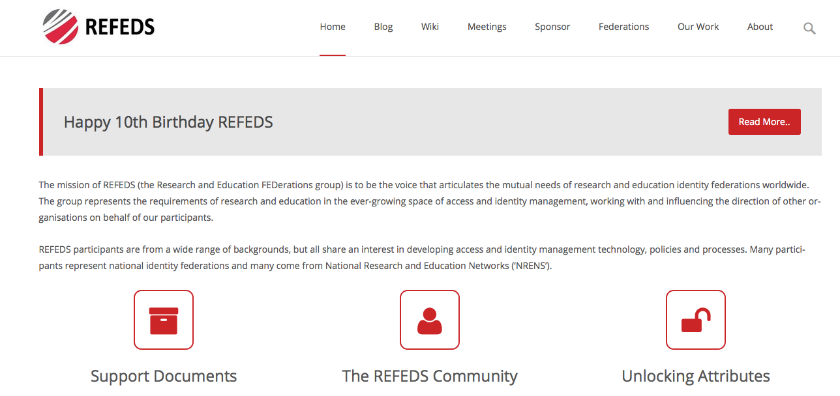

Slide 10
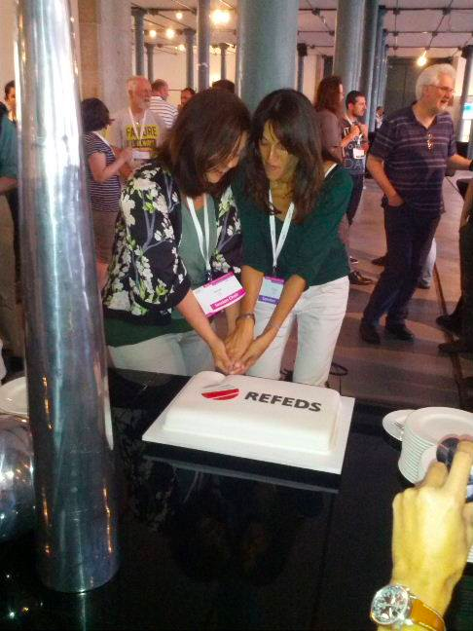

Slide 11
WHAT DO WE DO?
ENTITY CATEGORIES
FIM4R / SIRTFI
FEDERATION TEMPLATES
VIRTUAL ORGANISATIONS
MONITORING
SPECIFICATIONS AND SCHEMAS

Slide 12
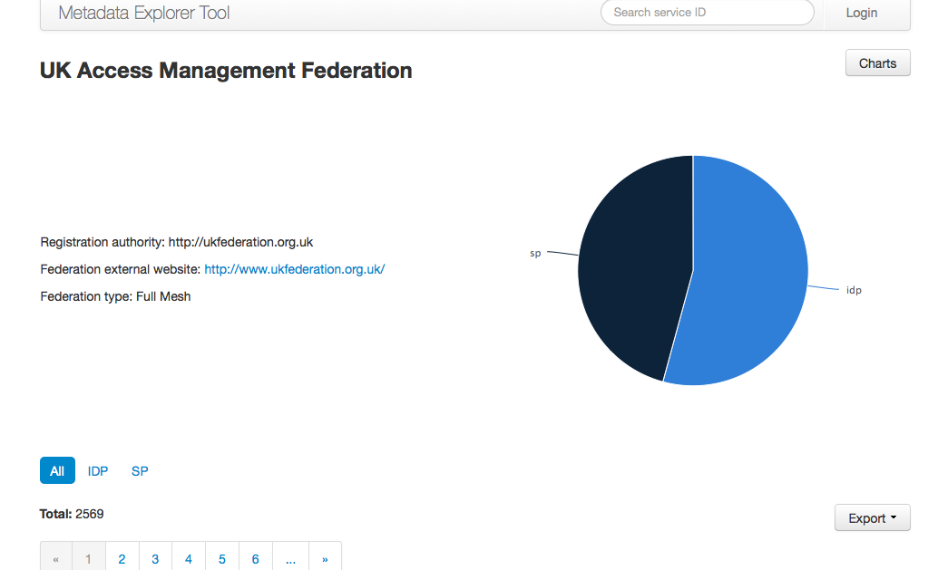
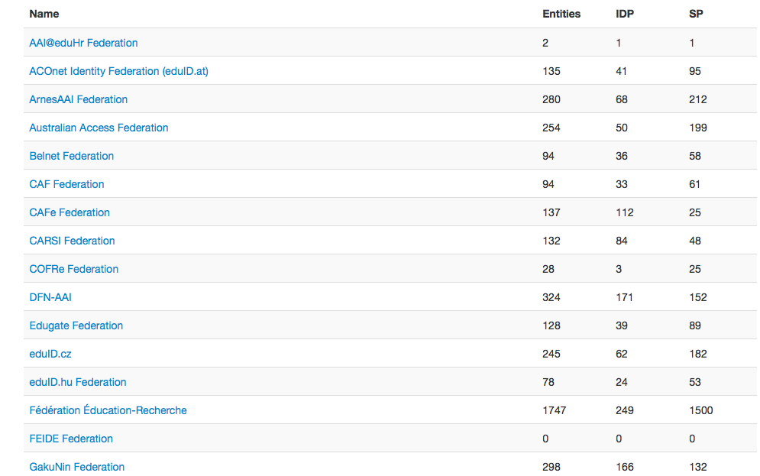

Slide 13
What is an Entity Category?
Entity Categories group federation entities that share common criteria.
obliged to conform to the characteristics set out in the definition of that category.
Can be SP or IdP tagged.
a way to facilitate IdP decisions to release a defined set of attributes to SPs (scaling attribute release policies).
Other use cases (see hide-from-discovery).
Expressed as a SAML Attribute.

Slide 14
CONSENT | The data subject has unambiguously given his consent.
CONTRACTUAL | Processing is necessary for the performance of a contract to which the data subject is party.
LEGAL OBLIGATION | Processing is necessary for compliance with a legal obligation to which the data controller is subject.
VITAL INTEREST | Processing is necessary in order to protect the vital interests of the data subject.
PUBLIC INTEREST | Processing is necessary for the performance of a task carried out in the public interest or in the exercise of official authority vested in the controller or in a third party to whom the data are disclosed.
LEGITIMATE INTERESTS | Processing is necessary for the purposes of the legitimate interests pursued by the controller or by the third party or parties to whom the data are disclosed.

Slide 15
CAN I RELEASE ATTRIBUTES?
SAFEGUARDS
TRANSPARENCY
IMPACT MANAGEMENT
LEGITIMATE REASONS
BALANCE
CASE BY CASE
https://wiki.refeds.org/display/ENT/Guidance+on+justification+for+attribute+release

Slide 16
7-STEP PLAN
STEP ONE
Check that Legitimate Interests is the best approach.
STEP TWO
Qualify the legitimacy of the request – lawful, clearly articulated, real need.
STEP THREE
Determine whether the processing is necessary to achieve the goal.

Slide 17
7-STEP PLAN
STEP FOUR
Balance the data controller’s needs against the interests of the subjects.
STEP FIVE
Identity safeguards you can put in place (tech design etc).
STEP SIX
Demonstrate (publish) compliancy.
STEP SEVEN
Allow the user to opt-out.

Slide 18


The Starting Point –
FIM4R and TERENA AAA Study
Attribute aggregation
User
friendliness
Credential translation
Attribute release
Levels of Assurance
Homeless
users
Bridging Communities
Non-web-browser
30+ Research Infrastructures in Europe
Countless more “long tail” users
Notes:
Also Authorisation under community control, open standards, well defined, harmonised attributes

