Slide 2
Agenda
Introduction security track
  Tech-poll: How tech can we be?
Introduction in (E-health) security
  Outlines the risk management process
Security in action
  More detailed description of the risk management process
Securing private data
  Data masking, anonymisation, pseudonymisation

Slide 3

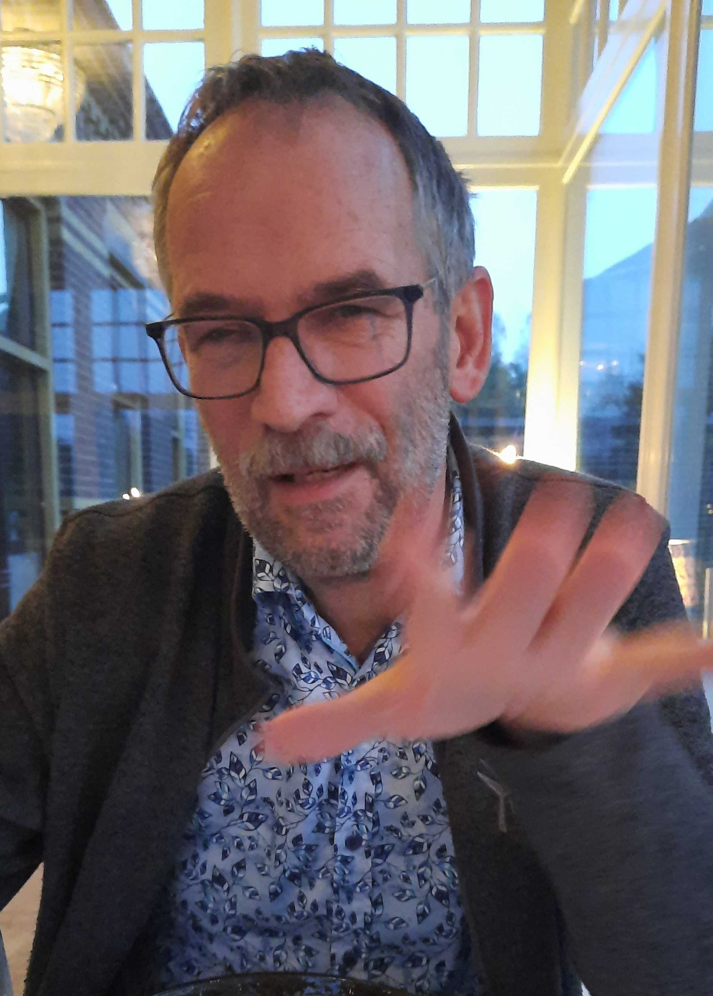


Who Am I?
Alf Moens, infected with collaboration virus
Notes:
Also insert slide with intro Tim

Slide 4
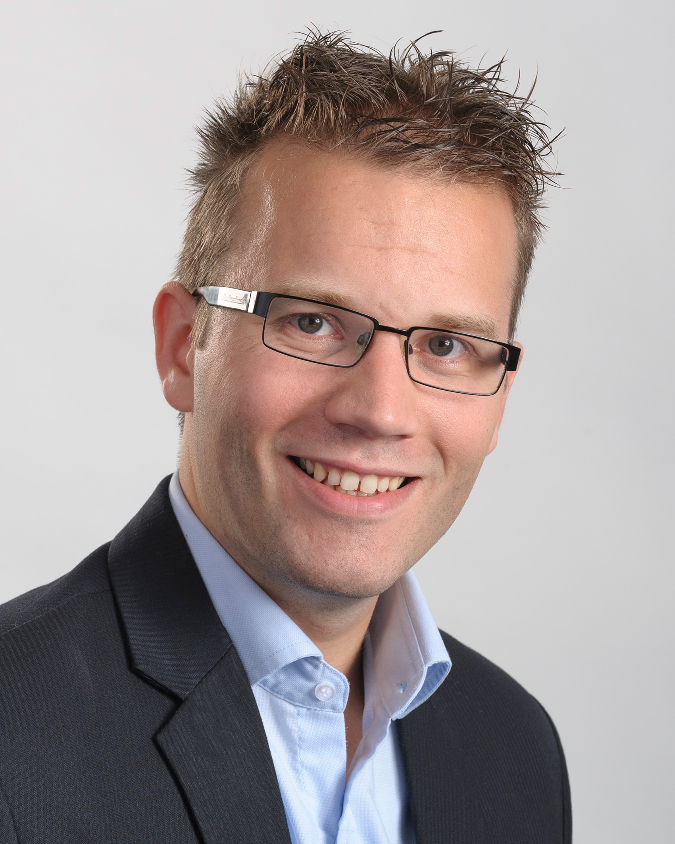
Introduction
Tim Waters
Bachelor in ICT
Master of Science in Business Administration
Experience
  Computer networking en systems administration
  Ethical hacking / Cyber security
  Teacher in CyberSecurity and awareness training
Joint GÉANT in 2022

Slide 5
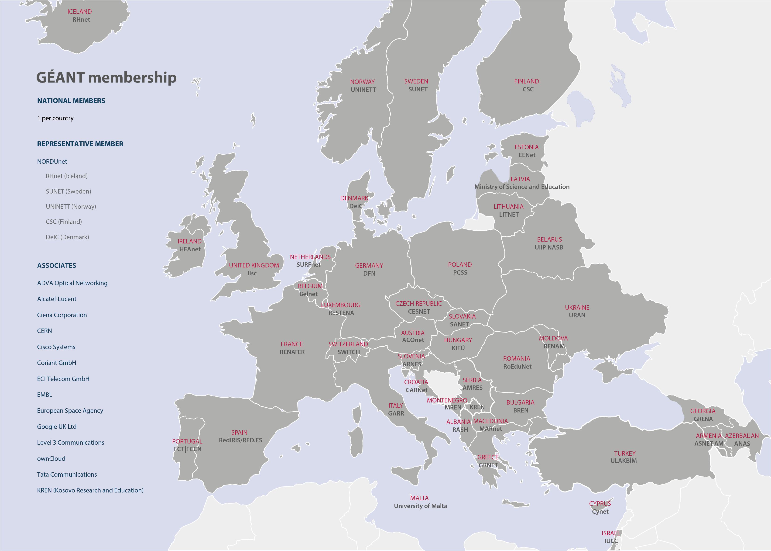
Membership Association
GÉANT Association supports and represents 38 NRENs and NORDUnet across Europe.
Together they support over 10,000 institutions and 50 million academic users.
Notes:
Alternative slide using map

Slide 6



Supporting collaboration and development amongst researchers, the dissemination of information & knowledge, and providing access to a portfolio of services and infrastructure resources:
Runs a membership association for Europe’s National Research & Education Networks (NRENs)
GÉANT Association
Coordinates and participates in EC-funded projects
Under Horizon 2020, the Horizon Europe programme, and other EC funding programmes, aimed at securing Europe’s global competitiveness.
Operates a pan-European e-infrastructure
GÉANT network
Manages a portfolio of services for research & education
eduX
Organises and runs community events & working groups
TNC, task forces & special interest groups

Slide 7
Network
The GÉANT network interconnects research, education and innovation communities worldwide, with secure, high-capacity networks.
We design, plan, build and operate the large-scale, high-performance GÉANT network that connects European NRENs to each other and the rest of the world for sharing, accessing and processing the high data volumes generated by research and education communities and for testing innovative technologies and concepts.

Slide 8
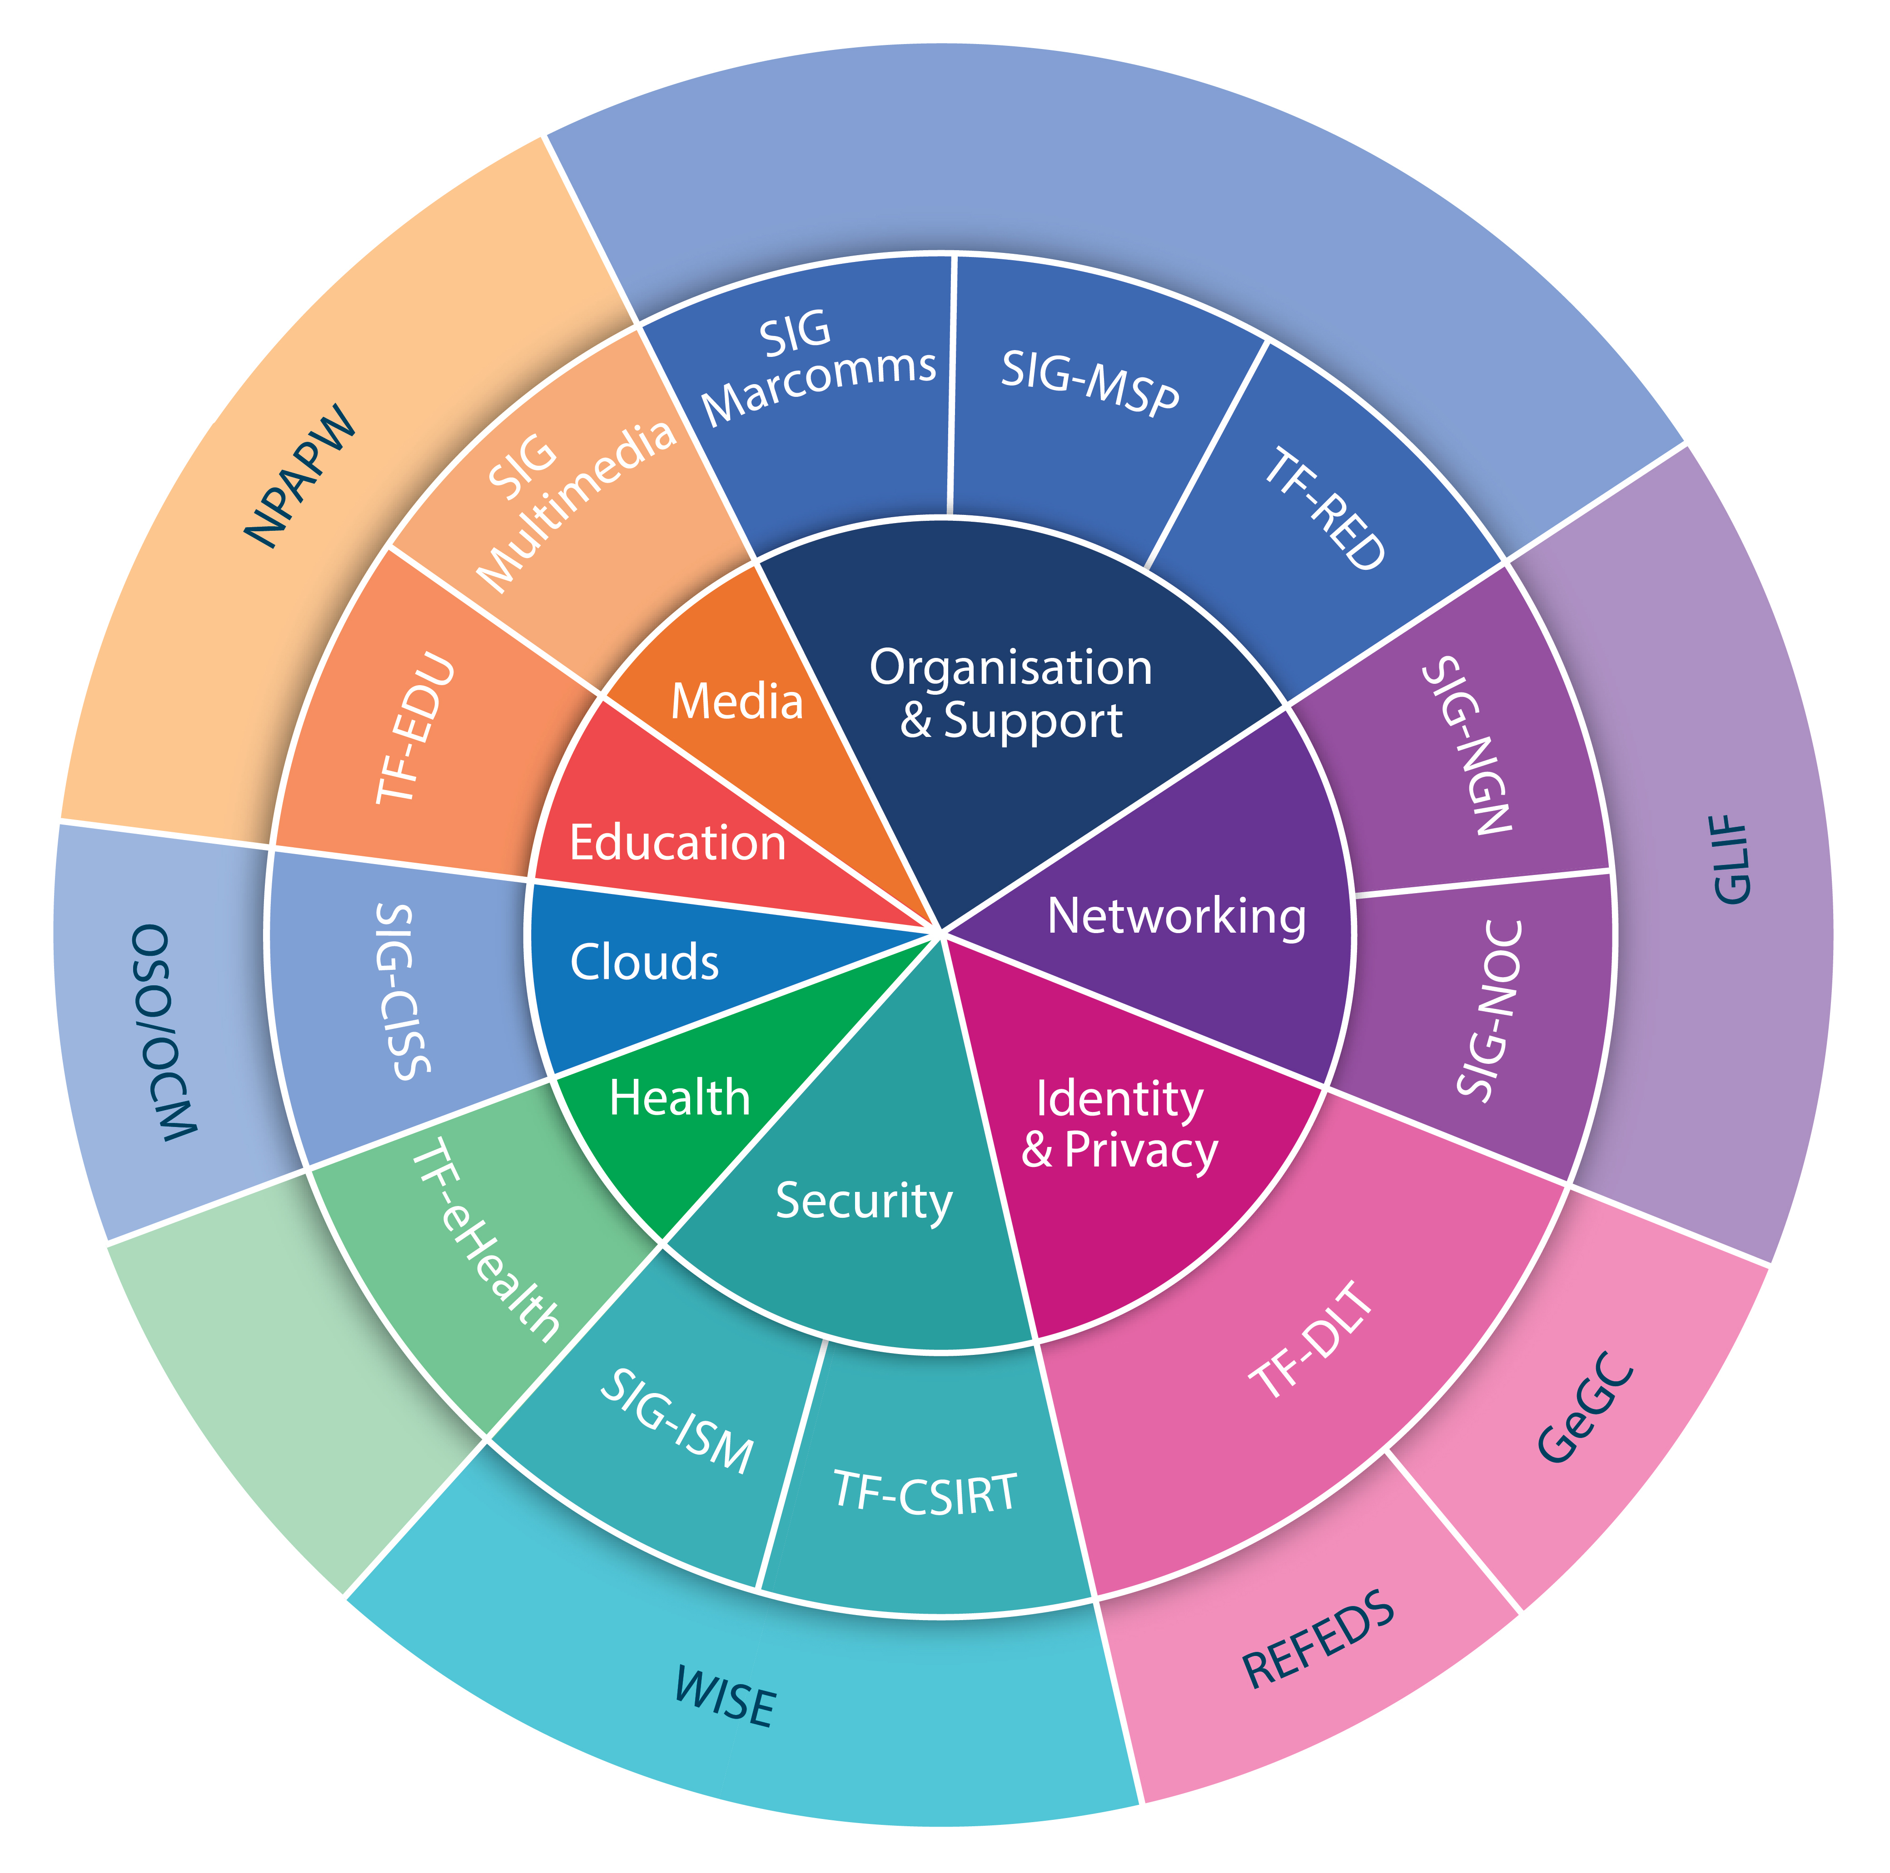
Special Interest Groups & Task Forces
community.geant.org

Slide 9
Introduction security track

Slide 10
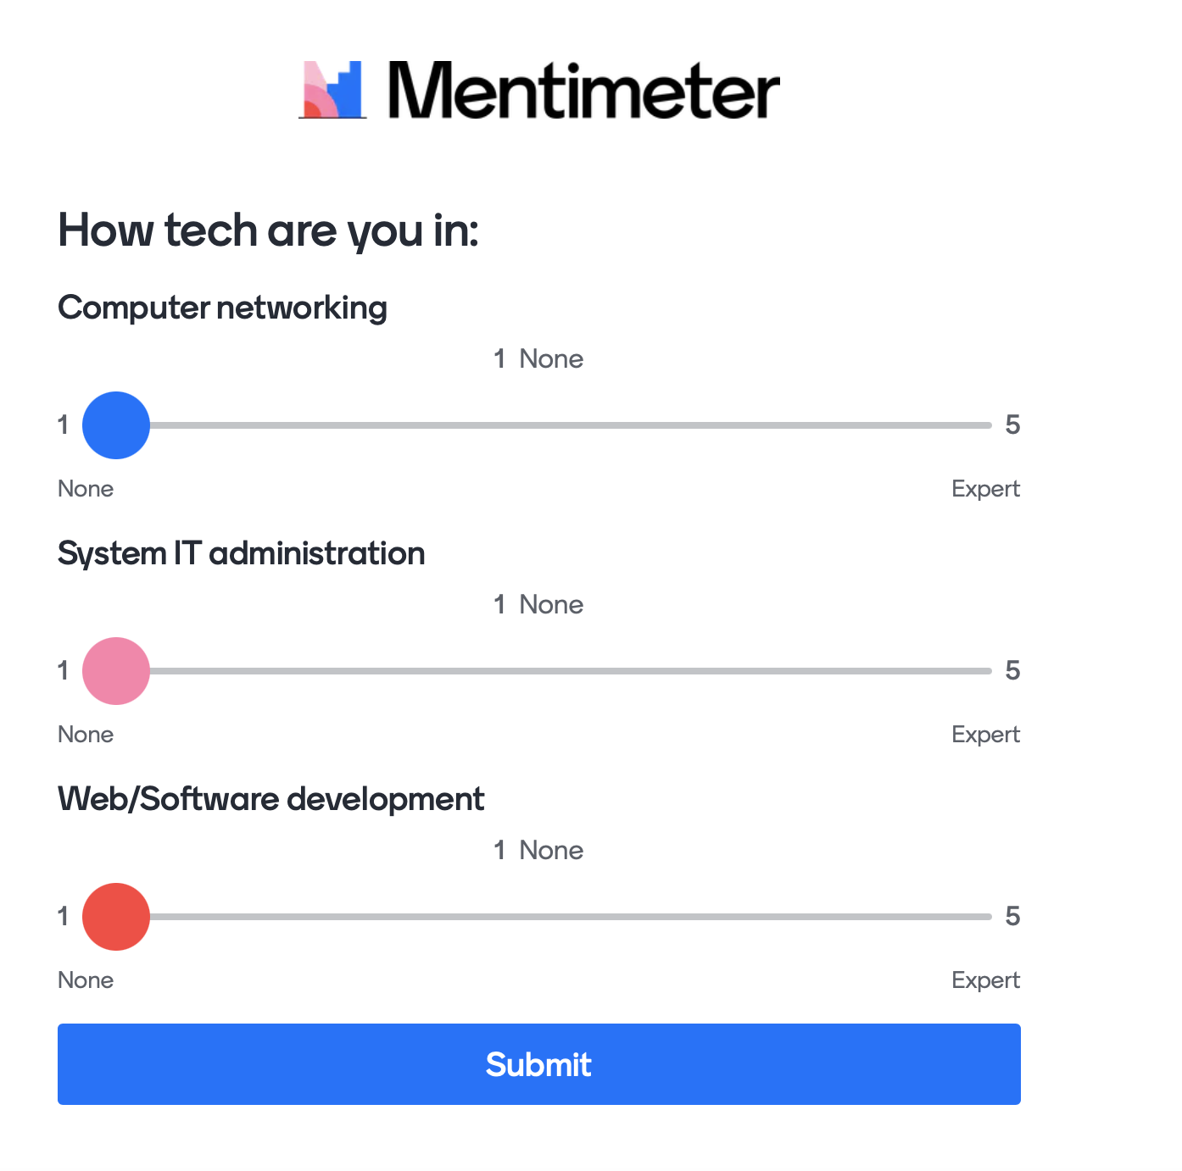
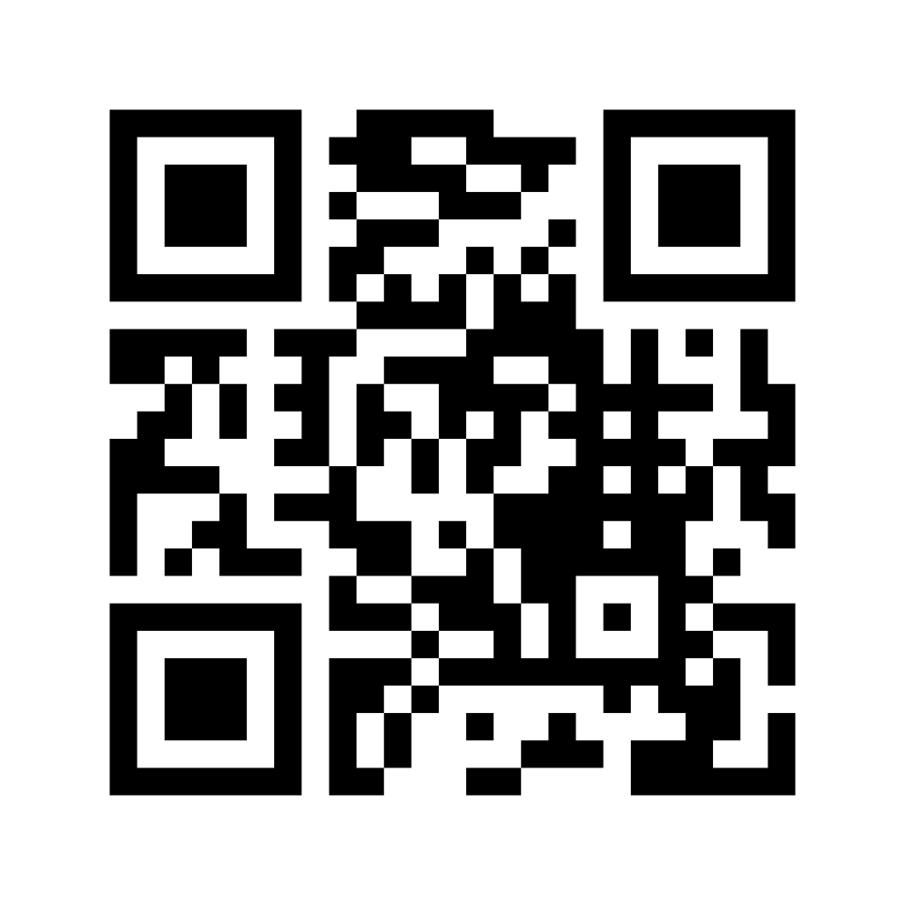
Introduction
Tech poll: How tech are you?
Go to
https://menti.com (Code 5439 2802)

Slide 11
Introduction in (ehealth) security

Slide 12
Security vocabulary
Information security
Confidentiality
Integrity
Availability
(Cybersecurity) Risk
Controls or measures
Vulnerabilities

Slide 13
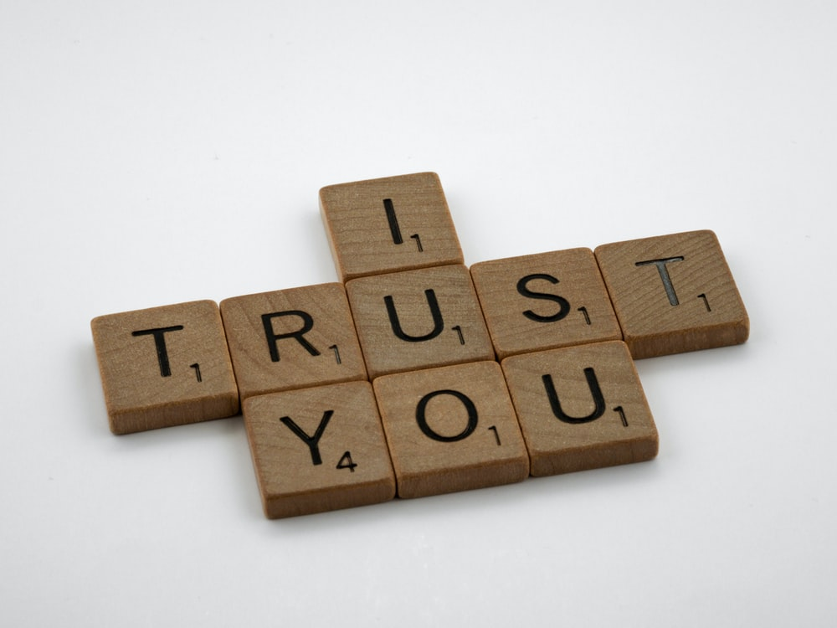

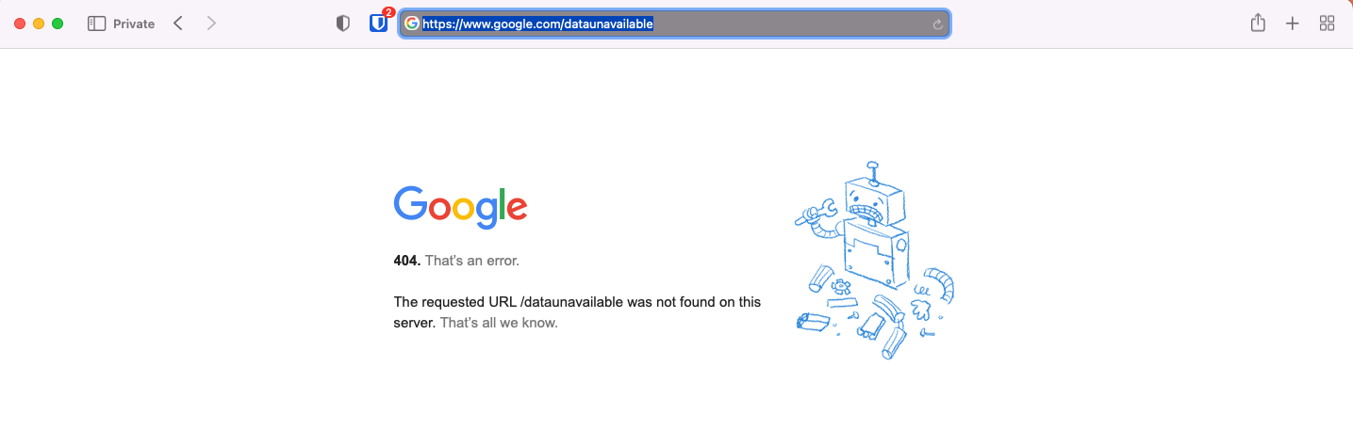
Security vocabulary
What is (Information) security?
  Confidentiality
  Integrity
  Availability
Notes:
Before diving in, let’s introduce some key terms in security
Information security: Information security is the protection of information and especially the processing of information
Confidentiality: keep things secret to unauthorized persons
Integrity: keep unauthorized persons from manipulating data so that data is always trustworthy
Availability: Keep data available ( for processing ). Includes preventing deletion and knocking it offline ((D)DOS)
Sources:
https://pixabay.com/illustrations/top-secret-report-file-secret-top-1076813/
https://unsplash.com/photos/CDoKLQeUHyk

Slide 14
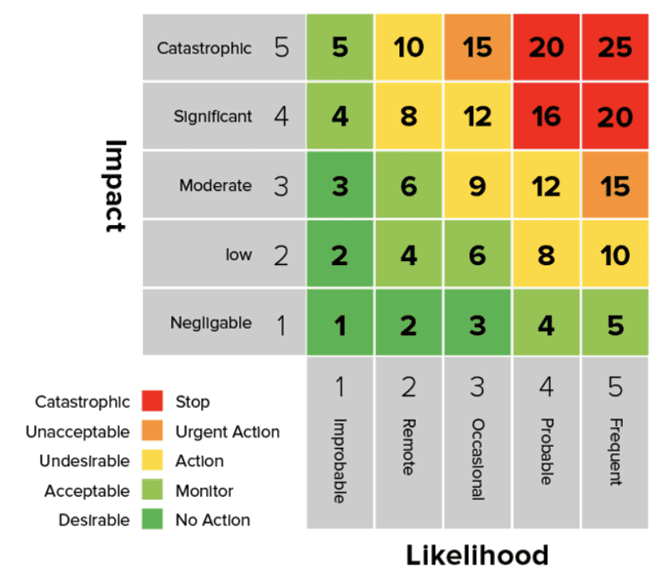

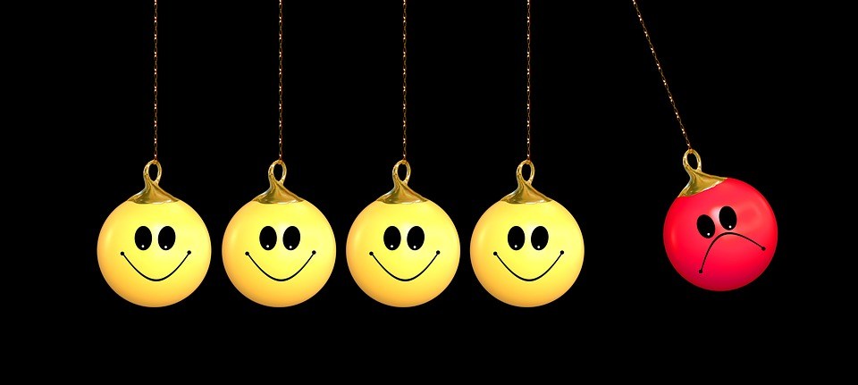
Security vocabulary
What is (Cybersecurity) Risk?
Probability / chance
Impact / loss
Notes:
Before diving in, let’s introduce some key terms in security
Risk can be broken down in two parts:
Probability and impact
The probability that an cyberattack / data breach will happen and the impact such attack has on the organization
In information security it is common to grade these for a specific IT-service on how they impact CIA and then multiply them.
This gives a sense of what risks a service is exposed to.
Example: Service downtime is more likely to happen in the inlands of Africa, but it might or might not have a large impact depending on the number of users using the service there
Sources
https://pixabay.com/photos/dice-given-isolated-probability-5363809/
https://pixabay.com/photos/terrorist-terror-be-happy-positive-2481808/
https://www.balbix.com/insights/cyber-risk-heat-map/

Slide 15
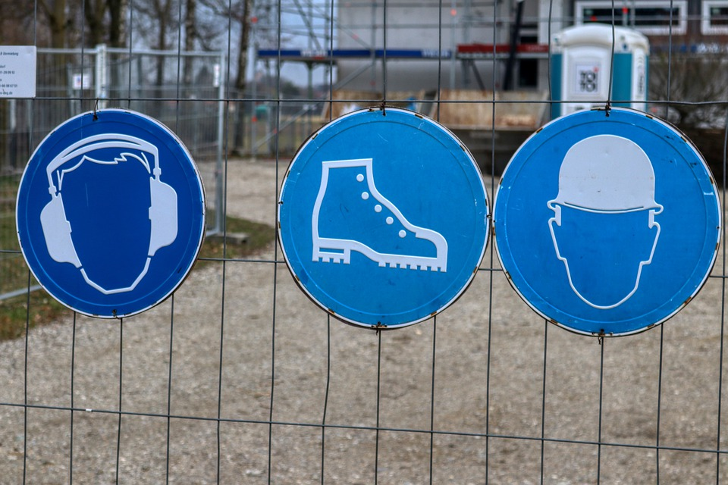
Security vocabulary
Controls or measures
  Lower probability
  Lower impact
Vulnerabilities
  Software
  Configuration
  People
Notes:
Controls or measures
Things an organization can do to either lower the probability of an incident happening or lower the impact of an incident happening
Headphones and hardhats lower the impact ( loud noises and impact of falling objects)
Working shoes both lower the impact (when equipped with steel noses ) and probability ( special soles provide more grip and traction while on buildingsite )
In our example from the last slide of the Africa service, a backup internet line will lower the probability. Lowering the impact could be to store data locally on devices so internet connectivity is only necessary in certain use cases.
Sources:
https://pixabay.com/photos/osh-sign-construction-fence-4911106/

Slide 16
Questions we should ask our selves
Which resources do we protect?
What can go wrong?
  CIA,Risk
To what extent do we secure our systems
  Risk, heatmap, controls
  Security / Usability trade off
  Finding the right balance
How do we deal with (insecure) systems of patients/workers?
Notes:
With resources we mean: Services, data, people or systems
On security / usability trade off: For example in medical situations you will want instant access to patient data (usability and availability). But you need to make sure you are accessing the data of the right patient (integrity) and that no one can abuse the information (confidentiality)
Solutions are smartcards for access, emergency buttons with logging etc.

Slide 17
Usecase: H&S HealthPlatform 1/3
Background: H&S is a private company aiming to serve hospitals and the home healthcare industry
Goal: The development of a telemedicine platform (contents and functionalities) to support pregnant women and their new-borns (first 1000 days of life)
and
caregivers of children undergoing tonsillectomy in a maternal and child health hospital.
By means of:
supporting the collaboration and knowledge exchange among professionals (teleconsultation or 2nd opinion)
improving the interaction between professionals and citizens
to improve the citizen's empowerment towards the health offer
Notes:
Usecase provided by Michele bava, Raffaella Dobrina

Slide 18
Usecase: H&S HealthPlatform 2/3
Notes:
Global overview of interactions between actors of the HealthPlatform
Image: taken from TNC22, Michele Bava and Raffaella Dobrina

Slide 19
Usecase: H&S HealthPlatform 3/3
Patient’s home
Health care facility
Notes:
Technical overview of the H&S Healthplatform
Image: taken from TNC22, Michele Bava and Raffaella Dobrina

Slide 20
Usecase: H&S HealthPlatform 3/3
Components of the H&S HealthPlatform
Medical devices
Gateways (smartphones)
Authentication providers
Web interfaces
Mail + SMS gateways
Different kind of communication technologies
(WiFi / Bluetooth /USB )
Patient’s home
Health care facility
Notes:
Technical overview of the H&S Healthplatform
The platform consistents of different components that can be problematic from a security perspective:
Medical devices ( how are the kept up-to-date? )
Smartphones ( same as medical, but also: what (malware) is installed on it?
Communication protocol between medical devices and the gateway ( is it send securely? Is an unencrypted public WiFi being used? )
Communication protocol between gateway and health platform (same as above )
User authentication: How is a user enrolled? (are you sure the user is who he says he is?) Are his credentials send and stored securely?
Web interface: Are data send securely? How is ensured that certain roles cannot get to data they should not get to?
Mail + SMS : if sending SMS is outsourced, what can that party infer from the messages send?

Slide 21
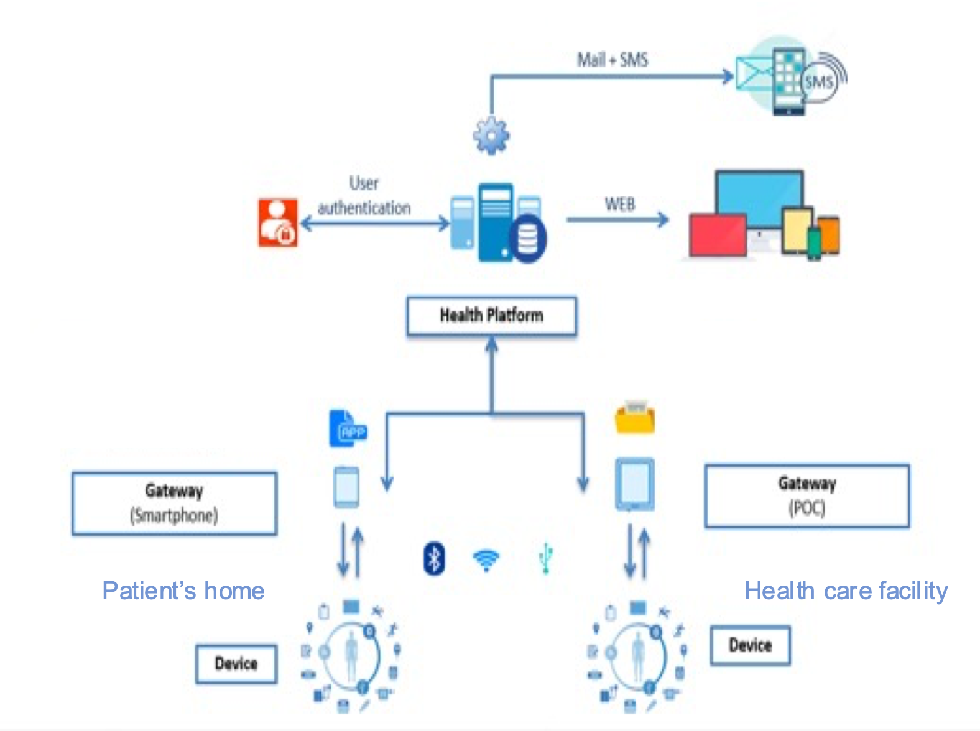
Which resources do we protect?
- Identify which systems and processess are necessary for running an e-health service
- Consult with system administrators or developers (the techies) or contractors
- Find dependancies between sub-systems
- Identify where potential private data is stored or processed
Notes:
All subsystems visible in this diagram
Administrators of the whole system or of components of the system
Dependencies include here at least the authenticiation service, the SMS and possibly email provider and the mobilephone/cellular provider of the gateway devices

Slide 22
What can go wrong? (Risk)
Try to be generic: not every detail can be conceived
  E.g: Users can not authenticate. (Availablility) Device is infected with malware (Integrity, Confidentiality)
  The details (how that came to effect) must be known by the techies.
Be specific about what this means for the service
Classify how this impacts
the service:
Terrible vs not at all?
X
X
Notes:
You can not exactly predict how a service will be hacked or influenced by an incident.
But you can try to predict what the effect is on the service and how to handle that
By classifying the impact priorities can be set upfront. That is especially important if more than one incident is taken place at the sametime because you will know on what to work first. In the use case the user authentication beging down is probably more important than one gateway infected, because the gateway probably only affects one person and the user authentication all users. That is however dependent on the type of service. What if the medical device would be a pace maker or other critical component in someones live? How to weigh that?

Slide 23
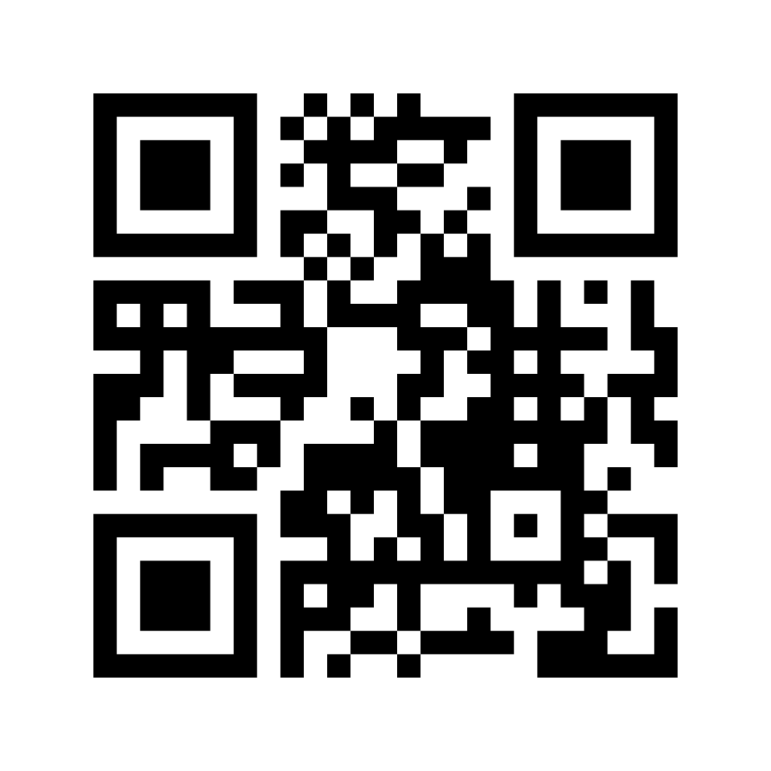
Exercise: risks
For the H&S Healthplatform, which other risks can you think of?
Go to https://menti.com (CODE: 2826 3397) on your mobile phone / webbrowser and enter the risks you perceive. In 2 minutes we will discuss some of your answers
Notes:
Mail + sms server goes down ( not sending any (medical) alerts )
Database corrupted ( data lost and unavailable )
Mail or sms server is hacked and sending phishing mail/sms to users

Slide 24
Risk & Controls
To what extent do we secure our systems?
Determine what risks you would like to minimize
  E.g: only the ‘terrible’
  Consult with your (Chief) Information Security Officer and other stakeholders
Go back to the techies and tell them which risks you want to minimize (Controls). Let them tell what it will cost (or which costs already are covered).
Notes:
In our previous example we concluded that the user authentication service is very important. We do want to have some controls in place to minimize that risk. We could:
Get redundant (2) internet connections in case one goes down
For some actions require a valid session and allow that session to be valid for up to one day ( solves short outages for some functionality)
Allow Gateways to cache data while not logged in and send the data after the user succesfully authenticates on the gateway

Slide 25
Security boundaries
How do we deal with (insecure) systems of patients/workers? (WiFi, PC’s)
Formaly speaking, these systems are out of our control (and thus scope).
Take due care: do your best!
  Security-by-default: prevail security above usability
  Detecting malicious activity from the server side
  Providing (security) guidelines on
  how to secure private environment
  (WiFi, Anti-virus )
Notes:
security-by-default: For example, actively deny clients/workstations that run old technology (windows Xp, internet explorer, Adobe Acrobat 5)
Detect when a client is trying to guess a username/password combination (bruteforcing)
Guidelines on securing smartphones / bluetooth /WiFi connections

Slide 26
Some last notes
Ask you (Chief) Information Security Officer for help if you feel not up to it on your own ( He probably is over the moon about you asking anyway)
If techies are starting to sound like Marshians (you can’t understand a word they are saying): tell them. And ask them to translate to language you can understand.

Slide 27
Summary part I
Assess risk for your service on risk of individual components
Consult IT and stakeholders on what risks are conceivable, acceptable or unacceptable
Budget for risks that are unacceptable
Take due care for situations out of your control

Slide 28
Security in action

Slide 29
Questions we should ask our selves
More detailed into these questions:
Which resources do we protect?
What can go wrong?
  CIA,Risk
To what extent do we secure our systems
  Risk, heatmap, controls
How do we deal with (insecure) systems of patients/workers?
Notes:
With resources we mean: Services, data, people or systems

Slide 30
Which resources do we protect?
For each resource:
  Personally Identifiable Information (PII) -> GDPR
  Intellectual property
  Security necessities ( usernames, passwords, tokens )
  Anything important really…
Notes:
PII. Data will be stored on the central database, but may also be downloaded from the User Authentication service.
PII data wil be originated from medical devices and flow through the gateways, and can be read/analysed through the web interface. So PII is potentially everywhere in an e-health system
PII data is not expected to be in mail + sms as these are only meant to be for notification purposes
Intellectual property is not shown in this diagram, but could be the sourcecode of the software of the Health Platfrom
PII will be gathered from the authenticaion database ( address, phone number) , stored on the Health Platform and could be used for verification when logging in (two factor)

Slide 31
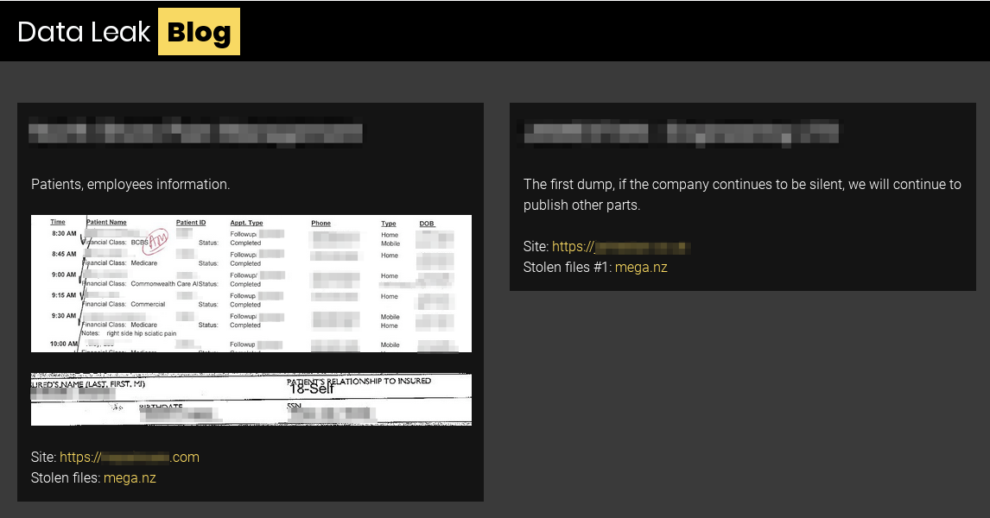
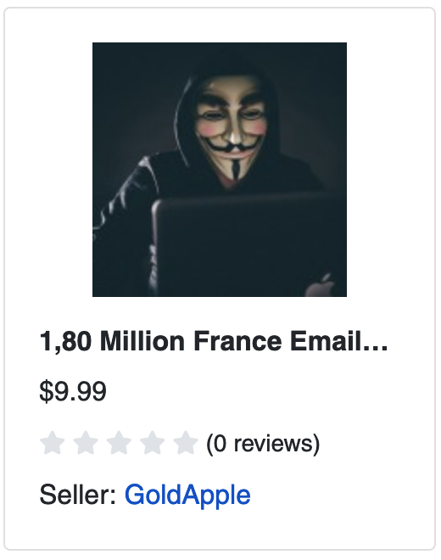
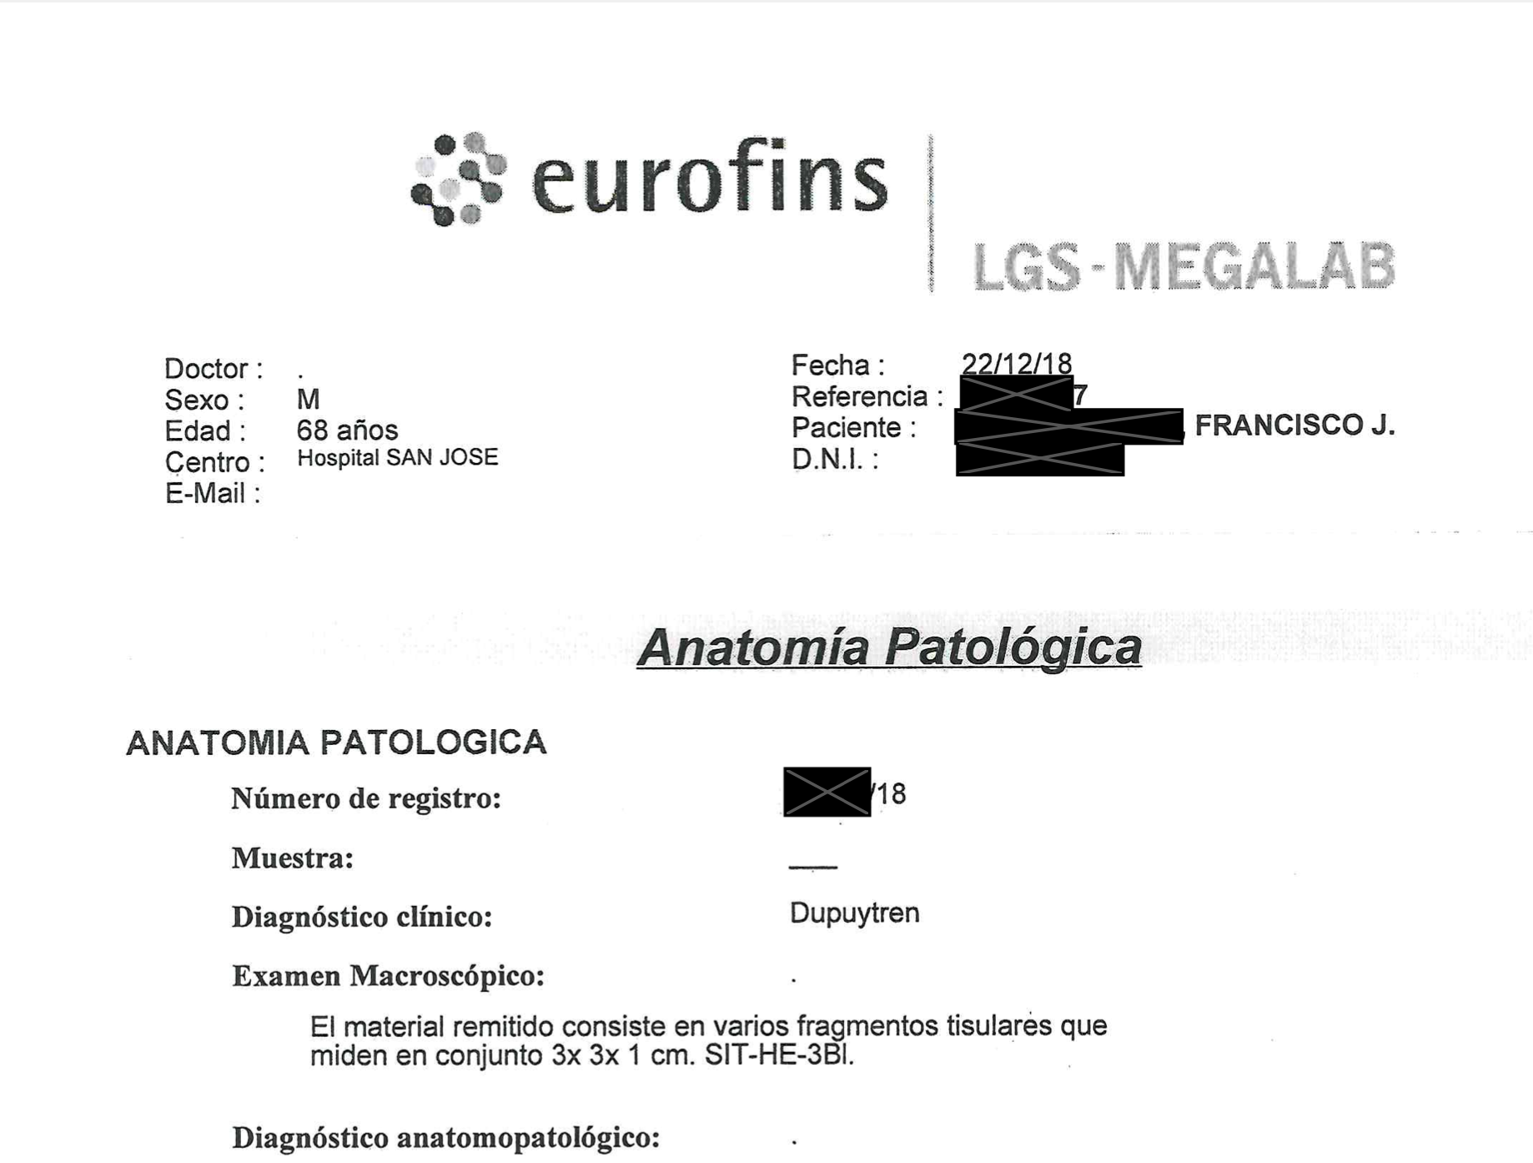
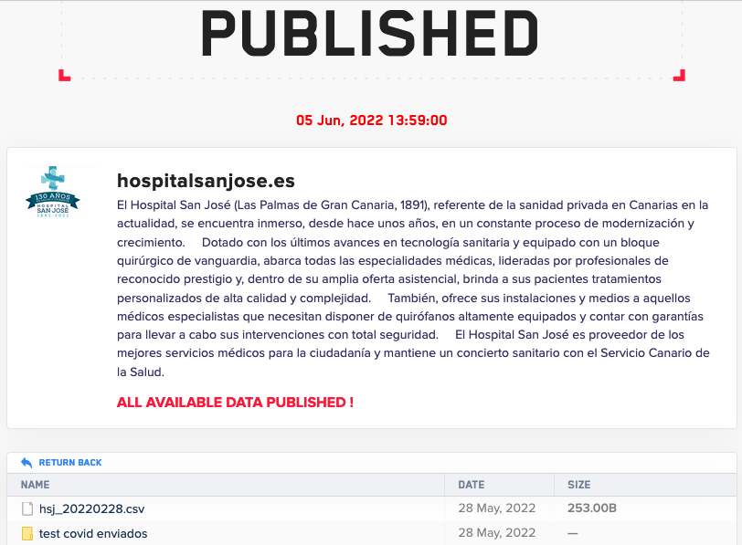
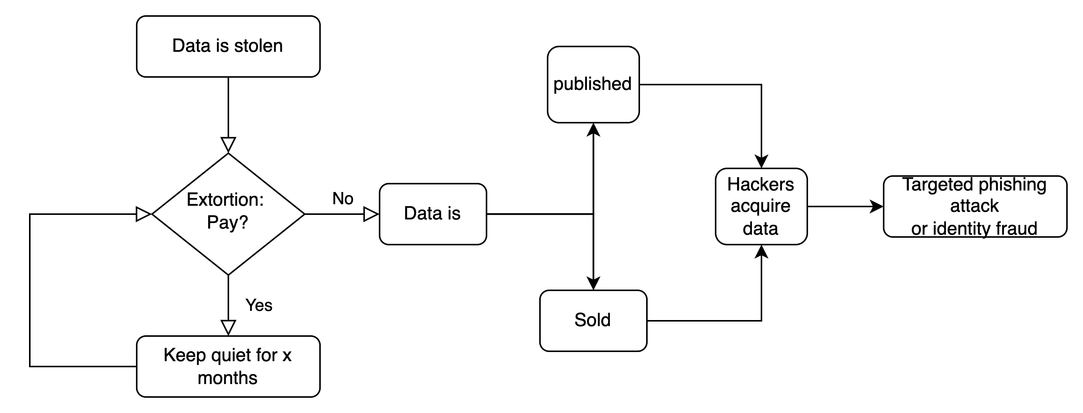
What can go wrong?
Example:
Patient data is stolen
Notes:
Sources: https://www.crowdstrike.com/blog/double-trouble-ransomware-data-leak-extortion-part-1/
Source2: screenshot from darkweb
Source images 3 + 4: screenshots from the darkweb
The published data from San Jose hospital includes covid test case results (1) but also laboratory results (2)

Slide 32
What can go wrong?
Further more (depending on the service):
Downtime of the service due to Denial of Service attacks
Legal disputes due to data manipulation
  Non-repudiation in transactions
  Non-repudiation involving medical advise / treatment
Loss of health / life when
monitoring systems
fail
X
Notes:
Non-repudiation = undeniability. You cannot deny you purchased / subscribed to something as the system logs that. If the system is not secure, there is a possiblity the system did not function properly and therefore the transaction can be disputed
This can happen at multiple components: The device or gateways, or the web interface

Slide 33
Controls: To what extent do we secure systems?
High risk: People can not log in
Cost: extra internet line: 3.600 Euro p/y
Low risk: Device can not communicate with Platform
Cost: development: 13.440 Euro once
X
X
Notes:
300 Euro p/m extra internet line = 3600 per year
Mitigate the Low risk will cost 28 days * 8 hours * 60 euro’s per hour development = 13.440

Slide 34
Controls: To what extent do we secure systems?
Do not reinvent the wheel. Use:
Common standards & guidelines
  EC health data electronic exchange guidelines
  Let your (sub)systems be MDR certified
  GDPR guidelines
  Local health security iniatitives ( AGID in Italy, NEN-7510 in Netherlands )
  International guidelines (NIST, ISO27001/ISO27002)
Technical standards & guidelines
  CIS benchmarks for secure systems
  OWASP secure coding guidelines
Notes:
Set an even higher standard of technical measures
With continually monitoring the chance of detecting an incident increases, and thus that an attack can be thwarted early
Having incident response procedures in place reduces mistakes and precious time while in an incident
Learn from an incident to improve systems security, monitoring and response
https://ec.europa.eu/health/system/files/2022-06/ehealth_health-data_electronic-exchange_general-guidelines_en.pdf
MDR certified = EU Medical Device Regulation (https://www.greenlight.guru/blog/eu-medical-device-classification)
AGID https://www.agid.gov.it/en/security/Minimum-ICT-security-measures-for-public-administrations
NEN-5710 https://www.nen.nl/zorg-welzijn/ict-in-de-zorg/informatiebeveiliging-in-de-zorg
NIST https://www.nist.gov/healthcare
ISO2700x series https://www.iso.org/isoiec-27001-information-security.html
CIS benchmarks https://www.cisecurity.org/cis-benchmarks/
OWASP https://owasp.org/www-project-secure-coding-practices-quick-reference-guide/migrated_content

Slide 35
Security boundaries
Broadly speaking two options:
Set perimeters and put liability with customers/contractors/workers.
Control as much as possible within the e-health service’s context
Notes:
1. - Store data on device and make user liable by contract
- Allow weak password and make user liable by contract
2.
Security-by-default: prevail security above usability
Multi or Two factor authentication
Enforce strong passwords
No data stored on device, or strong encryption
Detecting malicious activity from the server side
Providing (security) guidelines on how to secure private environment (WiFi, Anti-virus )

Slide 36
Summary part II
Identify privacy data and/or key resources for your service
When working with eHealth systems things can turn ugly fast
Use benchmarks and guidelines to standardize on best practices

Slide 37
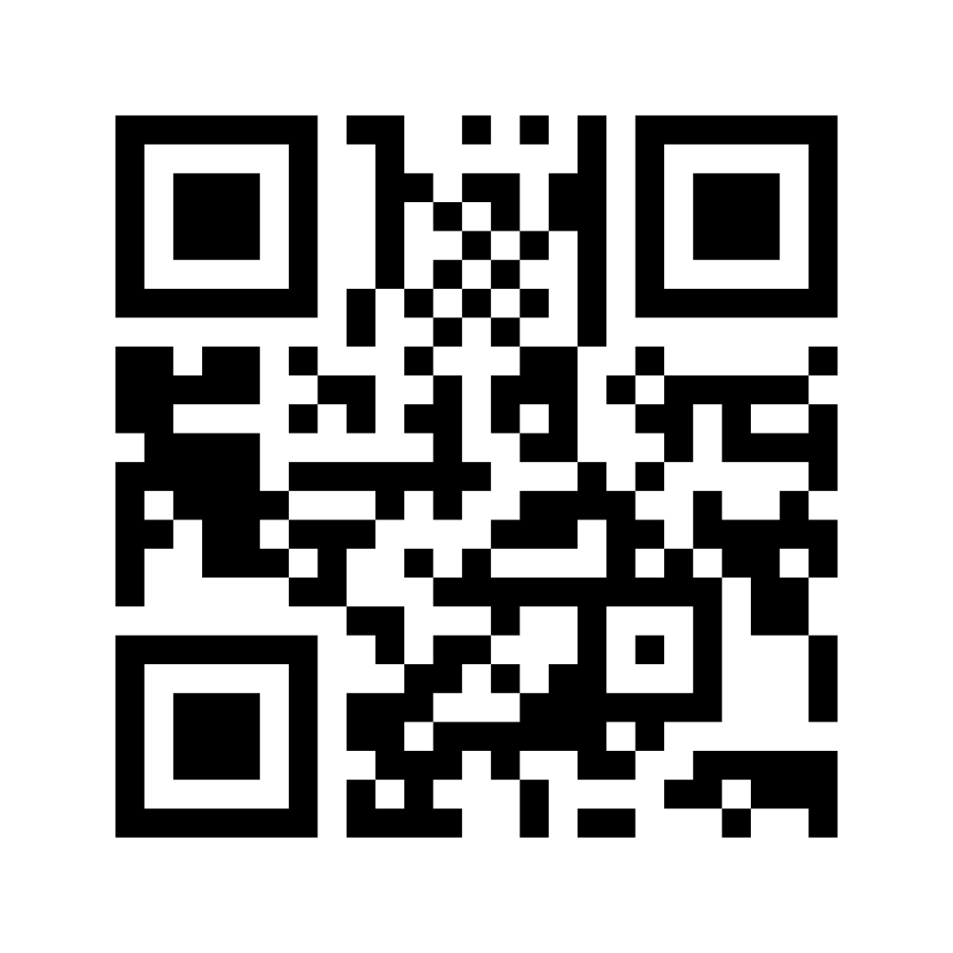
Exercise 2: Response
What to do if a security breach happens to you? (humor us)
Would you:
1. Do nothing
Panic
Yell and be yelled up on
Call IT
Start apologising
Enter your answer via https://menti.com (code: 7966 7096)

Slide 38
Exercise 2: Response
What to do if a security breach happens to you?
Answer: Do all! (in this order)
Panic (first reaction)
Call IT (or incident response team)
Yell and be yelled up on ( communicate with stakeholders )
Nothing (wait until incident has been dealt with)
Start apologizing ( clean up the mess )

Slide 39
Securing privacy data

Slide 40
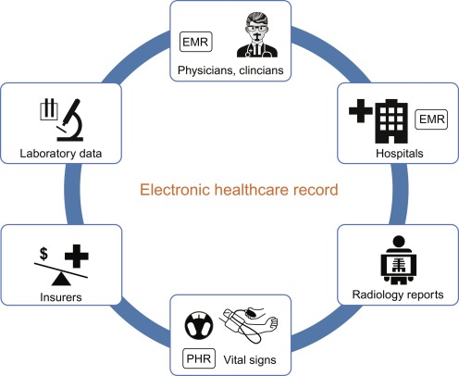
Securing privacy data
So we need to protect e-health data. Where to start?
Which services are involved?
Which data is being processed and in what form?
  Standardize on Electronic Health Records (EHR)
With whom is data shared with?
  Are Health Information Exchanges being used and who are connected to these exchanges (cloud/(inter)national)
How can you notice abuse of your data?
Notes:
https://en.wikipedia.org/wiki/Electronic_health_record
https://www.sciencedirect.com/science/article/pii/B9780128173565000164

Slide 41
Data can be used for datamining
Can be used for good…
Predicting cancer based on other similar cases
Detecting fraud
But has limitations
May be inaccurate or plain wrong
Might be used to infer privacy data (are you a smoker? Etnic background?)
Notes:
Predicting cancer with datamining https://www.researchgate.net/publication/333964096_CANCER_PREDICTION_SYSTEM_USING_DATA_MINING_TECHNIQUES.
Hazards of data mining in e-health: https://pubmed.ncbi.nlm.nih.gov/28679892/
Article on data mining and smoking status https://www.sciencedirect.com/science/article/pii/S0895435619304846
If your postal code is within the Chinatown area, you know something about his/her ethnic background
Data can be (ab)used by insurance, tax agencies, rental companies, financial industry etc.

Slide 42
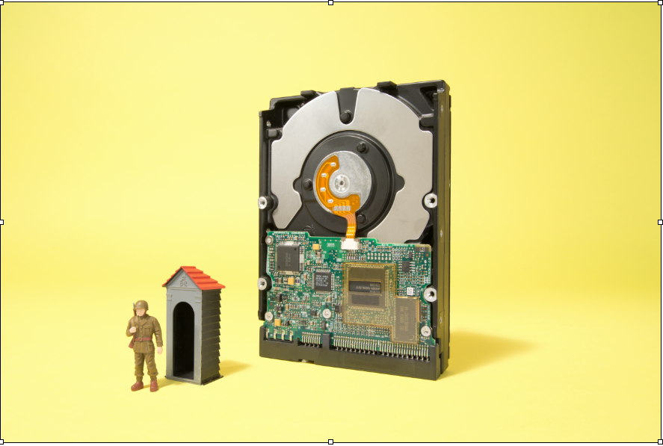
Controlling data
Keeping data secure within your perimeter
Encryption
  Data is locked with a secret key
  Can be unlocked by whoever has the key
Strict access controls
  Data not necessarily encrypted
  Access is granted granularly (e.g: some groups do, others don’t)
Log who had acccess to what and audit regularly
Caveat: What if data is copied by that user and saved insecurely?

Slide 43
Controlling data
Keeping data secure within your perimeter
Encryption
Strict access controls
Data masking: (pseudo) anonymisation
Use synthetic data
Keeping data secure outside of your perimeter
Data masking: (pseudo) anonymisation
Use synthetic data
Notes:
Within your perimeter you can use anything because the technique depends on what is needed.
Hashing/encrypting and access controls only lock the actual data. The other techniques should make it difficult or rather impossible to see the private data
Data masking is the process of removing or disguising data. Pseudo anonymisation and anonymisation are ways of doing that, using data masking techniques. The difference between pseudo anonymisation and anonymisation is that with anonymisation there is no way of linking the anonymised data to the original data. With pseudo anonymisation linking back to the orginal data is more difficult, but not impossible.
More on synthetic data: https://www.youtube.com/watch?v=blGLY-gX9U4
Data masking techniques https://satoricyber.com/data-masking/data-masking-8-techniques-and-how-to-implement-them-successfully/

Slide 44
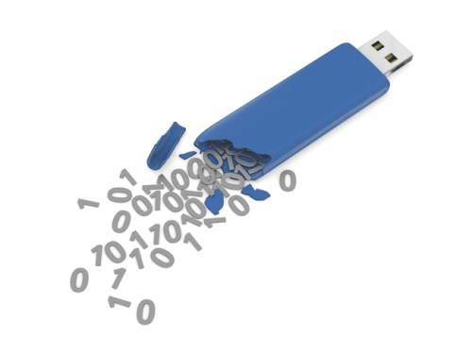
The basics
Protect your data
Encryption
  Data at rest
    Also on a USB stick!
  Data in motion (https/TLS, secure filetransfer)
Backup
  Test if your backup is complete
  Also backup your “intelligence”

Slide 45
Controlling data
Keeping data secure outside of your perimeter
Data masking – Substitution
replacing values with look-a-like values.
ID | First name | Last name | Gender | Date of birth | Conditions | Treatment
832315 | Susan | Shy | V | 03/05/1978 | Cavities | Use mouth wash
639842 | Pete | Policy | M | 09/12/1965 | Chicken pocks | Eggplant diet
278412 | Joan | Jackett | V | 01/03/1986 | Allergic to leather | leather milk prescription
359862 | Randy | Ransom | M | 05/08/1990 | Phobia for guns | Paintball therapy
Notes:
Original example data

Slide 46
Controlling data
Keeping data secure outside of your perimeter
Data masking – Substitution → Anonymisation
replacing values with random look-a-like values.
ID | First name | Last name | Gender | Date of birth | Conditions | Treatment
832315 | Sandra | Sloth | V | 01/04/1998 | Cavities | Use mouth wash
639842 | Patrick | Parrot | V | 01/04/1925 | Chicken pocks | Eggplant diet
278412 | Jeannette | Jansen | M | 02/08/1992 | Allergic to leather | Leather milk prescription
359862 | Rudolph | Rain | M | 01/04/1967 | Phobia for guns | Paintball therapy
Notes:
If done correctly, this is an example of anonimisation: All data should be randomly chosen. Original first/last name and date of birth can not be reversed

Slide 47
Controlling data
Keeping data secure outside of your perimeter
Data masking – Shuffling → Pseudonymisation
Shuffle data along the same column.
ID | First name | Last name | Gender | Date of birth | Conditions | Treatment
832315 | Randy | Jackett | M | 05/08/1990 | Cavities | Use mouth wash
639842 | Susan | Ransom | M | 03/05/1978 | Chicken pocks | eggplant diet
278412 | Joan | Policy | V | 09/12/1965 | Allergic to leather | Leather milk prescription
359862 | Pete | Shy | V | 01/03/1986 | Phobia for guns | Paintball therapy
Caveats:
1. If algorithm is known, can be reversed.
2. Make sure that fields can not be inferred from other fields
Notes:
Susan Sloth is no longer Susan Sloth, but Susan Ransom. Their conditions and treatments do not line up either.
Caveats: be sure that information can not be infered after shuffling: tim.waters@geant.org contains first en lastname and conditions and treatments can be linked quite easily as well
This is an example of pseudo-anonimisation: If the algorithm is known shuffling can be undone

Slide 48
Controlling data
Keeping data secure outside of your perimeter
Data masking – Number & Date variance → pseudonymisation
Randomly add numbers within bandwidth to keep mean and most other stats.
ID | First name | Last name | Gender | Date of birth | Conditions | Treatment
832315 | Randy | Jackett | M | 05/08/1991 +1 | Cavities | Use mouth wash
639842 | Susan | Ransom | M | 03/05/1977 -1 | Chicken pocks | eggplant diet
278412 | Joan | Policy | V | 09/12/1970 +5 | Allergic to leather | Leather milk prescription
359862 | Pete | Shy | V | 01/03/1981 -5 | Phobia for guns | Paintball therapy
Caveats: If algorithm is known, can be reversed.
Notes:
randomly add a number within a bandwidth to individual records (financial / dates). Will not have much effect on mean and most stats
If you would like to know the mean age of the people in your database, that number will not change.
This is an example of pseudo-anonimisation: If the algorithm is known, date of birth can be recovered

Slide 49
Controlling data
Keeping data secure outside of your perimeter
Data masking – Nulling out or deletion → Anonymisation
Delete unnecessary data.
ID | First name | Last name | Gender | Age | Conditions | Treatment
 |  |  | M | 30-40 | Cavities | Use mouth wash
 |  |  | M | 40-50 | Chicken pocks | eggplant diet
 |  |  | V | 50-60 | Allergic to leather | Leather milk prescription
 |  |  | V | 30-40 | Phobia for guns | Paintball therapy
Caveat: Why was that data stored anyway?
Notes:
Delete or replace data in order to keep private data secure.
This is an example of anonymisation. There is no way of linking this data to the person

Slide 50
Controlling data
Keeping data secure outside of your perimeter
Use synthetic data
Synthetic data is information that's artificially manufactured rather than generated by real-world events
Closely mimics real data
Can be used for testing / developing systems
Can be used for research purposes
Can be used for training machine learning algorithms
Notes:
Source: https://en.wikipedia.org/wiki/Synthetic_data

