Slide 1
GÉANT Marcomms Update
Laura Durnford, Melanie Pankhurst
GÉANT
TF-CPR, Cambridge
28 October 2015

Slide 2
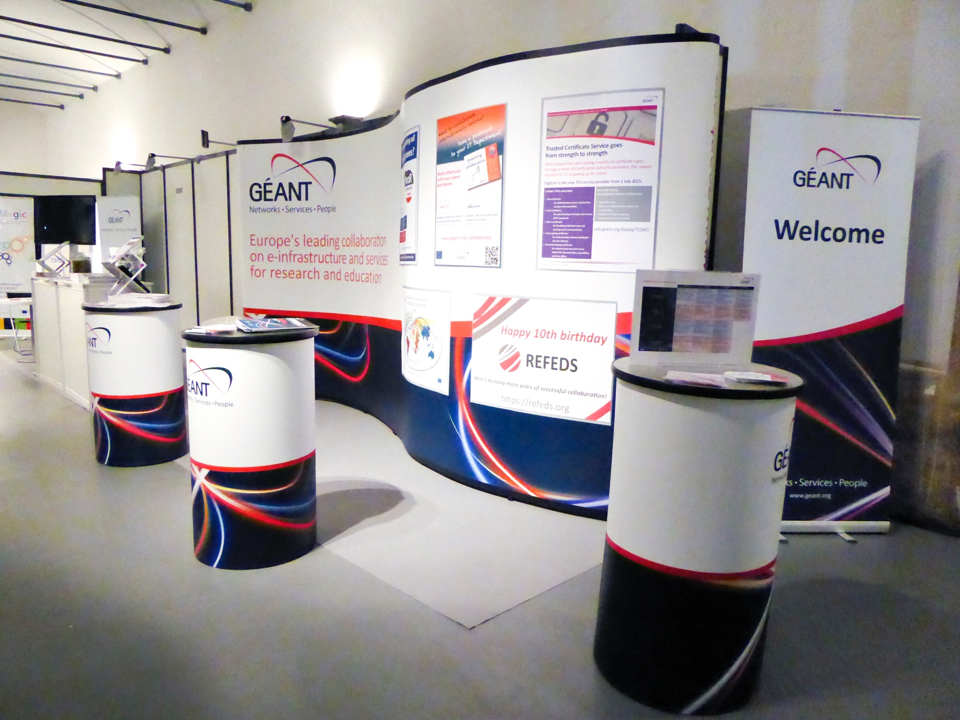
Brand development
Oct 2014: TERENA & DANTE became GÉANT Association
  Compendium published
May 2015: became simply “GÉANT” – meaning community collaboration
Logo and core visuals
Messaging and positioning
TNC launch
  Materials
    Annual Review
    Service descriptions
    Information sheets
    Videos
    Social media
Website

Slide 3




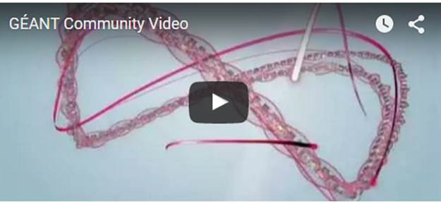
Branding in action

Slide 4
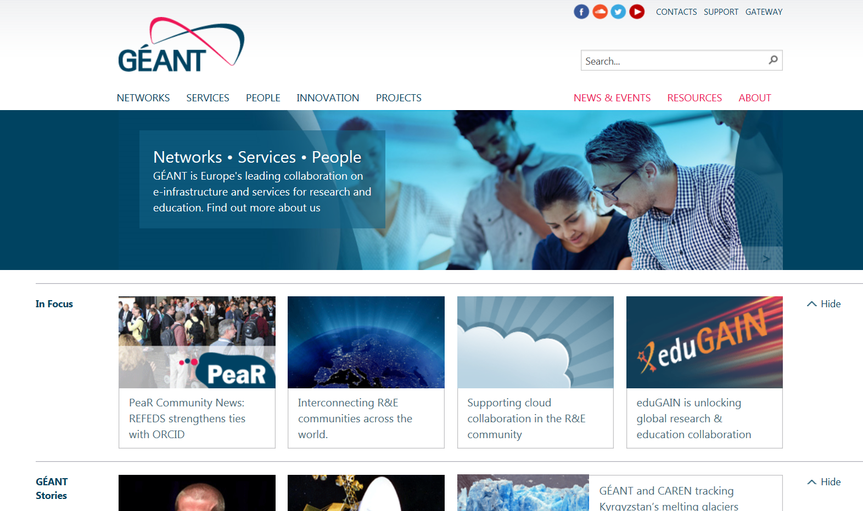
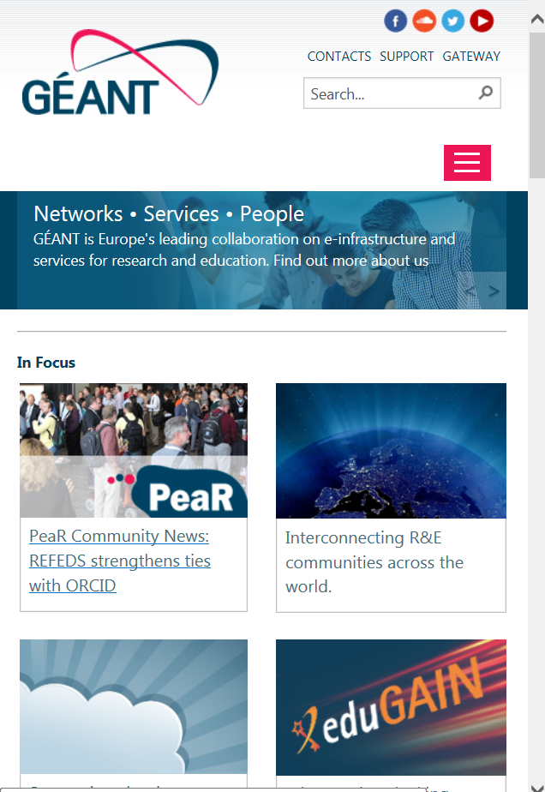
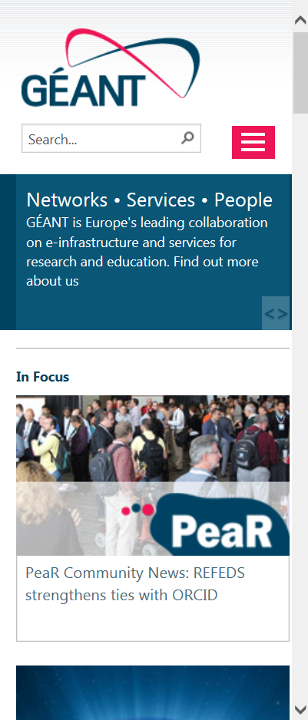
Website – scheduled to go live 2 November
1st ‘shop front’ for combined entity
One website for project, network and organisation
Business-to-business website
85% visits via PC
Responsive to serve our users
Flexible to allow for an evolving structure and content
Longer term plans:
Ongoing schedule of updates e.g. User type navigation
Web strategy/policy
10s of related websites/functional sites to be reviewed, rebranded and integrated
  Microsites & portals
  EventR, PeaR, Webshop…
  Compendium…

Slide 5
Marcomms challenges
Melding two organisations’ offerings together
Combining different approaches, styles etc.
Rationalising procedures, processes etc.
Long-term integration of web presences and functionality
Need for a repository tool
Review portfolio of materials, templates etc
Review requirements according to audience / channel / service or team needs.
News & channels integration - PeaR, blog; community news, media/wider
Product strategy and branding
Communications strategy within changing organisation structure

