Slide 2
Personas as a tool
October TF-CPR meeting, Cambridge

Slide 3
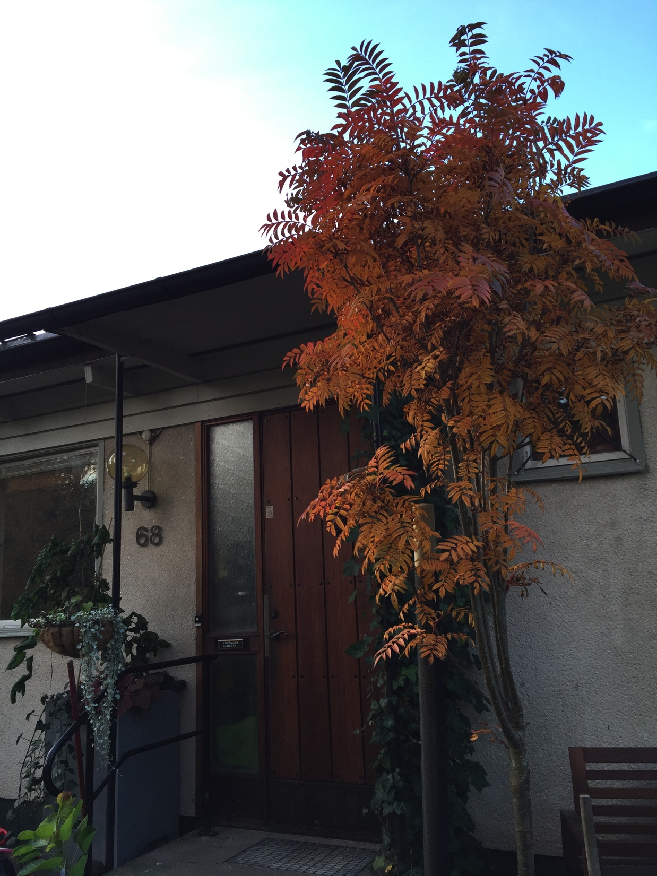
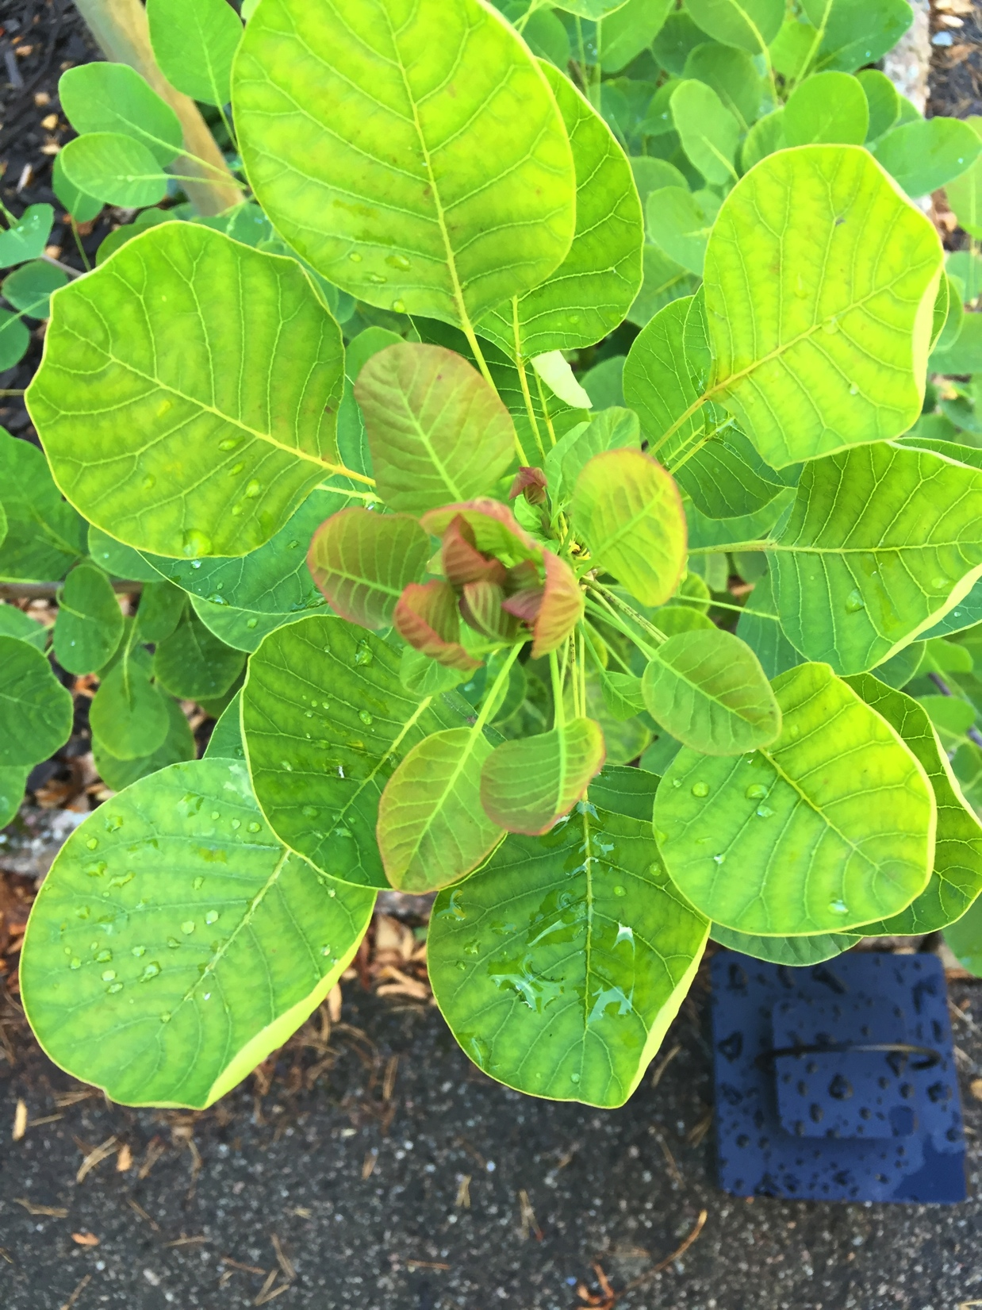
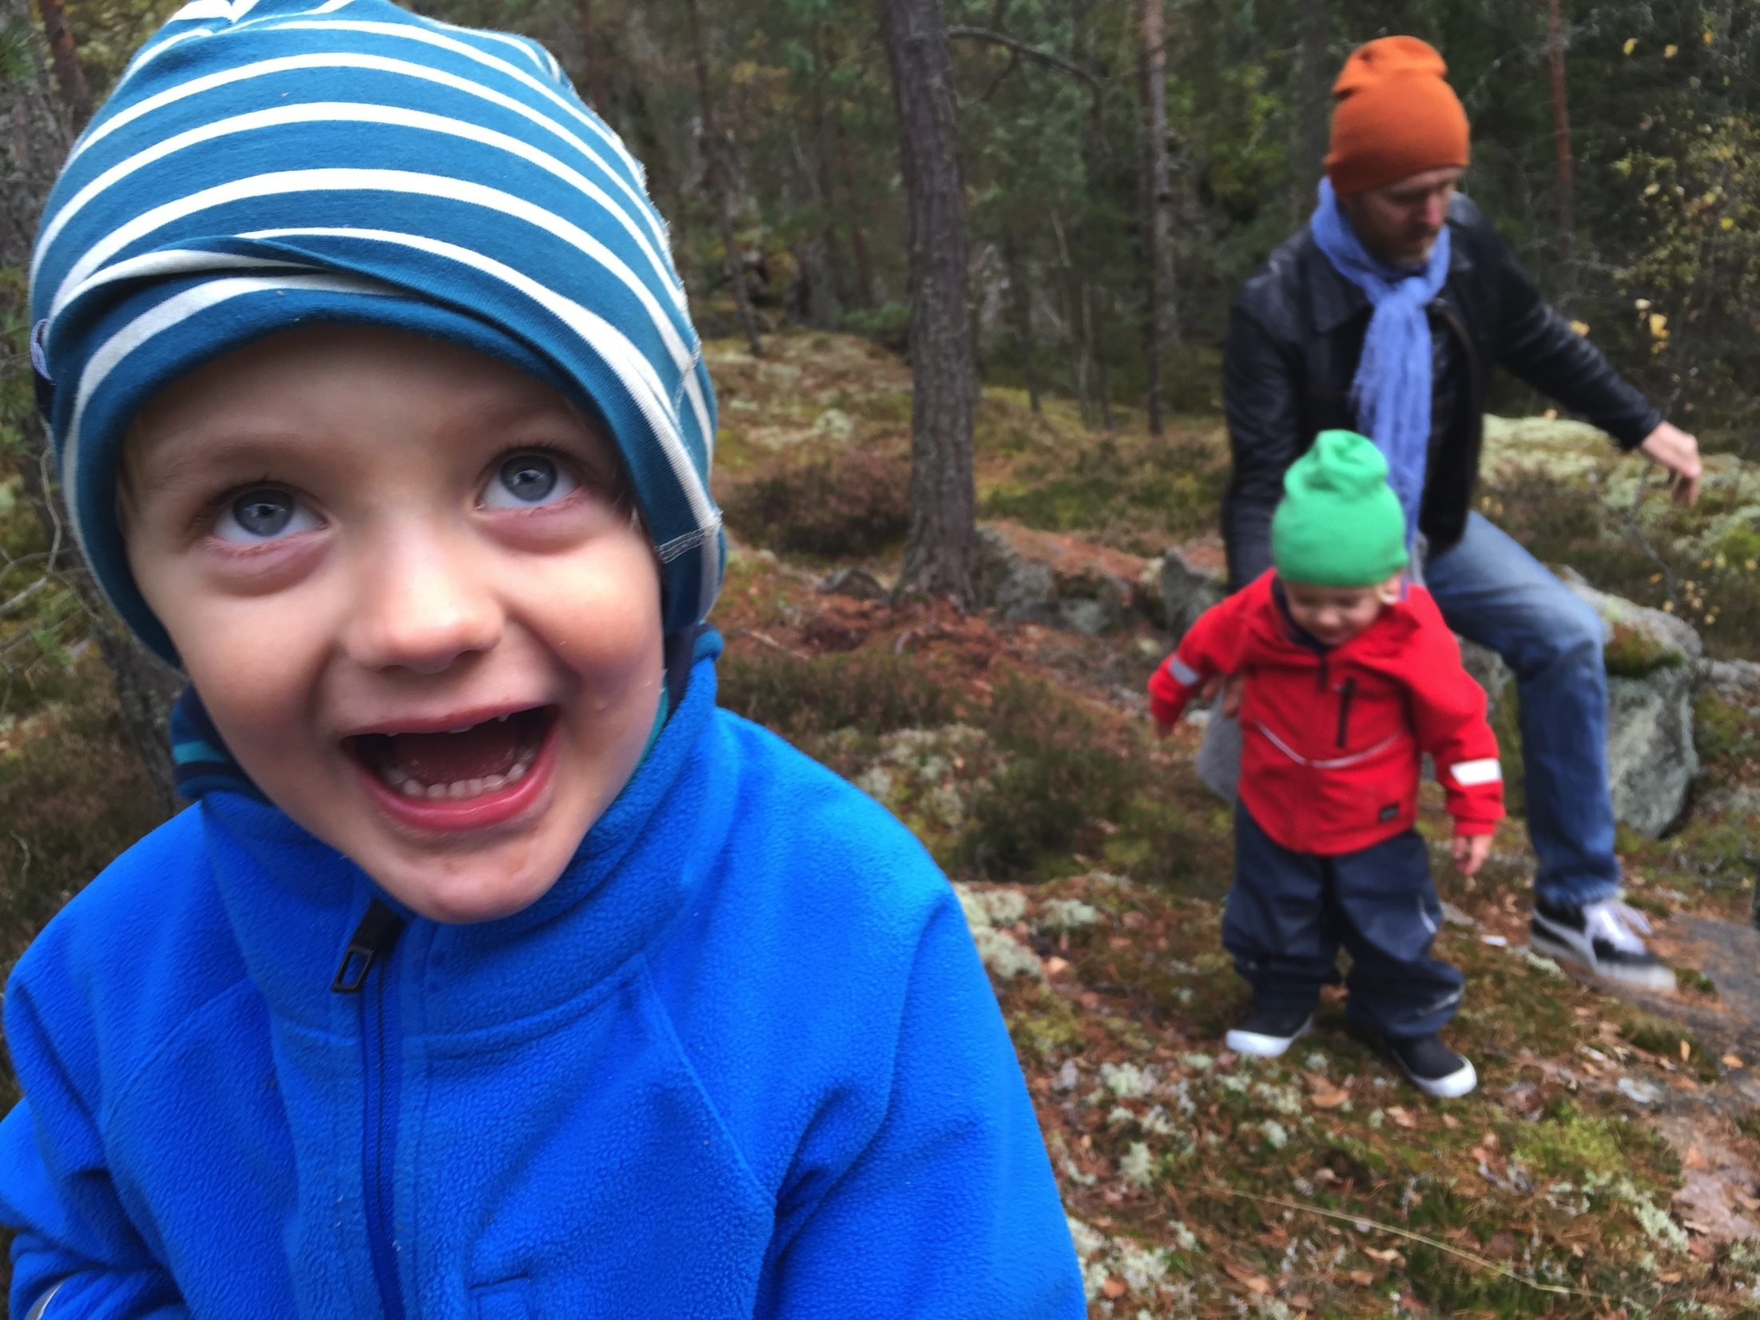
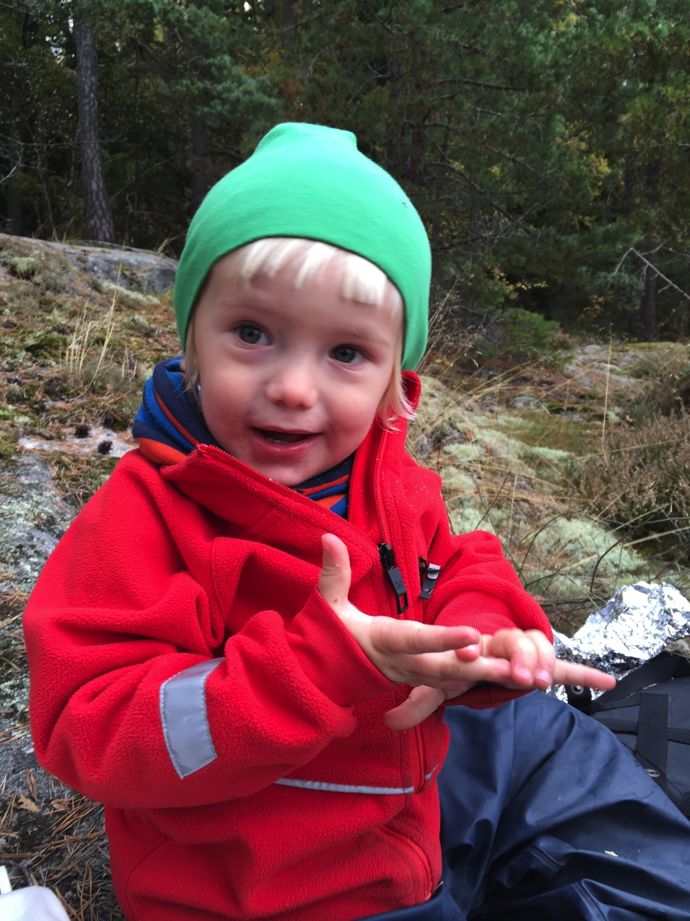
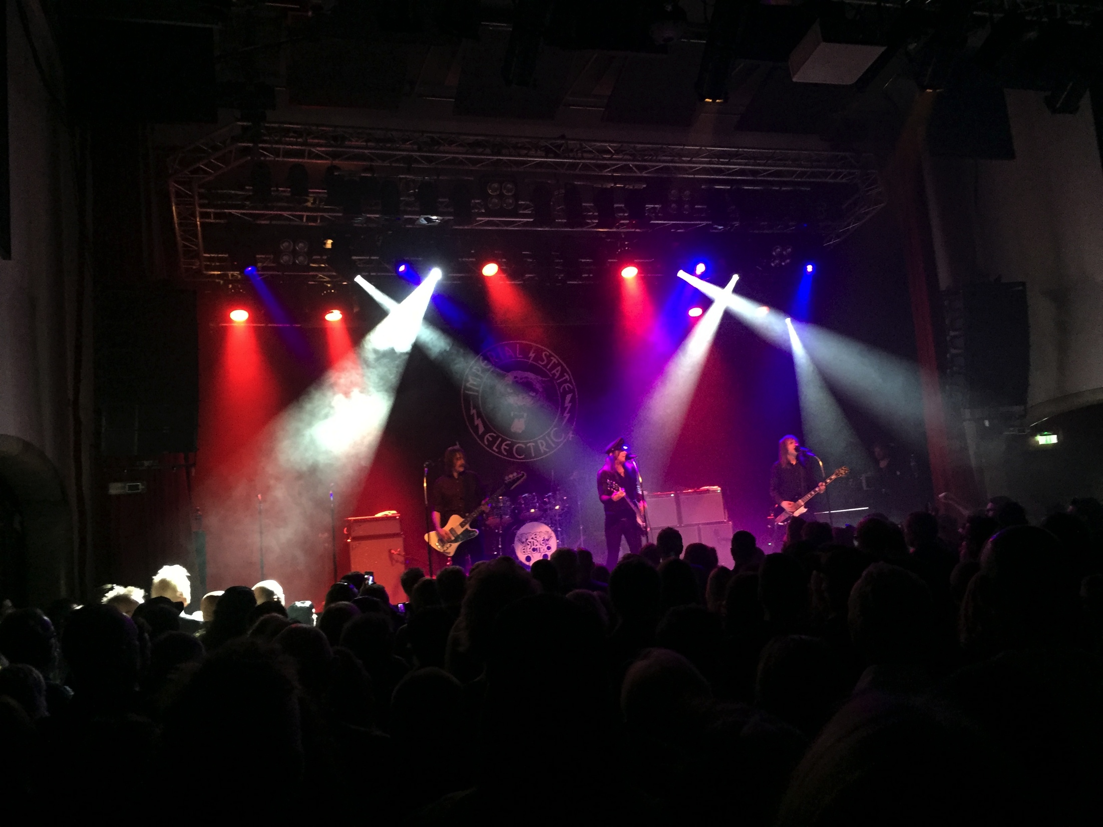
EMMA ALMROTH
SUNET communications/customer relations
+46(0)733 556 498
emma@sunet.se

Slide 4

SUNET IS CHANGING
New organizational structure
Notes:
Community cloud
Utilize NREN infrastructure
Identity & Federation tools
Backup as a service low hanging fruit
Secure and reliable (Trust)
Procurement process
PQQ, ITSOP, ITFB 5->2 anbudsgivare
PM/legal from Nordunet, Technical requirements from Sunet, Uninett, (KTH/CTH)

Slide 5



+
New services
New organizational structure
Notes:
Community cloud
Utilize NREN infrastructure
Identity & Federation tools
Backup as a service low hanging fruit
Secure and reliable (Trust)
Procurement process
PQQ, ITSOP, ITFB 5->2 anbudsgivare
PM/legal from Nordunet, Technical requirements from Sunet, Uninett, (KTH/CTH)

Slide 6
+
New services
New organizational structure
=
Marketing & product development?
Notes:
Community cloud
Utilize NREN infrastructure
Identity & Federation tools
Backup as a service low hanging fruit
Secure and reliable (Trust)
Procurement process
PQQ, ITSOP, ITFB 5->2 anbudsgivare
PM/legal from Nordunet, Technical requirements from Sunet, Uninett, (KTH/CTH)

Slide 7
+
New services
New organizational structure
=
Marketing & product development?
?
Notes:
Community cloud
Utilize NREN infrastructure
Identity & Federation tools
Backup as a service low hanging fruit
Secure and reliable (Trust)
Procurement process
PQQ, ITSOP, ITFB 5->2 anbudsgivare
PM/legal from Nordunet, Technical requirements from Sunet, Uninett, (KTH/CTH)

Slide 8
TARGETED GROUPS
USER
ICT teacher, lecturer, administrator
Research leader, researcher
End user (teacher, researcher, student)
DELIVERY
CIO, IT manager, operations manager, manager IT systems
Technician, IT architect
Procurer, lawyer
STAKEHOLDER
Politician, vice-chancellor, government offices, journalist
?
Notes:
Community cloud
Utilize NREN infrastructure
Identity & Federation tools
Backup as a service low hanging fruit
Secure and reliable (Trust)
Procurement process
PQQ, ITSOP, ITFB 5->2 anbudsgivare
PM/legal from Nordunet, Technical requirements from Sunet, Uninett, (KTH/CTH)

Slide 9
HOLD ON! WHO ARE WE REALLY TALKING TO?
?
Notes:
Community cloud
Utilize NREN infrastructure
Identity & Federation tools
Backup as a service low hanging fruit
Secure and reliable (Trust)
Procurement process
PQQ, ITSOP, ITFB 5->2 anbudsgivare
PM/legal from Nordunet, Technical requirements from Sunet, Uninett, (KTH/CTH)

Slide 10
PERSONAS
Notes:
Community cloud
Utilize NREN infrastructure
Identity & Federation tools
Backup as a service low hanging fruit
Secure and reliable (Trust)
Procurement process
PQQ, ITSOP, ITFB 5->2 anbudsgivare
PM/legal from Nordunet, Technical requirements from Sunet, Uninett, (KTH/CTH)

Slide 11
USER
ICT teacher, lecturer, administrator
Research leader, researcher
End user (student, teacher, researcher, admin)
DELIVERY
CIO, IT manager, operations manager, manager IT systems
Technician, IT architect
Procurer, lawyer
STAKEHOLDER
Politician, vice-chancellor, government offices, journalist
Notes:
Community cloud
Utilize NREN infrastructure
Identity & Federation tools
Backup as a service low hanging fruit
Secure and reliable (Trust)
Procurement process
PQQ, ITSOP, ITFB 5->2 anbudsgivare
PM/legal from Nordunet, Technical requirements from Sunet, Uninett, (KTH/CTH)

Slide 12
USER
ICT teacher, lecturer, administrator
Research leader, researcher
End user (student, teacher, researcher, admin)
DELIVERY
CIO, IT manager, operations manager, manager IT systems
Technician, IT architect
Procurer, lawyer
STAKEHOLDER
Politician, vice-chancellor, government offices, journalist
Notes:
Community cloud
Utilize NREN infrastructure
Identity & Federation tools
Backup as a service low hanging fruit
Secure and reliable (Trust)
Procurement process
PQQ, ITSOP, ITFB 5->2 anbudsgivare
PM/legal from Nordunet, Technical requirements from Sunet, Uninett, (KTH/CTH)

Slide 13
USER
ICT teacher, lecturer, administrator
Research leader, researcher
End user (student, teacher, researcher, admin)
DELIVERY
CIO, IT manager, operations manager, manager IT systems
Technician, IT architect
Procurer, lawyer
STAKEHOLDER
Politician, vice-chancellor, government offices, journalist
Notes:
Community cloud
Utilize NREN infrastructure
Identity & Federation tools
Backup as a service low hanging fruit
Secure and reliable (Trust)
Procurement process
PQQ, ITSOP, ITFB 5->2 anbudsgivare
PM/legal from Nordunet, Technical requirements from Sunet, Uninett, (KTH/CTH)

Slide 14
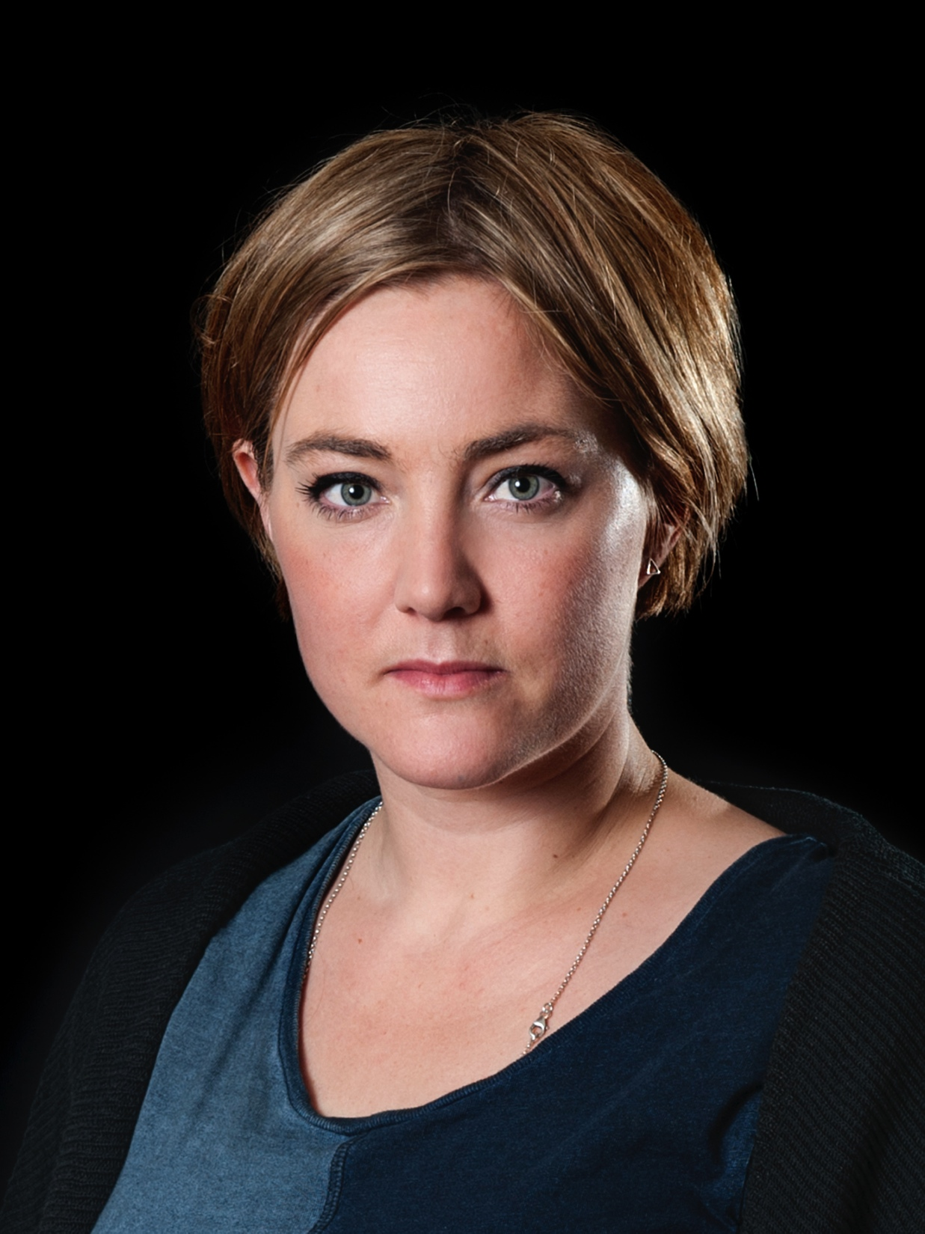
Thank you for listening
be in touch!
EMMA ALMROTH
SUNET communications/customer relations
+46(0)733 556 498
emma@sunet.se

