Slide 1
Towards an
integrated Service Set
Toby Young – GEANT Association
29th October 2015: TF-CPR

Slide 2
Agenda
Quick recap on PLM in GN4 year 1
  Process and gates
  service catalogue integration
    Cambridge, Amsterdam, and GEANT
The road ahead….
  External driver – the EC.
  EC Technical Readiness Levels (TRLs)
  FITSM

Slide 3
Quick Reminder about PLM in GN4

Slide 4
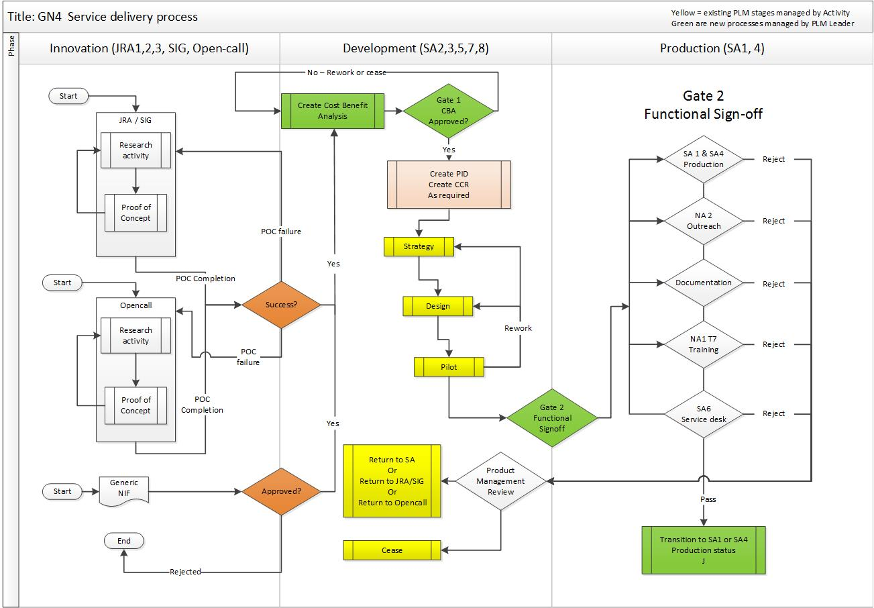
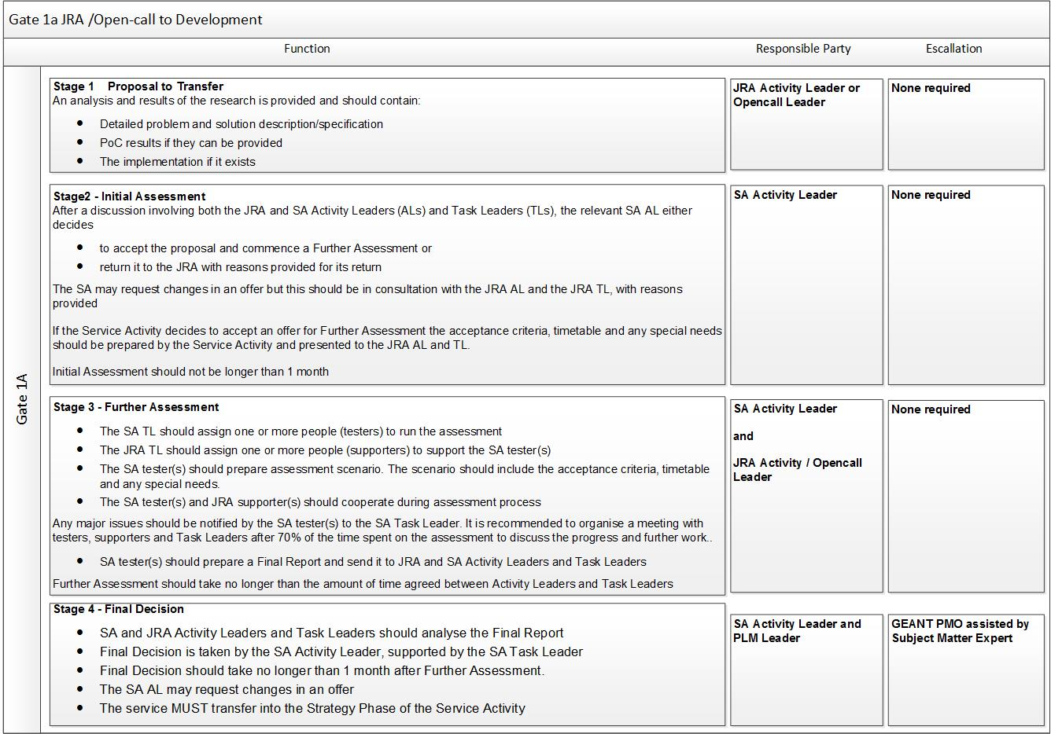
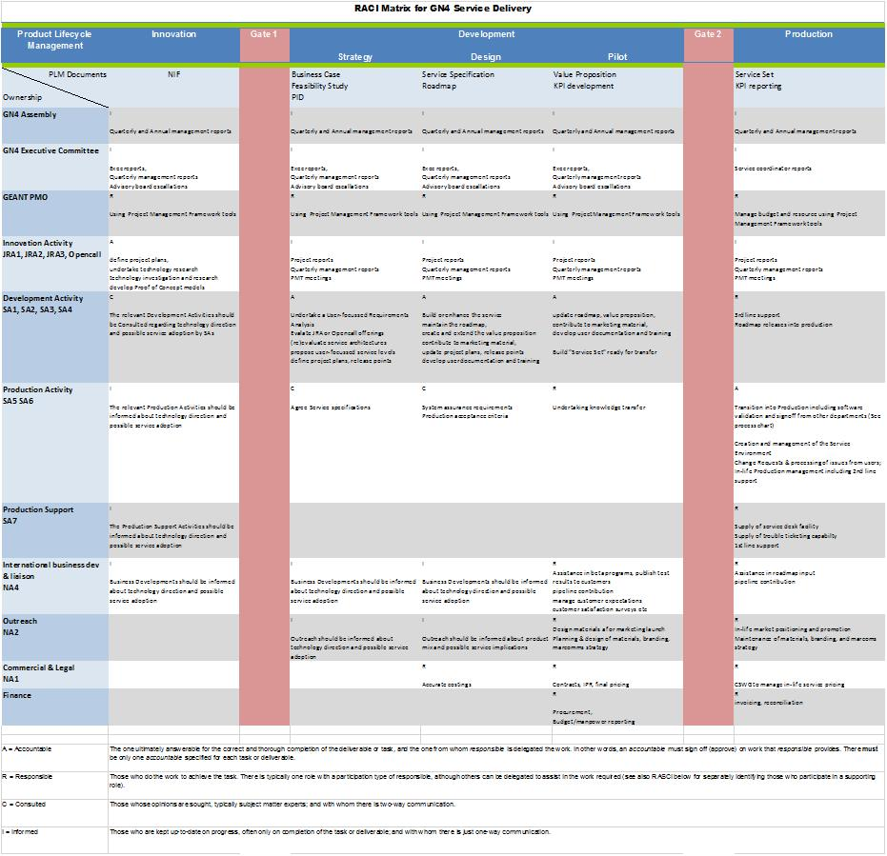
PLM process in GN4
Process Map
Escalation Process
Oh yes!!……. We have plenty of processes
RACI charts

Slide 5

Clouds on the horizon (2020)
We need to address;
  DANTE & TERENA combined service sets
  Adding in GEANT service sets
  Adding in NREN service sets
  Measuring and Reporting
  and
  Creating joint services with other e-infrastructures
  And doing it all “sustainably”

Slide 6
1st step towards integration
Segment the entire GEANT Assoc and GEANT project into 3 areas;
  Products:
    things we “make” with PLM control
  Utilities:
    Things we “make” but without PLM control
  Professional Services:
    Things we “do” (manpower driven) to aid our community

Slide 7
A categorisation for GÉANT Project and Association
proposed
 | Products | Tools and Utilities | Professional Services
Summary | Defined features Defined pricing structure | Software elements used to help manage/control other services or products Utilities with no defined support environment | Intangible activities May be separately charged, may be free to members
Examples | GEANT IP GEANT world Service, eduPKI | CNIS Autobahn Filesender Firewall on demand | eduPERT, Training, Campus Best Practice Procurement Services
Product Description | Yes | Optional | Yes
Service Targets / Levels | Yes | Optional | Optional
Business Case | Yes | No | Optional – usually “Yes”
RoadMap | Yes | Optional | No
KPIs | Yes | Optional | Optional – usually “Yes”
PLM controlled | Yes | No | No

Slide 8

3 The Road Ahead

Slide 9
EC Work Programme 16/17 – A new landscape
Combined e-infrastructures
  GEANT, EGI , PRACE, EUDAT, OpenAIRE
  Integration of service catalogues and new service sets and
  Delivering support for SMEs
Operational Services
  EC have split Innovation and production services
  GEANT has a focus on Operational services >=TRL 6
  Blue sky research and JRA style research is funded elsewhere
  Innovation belongs in other parts of the work programme
“decisions for investing in new networking services should be based on a clear business case and commitment by National Research and Education Networks” H2020 WP16/17 pg62

Slide 10
EC Assessment - Technical Readiness Levels
A way to formally assess the status of products
  Provides a common understanding of technology status
Assists Risk management
Used to make decisions concerning technology funding
Used to make decisions concerning transition of technology
Horizon 2020 TRL definitions
TRL 1 –basic principles observed
TRL 2 –technology concept formulated
TRL 3 –experimental proof of concept
TRL 4 –technology validated in lab
TRL 5 –technology validated in relevant environment (industrially relevant environment in the case of key enabling technologies)
TRL 6 –technology demonstrated in relevant environment
TRL 7 –system prototype demonstration in operational environment
TRL 8 –system complete and qualified
TRL 9 –actual system proven in operational environment
https://en.wikipedia.org/wiki/Technology_readiness_level#Brief_history_of_Technology_Readiness_Levels

Slide 11

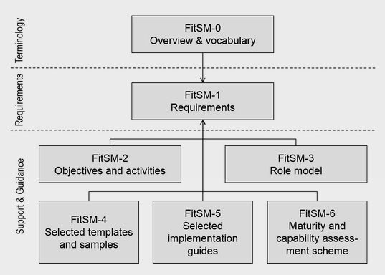
FITSM
A free standard for lightweight ITSM
FitSM is a free and lightweight standards family aimed at facilitating service management in IT service provision, including federated scenarios.
The main goals of FitSM are:
Create a clear, pragmatic, lightweight and achievable standard that allows for effective IT service management (ITSM).
Offer a version of ITSM that can cope with federated environments, which often lack the hierarchy and level of control seen in other situations.
Provide a baseline level of ITSM than can act to support ‘management interoperability’ in federated environments where disparate or competing organisations must cooperate to manage services.

