Slide 1

Campus Best Practice (CBP)
Project Participation
Maria Ristkok
GN4-1/NA3 T2
Project Manager, EENet/HITSA
TF-CPR, Cambridge
29 October 2015

Slide 2
What is Campus Best Practice (CBP)?
Aim:
  To address key challenges (security, technology, services) for campus networks
  To find the means to develop and maintain national best practices recommendations
Mission: to have as many campus networks adopt CBPs to maximise utility and value of services to their end users
Participating NRENs :
AMRES, ASNET-AM, BASNET, BREN, CESNET, CEENet, CSC/Funet, FCCN, GRENA, EENet/HITSA, MARnet, MREN, RENAM, RENATER, UNINETT, URAN

Slide 3
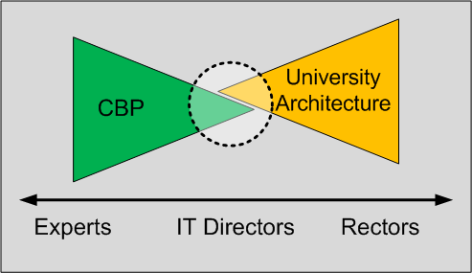
Collaboration
Collaboration
= saving resources:
  More results with less resources
  Common (IT) environments, tools,…
  Joint procurements

Slide 4
Activities (1/2)
Organises working groups:
  Participants from universities are invited to propose recommendations
  Creating common IT practices
Provides the community with Best Practice Documents (BPDs) that are collected to the Knowledge Base
  Ca 10 new documents during GN4-1 (4 already published)
  45 BPDs at final stage
Organises technical workshops and trainings (CBP Academy)
  CBP on demand
  FPA Technical Annex:„...training provided by the CBP trainers, the trainers in 1/NA1 and the PR and Communications specialists in 2/NA2“

Slide 5

Activities (2/2)
communicate
discover
peer
socialize
inform
collaborate
document
Workshops
Dissemination
Best Practice Documents
define
Trainings
Planning
monitor
recommend
interconnect
learn
teach
scout

Slide 6






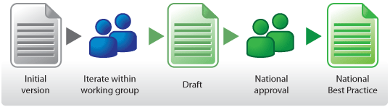
Work on BPDs and Areas of Focus
Campus
Networking
Physical
Infrastructure
Network
Monitoring
Real-time
communications
Wireless
Security

Slide 7
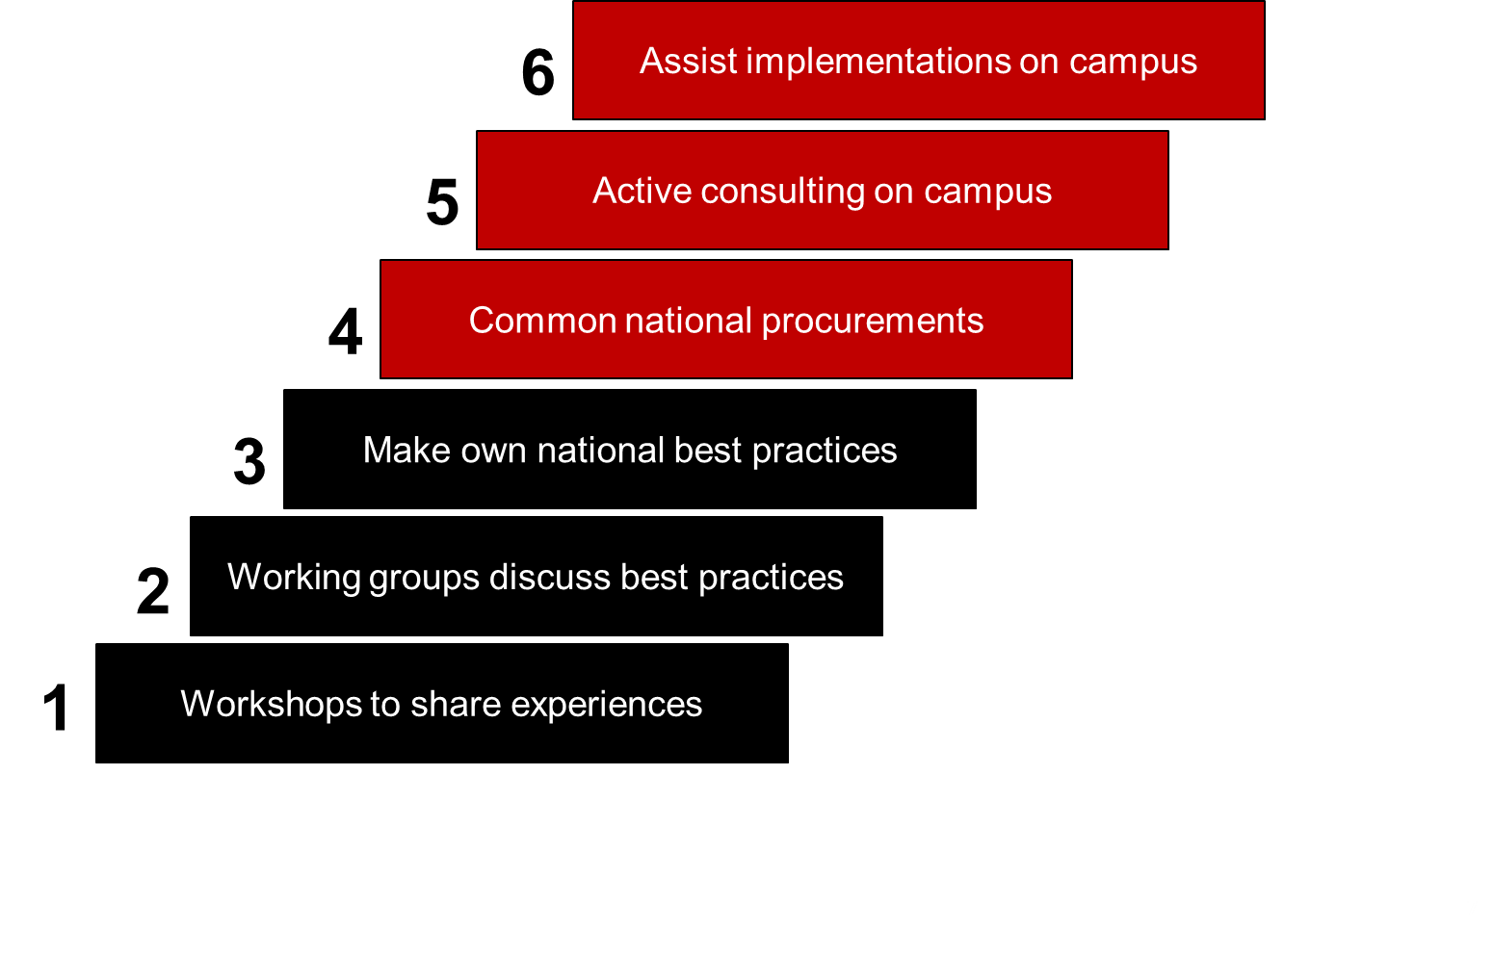
Campus Best Practice staircase
Strategic choice
[1] Vidar Faltinsen et al

Slide 8
White Papers and References
Vidar Faltinsen, Gunnar Bøe and Olaf Schjelderup (UNINETT), GÉANT Campus Best Practices:
  http://services.geant.net/cbp/Knowledge_Base/Reports/Documents/geant-campus-best-practices.pdf
Mara Bukvic, AMRES’ Experience with Implementing the “Campus Best Practices” Model:
  http://services.geant.net/cbp/Knowledge_Base/Reports/Documents/amres_experience_with_cbp.pdf

Slide 9
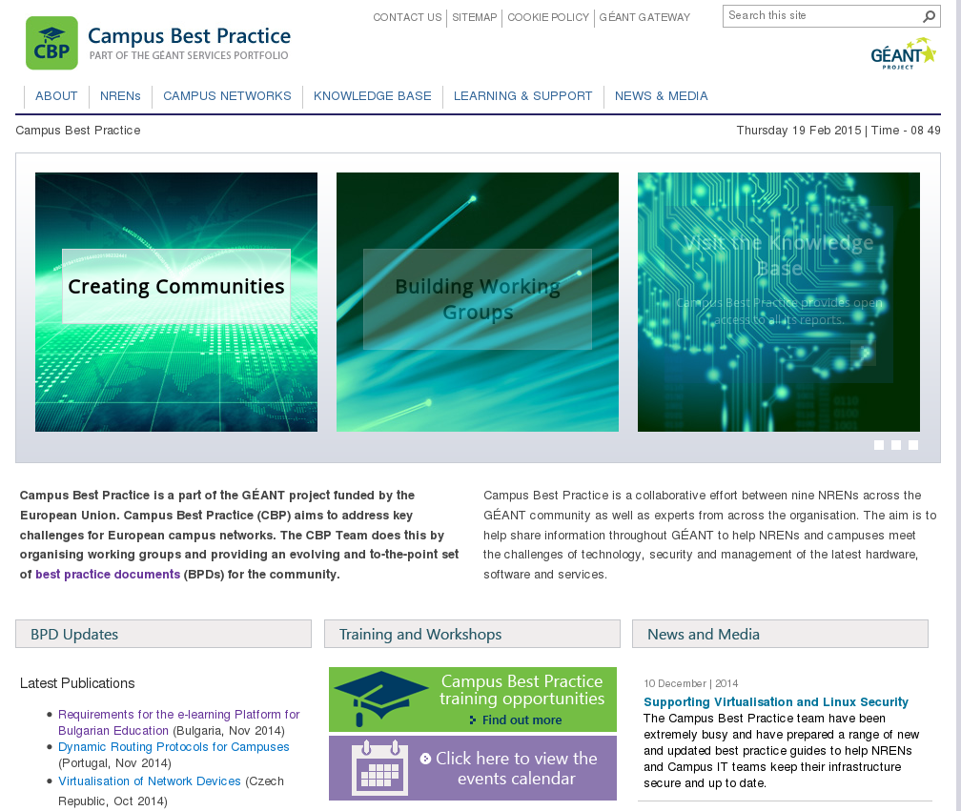
Further information
Campus Best Practice website:
  https://lists.geant.org/wiki/cbp/geantcampus/start
  http://cbp.geant.net/
Coming events:
    Network Security Workshop in January or February 2016 (3 days)
    Network Monitoring Workshop in Czech Republic in April 2016 (2 days)

Slide 10
I would like to know your opinion about:
Collaboration between CBP & TF-CPR
FOR
Marketing the Knowledge Base
Reaching the campus networks
Reviewing the way HOW to disseminate
Any other thoughts...

