Slide 1
GÉANT IaaS procurement
Status and communications
Lars Fuglevaag
SA7 Communications
Head of Communications, UNINETT
TF-CPR, Cambridge
2015.10.29

Slide 2

Our mission
Meeting user needs
through a community effort,
adding value in the process
Notes:
Meeting user needs: providing the right choices
Range of services
Buying power
Adapted to common requirements
Community effort – by the community, for the community
Trusted brokers and advisors
Sharing expertise and resources
Aggregating demand
Adding value – The benefits of clouds, adapted to the community
Maximizing benefits, minimizing risks
Meeting community requirements
Lowering cost through buying power and peering

Slide 3
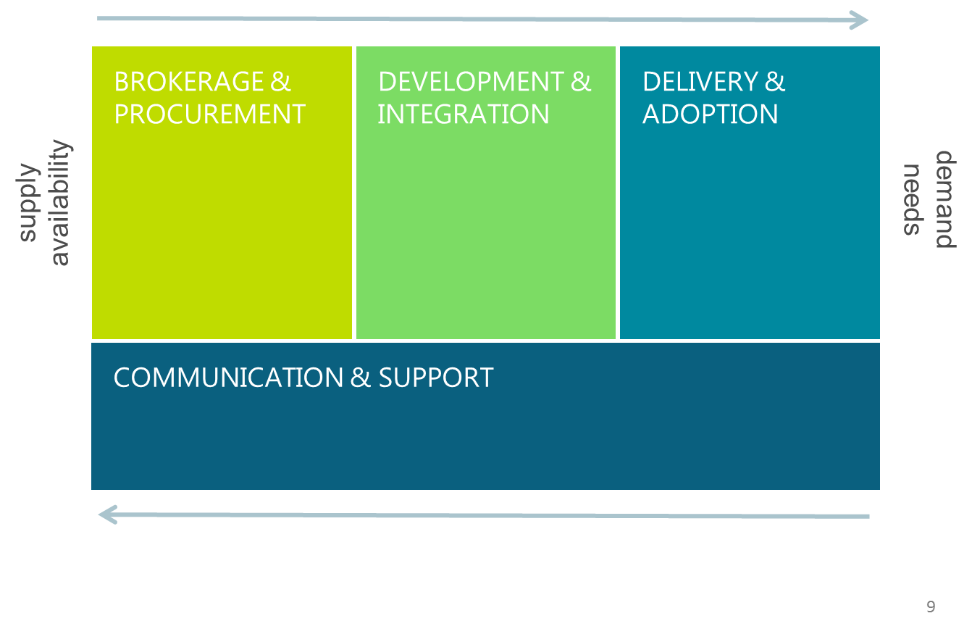
Towards Pan-European Cloud Services for Research and Education
Notes:
We want to set up this as an ecosystem, where we capture the demands of the community, and turn that into the services that they need. European service portfolio and life cycle
We work both ends, demand and supply
We monitor the market and keep in touch with the vendors

Slide 4
Foundation: four main areas
STRATEGY
STANDARDS
Initiated spring 2013 (GN3+)
Clouds are happening
Community demand
Willingness to work together
Common approach
REQUIREMENTS
CATALOGUE
Notes:
Some background

Slide 5
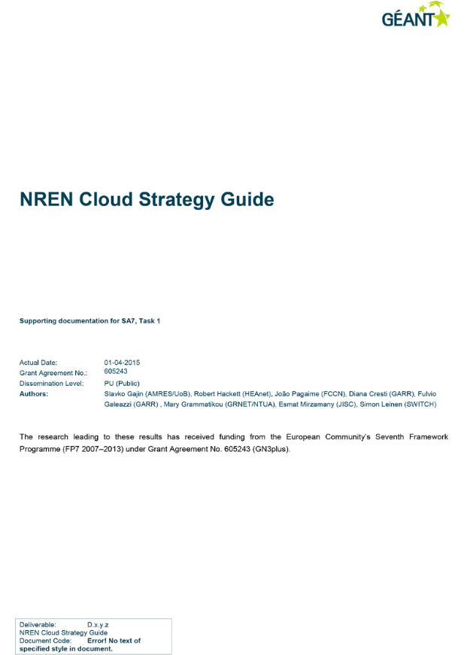
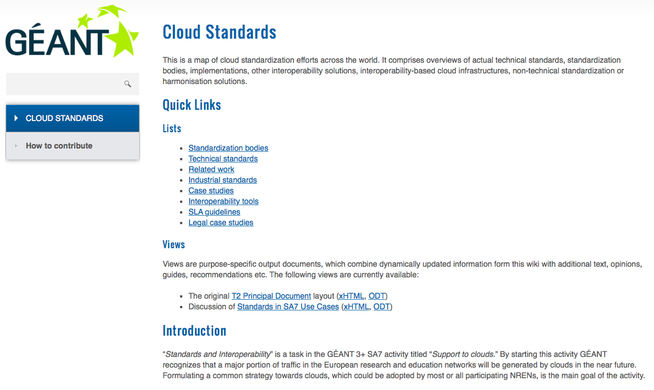
Community effort: Strategy and standards

Slide 6
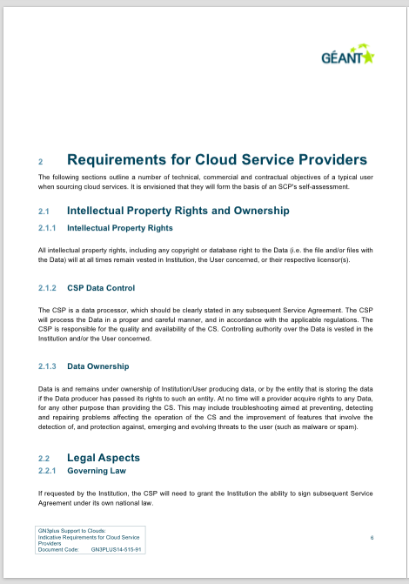
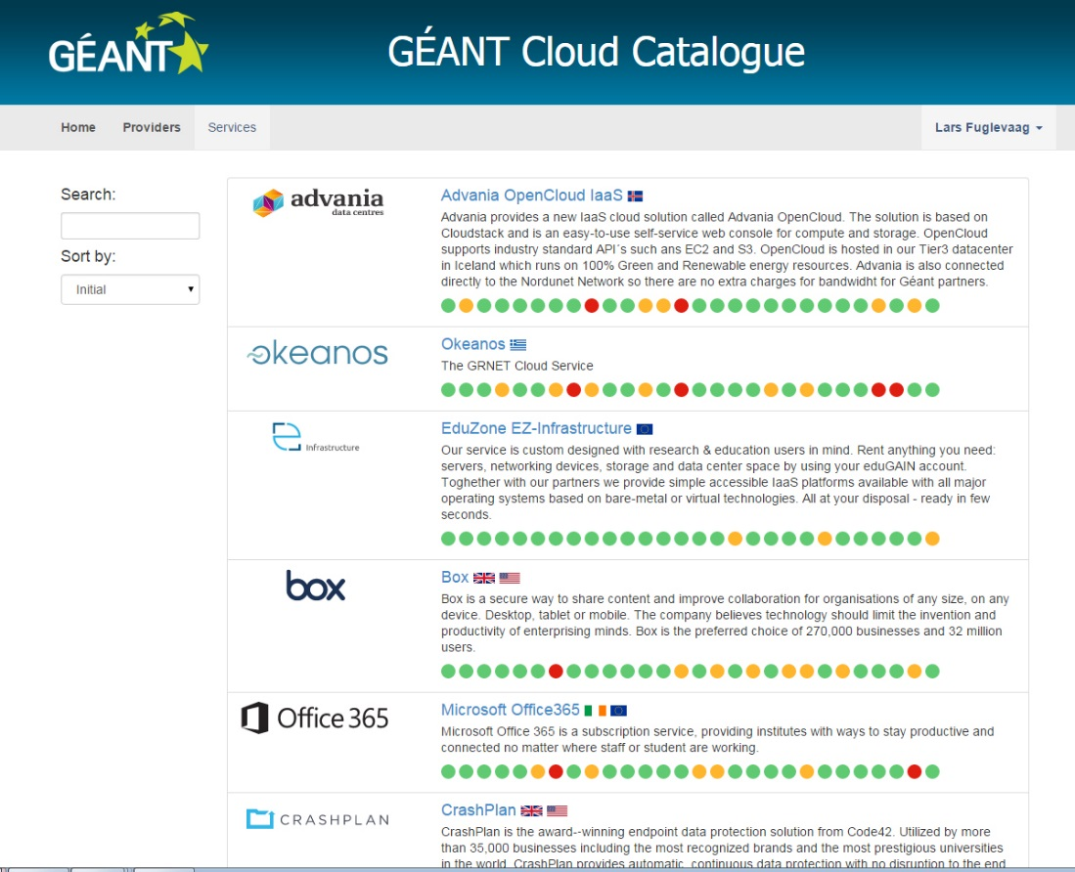
Community effort: Requirements and catalogue

Slide 7
Meeting user needs: Cloud collaboration areas
COLLABORATION
SUITES
REALTIME
COMMUNICATION
NREN Questionnaire:
Interest in specific types of services
Willingness to participate
Varying maturity
Varying scopes/mandates
IaaS highest priority
FILE STORAGE
AND SYNC
INFRASTRUCTURE
AS A
SERVICE
Notes:
Most imoprtant part – delivering services

Slide 8

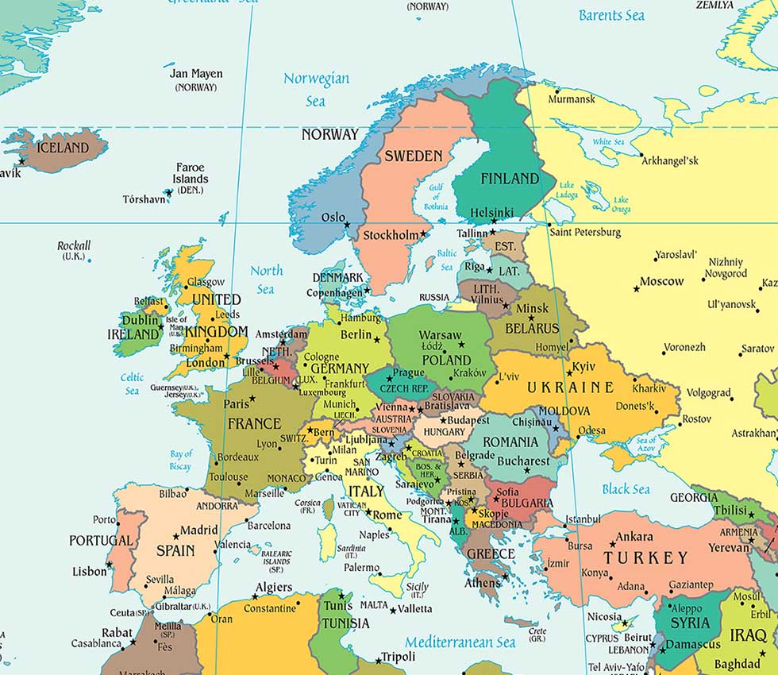
Legal basis for procurement activity
EC Procurement Directive (2014/24/EU)
- To be implemented by Member States no later than
18th April 2016
Member State Procurement Legislation
- New Directive sets out key provisions key to the success of the planned GEANT IaaS Frameworks:
  Framework Agreement use
  Cross-border procurements
  Centralised Purchasing Bodies

Slide 9
Timeline
Competitive Dialogue (original plan) | Draft ITSFB | Dialogue meeting | ITSFB |  | Final Bids | Contracts awarded
Open Procedure (new plan) |  |  |  |  |  |  | Tender issued | Final Bids | Contracts awarded
 | Oct 15 | Nov 15 | Dec 15 | Jan 16 | Feb 16 | Mar 16 | Apr 16 | May 16 | Jun 16
Market engagement

Slide 10

Communication and support
Website and catalogue
Webinars, showcases, tutorials
Workshops, conferences
Adaptable materials
Presentations at NREN meetings & user conferences
Coach / Key Account Manager

Slide 11
What’s happening?
Adoption pilots; Rendez-Vous…
Cloud management portals; HEAnet…
Preferential pricing agreements; Box…
Office 365 rollout
Adoption workshop spring 2016
Cloud conference April 2016 Dubrovnik
Showcase series from 2 November
Survey out now
Notes:
In random order…

Slide 12
Communications and support: web site
What information do you need from us?
- Three most important
How should it be presented?
- Three suggestions for the front page
Any other ideas

