Slide 1
TRAINING
Minimizing Threats & Maximising Opportunities
Ian Barker,
Training Coordinator, GÉANT Amsterdam and Cambridge
TF-CPR, GÉANT Cambridge
29 October 2015

Slide 2
Purpose
Examine GÉANT as an Organisation
Establish the value of Training for GÉANT
Clarify the contribution of Training for GÉANT
Collect insights on cooperation with TF-CPR

Slide 3
Diversity of activities & locations and lack of collaboration prevents GÉANT from delivering quality service
Strength
  Rich & long history
  Variety of expertise
  International presence & experience
  People of passion
Opportunities
  Merger
  Collaboration
  Remote communication
  Virtual teams
  Tapping into wide variety of geographical
  expertise and potential
Weaknesses
  Diversity and multitude of activities and tasks/ Internal competitiveness
  Diversity of needs and resources within community
  Lack of long-term planning
Threats
  Merger
  Commercial competitors
  Silo thinking & silo work design
  Protectionism & territorialism

Slide 4
How can GÉANT remain immune threats and realize its opportunities?
72% of top deck organisations report that they are improving productivity through learning (compared with 28% on average)
62% are more equipped to respond faster to changing business conditions (compared with 24% on average).
CIPD 2015
An organization's ability to learn, and translate that learning into action rapidly, is the ultimate competitive advantage.
Jack Welch

Slide 5
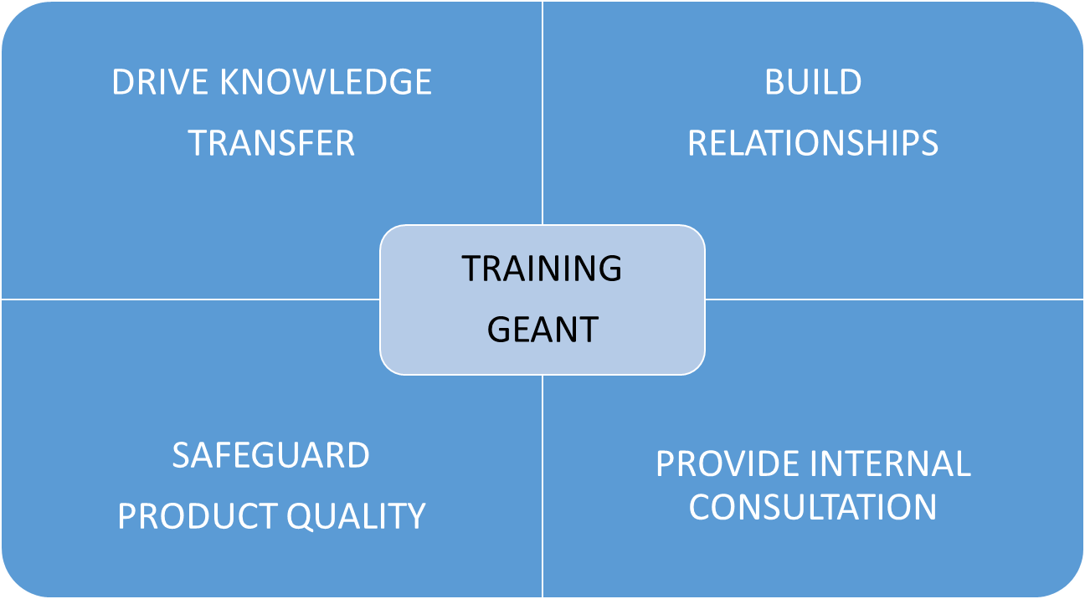
We are not working harder, but smarter!

Slide 6
Targets
Drive Knowledge Transfer
  Capturing and sharing best practices
  Identifying knowledge/ skill gaps
  Dissemination of knowledge
  Facilitating transfer and assimilation of knowledge across international community members
  Mapping internal expertise and knowledge
Safeguard Product Quality
  Identifying potential opportunities for new solutions within community
  PLM: facilitating timely development, introduction and adoption of solutions
Build Relationships
  Introducing, role modelling and developing new practice
  Developing mindsets, behaviours and competencies
  Enhancing hard and soft skills
Provide Internal Consulting
  Advising on learning related matters
  Develop in-house learning solutions
  Identify and contracting external experts and suppliers
  Identify external learning opportunities and champion them within the community

Slide 7
Question
    HOW CAN WE COLLABORATE ON COMMUNICATING THIS MESSAGE ?

Slide 8
Ian.Barker@GÉANT.org

