Slide 1



Slide 2
Agenda
Past & Present
Who we are & what we do
Activities
Challenges

Slide 3

Past
FCCN started its activity as a private, non-profit institution
in January 1987.
FCCN included the .pt domain registry (DNS) service.
Main mission: to plan and manage RCTS (the Portuguese NREN) and ensure operation of all the services provided to the RCTS community.

Slide 4

Present
FCCN = no longer a private non profit.
  It is now part of a public institution.
It is now commonly called FCT | FCCN.
What is different?
DNS.pt operates as a private association since 1 June, 2013
The mission remains the same:
To plan and manage RCTS (the Portuguese NREN) and ensure operation of all the services provided to the
RCTS community.
Notes:
Following a governmental decision in December 2012, FCCN was integrated within FCT (1 October, 2013)

Slide 5
What is FCT?
Fundação para a Ciência e a Tecnologia (FCT)
is the Portuguese national funding agency for science and research.
FCT is a publicly-funded government agency, under the responsibility of the Ministry of Education and Science.
FCT’s vision is to:
Establish Portugal as a global reference for science, technology and innovation;
Fully harness knowledge generated by scientific research for economic development and social progress.

Slide 6
As an FCT Unit FCCN is
The National Computing Infrastructure
The FCCN Unit plans, manages and operates RCTS – Rede Ciência, Tecnologia e Sociedade – Science, Technology and Society Network

Slide 7

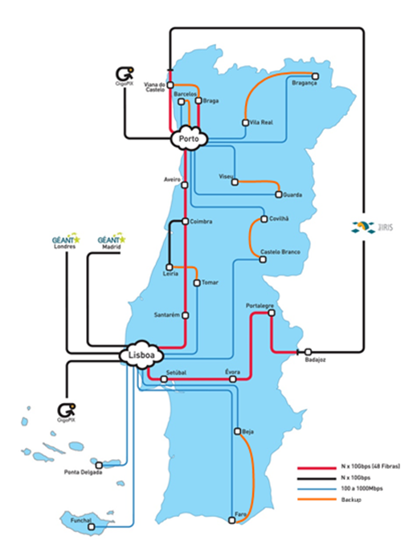
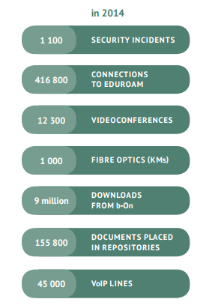
77
Connected institutions

Slide 8
FCCN distributes its actions and services within RCTS among the following pillars:
CONNECTIVITY
COLLABORATION
KNOWLEDGE
SCIENTIFIC COMPUTING
SECURITY

Slide 9





CONNECTIVITY
A wide range of network services are made available through the RCTS academic network supporting numerous applications and services providing collaboration & knowledge.

Slide 10


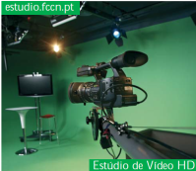





COLLABORATION
A range of services, brought together to provide interoperable services that support global collaborations and enable access to a multimedia universe: online classes, video streaming, web meetings, videoconferencing, VoIP network services, among others.

Slide 11




KNOWLEDGE
b-on – the Online Knowledge Library provides unlimited and permanent access to thousands of international scientific publications from major scientific providers.
FCCN also supports and maintains open access digital repositories and a web archiving service.

Slide 12
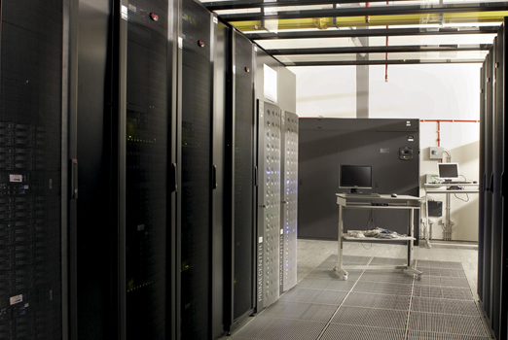



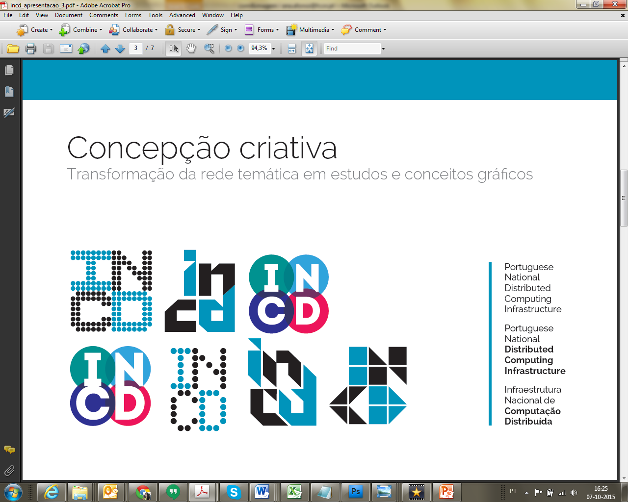
SCIENTIFIC
COMPUTING
The scientific datacentre provides effective and trustworthy storage solutions as well as computing power, helping to develop and support increasingly complex advanced research and/or technological activities.
** Portuguese traffic exchange point between IP networks.
*

Slide 13





A certified authentication service using a single user name and password) gives access to a large number of systems and web applications to guarantee the correct identification of users and servers.
Emergency and Response Team (CERT) deals with issues relating to IT security, whether they are due to system failures caused by virus attacks, acute security gaps in applications or enquiries regarding individual protection measures for computer systems.
SECURITY

Slide 14
What’s new?
To satisfy leading edge research needs for huge data processing and computing capacities that cannot be provided by isolated research centres.
(OpenStack cloud computing ,
High-throughput computing (HTC),
Storage, Grid Computing, Virtualization...)
A national integrated information ecosystem.
A central hub for information exchange between the various national and international systems.

Slide 15
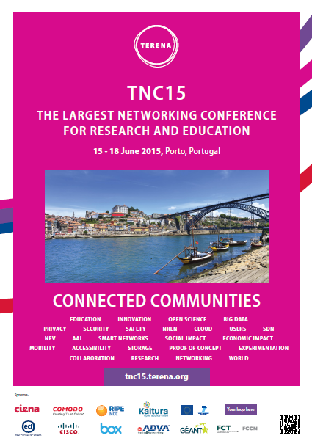

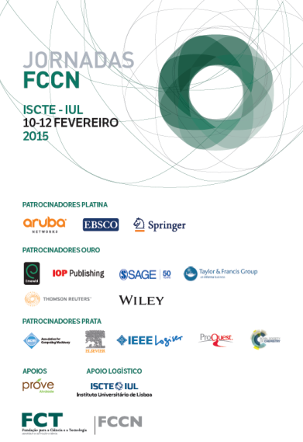
2015 challenges
Lisbon – 417 participants
Porto – 667 participants
Lisbon – 6000 participants

Slide 16

Future
Spread services awareness
Communicate better & easier
New simpler website
Keep the community informed:
Develop messaging & produce Content:
create and update collateral materials, brochures & deliverables
– Invest more in Social Media.
Continue Innovating to meet community needs
New services
New ways to get to users
More Awareness
Comms & PR
2016 challenges
Annual Conference 2016
UALG – March / April
Targeted Communication actions (workshops, meetings,
smaller events…)
Institutional Identity
Branding Image
conformity and sedimentation

Slide 17


