Slide 1
User outreach, GÉANT and you
John Chevers, Beatrix Weber
NA4 T2 User Liaison
International Business Development
TF-CPR meeting, Cambridge
30/10/2015

Slide 2
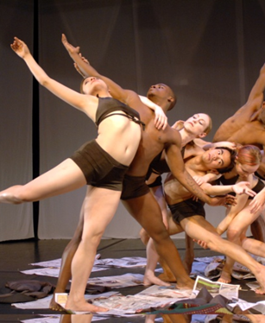
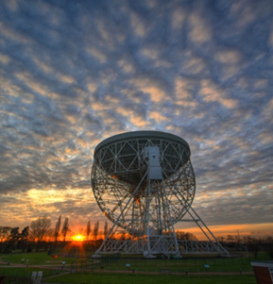
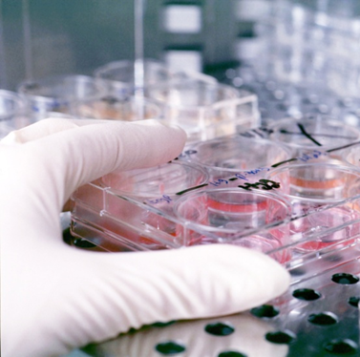
User Liaison in GÉANT
Physics sciences
Astronomy and Earth observation
E-Infrastructures
Life sciences
Future Internet
Arts and Humanities
Public services
One Stop Shop + Outreach
→ re-active and pro-active working approach
Notes:
We work with a broad variety of users
Different engagement levels
Different requirements and maturity levels (knowledge of their requirements, R&E networking in general, GÉANT and NRENs)

Slide 3
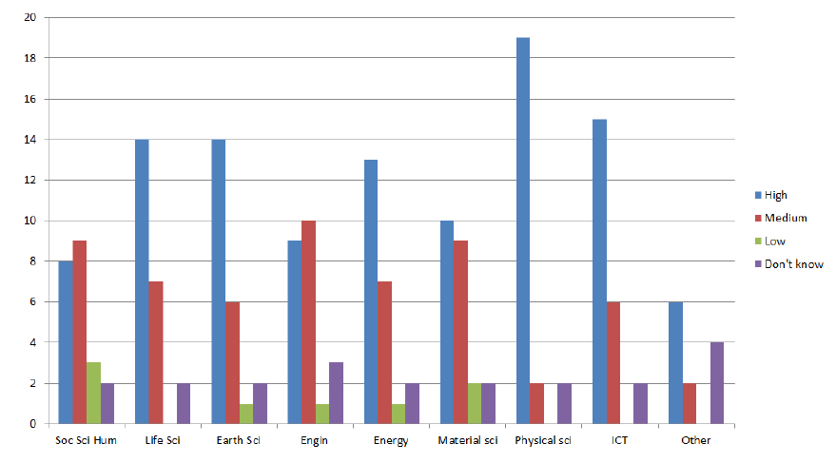
Defining the strategy
With start of GN3+ survey among European NRENs to
  obtain overview of NREN activities with international user projects and user engagement strategy
  Infer strategy and focus areas for own work
Physics and ICT traditional demanding areas
New: Earth and Life Sciences emerging areas
Particular focus on outreach activities on emerging areas
Notes:
Survey to identify priority areas for our work in GN3+ and GN4-1
25/32 NRENs responded

Slide 4

Expanding the user base –Earth Observations
Status by the start of GN3+:
Longstanding engagement with ESA, but slow progress
Preparation work for EUMETCast Project
Single project support
No comprehensive overview or knowledge of the sector
    Note: ESA and EUMETSAT operate quite differently to research collaborations
Widespread sector with many different research communities (marine sciences, seismology, meteorology, physical sciences, geodesy..)
A lot of unknowns…

Slide 5

Objectives
Develop a deeper understanding of the sector and how earth scientists work:
  How is the sector structured?
  What are the key organisations and projects?
  What challenges do they face?
  What tools do they use?
  What are their data transfer requirements?
  Which GÉANT services are relevant for them?
Raise visibility of GÉANT and NRENs
Provide guidance what R&E networking is and how scientists can benefit
Enhance existing and develop new relationships
Obtain strategic and operational user feedback
Identify specific use cases to support

Slide 6
What did we do?
Identified key organisations, collaborations and projects:
  Assessment of existing engagement level
  Talked to existing user contacts, NREN colleagues and other e-infras working with Earth science users
  (the odd) Desk research
Defined best engagement channel for:
  Existing working contacts
  Loose contacts
  Unknowns
Broad engagement activities on strategic and operational level:
  User relevant events (attendance, booth, presentations)
  Invite user to present at GÉANT /NREN events
  International User Advisory Committee
  Enhance partnerships
  Outreach material
  PR work
Notes:
Proactive, multi -channel strategy

Slide 7
Some examples…..

Slide 8



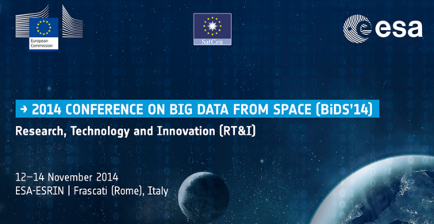
Events
Sector specific main events
  ESA Big Data in Space
  EUMETSAT Annual conference,
  Copernicus Workshop….
E-Infra/ ICT
  3rd EUDAT User Forum
  EGI conference
  Events from eIRG, RDA …
GÉANT / NREN events
  EUMETSAT@ ACO:25)
  TNC15
Objectives:
  Raise visibility of GÉANT
  Explore the field
  “Meet” the users

Slide 9
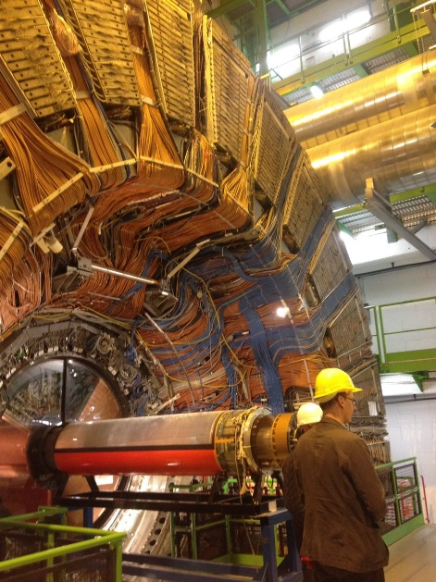
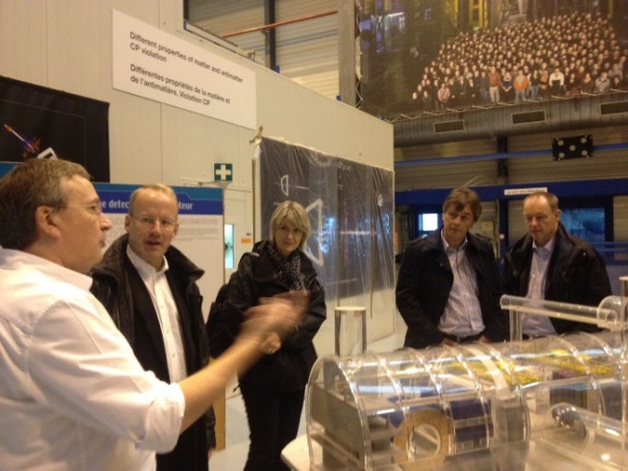
International User Advisory Committee
Incepted in GN3+
11 representatives of large research organisations and collaborations
Bi-annual meetings to provide advice and support on GÉANT strategy, project and services from an users view
Strong representation of earth sciences: ESA (Chair), EUMETSAT, ENES
Presentation of their use of the GÉANT network, future developments and requirements
Objective:
Obtain strategic user view from “mature” users (know GÉANT /NRENs and use our services)
Deepen strategic relationships

Slide 10

Enhance Partnerships: GEO
Partnership of 90 governments (incl. EC) and 77 international organisations (incl. ESA, EUMETSAT, WMO, NASA….)
Aim: Improve and facilitate data sharing and access worldwide by linking together earth observation collaborations and projects through GEOSS
Key organisation!
GÉANT Member of GEO since 2012, but complex and scattered set up – little active involvement
Summer 2014 meetings and calls to deepen mutual understanding and explore ways of working together
Expansion of contributing role in the Work Plan (2014 – 2015) via report on data sharing and engagement with community
Lead role in Global Network Architecture Work package and support for AfriGEOSS (2016ff)
Objective:
Further expand contribution role and become more visible
Become the 1st PoC for networking needs (tbc…)

Slide 11

Outreach material
Global data sharing report
  Part of GEO contribution, but reusable for wider audience
  Design and structure easy adoptable to other science areas
1st edition: 500 copies (Nov 14)
  Dissemination at GEO Summit 14, TNC14, User events, ..
2nd edition (Oct 15)
  Updated and new EUMETCast case study
  Dissemination at SC15, TNC16….
Objective:
Provide high level guidance and information for scientists
Showcase experience and expertise in the area

Slide 12
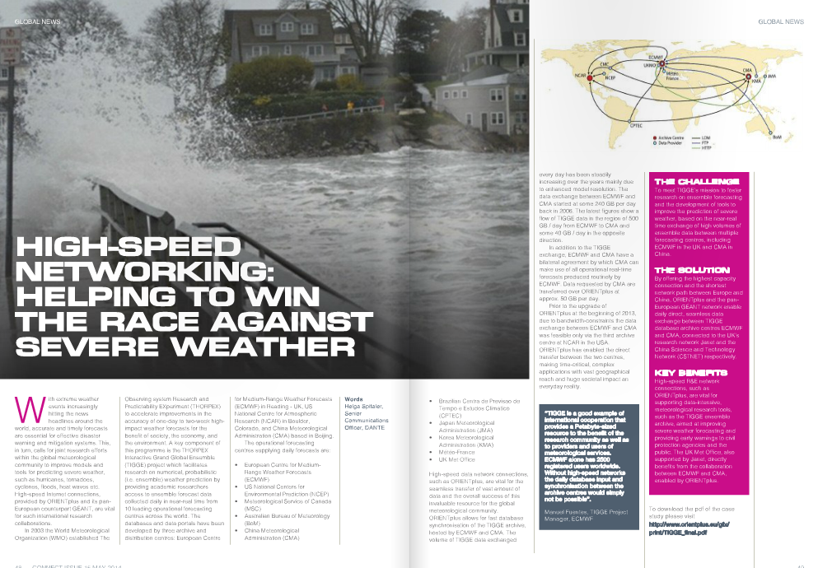
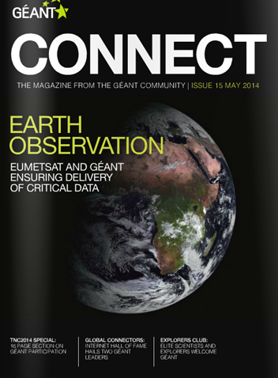
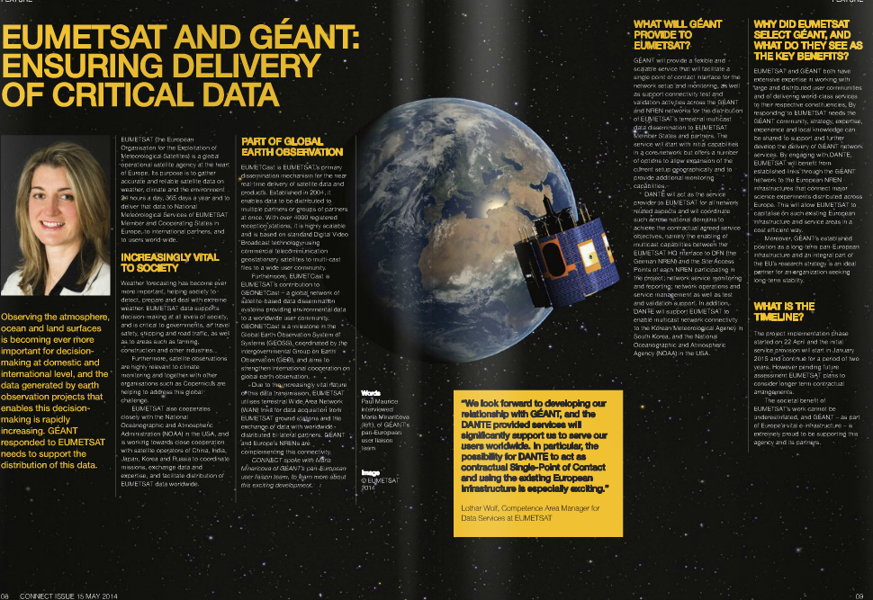
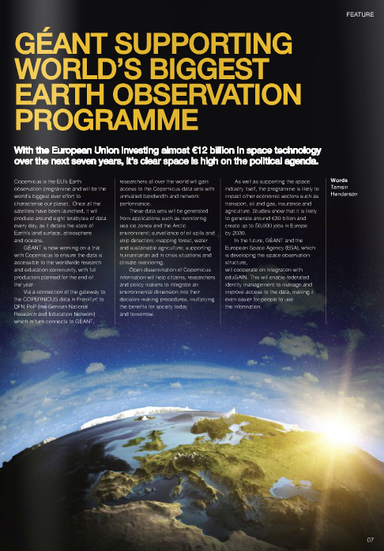
PR work (Thanks to Comms!)
CONNECT May 15 Earth Observation Focus Edition, incl.:
  EUMETCAST and TIGGE Use Cases
  GEO report Announcement
Further CONNECT Features:
  Interview with Barbara Ryan , Director of GEO
  Report on User - eInfra Workshop
Objective:
Raise visibility within the wider NREN community

Slide 13

Earth Sciences – eInfrastructure workshop
22 – 23 Jan 2015, CWI, Amsterdam, The Netherlands
Jointly organised by user groups (EPOS and EIDA) and eInfras (EGI, EUDAT, PRACE, GÉANT)
35 participants, 5 user groups from Seismology, Geodesy and Climatology
Appropriate user groups were identified and approached by EIDA and EPOS
Written assessment of data requirements upfront
Covered topics:
  Connectivity Services and performance monitoring , AAI
  Computing needs and types of computing
  Cloud services
Objectives:
Develop a deeper understanding of the sector and how earth scientists work
Start a co-ordinated dialogue between earth sciences and e-Infrastructures
Identify specific use cases to focus on and support

Slide 14
Conclusion – User outreach, GÉANT and…you?
Engagement activities have proven successful:
Knowledge on sector structure, key projects/organisations and requirements obtained
  Strategic and working relationships established and nurtured
Experiences and produced material good base line for adoption in other areas
Your feedback!?
Anything we should do but haven’t done yet?
Do you reach out? Who talks to users at your NREN?
Synergy Opportunities?
Strategic report – Deliverable March 2015: http://www.geant.net/Resources/Deliverables/Documents/D4-5_DN4-3-1_Strategic-Report-on-the-G%C3%89ANT-Community.pdf

Slide 15
john.chevers@geant.org
beatrix.weber@geant.org
businessdevelopment@geant.org

