Slide 1



Slide 2
The project
The In The Field Blog Project aims to trial creating dynamic global case studies in the form of collections of stories posted on a collaborative blog site open to contributions from all R&E Networks.
Objectives:
Trial a new way for all NRENs/global PR network to share, access and showcase use case information using a digital/blog platform
Raise awareness of the impact of R&E networking, regionally and globally

Slide 3
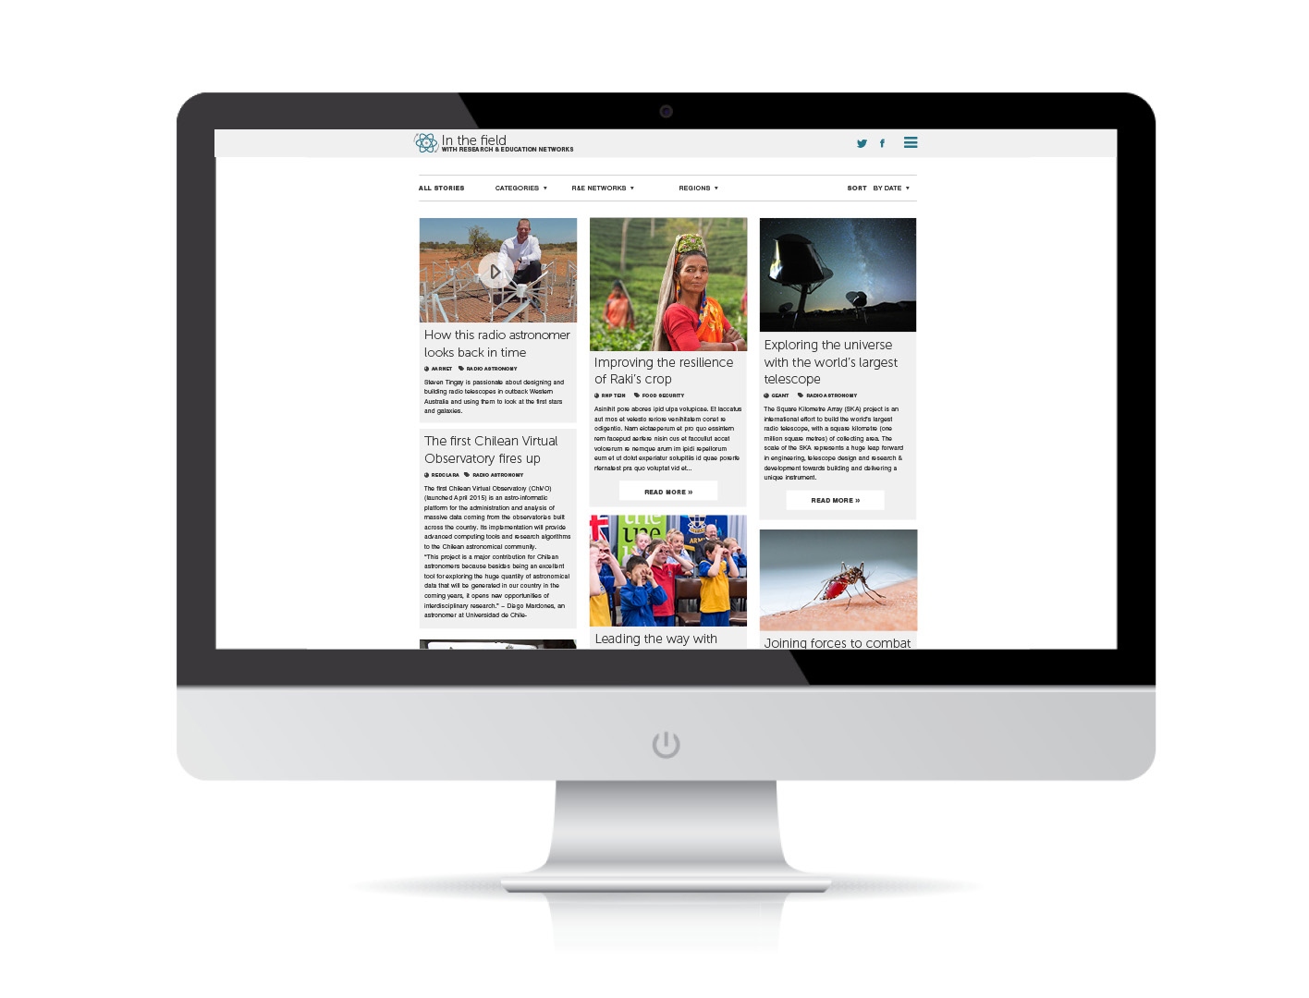
Notes:
Two Objectives:
Trial a new way for all NRENs/global PR network to share, access and showcase use case information using a digital/blog platform
Raise Awareness of the impact of R&E networking, regionally and globally

Slide 4
The concept
Stories can involve one or several NRENs.
Curating a wide range of stories from NRENs around the globe builds a resource of use case examples for all NRENs to utilize for proposals, presentations etc.
Paints a rich picture of our impact on a global scale.
Offers a glimpse at the human side of what R&E networking enables (inspired by Humans of NY blog)

Slide 5
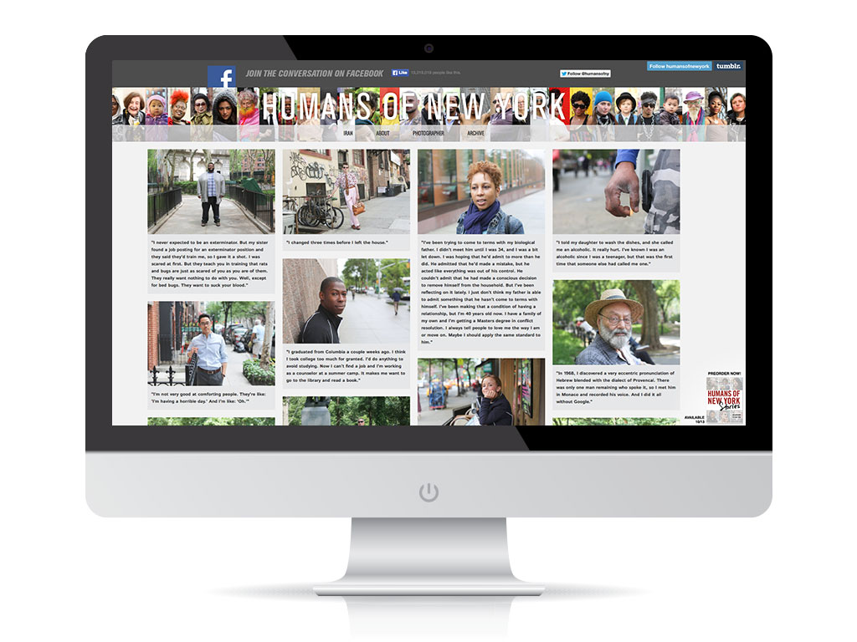

Slide 6
Target audiences
Global PR network members (NRENs)
A resource for sharing use case stories, which will assist in their work (e.g. provide content and messages to target user communities, seek collaborators, demonstrate value and impact to funding bodies etc.)
Funding bodies
A resource for (NRENs to direct) funding bodies to demonstrate the role and value of R&E networking organisations; reinforcing/aiding funding decisions
Other NREN staff and other partners
An accessible resource for material about user communities’ usage of R&E networks and services, and supporting funding decisions
R&E networking community
To get ideas of successful networking solutions of other users/communities;
To seek collaborations

Slide 7
The stories
Stories can involve one or several R&E Networks – each story will be tagged to feature name of network/s involved as well as category under headline. All the stories work together to tell a bigger regional or global story.
Types of posts
Image with caption
Video with caption
Text only
Text and image or video
READ MORE will be an option for any post if there is more to read. Logos for all R&E Networks involved in the story will feature in sidebar of sub page and hyperlink back to NREN websites.
Stories can be searched and viewed by R&E Network, Region, and Categories, such as education, health, food security, radio astronomy etc. and Sub-categories, such as Dengue Fever, SKA, K-12 schools.

Slide 8
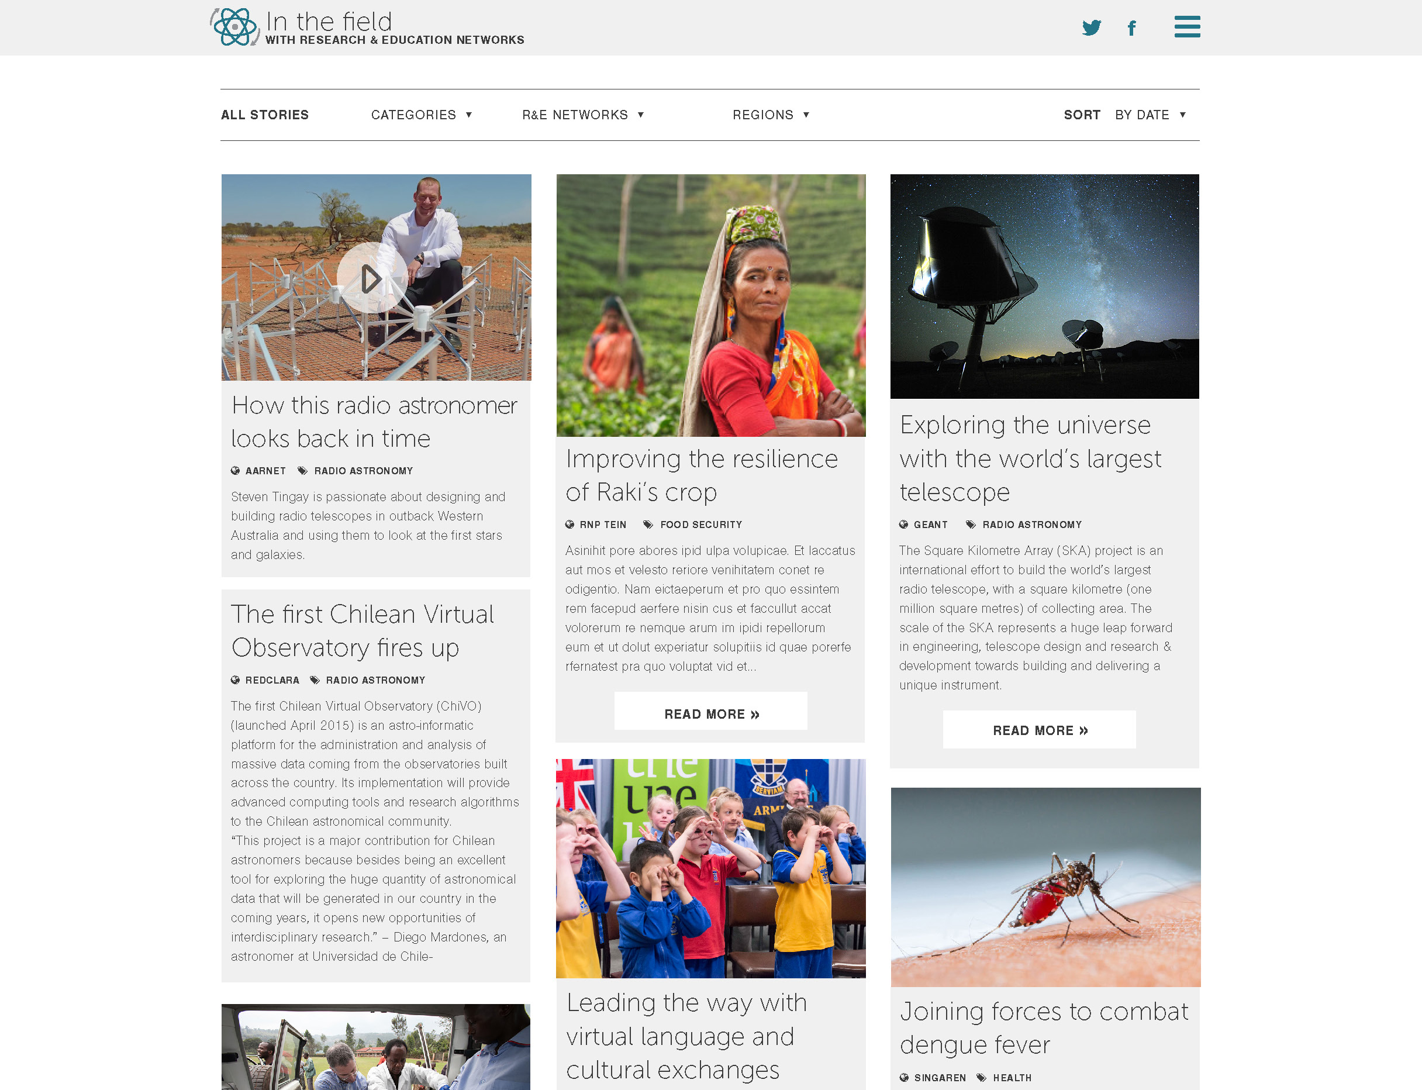

Slide 9
How to submit stories?
The aim is to make submitting stories very, very easy.
Clicking on the Submit Now button in bottom right corner of home page will give contributors a choice of submitting text and images:
  via email or
  via a specially designed form in the WordPress CMS, with fields to complete for NREN name, region, category, heading, subhead, image/s, intro text, body text etc.
To maintain quality and style, all submissions will be moderated and if needed edited by a working group member before publishing.
Advice and assistance will be provided by the working group.

Slide 10
Promotion
Branding (visual and URL)
Logo/icon is to be NREN neutral and unique to the In the Field blog.
URL is to be NREN neutral, eg: inthefieldstories.net or inthefield-re.net
Phase 1
Generating invested interest amongst global PR members so that they will utilise the resource both as a contributor and consumer of stories
Phase 2
Driving traffic to the site e.g. publish a “launch” news item and banners/images for PRs to post on NREN and RREN websites, social media, newsletters, and other places, such as GEANT’s Case for NRENs website, etc.
Other
Consider running a competition to engage users and NRENs to make posts – suggest this is considered for Y2 of trial

Slide 11
How will we measure success?
Demonstrated engagement from Global PR Network members:
  Stories from all regions are regularly submitted
  Resource is used as a source of information by global R&E Network community
Indicators of success
  Posts for launch - at least 20 posts from at least 10 NRENs (including at least one NREN from each continent)
  Posts over 24 month trial – at least 60 posts from at least 20 NRENs (including at least two NRENs in each region)
  Usage - blog stats, word-of- mouth feedback, participant survey

Slide 12
Questions and feedback for In the Field blog
Please contact:
Jane Gifford
Media and Communications Manager
AARNet (Australia’s Academic and Research Network)
Jane.gifford@aarnet.edu.au

