Slide 1
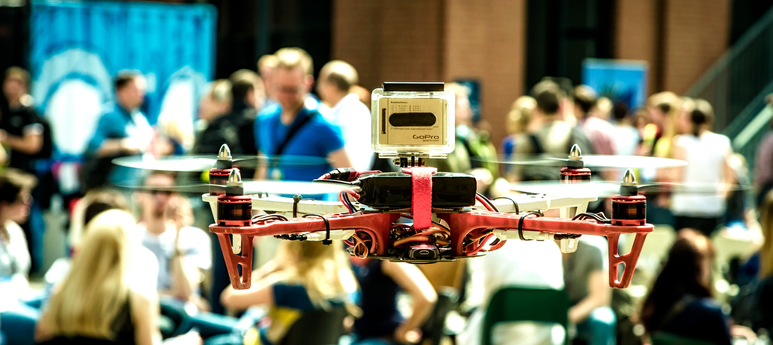

MindDrone – International Demo
Wladimir Mufty
Wladimir.mufty@surfnet.nl

Slide 2


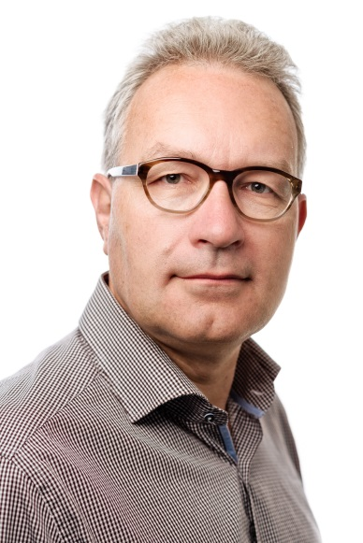


Global Conference on Cyberspace 2015
Panel discussion “Rethinking the social impact of new cyber technologies”
Innovations have great potential in improving and enhancing healthcare, education, research, business….
But policymakers often lag behind in estimating social impact of these innovations.
Understanding new technologies starts by experiencing them.
Erik Huizer,
SURFnet CTO
To kick off the session: MindDrone demonstration SURFnet

Slide 3

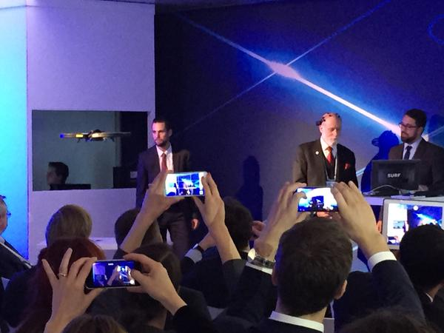


MindDrone – fly a drone with your brain activity
Drone
Brain Computer Interface
(BCI)
Demo-victim
Laptop + MindDrone
software

Slide 4

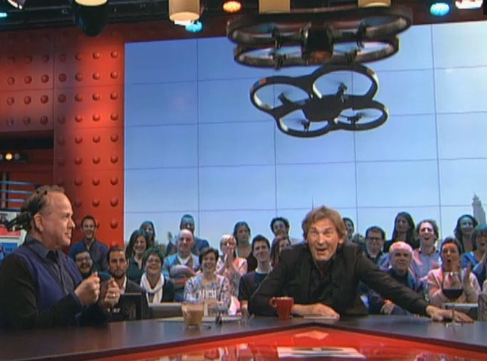




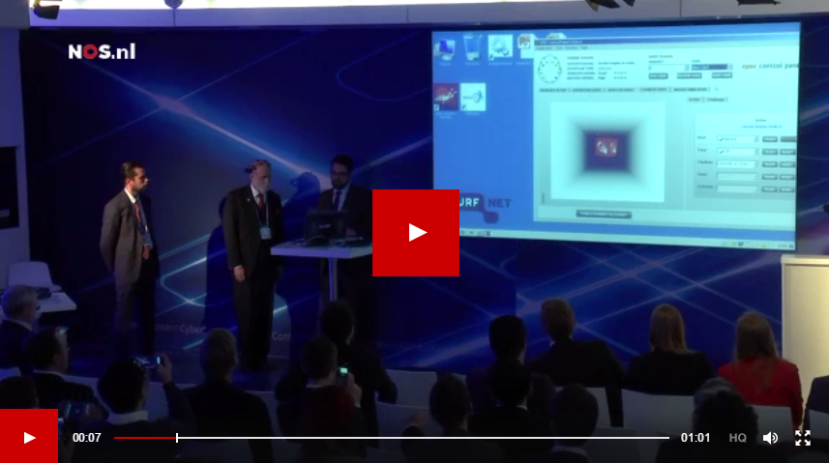

Global Conference on Cyberspace 2015
Session: “Rethinking the social impact of new cyber technologies”
8 O’Clock news
Dutch daily show
Friends with
Erik Huizer,
SURFnet CTO
Vint Cerf

Slide 5
MindDrone – setup
1.
3.
2.
1. Record thought-pattern: “TAKEOFF” (once)
2. Evoke thought “TAKEOFF”
3. If “TAKEOFF” = True → run command XYZ

Slide 6
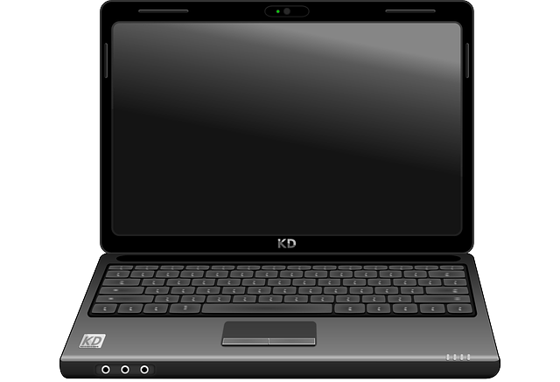
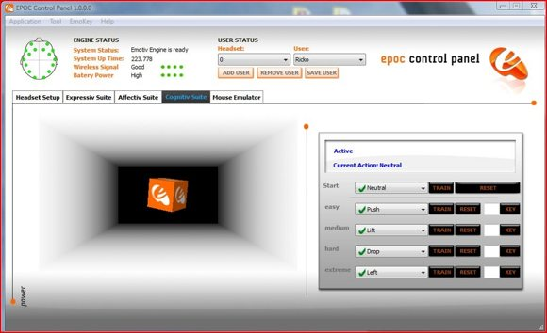
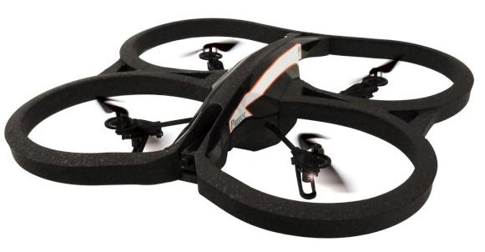

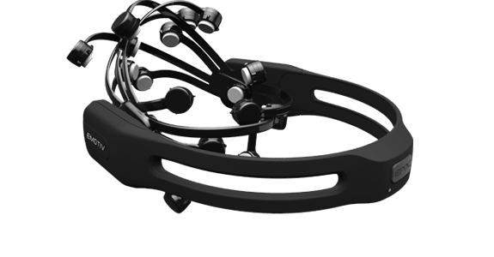
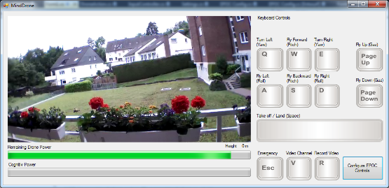

MindDrone – current setup

Slide 7
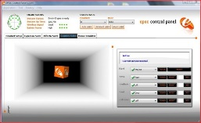




MindDrone – future setup
The Internet

Slide 8


Seeking a remote location!
Location X ?!
The Netherlands (SURFnet)

Slide 9
Remote location requirements
Inside, but landmark location (in the background)!
  The drone has a camera that will stream the video back to the NL location!
Some minimal space to fly the drone.
  Only take-off and landing space is needed:
    1,5 meter x 1,5 meter on the ground.
    1,5 meter in height… no objects like lamps or decoration.
    The drone will not fly left/right or move forward/backward (safety).
Decent internet connection (public IP).
A willing laptop!

Slide 10
Interested?!
Do you have a suitable location and want to be part of this demo?
Please contact wladimir.mufty@surfnet.nl

Slide 11

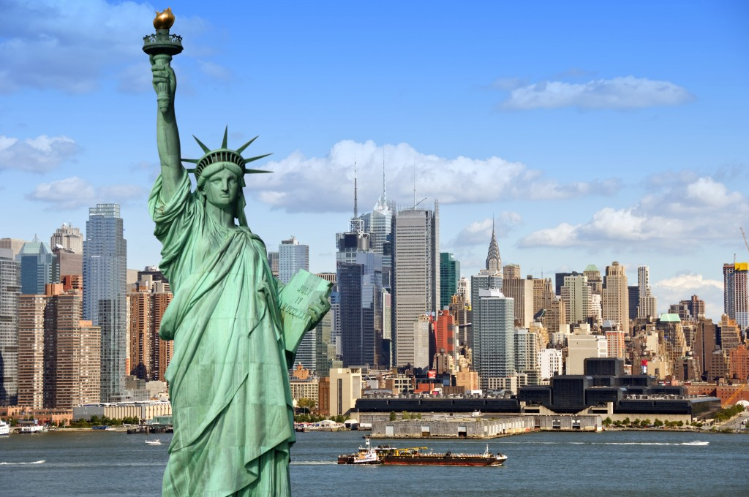

Some inspiration!

Slide 12

The audience in the Netherlands should
really believe that the drone is actually being controlled at a remote location (and not sneaky in conference room 8b at the NL venue)!

Slide 13


Slide 14
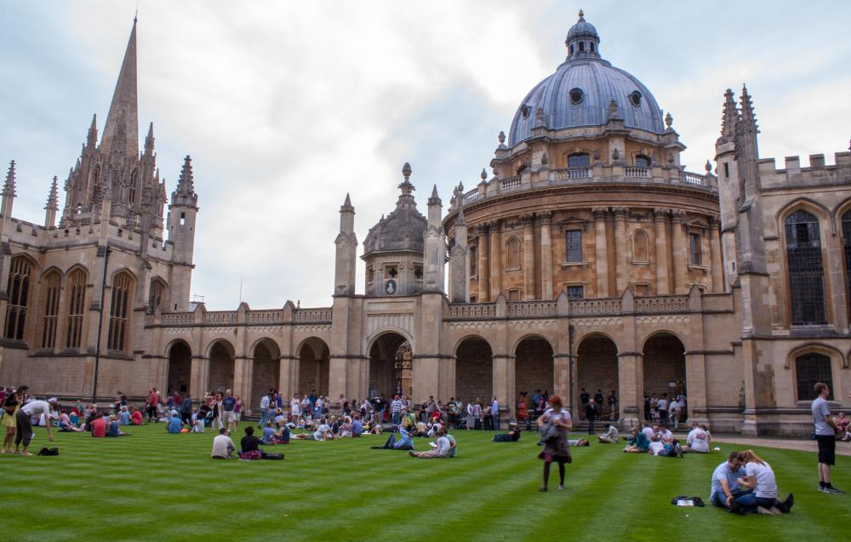

Slide 15
Let’s share our thoughts over the internet!
https://www.washingtonpost.com/news/innovations/wp/2015/04/17/what-it-feels-like-to-fly-a-drone-with-your-brain/
https://www.youtube.com/watch?v=v-ghkt5t4dY
http://dewerelddraaitdoor.vara.nl/media/338262

Slide 16


Cover image
CC BY-NC 2.0
Author: Frederik Fehling
Title: Flying eye
Url: https://flic.kr/p/eieZ6G
Attribution - NonCommercial 2.0 Generic
wladimir.mufty@surfnet.nl
https://www.surf.nl/gccs2015
https://twitter.com/surfnet

