Slide 1
GÉANT Project (GN4-1)
The first 6 months…
Melanie Pankhurst
NA2 (Communication & Promotion) Activity Leader
Head of Communications (Cambridge office)
TF-CPR, Cambridge
29 October 2015

Slide 2

GÉANT Project - GN3plus
The GÉANT (GN3plus) Project was successfully reviewed in July, and we are proud to have received an EXCELLENT rating (4th consecutive year).
GÉANT Open Call attracted 30 new partners from industry and academia, with 75% of those projects continuing beyond the funding programme.
Service facts:
  eduGAIN IdP and SP providers up 700% in year
  eduroam authentications doubled to 180m/ month
  The average monthly access availability is 100%
The visibility of GÉANT is unquestionable

Slide 3


A Trusted EC partner - supporting Horizon 2020
– FPA and GN4-1
Objectives:
  “To provide a stable, though innovative, environment, for the growth of GÉANT (network and services) as the unified European Communications Commons for the European Research Area (ERA), providing the best possible digital infrastructure to ensure that Europe remains at the forefront of research.”
  “To maintain the operational excellence of the established GÉANT services, while achieving significant economies on the costs of the backbone network.”
28 October 2015: the GN4-1 grant agreement was signed by the Commission. It was the first multi-party SGA signed by the Commission.
Co-funded: B​y the EU and Europe’s NRENs​. As part of the GÉANT 2020 Framework Partnership Agreement (FPA), the project receives funding from the European Union's Horizon 2020 research and innovation programme under Grant Agreement No. 691567 (GN4-1).
Notes:
Showing how the

Slide 4

GN4-1 project profile
Accelerating research,
driving innovation
and enriching education.
​​​Start date: ​ | 1 May 2015​
​​Duration: | ​12 months​
​​Total budget | ​​€43m
​EC contribution | ​​€25m
​Participa​nts​ | ​500+​​​
​​38 Project Partners: 35 NRENs, NORDUnet (representing 5 Nordic countries) and GÉANT (comprising GÉANT Association and GEANT Limited as coordinator).​​​

Slide 5
NA2 in the GÉANT project (GN4-1)
Activity Leader, NA2 (Communications & Promotion) - Melanie Pankhurst, GÉANT
Task 1: Project Communications – Paul Maurice, GÉANT
  Audrey Gerber, IUCC
  Helga Spitaler, GÉANT
  Tamsin Henderson, GÉANT
  Anna Everitt, GÉANT
Task 2: Product Marketing and Promotion – Karl Meyer, GÉANT
  Damian Niemir, PSNC
  Nino Cosic, CARNet
  Laura Durnford, GÉANT
Task 3: Web and Online Identity – Paul Hasleham
  Fiona Bayliss
42 MM (3.5MY)
460 – 566 Euro

Slide 6
Other Communications roles in GÉANT2020 (GN4-1)
GN4 JRAs
GN4 Development SAs
GN4 Production & Security SAs
JRA1 Future Network Topologies
SA5 Trust & Identity Service Developmentt
SA1 Network Services
SA7 Supply Chain Support
JRA2 Future Network Services
SA2 Testbeds
SA4 Production Application Services & Infrastructure
JRA3 Trust & Identity Research
SA3 Network Delivery & Support
SA6 Production Support
SA8 Real-Time Applications and Multimedia Management
GN4 NAs
NA1 Management
NA2 Communications
NA3 Status & Trends Management
NA4 International Bus Dev
SA7 – Lars Fuglevaag, UNIETT
SA5 – Tangui Coulouarn (NDN/DeiC; Andres (CESNET); Arad Alper (IUCC)

Slide 7

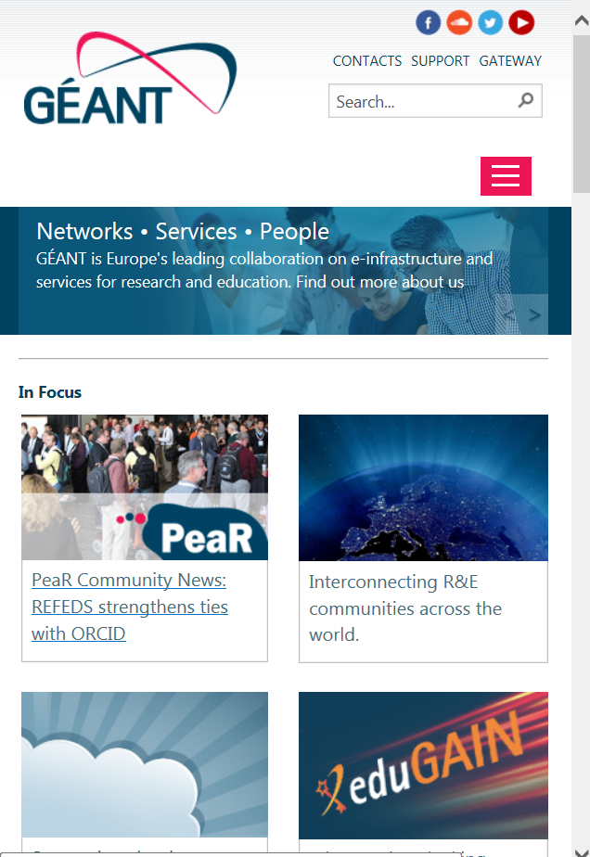
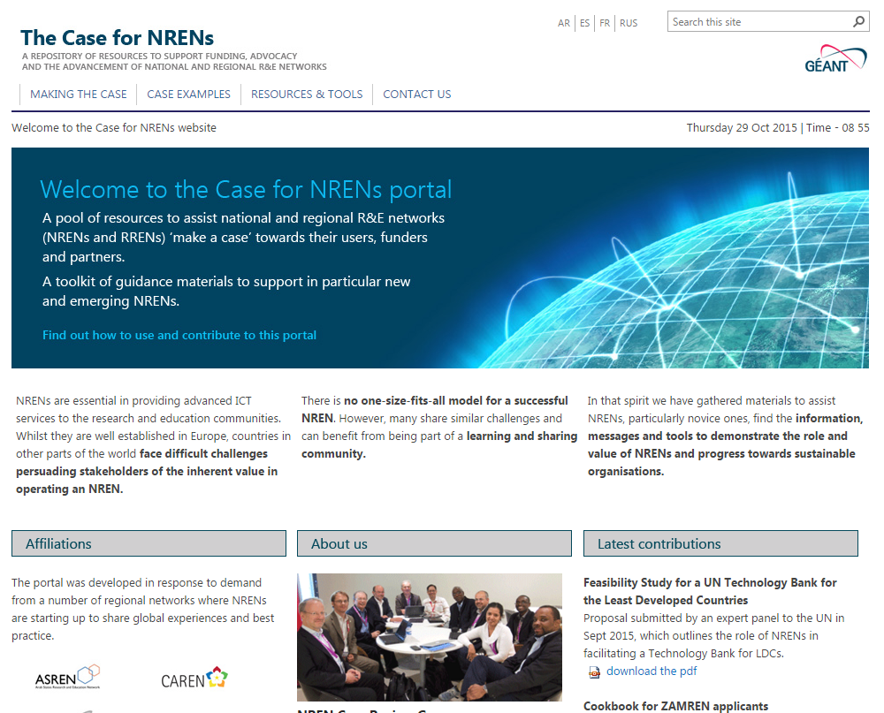
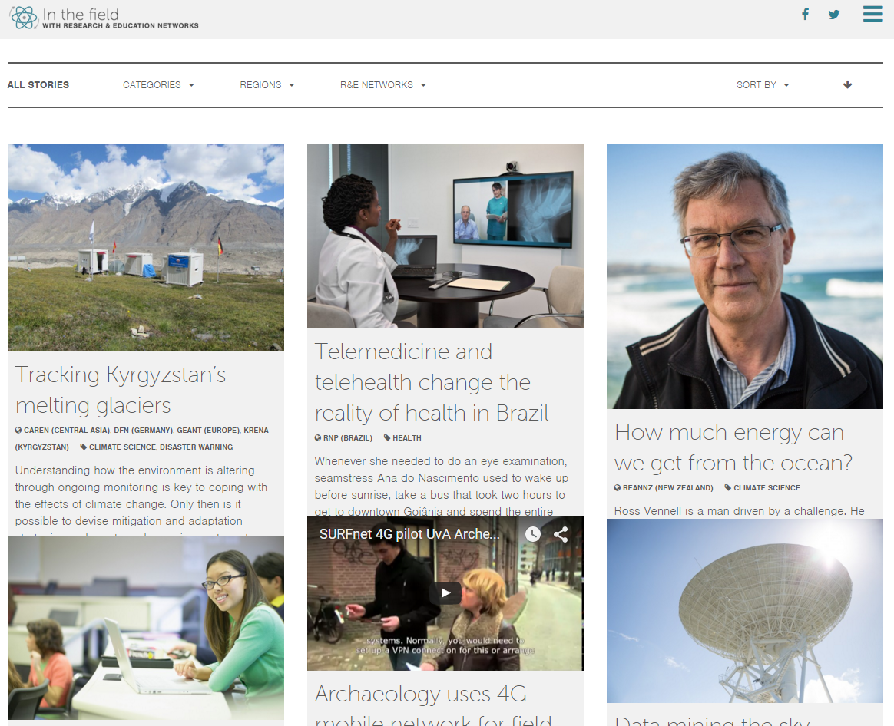


Communications and outreach - updates
CONNECT magazine
  Issue #20 out now
  Issue #21 in planning, due February 2016 - contributions welcome or re-use of content (e.g. this issue’s eduroam…..)
New website coming 2 November – www.geant.org
Global PR Network – support and facilitate
  ‘Case for NREN’ portal www.casefornrens.org
  ‘In the field blog’ http://www.inthefieldstories.net/
Case studies underway on EUMETSAT and CERN

Slide 8
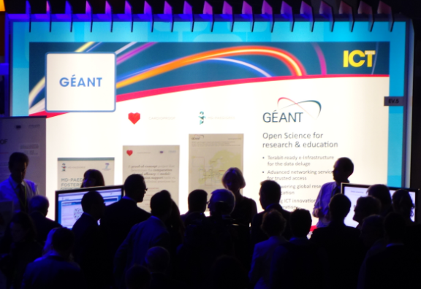


Communications and outreach - updates
External events
  ICT, Lisbon, 20-22 October – booth with invited users - MD-PAEDIGREE and CARDIOPROOF - ‘VIP visitors’ of Commissioner Moedas and DG Viola.
  SC15 attendance
Symposium, 7-10 March, Vienna.
News
  Check out News pages, facebook and twitter for the latest.
  Introducing blogging for key areas such as networks, users, services, innovation.

Slide 9
The FPA and SGA-2 planning
Work Programme 2016/17 published by EC (also an input)
GÉANT Project Planning Committee (GPPC)
  White papers written in 6 topic areas
  Sent to NRENs with questionnaire to prioritise aspects
  GPPC scrutinised input
White papers + input from NRENs + EC requirements = proposals for Activities
  Rationalising and reorganising the activities
  Closed process, completed work plan by end of March 2016
Calls for participation
  SGA2 Activity Leader vacancies now advertised – apply via the GÉANT Jobs Board
  Expect to advertise for other participants later this year.

Slide 10
Services Update…
…over to Karl

