Slide 1
The new, one GÉANT
Niels Hersoug
General Manager, GÉANT
TF-CPR, Cambridge
28 October 2015

Slide 2
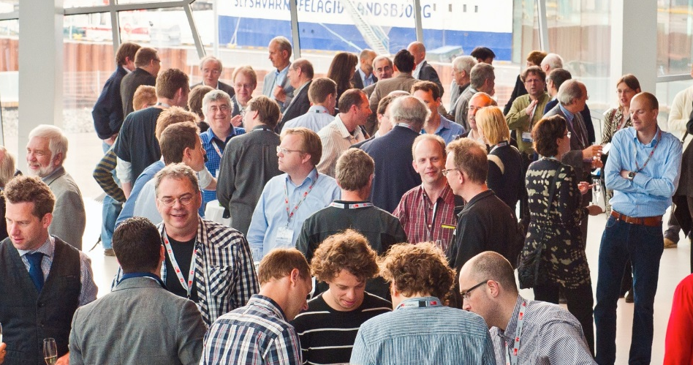
The new one GÉANT
Europe’s leading collaboration on e-infrastructure and services for research and education.
Owned by core membership :
  European NREN organisations
  Associate members
    Commercial organisations
    Multi-national research infrastructures and projects.
October 2014:
  TERENA and DANTE joined forces to become GÉANT Association
May 2015:
  Now rebranded simply as “GÉANT” which has a new meaning of community collaboration

Slide 3
Structure and governance
GENERAL ASSEMBLY
National
Members
Representative
Members
Associate
Members
GA Committees
Board of Directors
CEO & Management
Staff
Simplified governance
& more efficient
management
Combined
expertise for more
flexible use
of resources
Enhanced
innovation, service
delivery and
knowledge-sharing
Strengthened
relationship with members and community

Slide 4
Who’s who in governance and management?
  Board of Directors
  Pierre Bruyère BELNET (Chair)
  Erwin Bleumink SURFnet
  Marko Bona​č ARNES
  Christian Grimm DFN
  Sabine Jaume-Rajaonia RENATER
  Ivan Marić CARnet​
  Dorte Olesen Uni of Denmark
  Alberto Pérez RedIRIS
Executive team
  Valentino Cavalli - Community & Innovation
  Niels Hersoug – Business Development
  Matthew Scott – Services & Operations
  David Wrathnall – Finance, Resources & Board support
  Bert van Pinxteren – Membership
  CEO
  interim CEO Bob Day / JISC
  Steve Cotter to start 2 November

Slide 5
GÉANT operational objectives
GÉANT is a membership organisation acting with and for its members to further research and education networking in Europe and globally
Development, delivery and operation
  …of advanced network and e-infrastructure services
Promotion of innovation
  …amongst membership and with others
Coordination and collaboration
  …amongst membership and in projects
Development of knowledge, skills and competencies
  …across Europe
Promotion of consensus
  …in development of e-infrastructures services

Slide 6
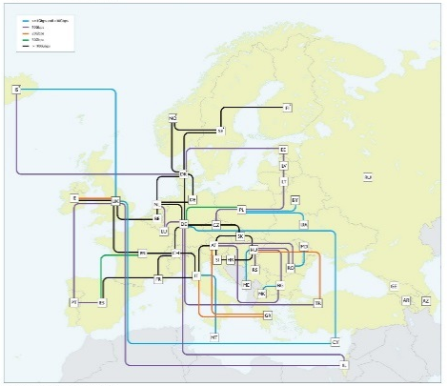
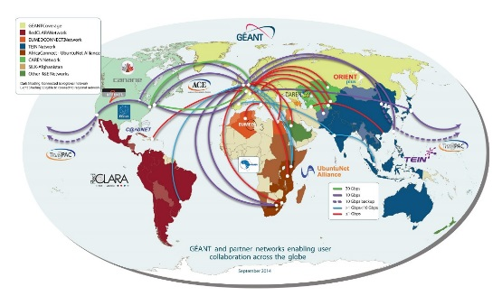
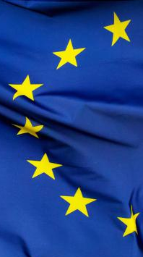
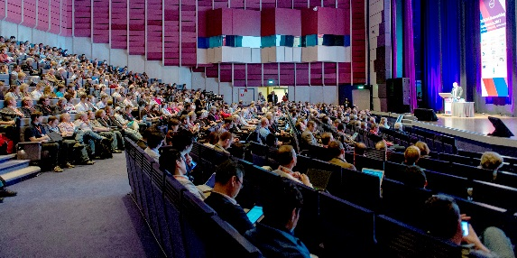
GÉANT strategic priorities
A provider of services
  –delivered via partnerships, by third parties and by federation
An innovator by collaboration
  - with a wider range of partners
A global player
  - of large importance
Increasing its profile and confidence
  - in influencing European policy

Slide 7
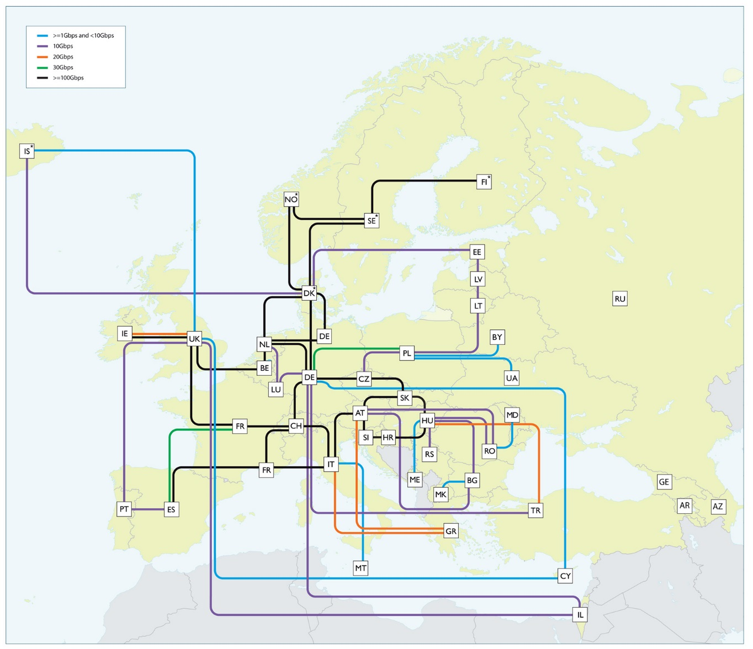
What does GÉANT do?
GÉANT Pan-European network
500Gbps super-channels
1,000+ terabytes of data across network per day
50,000km network infrastructure on 44 routes
Widely diversified footprint
  Serves 50m users
  10,000 institutions
  100 countries worldwide

Slide 8
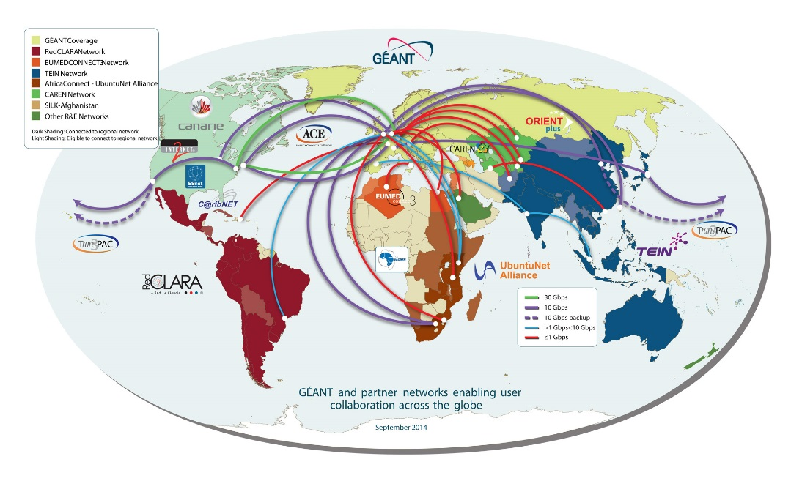
What does GÉANT do?
Global networking
The GÉANT network has extensive links to networks in other world regions:
  North America, Latin America, the Caribbean, North Africa and the Middle East, Southern and Eastern Africa, the Eastern Partnership, Central Asia and the Asia-Pacific Region.
  Work is also on-going to connect to Western and Central Africa.
Extensive partnerships worldwide
GÉANT reaches 100 countries worldwide i.e. more than 50% of the countries in the world.

Slide 9




What does GÉANT do?
Network projects
Manage research & education networking projects
Procure, build and operate large-scale, advanced international high-speed networks
  GÉANT (Europe)
  EUMEDCONNECT (Mediterranean)
  AfricaConnect2 (Sub-Saharan Africa)
  CAREN (Central Asia)
  EaPConnect (Eastern partnership countries)
Support and assist other regional projects
  ORIENTplus (Europe-China collaboration)
  RedCLARA (Latin America)
  CKLN (Caribbean)
  TEIN*CC (Asia-Pacific)

Slide 10




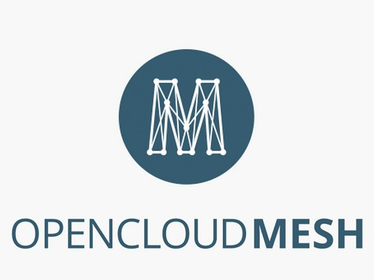
What does GÉANT do?
Trust & Identity and Collaboration projects
AARC
  authentication and authorisation for research and education; GÉANT leads 20 partners from NRENs, e-Infrastructures, service providers and libraries.
REFEDS
  the voice of research and education identity federations worldwide; GÉANT provides secretariat support for the group.
MAGIC
  middleware for collaborative applications and global virtual communities​; GÉANT is one of 21 global project partners this successor to the ELCIRA project, led by RedCLARA.
TANDEM
  trans-African network development; GÉANT is one of 9 project partners from Latin America, Africa, and Europe, led by RedCLARA.
OpenCloudMesh
  interconnected, secure private clouds; a joint international initiative jointly managed by own​Cloud Inc., CERN and GÉANT.​​

Slide 11
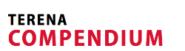


What does GÉANT do?
Services
Develop, operate and support innovative services relating to such areas as
  Connectivity options, network management and test bed facilities
  Trust and identity
  Security
  Cloud services
  Mobility and access
  Real-time communications
Professional services – project management, consultancy, secretariat.
Provide practical support for members, educators, researchers and other partners to collaborate, innovate, share knowledge and agree on policies and strategies.

Slide 12
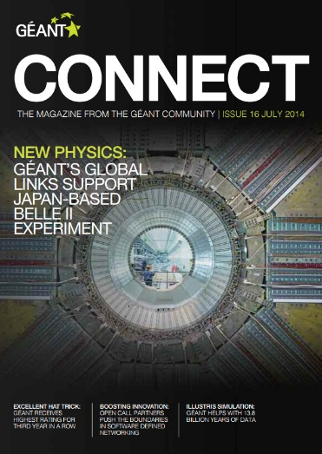




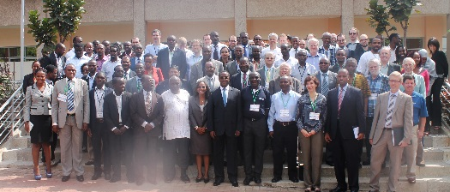
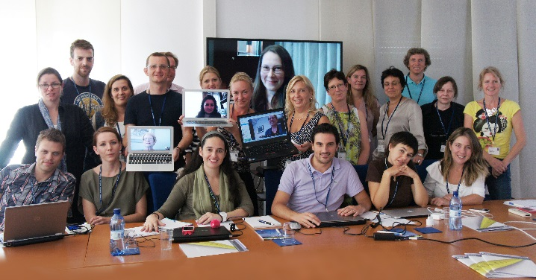
What does GÉANT do?
People
Provide expertise in procurement, project management, community engagement, network operations, and outreach, dissemination and training.
Mobilise and coordinate community expertise to achieve collaborative innovation and knowledge sharing.

Slide 13
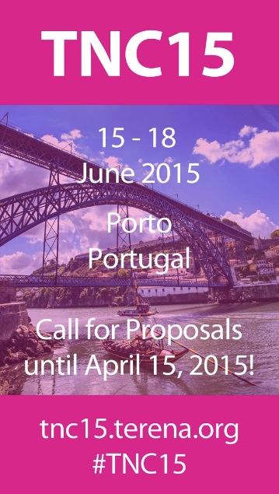


What does GÉANT do?
People
Organise workshops, meetings and conferences
  Including TNC – Europe’s largest networking conference for research
  and education
Liaise with other e-infrastructure organisations, user communities,
industry and the European Commission

Slide 14
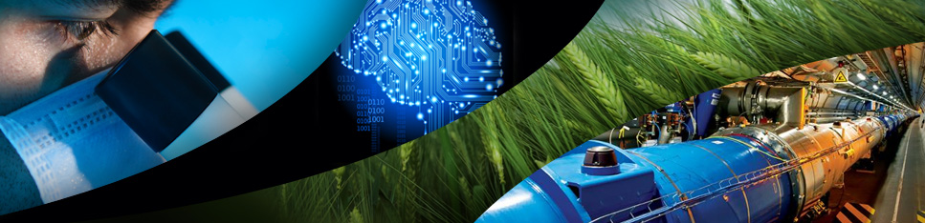
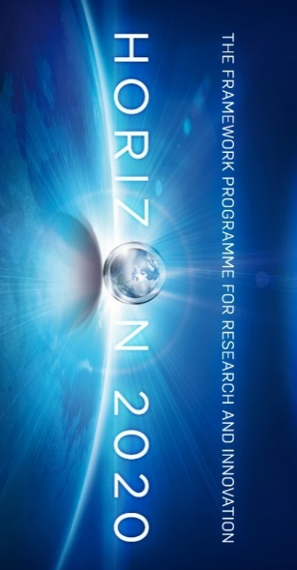

A trusted EC partner
Accelerating research,
driving innovation
and enriching education.
Supporting a strategy to achieve the Horizon 2020 vision.
A trusted EC partner in many global collaboration projects and initiatives through our special relationship with the European Union.
  DG CONNECT, DG DEVCO, DG NEAR, DG GROW

Slide 15
The GÉANT 2020 Framework Partnership Agreement (FPA)
Stability for users
7-year “Framework Partnership Agreement” (FPA) with the EC started Spring 2015
Provides a stable environment for the implementation of GÉANT as the European Communication Commons
  Specific Grant Agreements (SGAs) define the work in detail – at least 3 are planned. May include more than 1 project.
Six “Actions” underpinning the FPA
Drive the Evolution of the Network
Support the Knowledge Community
Provide Security, Trust and Identity
Deliver GÉANT’s Collaborative Ecosystem
Develop the Human Capital of the GÉANT Partnership
Ensuring the Long-Term Future of the GÉANT Infrastructure
This FPA aims to "...make every European researcher digital, increasing creativity and efficiency of research and bridging the divide between developed and less-developed regions.”

Slide 16
The new, one GÉANT
Niels Hersoug
End
General Manager, GÉANT
TF-CPR, Cambridge
28 October 2015

