Slide 1
PRACE Legacy
Marjolein Oorsprong (she/her/hers)
Head of Communications, PRACE aisbl

Slide 2
PRACE Legacy
After 10+ years of making Tier-0 HPC available to academia and industry, the ecosystem is changing with the arrival of EuroHPC
A good moment to summarise & promote what we have achieved over the years
  24 Calls for Proposal for Project Access
  44 cut-off for Preparatory Access
  14 SHAPE Calls for Proposals
  17 DECI Calls for Proposals
  11 ICEI Calls for Proposals
  2 international collaborative calls
  COVID-19 Fast Track Call for Proposals
Notes:
Almost 20 years if you count from the first Scientific Case for HPC created by HPCEUR in 2004
SHAPE (SME HPC Adoption Programme in Europe) > industry (SMEs)
Distributed European Computing Initiative (DECI) programme > Tier-1

Slide 3



PRACE Publications
  Annual Report (10+1)
  Digest magazine (9)
  PRACE Women in HPC Magazine
  Stand-alone articles (>20)
  Fact Sheets (18)
  Scientific Case (3)
  Position Paper (1)
  >125 videos
Notes:
Software Strategy For European Exascale Systems
Special Report on HPC for All

Slide 4


PRACE Events
EuroHPC Summit Week & PRACEdays > since 2012
ISC > www.isc-hpc.com > since 2008
SC > https://supercomputing.org/ > since 2007
Other events such as: DI4R, EAGE, ICT, ICRI, BDEC, HiPEAC, PARI, etc.

Slide 5
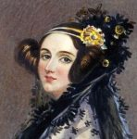
PRACE Awards
PRACEdays Awards
  Best Student Poster
  Best Poster
  Best Industrial Presentation
  Best Scientific Presentation
  PRACE Ada Lovelace Award for HPC
PRACE-ISC Research Poster Award
PRACE Summer of HPC
  Ambassador
  Best Visualisation
PRACE HPC Excellence Award
PRACE Award at EUCYS
Awards are meant to celebrate excellent HPC-supported research & innovation, as well as to encourage students and women in HPC.

Slide 6



PRACE Training
PRACE Summer of HPC > since 2013
International HPC Summer School > since 2011
MOOCs via FutureLearn
>17 000 people trained via
  Training events
  Seasonal School
  Workshops

Slide 7
PRACE Website
www.prace-ri.eu
  Will be re-organised and partially rewritten to better show what we have achieved
    Improved search function
  Will host the Calls for Proposals by EuroHPC
Notes:
Subdomains and sites such as www.training.prace-ri.eu/
Project-focussed websites such as www.exdci.eu

Slide 8


Slide 9
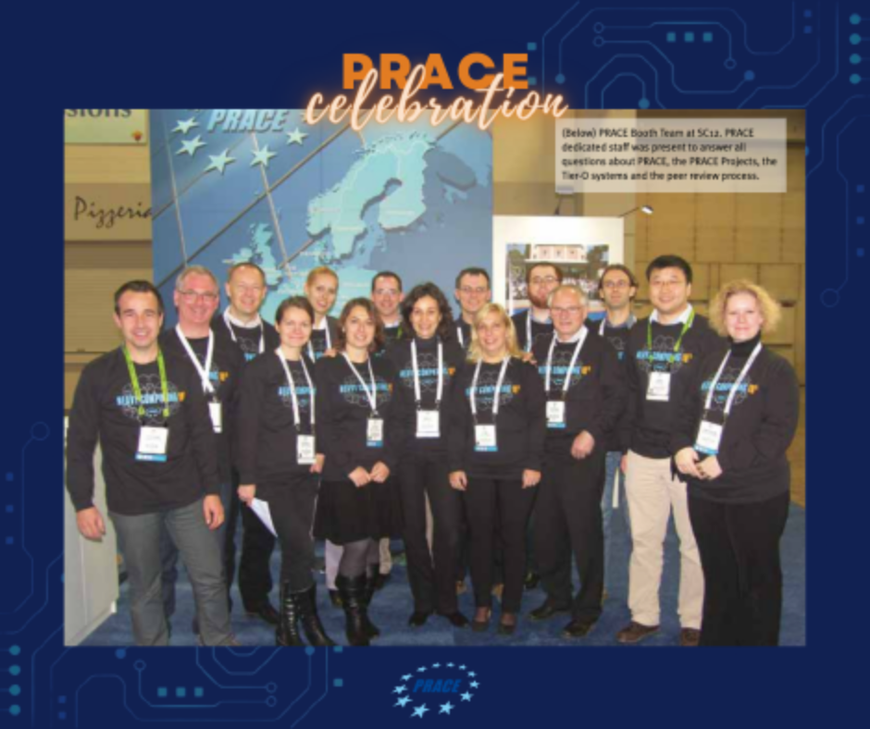

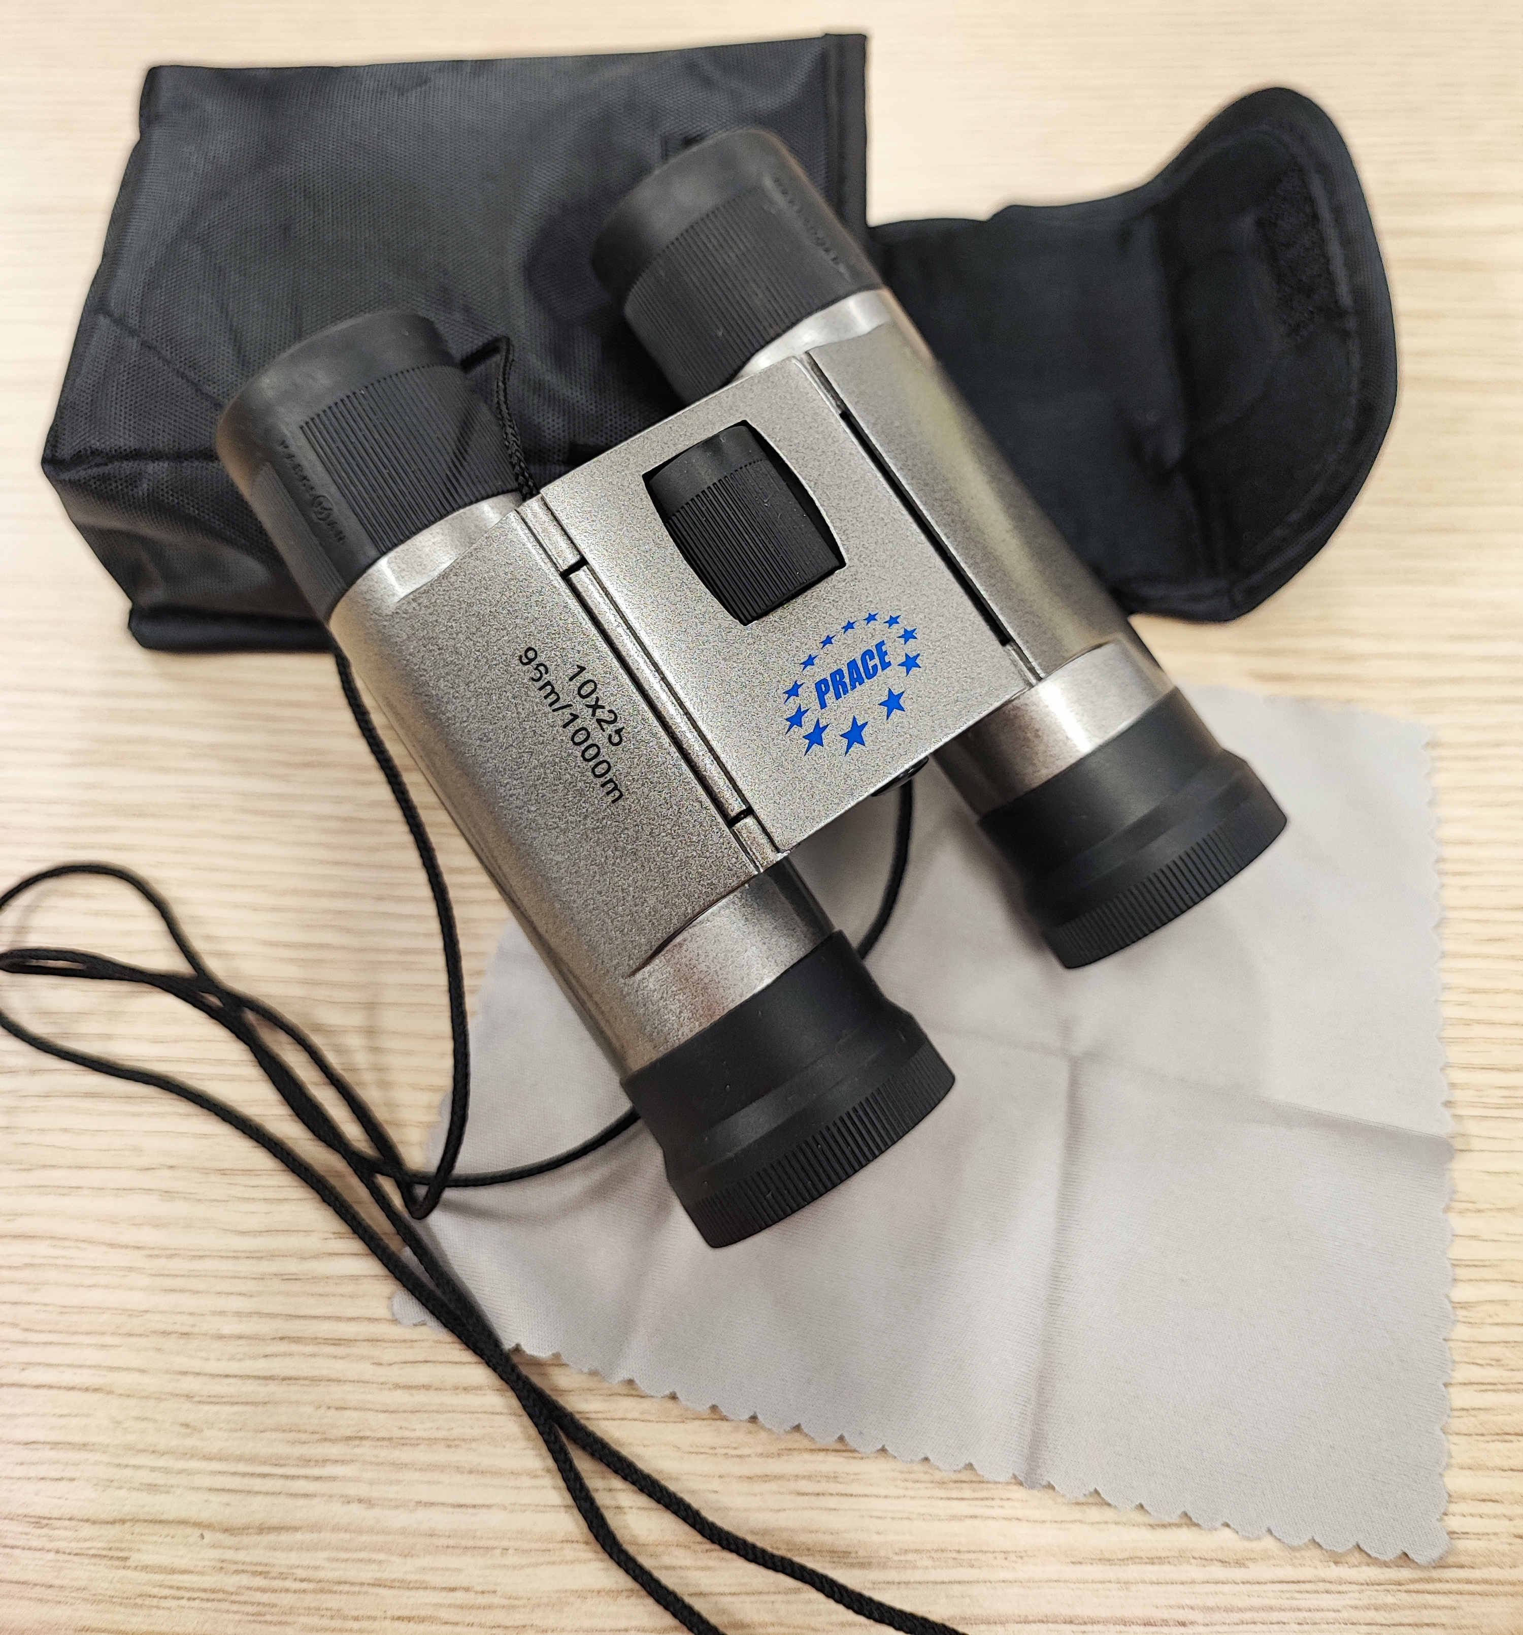
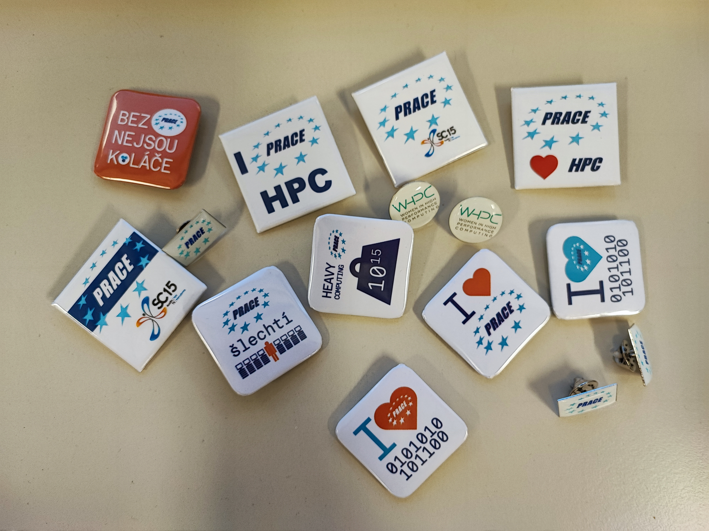
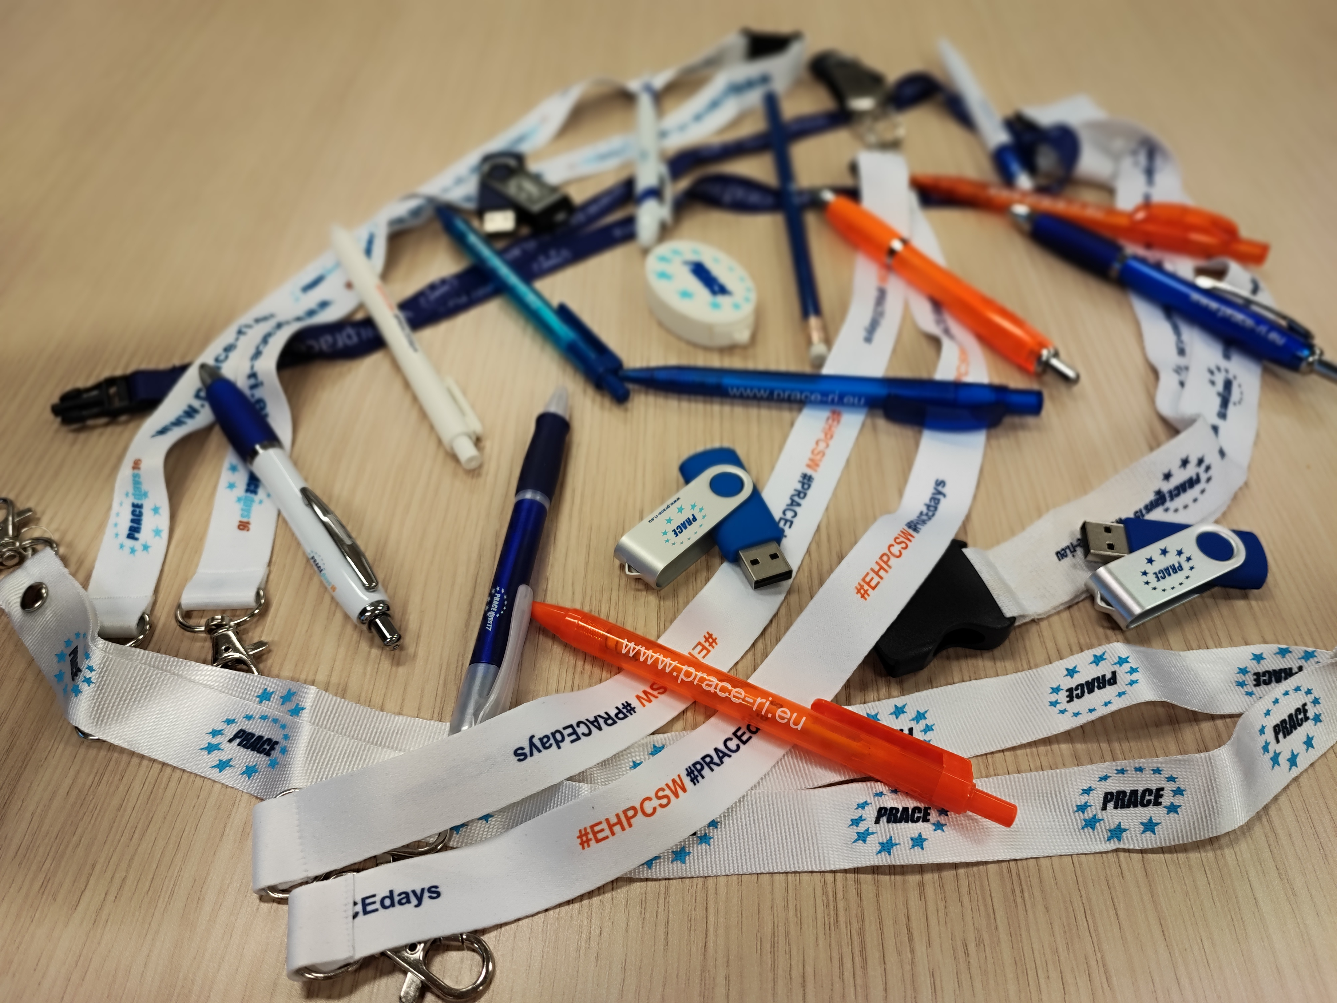
PRACE Social Media
LinkedIn & Twitter
  Launched on 3 October 2022
    #PRACEcelebration
      #triviaTuesday
      #throwbackThursday
      #PRACEswag

Slide 10

PRACE @SC22
#PRACEcelebration campaign was launched on 3 October 2022, leading up to SC22 (November, Dallas)
PRACE booth will be decorated with
  Timeline from 2004 to present
  Excerpts of Success Stories, including imagery
  Instagram booth for fun pictures from our community

Slide 11
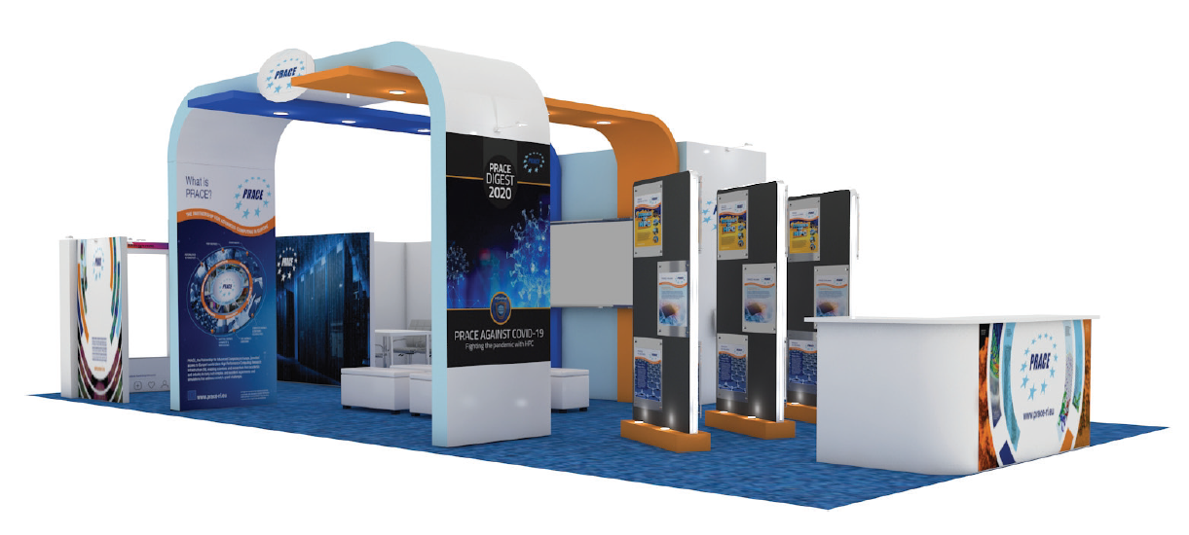

Slide 12
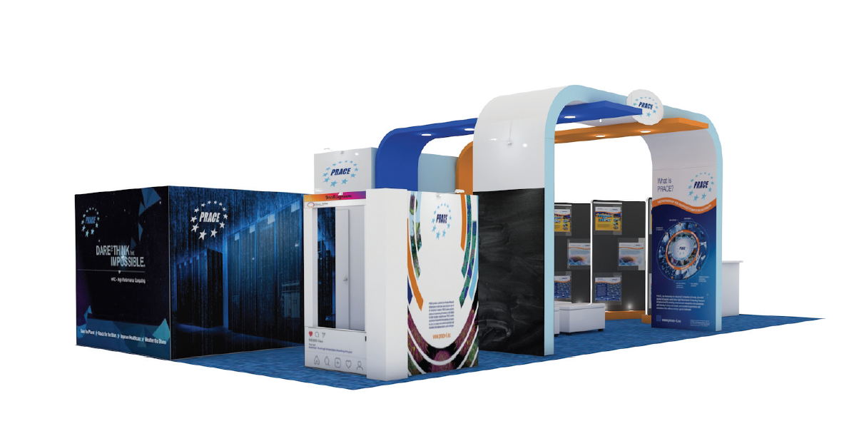

Slide 13
PRACE Sign-up
PRACE mailing lists https://prace-ri.eu/subscribe-to-prace-mailing-lists/
  Info Bulletin (general PRACE News & Announcements)
  Training Bulletin
  Outreach to Universities
PRACE SIG Mailing Lists
  sig-operation@prace-ri.eu
  sig-new-tech@prace-ri.eu
  sig-industry@prace-ri.eu
  sig-application-enabling@prace-ri.eu
  sig-marcomms@prace-ri.eu
  sig-training@prace-ri.eu
Notes:
SIG Lists are currently inactive – will be activated when dedicated activities will be developed

Slide 14
THANK YOU FOR YOUR ATTENTION
Marjolein Oorsprong
Head of Communications
M.Oorsprong@staff.prace-ri.eu
www.prace-ri.eu
Twitter: @PRACE_RI
LinkedIn: www.linkedin.com/company/prace

