Slide 1
Employer branding @ Belnet
Freya Goeminne & Davina Luyten
SIG-Marcomms - 5 October 2022

Slide 2
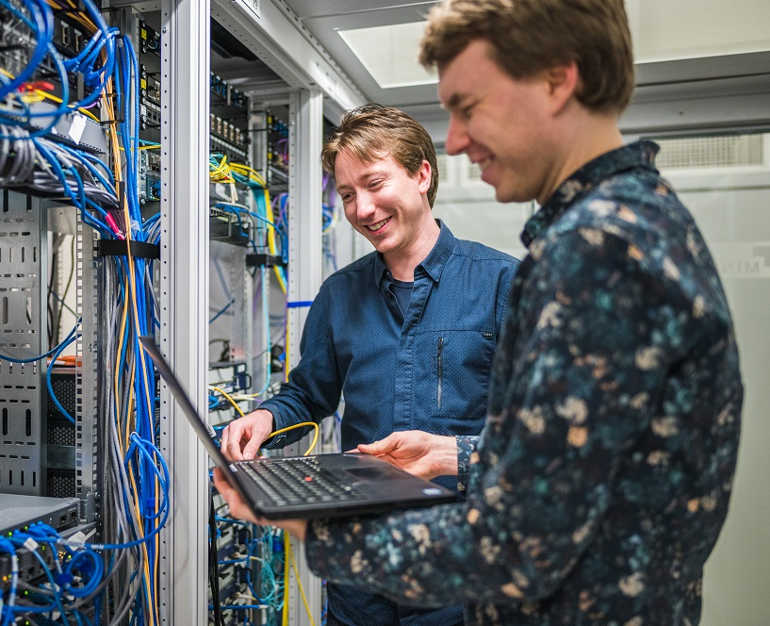
Current situation
75 colleagues
  43 technical profiles
  30 admin & community profiles
  1 general manager
  1 CISO

Slide 3
Strenghts and weaknesses
- | +
Strong competition in the labour market for IT professionals | Work-life balance (flexible working hours, holidays, home office)
Recruitment through a long and administrative procedure | Training opportunities
Limited remuneration opportunities | Contributing to the Research & Education community

Slide 4



Main goals of our employer branding
Inform candidates about Belnet's societal role
Highlight Belnet as an attractive employer
Branding
Reach and attract IT experts in a competitive market
Increase the inflow
of qualitative
profiles and encourage them
to take action
Action
Relation
Give Belnet a face and visibility

Slide 5
Overview of the project
Intake
(in-depth interviews)
Research
(focus groups)
Strategy
(EVP*)
Plan
(campaign material)
1
2
3
4
*EVP = Employer Value Proposition

Slide 6








Conclusions intake & research (1)
EVP
Advantages
Opportunities for growth
Culture
Branding
“Working at Belnet is a commitment’
“A modern organisation on a human scale”
Job content
“Focus on impact rather than targets”
Notes:
3 most important blocks for Belnet:
Culture: stability, small organisation, ‘family’, human, empathic, informal but decision making / leadership should be better. Difference between tech and non-tech departements
Job content: Belnet offers you more then a job, it’s an engagement, societal role, innovation, top technologies. Focus on customer satisfaction rather then commercial target (but job content is very different depending on the team you’re working in) → the focus is more on customer satisfaction, expertise, job content, learning, collaboration and co-creation with customers than on commercial targets.
Branding: not just another ISP but thé Belgian NREN but we have to work on Belnet’s main visibility (increase brand awareness)

Slide 7

Conclusion intake & research (2)
Key issue: brand awareness and visibility
Day-to-day job is not always clear for applicants
Belnet employees consider themselves as the perfect ambassadors

Slide 8
Strategy: our EVP
Has to respond to the three checks:
Attractive
Credible
Sustainable
Welcome to our network!
Notes:
Toelichting: “welkom” is een warme, familiale binnenkomer (cf. cultuur),
terwijl “ons netwerk” kan slaan op zowel de uitzonderlijke
internettoegang (externe branding) waar alle belnetters trots op zijn (“ons
netwerk”) als het hechte netwerk van collega’s (cultuur).

Slide 9


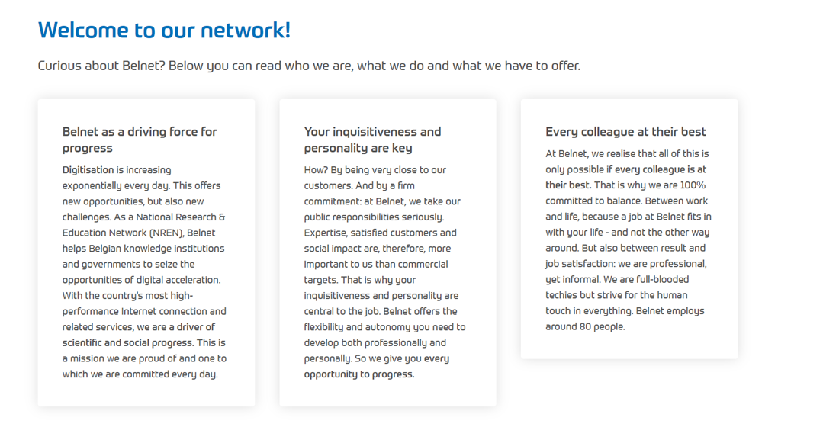


Renewal of our jobsite (1)
Notes:
Employer Value Proposition is now well defined and communicated on the website
We’ve visualised the “Selor” procedure
Information about the onboarding

Slide 10
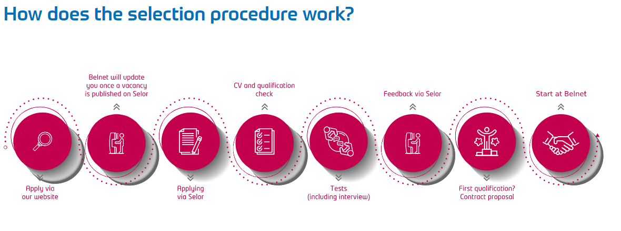
Renewal of our jobsite (2)

Slide 11
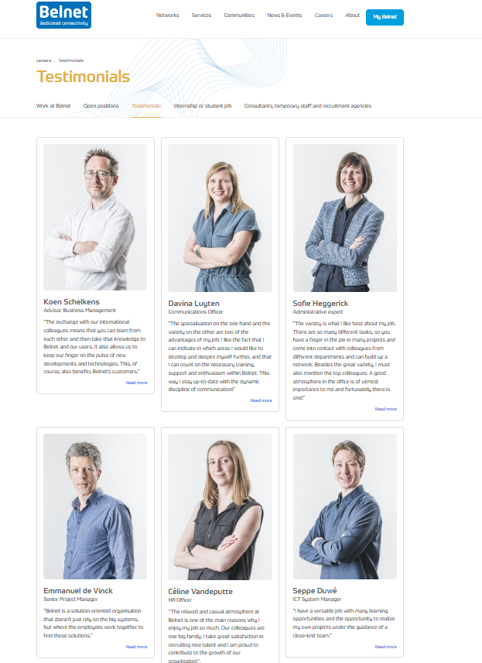
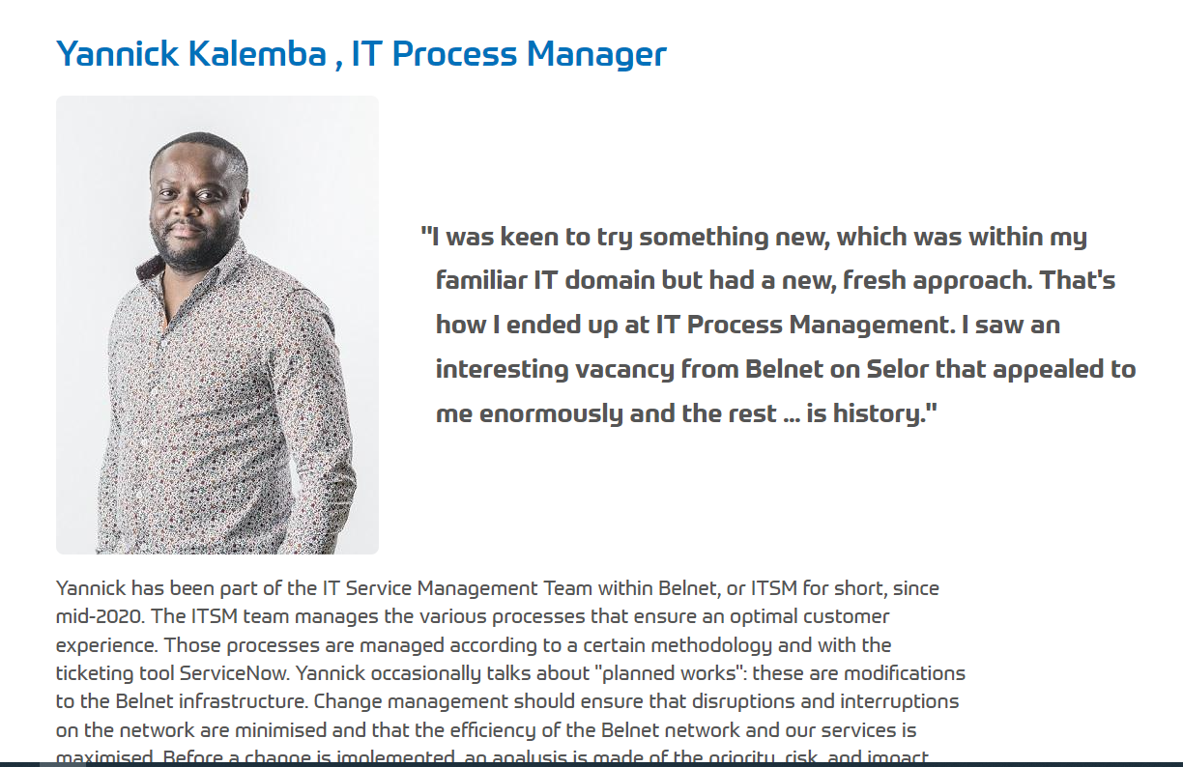
Renewal of our jobsite (3)
Notes:
Herwerking van de testimonials: visueel en inhoudelijk – applicants get a better insight in Belnet’s jobs
Specific page about internships / student jobs
Dedicated page for consultants and recruiting agencies

Slide 12
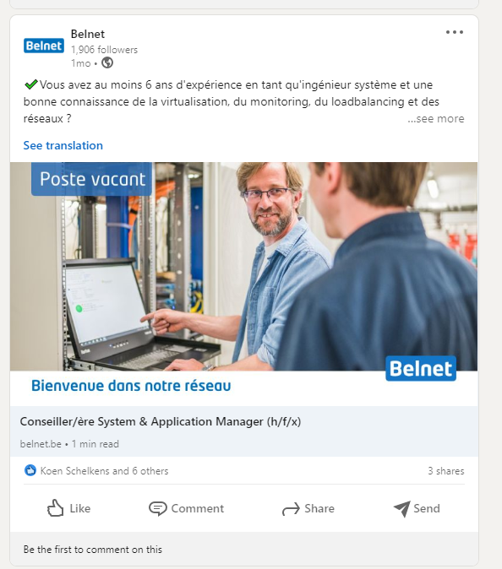


Visuals & social media
Notes:
Photoshoot with our employees (two days at the office) – much enthusiasm (and lots of visual material for us ☺)

Slide 13

Coming soon…
A brand new corporate video!
Notes:
With our employees! Over 20 employees participated

Slide 14
Thank you
for your attention

