Slide 1
How to Connect with Different Audiences: Social Media Strategy of Arnes as NREN vs. SLING for EuroCC Project
SIG-Marcomms Autumn Meeting
Brussels, 4-5 October 2022
Ariela Herček
ariela.hercek@arnes.si
Academic and Research Network of Slovenia - Arnes

Slide 2
DIFFERENT AUDIENCES REQUIRE DIFFERENT STRATEGIES
USERS / INSTITUTIONS
GENERAL AUDIENCE
RESEARCHERS
the widest audience;
general facts about WHAT an NREN does;
the level of communication should be understandable to everyone;
important to keep in touch with to further establish what an NREN does for the general public
the most important audience;
in-depth facts about NREN‘s services;
frequent and timely updates about NREN‘s services;
how-to guides;
checked by internal experts
in-depth recommendations of NREN‘s services with regard to a researcher‘s field;
LinkedIn & FaceBook as primary social media channels for communication;
special services like HPC

Slide 3


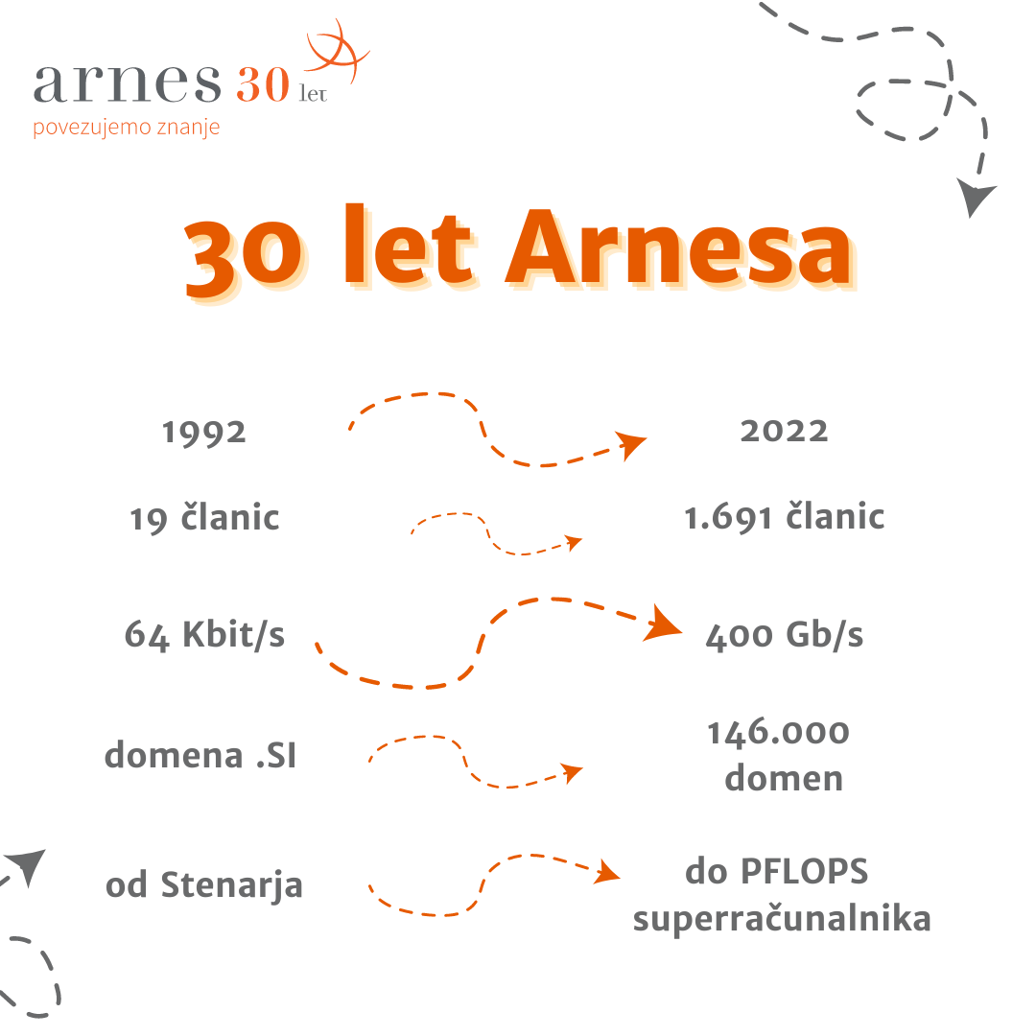
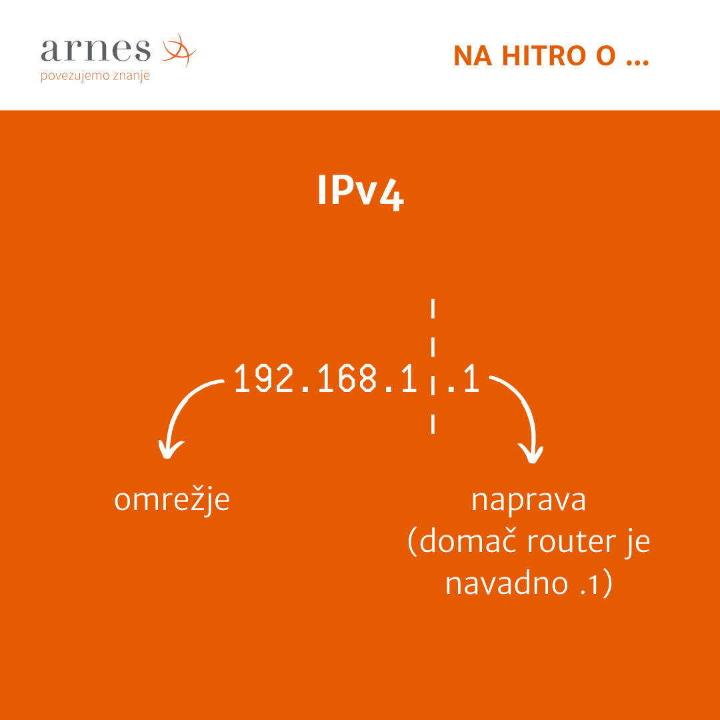
GENERAL AUDIENCE

Slide 4

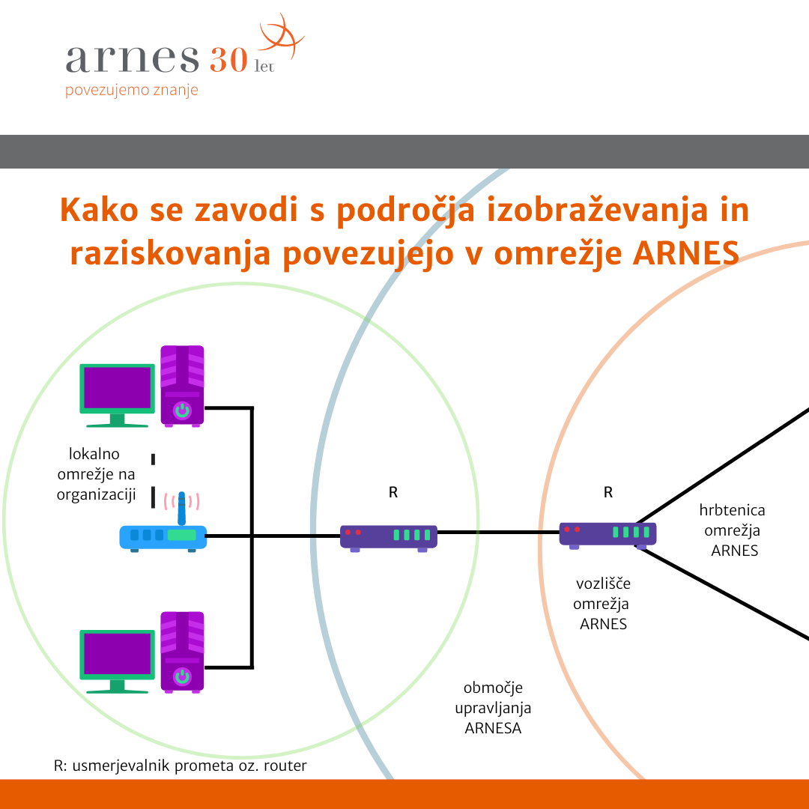

USERS/INSTITUTIONS

Slide 5



RESEARCHERS
more specific demands;
connection to international network and data structures
+ SMEs as INDUSTRY
→ potential industry applications of research projects performed using NREN‘s services

Slide 6


EUROCC PROJECT
connection to a European supercomputing network → shared knowledge
potential industry applications of research projects performed using NREN‘s services
support for SMEs in applying HPC infrastructure
﻿This project has received funding from the European High-Performance Computing Joint Undertaking (JU) under grant agreement No 951732. The JU receives support from the European Union’s Horizon 2020 research and innovation programme and Germany, Bulgaria, Austria, Croatia, Cyprus, Czech Republic, Denmark, Estonia, Finland, Greece, Hungary, Ireland, Italy, Lithuania, Latvia, Poland, Portugal, Romania, Slovenia, Spain, Sweden, United Kingdom, France, Netherlands, Belgium, Luxembourg, Slovakia, Norway, Switzerland, Turkey, Republic of North Macedonia, Iceland, Montenegro

Slide 7

Collaboration
Communication
Sharing relevant posts from other projects and institutions involved in HPC
  FF4EuroHPC
  EuroHPC-JU
  CASTIEL
  Other NCCs
Co-organization of workshops and events
A simple way of explaining what a supercomputer is or what HPC is?
    NO
Good practices
Focus on SMEs
More directly targeting already active researchers and industry rather than bringing in new potential users like students
communication tactics are different → more time

Slide 8
COLLABORATION
the different topics are verified by experts before posted;
content for services updates and intricacies is usually written by the experts;
various projects, SI-CERT, Registry.si, MOOCs: data forwarded by people directly working on these
EXTERNAL
INTERNAL
Slovenian Computer Museum,
Agency for Communication Networks and Services of the Republic of Slovenia,
Various libraries, museums, schools and other educational institutions,
Časoris (web magazine for children and youth).
Ministry for Education
Government Office for Digital Transformation
…

Slide 9
Thank you for your attention.
Ariela Herček
Arnes
ariela.hercek@arnes.si

